Slide 1
Section 18.4
Monitoring with a p Chart

Slide 2
Formula: 3σ Control Chart for p When the Process Proportion Is Known
where p = the standard process percent defective and n = the sample size.

Slide 3
Formula: 3σ Control Chart for p When the Process Proportion Is Unknown
and n = the sample size.

Slide 4
Example 1: Determining if a Process Is in Control Using a p Chart—Slide 1
Silvia Garcia is monitoring the operation of a machine that makes radar components. Historically, she expects about 2% defectives and some chance variation. After studying the process, Silvia decides to construct a 3σ p chart. She takes 10 daily samples of 200 components. Her results are shown in Table 1. What does her p chart look like, and which samples (if any) are out of control?

Slide 5
Example 1: Determining if a Process Is in Control Using a p Chart—Slide 2
Table 1 – Sampling Data for Components
Sample Number | Number Defective
1 | 9
2 | 7
3 | 7
4 | 8
5 | 9
6 | 15
7 | 11
8 | 6
9 | 9
10 | 8

Slide 6
Example 1: Determining if a Process Is in Control Using a p Chart—Slide 3
Solution
Since a "standard" percent defective has been specified in the problem, we will not have to estimate the process percent defective with the sample data. Silvia calculates the percent defective for each sample. For example, in Sample 1, the percent defective is
The results are shown in Table 2. Using
the data in Table 2 with the UCL and LCL, we construct the p chart.

Slide 7
Example 1: Determining if a Process is in Control Using a p Chart—Slide 4
Table 2 – Sampling Percent Defectives
Sample Number | Percent Defective
1 | 4.5
2 | 3.5
3 | 3.5
4 | 4.0
5 | 4.5
6 | 7.5
7 | 5.5
8 | 3.0
9 | 4.5
10 | 4.0

Slide 8
Example 1: Determining if a Process is in Control Using a p Chart—Slide 5
The 3σ control limits are set as follows.

Slide 9
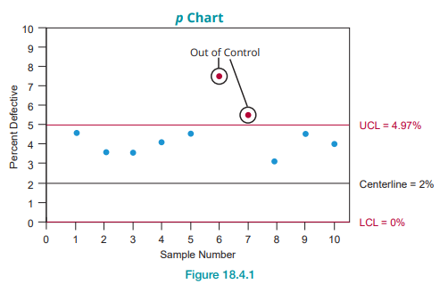
Example 1: Determining if a Process is in Control Using a p Chart—Slide 6
Figure 1
From the p chart, we can see that samples 6 and 7 are out of control.

Slide 10
Example 2: Constructing a p Chart for a Process—Slide 1
In Example 1, a standard process value was known. Use the sample data in Example 1 to create a 3σ control chart for p (p chart) assuming there is no standard process value.

Slide 11
Example 2: Constructing a p Chart for a Process—Slide 2
Solution
In many instances, the process proportion of interest is not known and has to be estimated from the data. In this example, there are 10 samples of size 200 and we wish to know the proportion of defective output the process is producing. To estimate the process proportion, we need to pool the data from all 10 samples.

Slide 12
Example 2: Constructing a p Chart for a Process—Slide 3

Slide 13
Example 2: Constructing a p Chart for a Process—Slide 4
Using the estimate for p from the sample data, the control limits are calculated as follows.

Slide 14
Example 2: Constructing a p Chart for a Process—Slide 5
Using the data in Table 2 and the UCL and LCL allows Silvia to draw the p chart and to plot each sample, as shown in Figure 2.

Slide 15
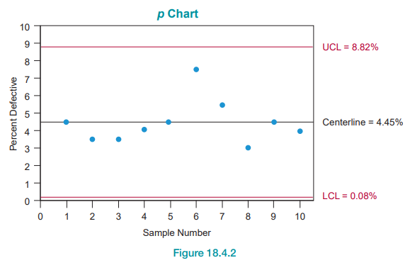
Example 2: Constructing a p Chart for a Process—Slide 6
Figure 2

Slide 16
Example 2: Constructing a p Chart for a Process—Slide 7
From the p chart, we can see that for this data, when the standard percent defective is unknown, all of the samples fall within the control limits.

