Slide 1
Section 2.1
Data and Decision Making

Slide 2
Procedure: Do we have good measurements?
Is the concept under study adequately reflected by the proposed measurements?
Are the data measured accurately?
Is there a sufficient quantity of the data to draw a reasonable conclusion?

Slide 3
Example 1: Identifying Well-Defined Variables₁
Specify whether the following variables are well-defined or not. Justify your answer.
a. ​Interest rate on a mortgage
b.​ Sales price of a textbook
c.​ Tall

Slide 4
Example 1: Identifying Well-Defined Variables ₂
Solution
a. The first variable, interest rate on a mortgage, can be adequately studied if an analyst wants to draw a conclusion about mortgage interest rates. Additionally, interest rate on a mortgage can be measured accurately and can certainly be collected in a large enough quantity to allow an analyst to draw a reasonable conclusion. Thus, if one collects data for interest rate on a mortgage, these data will possess good properties. This variable is well-defined.

Slide 5
Example 1: Identifying Well-Defined Variables ₃
b. Like part a., sales price of a textbook can be well-defined such that it can be measured in US dollars, certainly can be collected in large quantities to allow an analyst to draw conclusions, and can be measured accurately. The sales price of a textbook is a variable that possesses good properties. This variable is well-defined.

Slide 6
Example 1: Identifying Well-Defined Variables ₄
c. ​The variable, tall, is an interesting variable. We should ask ourselves, "How do we define tall?" Is there a standard measure that can be used to define tall? Tall is a relative term from one person’s perspective to the next. With that said, tall is not a well-defined variable.

Slide 7
Procedure: The Scientific Method
1​. Gather information about the phenomenon being studied.
2. On the basis of the data, formulate a preliminary generalization or hypothesis.
3. ​ Collect further data to test the hypothesis.
4. ​ If the data and other subsequent experiments support the hypothesis, it becomes a law. If the experiment does not support the hypothesis, construct a new hypothesis and start the method over again. Sometimes, even if the hypothesis is supported, you may want to test it again but in a different way.

Slide 8
Definition: Confounding Variable
A confounding variable is a variable that was not controlled or accounted for by the researcher and thus damaged the integrity of the experiment.

Slide 9
Definition: Descriptive Statistics
The branch of statistics that focuses on exploratory methods for examining data that help to formulate a hypothesis is called descriptive statistics.

Slide 10
Definition: Inferential Statistics
The branch of statistics that develops theories to test the hypothesis using data collected from an experiment and makes formal conclusions about a population or parameter is called inferential statistics.

Slide 11
Procedure: The Decision-Making Method
1. Clearly define the problem and any influential variables.
2. ​ Decide upon objectives and decision criteria for choosing a solution.
3. ​ Create alternative solutions.
4. ​ Compare alternatives using the criteria established in the second step.
5. ​Implement the chosen alternative.
6. ​ Check the results to make sure the desired results are achieved.

Slide 12
Definition: Controlled Experiment, Control Group, Experimental Group & Treatment₁
In a controlled experiment, a researcher attempts to control the environment of the experiment so that the effect of one variable on another can be isolated and measured.

Slide 13
Definition: Controlled Experiment, Control Group, Experimental Group & Treatment₂
In an experiment,
the control group is the group of subjects that does not receive the treatment;
the experimental group is the group of subjects that receives the treatment;
the treatment is the factor that changes the level of the explanatory variable.

Slide 14
Definition: Response Variable & Explanatory Variable
The response variable is the variable of interest in an experiment.
An explanatory variable is a variable that affects the variable of interest (response variable) in an experiment.

Slide 15
Definition: Completely Randomized Design
A completely randomized design is an experimental design in which experimental units are randomly assigned to two or more different treatments.

Slide 16
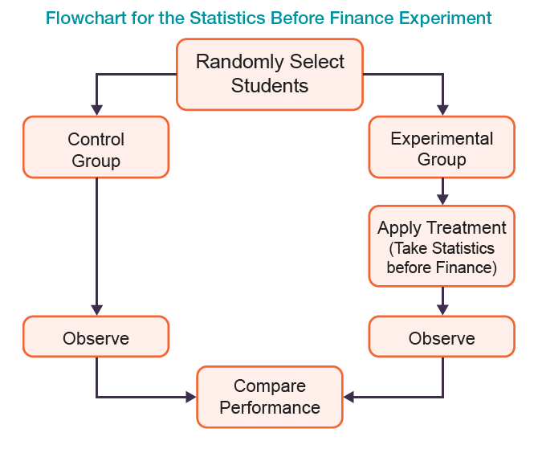
Comparative Experiments
Randomization is often used as a method of controlling bias and is an important principle in the design of experiments.

Slide 17
Example 2: Identify the Control Group and the Experimental Group₁
Suppose the director of dining facilities at a major university has implemented a new meal plan. The director wants to determine if the amount of money spent by students who subscribed to the old meal plan differs from the amount of money spent by students who subscribe to the new meal plan.

Slide 18
Example 2: Identify the Control Group and the Experimental Group₂
Solution
In this experimental design, the students will be divided into two groups, one that contains the students that subscribed to the old meal plan and one that contains the students that subscribed to the new meal plan. The group containing the students who subscribed to the new meal plan will be called the experimental group, and the group containing the students who subscribed to the old meal plan will be called the control group.

Slide 19
Example 2: Identify the Control Group and the Experimental Group₃
If the experiment is properly performed, any change in the response variable (amount of money spent) can be attributed to the explanatory variable (type of meal plan) and not to other variables that are controlled. The untangling of variables at the data-gathering stage makes the analysis of the data much easier. There is no better way to establish a causal relationship.

Slide 20
Example 2: Identify the Control Group and the Experimental Group₄
Variables like living situation (on- or off-campus), the student's class year (freshman, sophomore, junior, senior, or graduate), or their parents' income level can affect the amount of money students spend in a dining facility. These variables must be controlled in the experiment so that differences in the amount of money spent in the dining facility between meal plans can be attributed just to the specific meal plans. One possible method of controlling for these variables is to create small groups of students in the same dormitory.

Slide 21
Example 2: Identify the Control Group and the Experimental Group₅
The meal plan usage (i.e., the amount of money spent using each meal plan) is monitored, assuming that each student has the same opportunity and access to the dining halls to use their meal plans. Thus, any difference in the amount of money spent by the students will be due to the different plans and not any other confounding variables.

Slide 22
Example 3: A Before and After Study₁
Suppose one is interested in determining if an SAT preparation course improves the performance on the SAT Reasoning Test. Would this be a good study for a before and after study?

Slide 23
Example 3: A Before and After Study₂
Solution
A group of high school students take the SAT. Then they are given an SAT preparation course. They retake the SAT. If the group's second SAT performance improves, then it may be related to the SAT preparation course.
For this example of a before and after study:
Explanatory variable: SAT preparation course.
Response variable: SAT scores.

Slide 24
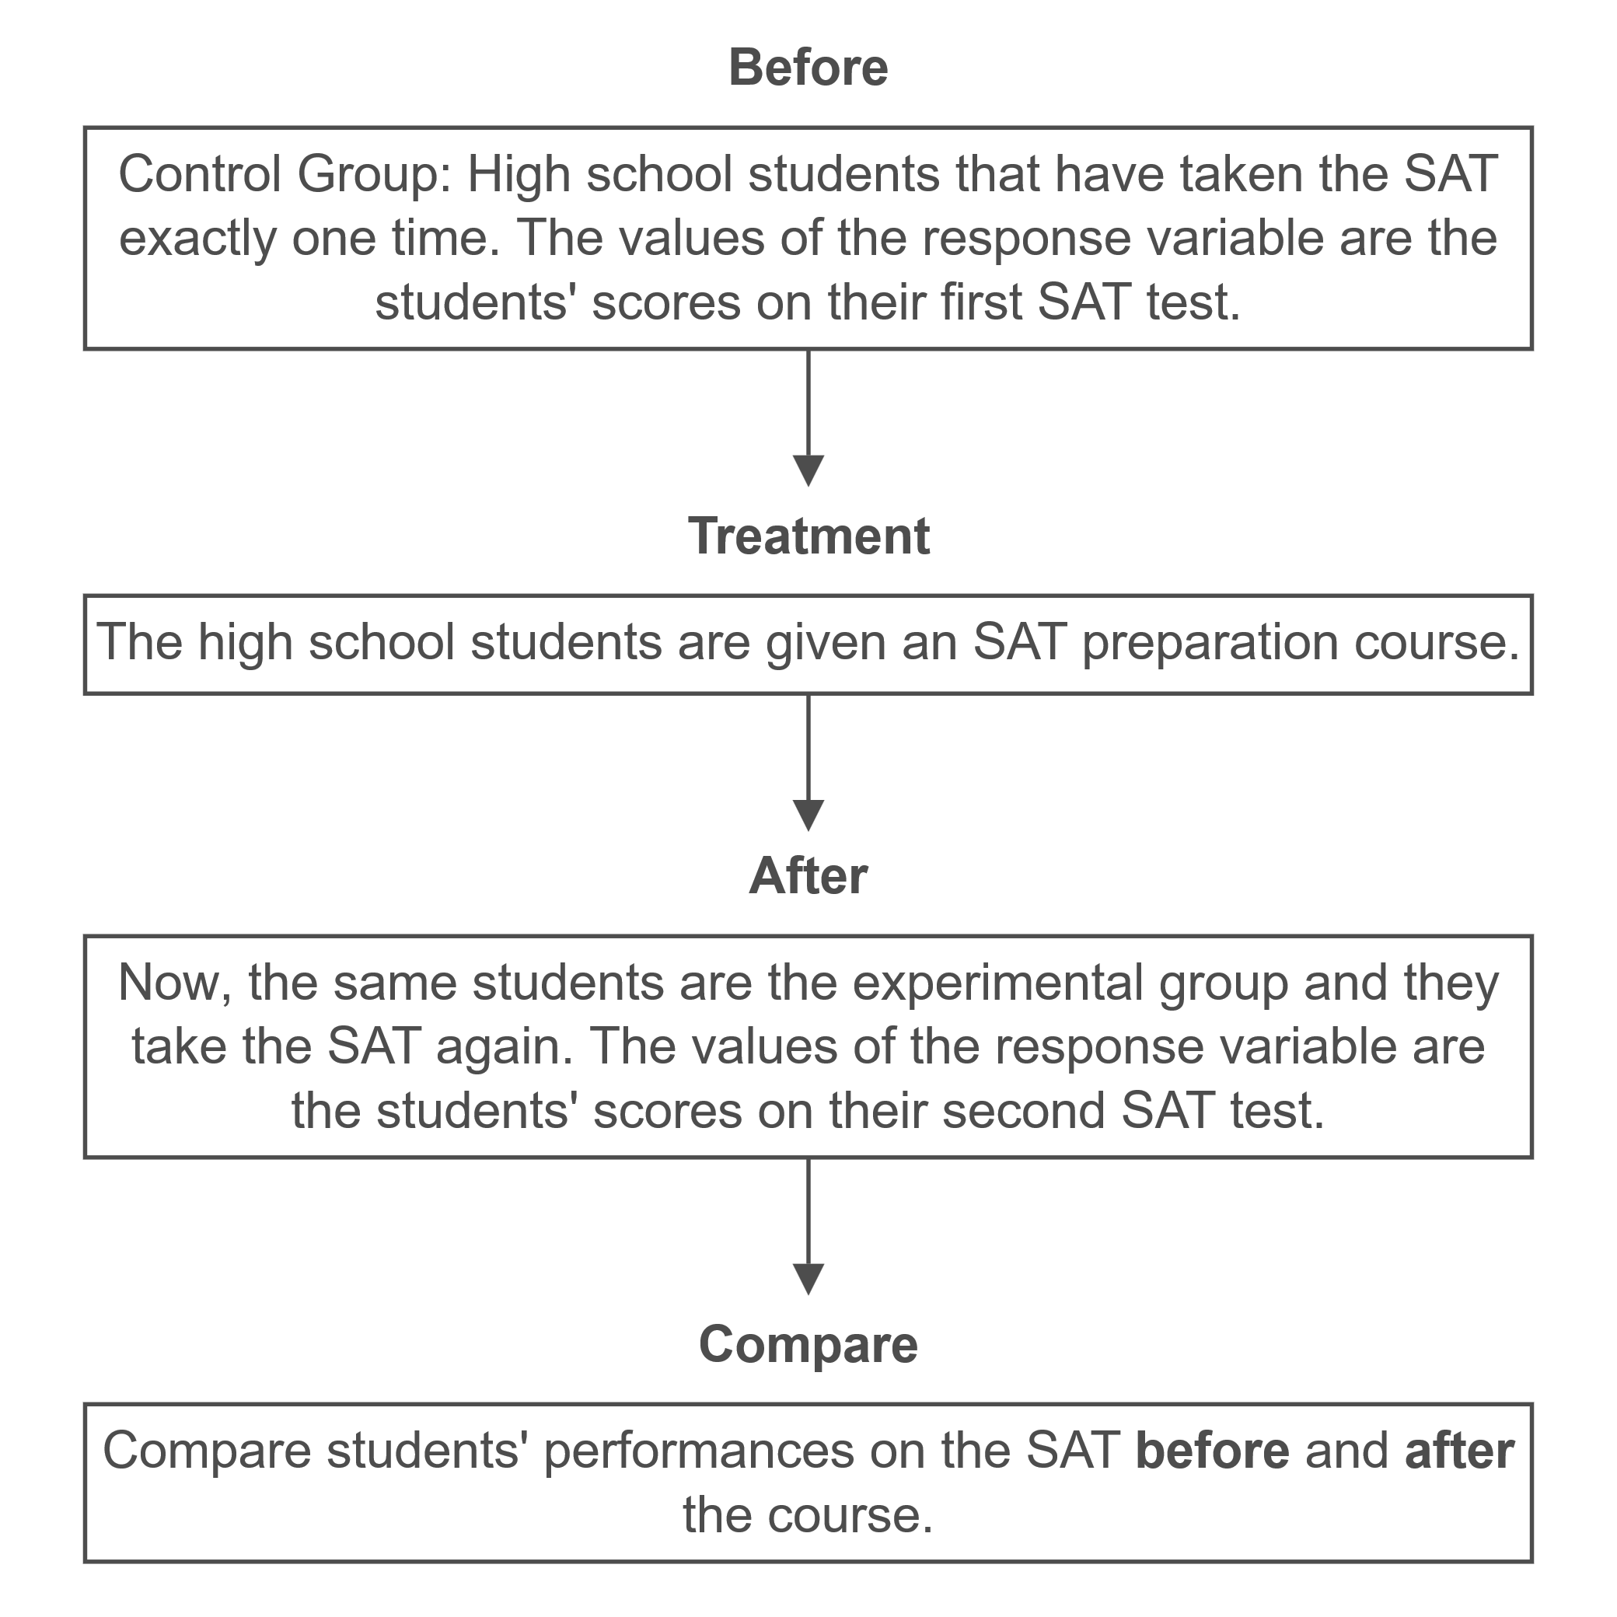
Example 3: A Before and After Study₃

Slide 25
Example 3: A Before and After Study₄
In this experiment there is only one group of students. Suppose there were two groups of students, one that had taken the course (experimental group) and one that had not (the control group). Could you assign any difference in results solely to the SAT preparation course?

Slide 26
Example 3: A Before and After Study₅
Because of potential differences in the cognitive abilities of the two groups of students, this experiment would be much more vulnerable to the justifiable criticism that the differences in student cognitive ability caused the difference in the group's SAT performance rather than the SAT preparation course. However, by using a before and after study we have only one group of students and cognitive ability is controlled.

Slide 27
Definition: Placebo
A placebo is a fake treatment that contains none of the drug being tested.

Slide 28
Definition: Placebo Effect
The placebo effect is the belief that the subject improves (or has a reaction to the placebo) when they haven't received the treatment.

Slide 29
Definition: Double Blind Study
A study in which the subjects are not told whether they are members of the experimental group or the control group and the evaluators are also not told whether their subjects are members of the experimental or control group is called a double blind study.

Slide 30
Definition: Observational Data
Data that we routinely encounter and do not involve experimentation are called observational data. A distinguishable fact about observational data is that the data are collected without any influence or interaction with the experimenter.

Slide 31
Definition: Simpson'S Paradox
Simpson's Paradox is a phenomenon in statistics in which an effect or trend appears in several different groups of data when considered separately but disappears or reverses when the groups are combined.

Slide 32
Steps to Consider When Conducting a Survey
1. Have specific goals.
2. Consider alternatives for collecting data.
3. ​ Select samples to represent the population.
4. ​Match question wording to the concepts being measured.
5. Pretest questionnaires.
6. ​ Construct quality checks.
7. ​ Use statistical analysis and reporting techniques.
8. ​ Disclose all methods used to conduct the survey.
Source: American Association for Public Opinion Research

Slide 33
Definition: Causal Factors
Causal factors are factors or variables that influence the response variable.

