Slide 1
Section 2.4
Time Series Data and Cross-Sectional Data

Slide 2
Definition: Time Series Data
Time series data are measurements taken from a process over equally spaced intervals of time.

Slide 3
Definition: Stationary Process
In a stationary process the time series varies around some central value and has approximately the same variation over the series.

Slide 4
Definition: Nonstationary Process
In a nonstationary process the time series possesses a trend—the series either increases over time or decreases over time.

Slide 5
Example 1: Identifying a Time Series as Stationary or Nonstationary₁
The gross domestic product (GDP) is the value of the goods and services produced by the nation's economy less the value of the goods and services used up in production. GDP is also equal to the sum of personal consumption expenditures, gross private domestic investment, net exports of goods and services, and gross investment. Real values are inflation–adjusted estimates—that is, estimates that exclude the effects of price changes. The data in Table 2 represent the percent change in GDP from 2000 to 2019. Determine if this time series is stationary or nonstationary.

Slide 6
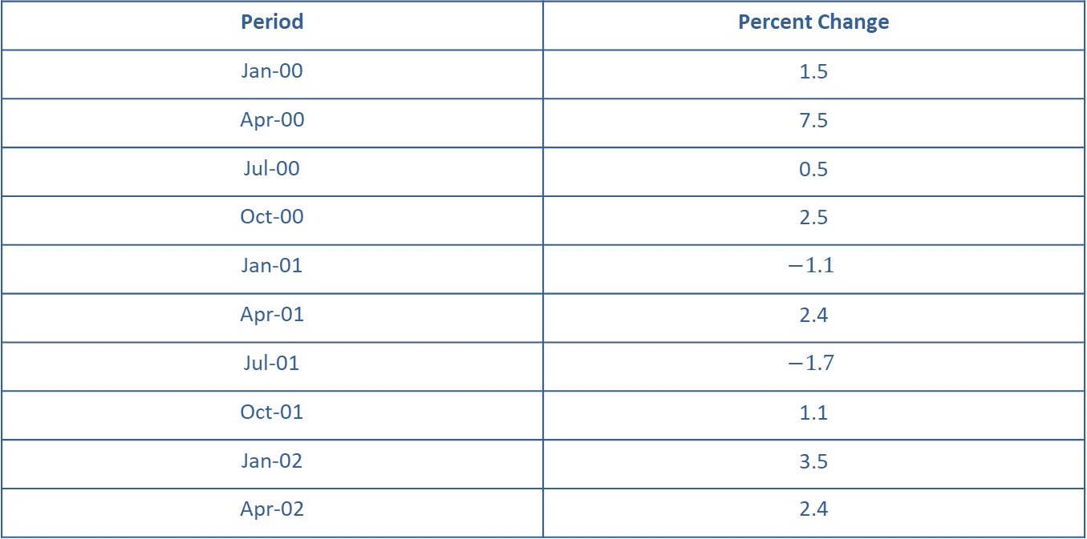
Example 1: Identifying a Time Series as Stationary or Nonstationary₂
Table 2 – Real Gross Domestic Product, Percent Change from Preceding Period, Quarterly, Seasonally Adjusted Annual Rate
Period | Percent Change
Jan-00 | 1.5
Apr-00 | 7.5
Jul-00 | 0.5
Oct-00 | 2.5
Jan-01 | $$−1.1$$
Apr-01 | 2.4
Jul-01 | $$−1.7$$
Oct-01 | 1.1
Jan-02 | 3.5
Apr-02 | 2.4

Slide 7
Example 1: Identifying a Time Series as Stationary or Nonstationary₃
Table 2 – Real Gross Domestic Product, Percent Change from Preceding Period, Quarterly, Seasonally Adjusted Annual Rate
Period | Percent Change
Jul-02 | 1.8
Oct-02 | 0.6
Jan-03 | 2.2
Apr-03 | 3.5
Jul-03 | 7.0
Oct-03 | 4.7
Jan-04 | 2.2
Apr-04 | 3.1
Jul-04 | 3.8
Oct-04 | 4.1

Slide 8
Example 1: Identifying a Time Series as Stationary or Nonstationary₄
Table 2 – Real Gross Domestic Product, Percent Change from Preceding Period, Quarterly, Seasonally Adjusted Annual Rate
Period | Percent Change
Jan-05 | 4.5
Apr-05 | 1.9
Jul-05 | 3.6
Oct-05 | 2.6
Jan-06 | 5.4
Apr-06 | 0.9
Jul-06 | 0.6
Oct-06 | 3.5
Jan-07 | 0.9
Apr-07 | 2.3

Slide 9
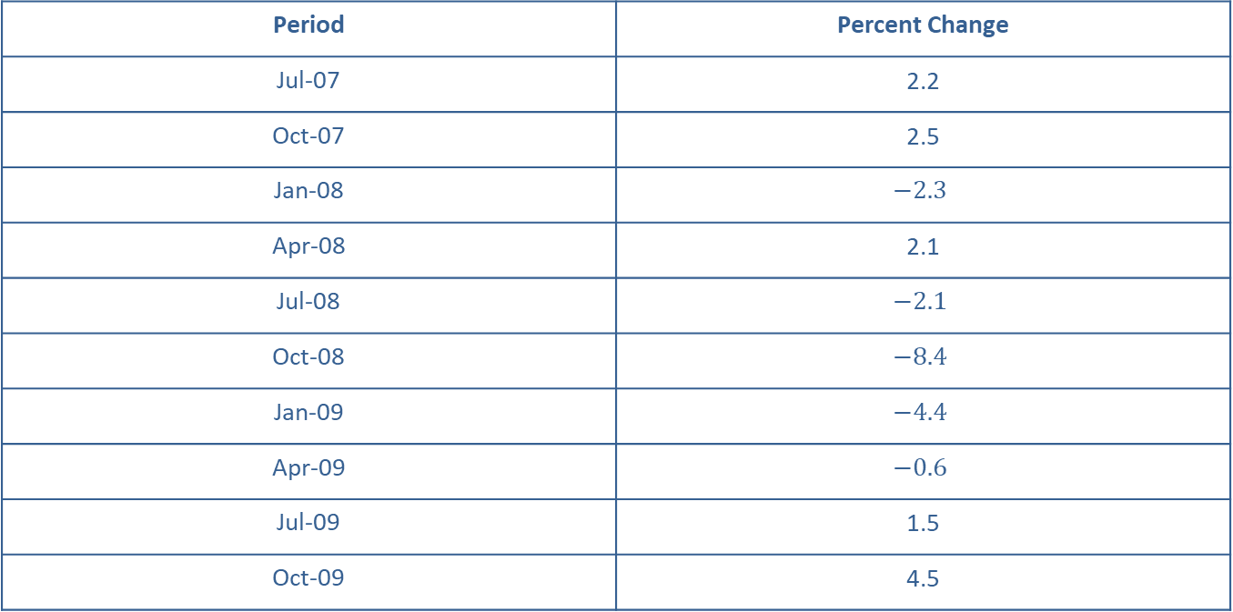
Example 1: Identifying a Time Series as Stationary or Nonstationary₅
Table 2 – Real Gross Domestic Product, Percent Change from Preceding Period, Quarterly, Seasonally Adjusted Annual Rate
Period | Percent Change
Jul-07 | 2.2
Oct-07 | 2.5
Jan-08 | $$−2.3$$
Apr-08 | 2.1
Jul-08 | $$−2.1$$
Oct-08 | $$−8.4$$
Jan-09 | $$−4.4$$
Apr-09 | $$−0.6$$
Jul-09 | 1.5
Oct-09 | 4.5

Slide 10
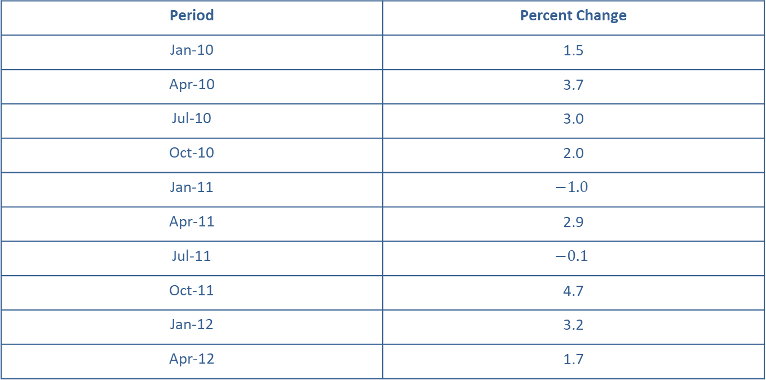
Example 1: Identifying a Time Series as Stationary or Nonstationary₆
Table 2 – Real Gross Domestic Product, Percent Change from Preceding Period, Quarterly, Seasonally Adjusted Annual Rate
Period | Percent Change
Jan-10 | 1.5
Apr-10 | 3.7
Jul-10 | 3.0
Oct-10 | 2.0
Jan-11 | $$−1.0$$
Apr-11 | 2.9
Jul-11 | $$−0.1$$
Oct-11 | 4.7
Jan-12 | 3.2
Apr-12 | 1.7

Slide 11
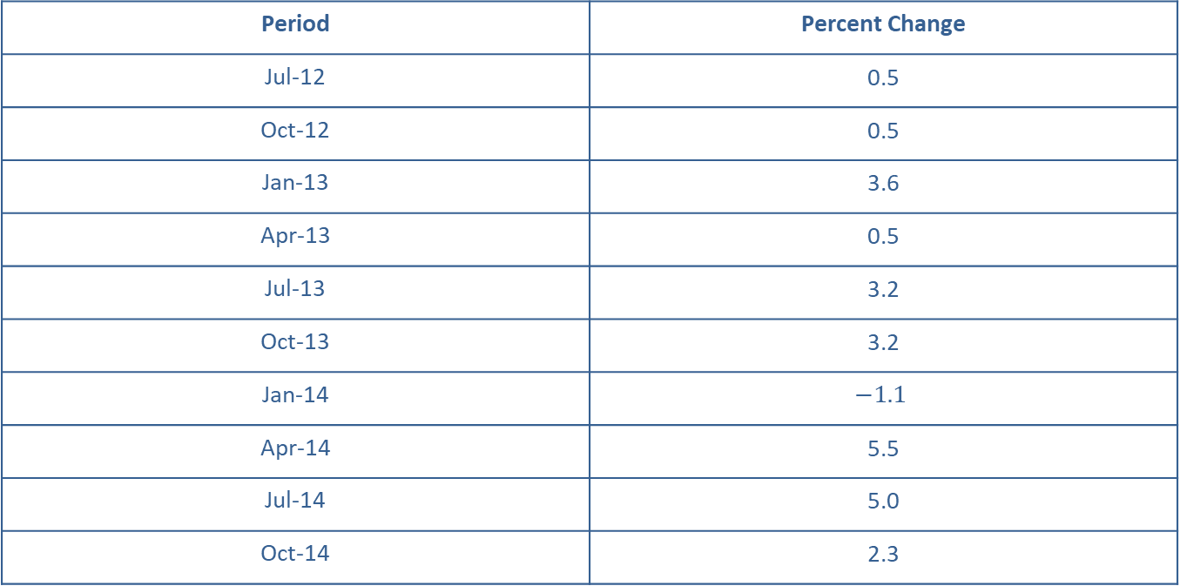
Example 1: Identifying a Time Series as Stationary or Nonstationary₇
Table 2 – Real Gross Domestic Product, Percent Change from Preceding Period, Quarterly, Seasonally Adjusted Annual Rate
Period | Percent Change
Jul-12 | 0.5
Oct-12 | 0.5
Jan-13 | 3.6
Apr-13 | 0.5
Jul-13 | 3.2
Oct-13 | 3.2
Jan-14 | $$−1.1$$
Apr-14 | 5.5
Jul-14 | 5.0
Oct-14 | 2.3

Slide 12
Example 1: Identifying a Time Series as Stationary or Nonstationary₈
Table 2 – Real Gross Domestic Product, Percent Change from Preceding Period, Quarterly, Seasonally Adjusted Annual Rate
Period | Percent Change
Jan-15 | 3.8
Apr-15 | 2.7
Jul-15 | 1.5
Oct-15 | 0.6
Jan-16 | 2.3
Apr-16 | 1.3
Jul-16 | 2.2
Oct-16 | 2.5
Jan-17 | 2.3
Apr-17 | 1.7

Slide 13
Example 1: Identifying a Time Series as Stationary or Nonstationary₉
Table 2 – Real Gross Domestic Product, Percent Change from Preceding Period, Quarterly, Seasonally Adjusted Annual Rate1
Period | Percent Change
Jul-17 | 2.9
Oct-17 | 3.9
Jan-18 | 3.8
Apr-18 | 2.7
Jul-18 | 2.1
Oct-18 | 1.3
Jan-19 | 2.9
Apr-19 | 1.5
Jul-19 | 2.6
Oct-19 | 2.4
Source: U.S. Bureau of Economic Analysis, Real Gross Domestic Product [A191RL1Q225SBEA], retrieved from FRED, Federal Reserve Bank of St. Louis; https://fred.stlouisfed.org/series/A191RL1Q225SBEA, September 6, 2020.

Slide 14
Example 1: Identifying a Time Series as Stationary or Nonstationary₁₀
Solution
The GDP data from Table 2 are plotted in Figure in the next slide. Notice that the time series plot seems to fluctuate up and down around some central value and the dispersion around the central value is reasonably constant throughout the timeframe. Thus, the time series appears to be stationary.

Slide 15
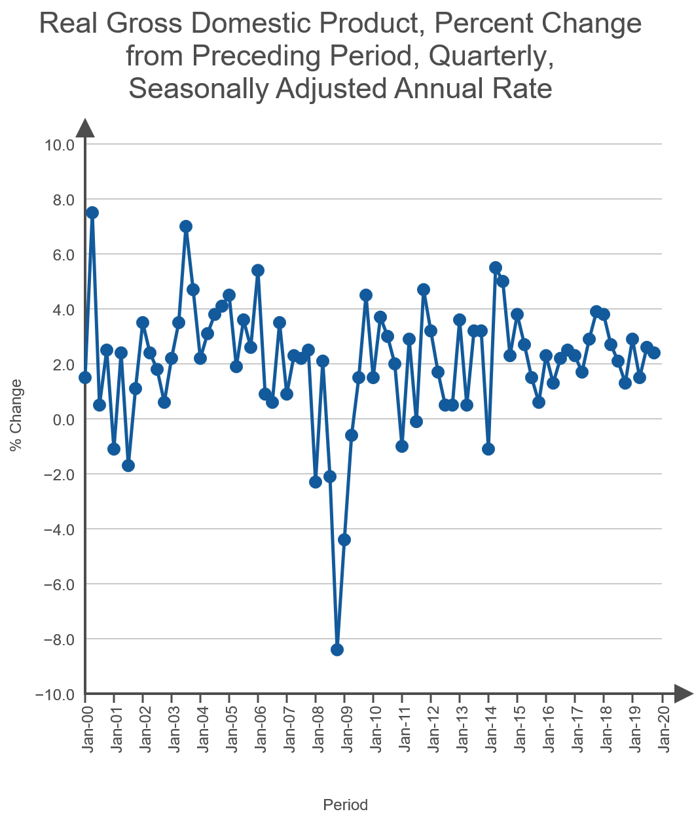
Example 1: Identifying a Time Series as Stationary or Nonstationary₁₁
Figure 1

Slide 16
Example 2: Identifying a Time Series as Stationary or Nonstationary₁
Determine if the time series corresponding to the divorce data given in Table 1 is stationary or nonstationary. Table 1 is repeated here for your convenience.

Slide 17
Example 2: Identifying a Time Series as Stationary or Nonstationary₂
Table 1 – Divorce Rate in the United States 2000–2018 (Per 1000 People)
Year | Divorce Rate
2000 | 4.0
2001 | 4.0
2002 | 3.9
2003 | 3.8
2004 | 3.7
2005 | 3.6
2006 | 3.7
2007 | 3.6
2008 | 3.5
2009 | 3.5

Slide 18
Example 2: Identifying a Time Series as Stationary or Nonstationary₃
Table 1 – Divorce Rate in the United States 2000–2018 (Per 1000 People)
Year | Divorce Rate
2010 | 3.6
2011 | 3.6
2012 | 3.4
2013 | 3.3
2014 | 3.2
2015 | 3.1
2016 | 3.0
2017 | 2.9
2018 | 2.9

Slide 19
Example 2: Identifying a Time Series as Stationary or Nonstationary₄
Solution
Figure 2 in the next slide shows the divorce data from Table 1. There is strong evidence of a downward trend. Thus, the time series is nonstationary. (Note these data are not affected by population increases over the years since it is given in divorces per 1000 people.)

Slide 20
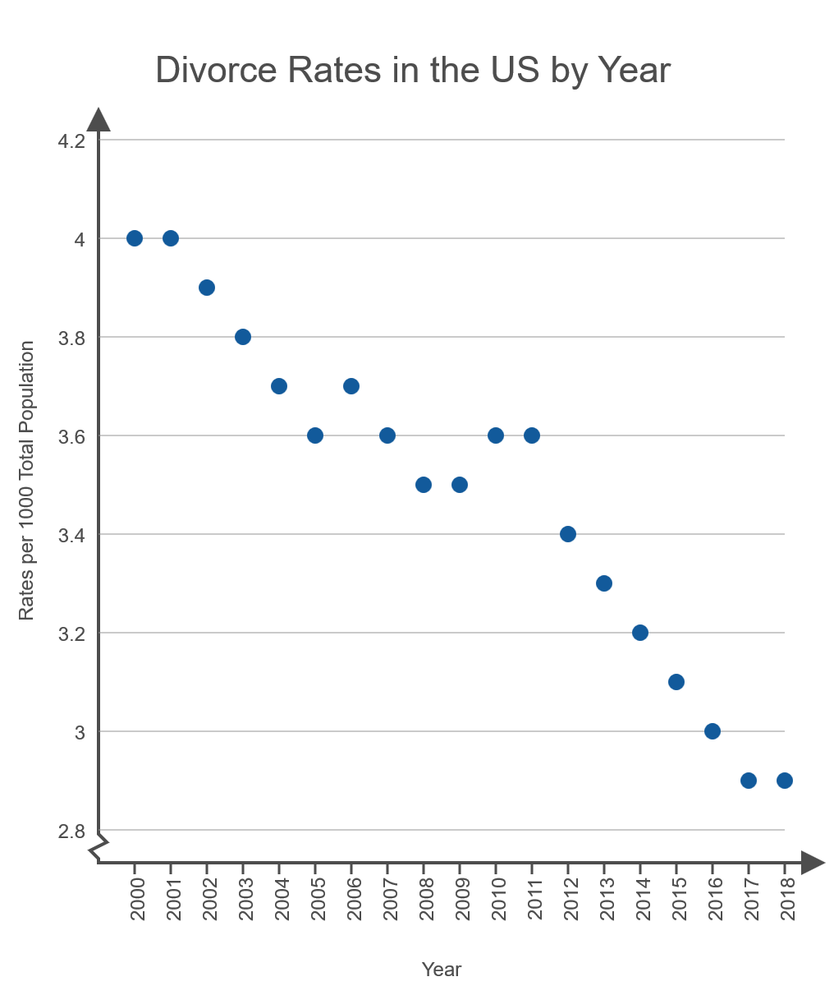
Example 2: Identifying a Time Series as Stationary or Nonstationary₅
Figure 2

Slide 21
Example 3: Identifying a Time Series as Stationary or Nonstationary₁
Consider the following data regarding the average hourly earnings for all employees. Determine if the time series associated with these data is stationary or nonstationary.

Slide 22
Example 3: Identifying a Time Series as Stationary or Nonstationary₂
Table 3 – Average Hourly Earnings for All Employees, Total Private (US Dollars)
Year | Average Hourly Earnings
2007 | 20.91
2008 | 21.56
2009 | 22.17
2010 | 22.58
2011 | 23.03
2012 | 23.47
2013 | 23.96
2014 | 24.46
2015 | 25.01
2016 | 25.65

Slide 23
Example 3: Identifying a Time Series as Stationary or Nonstationary₃
Table 3 – Average Hourly Earnings for All Employees, Total Private (US Dollars)
Year | Average Hourly Earnings
2017 | 26.31
2018 | 27.10
2019 | 28.00
Source: Federal Reserve Bank of St. Louis

Slide 24
Example 3: Identifying a Time Series as Stationary or Nonstationary₄
Solution
As can be seen in Figure 3 in the next slide, the average hourly earnings for all employees has been on a steady increase since 2007. Given that the time series increases from year to year, this is obviously not a stationary series.

Slide 25
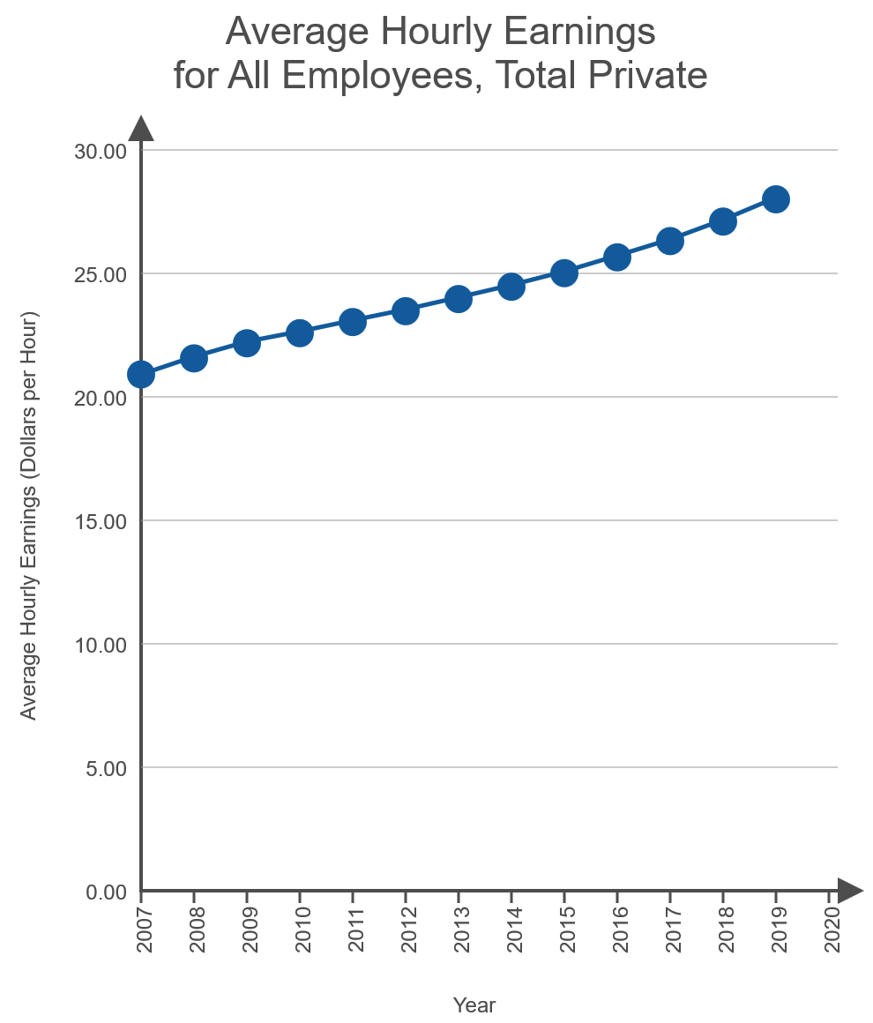
Example 3: Identifying a Time Series as Stationary or Nonstationary₅
Figure 3

Slide 26
Definition: Cross-Sectional Data
Cross-sectional data are measurements created at approximately the same period of time.

