Slide 1
Section 3.1
Frequency Distributions

Slide 2
Definition: Frequency Distribution
A frequency distribution summarizes data into classes and provides in tabular form a list of the classes along with the number of observations in each class.

Slide 3
Frequency Distribution—Slide 1
Table 1 – Population Counts of Individual Sates in 2010 and 2019 (in Thousands)
State | 2010 Population | 2019 Population | Growth | Percent Growth
Alabama | 4780 | 4903 | 123 | 2.57
Alaska | 710 | 732 | 21 | 2.96
Arizona | 6392 | 7279 | 887 | 13.88
Arkansas | 2916 | 3018 | 102 | 3.50
California | 37,254 | 39,512 | 2258 | 6.06
 |  | …
Puerto Rico | 3726 | 3194 | −532 | −14.28

Slide 4
Frequency Distribution—Slide 2
Table 2 – Frequency Distribution of State 10-Year Population Growth Rates
Percentage Population Growth 2010-2019 | Frequency
Less than or equal to 0 | 5
0.01 to 5 | 23
5.01 to 10 | 12
10.01 to 15 | 9
15.01 to 20 | 3

Slide 5
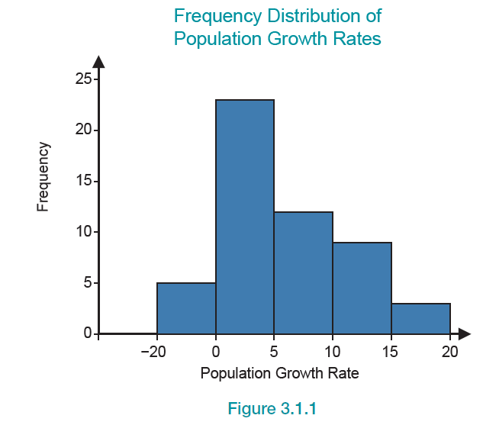
Frequency Distribution—Slide 3
Figure 1

Slide 6
Frequency Distribution—Slide 4
With the frequency distribution table, we are able to see the broader structure of the data. It is now easy to see that most state population 10-year growth rates are between 0 and 5 percent. Further, growth rates above 20% are uncommon. Without the organization that a frequency distribution provides, these conclusions would be more difficult to establish. If there were 10,000 data values instead of 52, it would be much more difficult to make similar conclusions.
There are only two steps in the construction of a frequency distribution.
Step 1: Choose the classifications.
Step 2: Count the number in each class.

Slide 7
Frequency Distribution—Slide 5
For simple data, such as the results from tossing a coin, the choice of classifications is easy. Heads is one category and tails the other. However, for continuous data, such as weights, heights, and volumes, the choice of classification scheme becomes less obvious, since there are an enormous number of possibilities. There are two requirements that should be met when setting up the categories for classification: the categories must be both mutually exclusive and exhaustive. Essentially, this means categories should not overlap and should cover all possible values.

Slide 8
Frequency Distribution—Slide 6
Since choosing the classification depends on whether the data are qualitative (nominal or ordinal) or quantitative (interval or ratio), the discussion of frequency distributions will be presented on the basis of these data types. This section will present how to construct a frequency distribution for qualitative data, and Section 3.3 will introduce constructing frequency distributions for quantitative data.

Slide 9
Example 1: Creating a Frequency Distribution of Survey Responses—Slide 1
Apple Inc. introduced its third generation iPad in March of 2012. After months of anticipation, owners were thrilled with their new iPads. Two of the main features that separated the 3 ^{rd} generation iPad from its predecessors were an improved camera and a higher resolution display. In spite of the excitement of the launch, there were still things that owners did not like about the new device. The following table contains the responses from a survey of 30 new iPad owners when asked what they dislike about the iPad.

Slide 10
Example 1: Creating a Frequency Distribution of Survey Responses—Slide 2
Table 3 – Survey Responses
Cost of Device | Size/Weight | Excessive Heat from Device
Battery Life Too Short | Size/Weight | Cost of Device
Cost of Device | Battery Life Too Short | Excessive Heat from Device
Cost of Wireless Data Plan | Amount of Flash Memory Storage | Size/Weight
Cost of Device | Battery Life Too Short | Cost of Device
Amount of Flash Memory Storage | Cost of Device | Integration with Other Devices
Amount of Flash Memory Storage | Battery Life Too Short | Integration with Other Devices

Slide 11
Example 1: Creating a Frequency Distribution of Survey Responses—Slide 3
Table 3 – Survey Responses
Cost of Wireless Data Plan | Cost of Device | Excessive Heat from Device
Amount of Flash Memory Storage | Cost of Wireless Data Plan | Cost of Device
Cost of Device | Battery Life Too Short | Cost of Wireless Data Plan
Create a frequency distribution using the data in Table 3 to summarize what iPad owners dislike about their devices.

Slide 12
Example 1: Creating a Frequency Distribution of Survey Responses—Slide 4
Solution
Examining the table of responses, one can see that there are seven responses (or categories) that were given by the 30 new iPad owners. Summarizing the responses in a table (by counting the number of times that each reason was given), we can create a frequency distribution.

Slide 13
Example 1: Creating a Frequency Distribution of Survey Responses—Slide 5
Table 4 – Frequency Distribution of Survey Responses
Response | Frequency
Cost of Device | 9
Battery Life Too Short | 5
Cost of Wireless Data Plan | 4
Amount of Flash Memory Storage | 4
Size/Weight | 3
Excessive Heat from Device | 3
Integration with Other Devices | 2

Slide 14
Example 1: Creating a Frequency Distribution of Survey Responses—Slide 6
The frequency distribution makes it easy to see the greatest concern for iPad owners. From the table, it is evident that in spite of the anticipation and the rush for many consumers to purchase the new iPad, the cost of the device was the number one reason that new owners disliked it. We can also see that iPad integration with other devices is not much of a concern for new customers. These conclusions would have been much more difficult to make if we considered the raw data alone without consolidating the responses into a frequency distribution.

Slide 15
Example 2: A Model to Determine Virtual Security Practices—Slide 1
Our increased reliance on digital information and our expansive use of the Internet for a steadily rising number of tasks requires that more emphasis be placed on digital information security. The importance of securing digital information is apparent but the success in persuading individual users to adopt and utilize tools to improve security has been arguably more difficult. A recent study conducted by Information Security Associates wanted to determine the extent to which students are aware of security measures available to protect personal information on their computers and the importance of such measures.

Slide 16
Example 2: A Model to Determine Virtual Security Practices—Slide 2
One of the survey items was, "I am aware that there are measures that I can take to help protect my personal information on my personal computer." The frequency of each response category is shown in Table 5. The frequency distribution for the second item, "I am aware that I can reduce exposure to system compromise by restricting who uses my personal computer," is given in Table 6.

Slide 17
Example 2: A Model to Determine Virtual Security Practices—Slide 3
The summary tables are much more informative than looking at more than a thousand observations for each question (note that the number of observations for each question is different because every student did not answer every question on the survey).

Slide 18
Example 2: A Model to Determine Virtual Security Practices—Slide 4
Table 5 – Frequency Distribution of Responses
"I am aware that there are measures that I can take to help protect my personal information on my personal computer."
Strongly Agree | 419
Slightly Agree | 327
Neutral | 250
Slightly Disagree | 124
Strongly Disagree | 85

Slide 19
Example 2: A Model to Determine Virtual Security Practices—Slide 5
Table 6 – Frequency Distribution of Responses
"I am aware that I can reduce exposure to system compromise by restricting who uses my personal computer."
Strongly Agree | 520
Slightly Agree | 435
Neutral | 310
Slightly Disagree | 115
Strongly Disagree | 90

Slide 20
Definition: Relative Frequency Distribution
A relative frequency distribution summarizes data into classes and provides in tabular form a list of the classes along with the proportion (or percentage) of observations in each class.

Slide 21
Relative Frequency Distribution—Slide 1
In Table 7 and Table 8, relative frequency distributions are calculated. In these tables, the frequencies are converted into percentages. These are defined as relative frequencies, i.e., the proportion relative to the total. They are valuable in assessing the data quickly in terms we use frequently. (See Section 3.3 for an additional discussion of relative frequency distributions.)

Slide 22
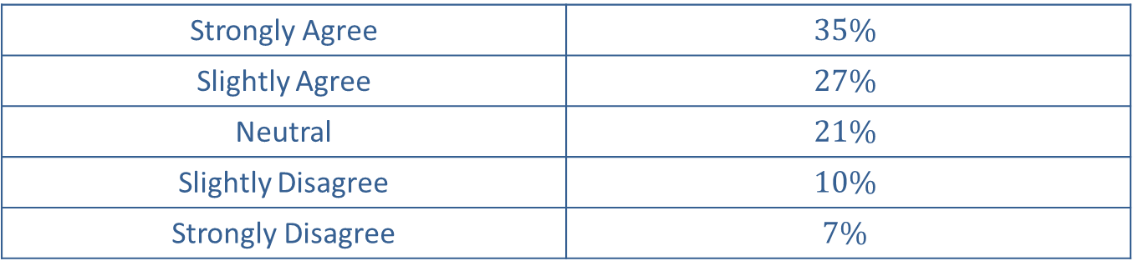
Relative Frequency Distribution—Slide 2
Table 7 – Relative Frequency Distribution of Responses
"I am aware that there are measures that I can take to help protect my personal information on my personal computer."
Strongly Agree | $$35\%$$
Slightly Agree | $$27\%$$
Neutral | $$21\%$$
Slightly Disagree | $$10\%$$
Strongly Disagree | $$7\%$$

Slide 23
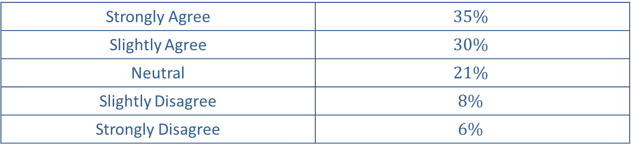
Relative Frequency Distribution—Slide 3
Table 8 – Relative Frequency Distribution of Responses
"I am aware that I can reduce exposure to system compromise by restricting who uses my personal computer."
Strongly Agree | $$35\%$$
Slightly Agree | $$30\%$$
Neutral | $$21\%$$
Slightly Disagree | $$8\%$$
Strongly Disagree | $$6\%$$

Slide 24
Relative Frequency Distribution—Slide 4
As one can see in Tables 5 through 8, the majority of students are aware that there are measures that they can take to protect the information on their personal computers. Summarizing the qualitative data (via a frequency distribution table or relative frequency distribution table) allows the researcher to make conclusions about the data without having to view each observation.

