Slide 1
Section 3.2
Displaying Qualitative Data

Slide 2
Definition: Bar Chart
The bar chart is a simple graphical display in which the length of each bar corresponds to the number of observations in a category.

Slide 3
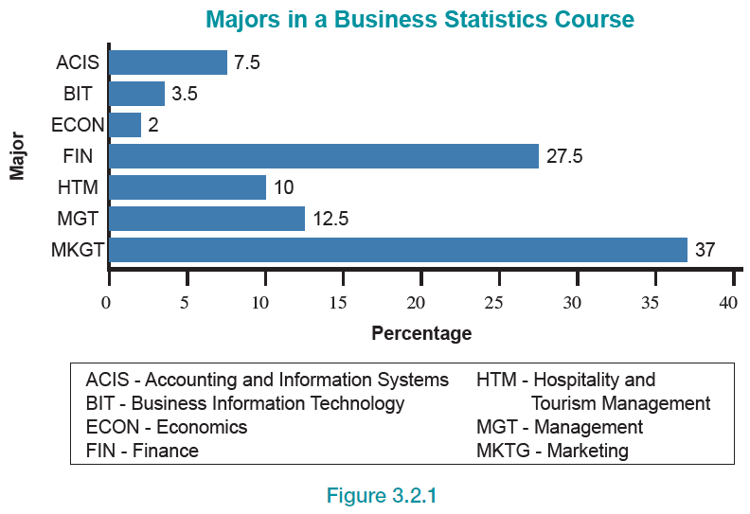
Bar Chart
Figure 1

Slide 4
The Aesthetics of Bar Chart Construction—Slide 1
Bar chart construction requires numerous layout decisions such as size, use of color, and labeling locations. These decisions are frequently made on a trial-and-error basis. However, certain conventions have been developed that improve the quality and effectiveness of charts. They are presented below as suggestions, not rules. Actually, several of the points are general in nature and would serve as useful guidelines in the construction of any graph.

Slide 5
The Aesthetics of Bar Chart Construction—Slide 2
Bar charts can be constructed horizontally or vertically. Customarily, horizontal orientation is used for categories that are descriptively labeled, and vertical (or columnar) orientation is used for categories that are numerical. It is important to remember that this idea is only a suggestion. If you believe that a vertical bar chart is more appealing, use it.
If the categories have some associated order, they maintain that order in the bar chart. Otherwise, the categories may be listed alphabetically, in either ascending or descending order, or in some other pattern related to the nature of the data.

Slide 6
The Aesthetics of Bar Chart Construction—Slide 3
Miscellaneous or “other” categories should be listed at the bottom of the chart (if oriented horizontally) or at the far right (if oriented vertically).
The difference in bar length is the principal visual feature in comparing differences in category amounts. Consequently, scales for the axes should be chosen that will most effectively allow for the desired comparisons. Unless there is a good reason, the axis used to measure the bars should start at zero. Otherwise, the axis can be stretched to exaggerate differences in the bar lengths. For example, suppose the data in the following table were plotted.

Slide 7
The Aesthetics of Bar Chart Construction—Slide 4
Table 1 - Sales Performance
Salesperson | Total Sales (Thousands of Dollars)
Susan | 187
William | 201
Beth | 207
Rob | 193

Slide 8
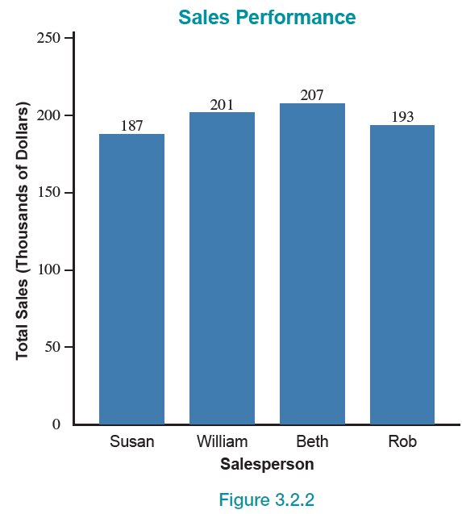
The Aesthetics of Bar Chart Construction—Slide 5
Figure 2

Slide 9
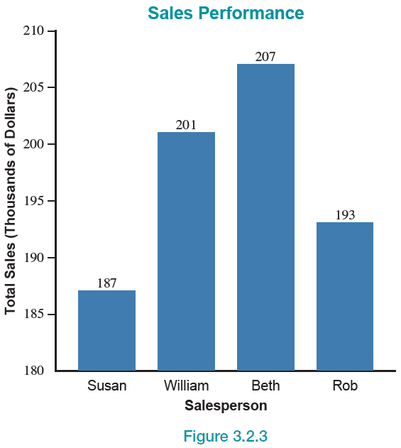
The Aesthetics of Bar Chart Construction—Slide 6
Figure 3

Slide 10
The Aesthetics of Bar Chart Construction—Slide 7
Figures 2 and 3 are plots of the same data (Table 1). What a difference axis selection can make on perception! In Figure 3 the y-axis begins at 180 instead of zero. If you want to emphasize similarity, use
Figure 2 to do the job. If you want to emphasize differences, use Figure 3. However, it is difficult to imagine any legitimate reason for using Figure 3 to represent the data. Axis stretching is often employed to mislead. When you see an axis that does not start at zero, you should be a bit skeptical as to the conclusions the author intends for you to make.

Slide 11
The Aesthetics of Bar Chart Construction—Slide 8
Bar widths should be chosen that are visually pleasing and should not be allowed to vary within a particular chart.
Appropriate shading, crosshatching, and coloring of the bars can help in presenting data. Many spreadsheet programs incorporate sophisticated graphing programs which make changes in shading, color, and crosshatching patterns extremely easy.

Slide 12
The Aesthetics of Bar Chart Construction—Slide 9
The spacing between bars can dramatically affect the perception of the graph. Spacing should be set at approximately one-half the width of a bar. This, however, is not a rigid rule. Artistic judgment is needed.
Gridlines extended into the body of the chart are often useful and may be included if deemed helpful. Study Figure 4 and Figure 5. Both bar charts illustrate the same data. Notice that the readability of the graph in Figure 5 is improved by adding gridlines.

Slide 13
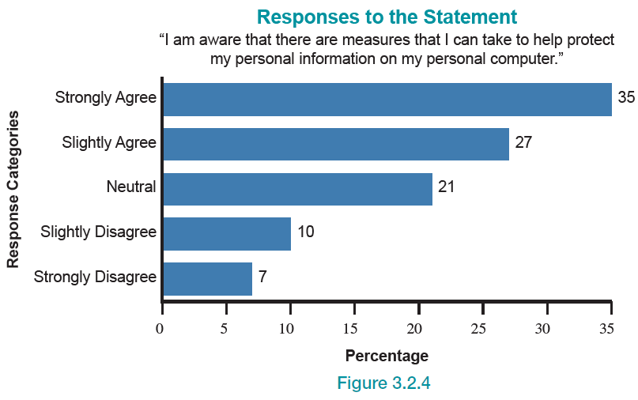
The Aesthetics of Bar Chart Construction—Slide 10
Figure 4

Slide 14
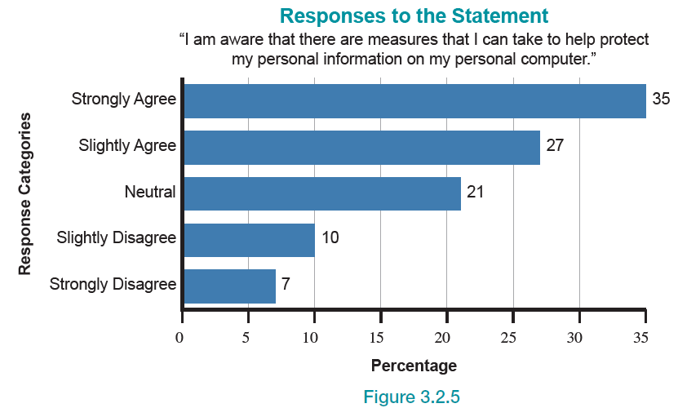
The Aesthetics of Bar Chart Construction—Slide 11
Figure 5

Slide 15
The Aesthetics of Bar Chart Construction—Slide 12
Labels should be provided for each bar (category) and for each axis.
Notes on sources of data or other footnotes should be given below the chart.
Bar charts used to be flat and simple. Now, computer graphics packages offer three-dimensional, stacked, side-by-side, colored, and other variations of bars. These capabilities offer the user the chance to create spectacular, multidimensional, eye-catching graphics.

Slide 16
The Aesthetics of Bar Chart Construction—Slide 13
Rotating the axes on a bar chart can create a very different graphical perspective. Figures 6 and 7 are identical graphs with a slight difference in perspective. (Note also the change in perspective by making the graphs 3-D. These are the same data that are graphed in Figures 4 and 5.) If you are using a large number of graphics in a document, even
3-D graphs can be burdensome. It would be more visually interesting to change the perspective of the graphic from time to time. Making the changes from 2-D to 3-D and performing the rotation are simple operations in most software packages.

Slide 17
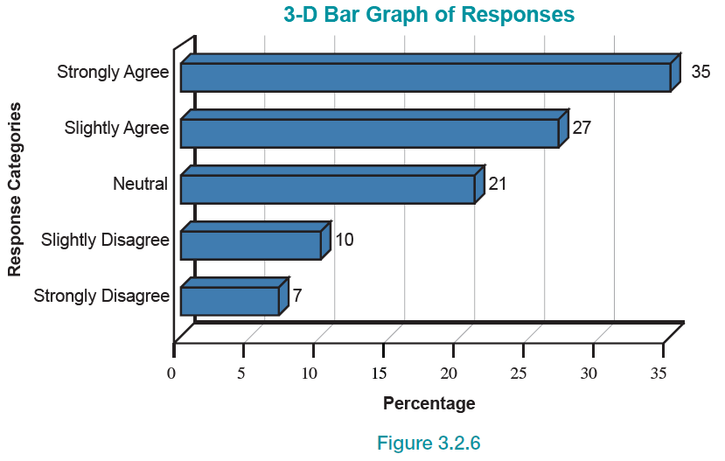
The Aesthetics of Bar Chart Construction—Slide 14
Figure 6

Slide 18
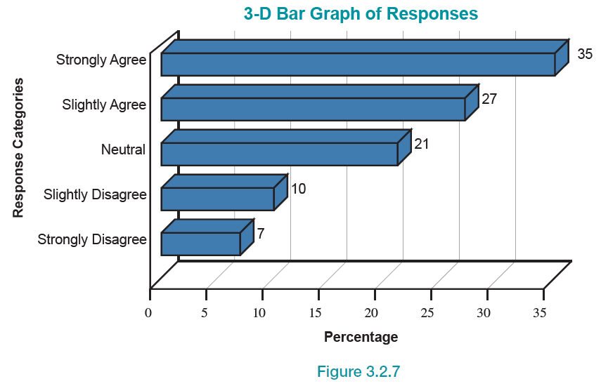
The Aesthetics of Bar Chart Construction—Slide 15
Figure 7

Slide 19
The Aesthetics of Bar Chart Construction—Slide 16
One of the themes of this chapter is that a graph can be an analytical device and a presentation tool. Simple graphics are fine for analytical purposes, but if you are trying to make a point, then a higher standard is required to create visual impact. Designing effective graphics is not just about making things look better; graphics can help the reader comprehend information. Using graphics well can emphasize meaning and organize content. It pays to know your audience’s likes and dislikes in viewing graphics so that the maximum impact can be achieved.

Slide 20
Stacked Bar Charts—Slide 1
Stacked bar charts are an interesting variation on the standard bar chart. The number of medals (gold, silver, bronze) won during the 2016 Summer Olympics for selected countries is given in Figure 8.

Slide 21
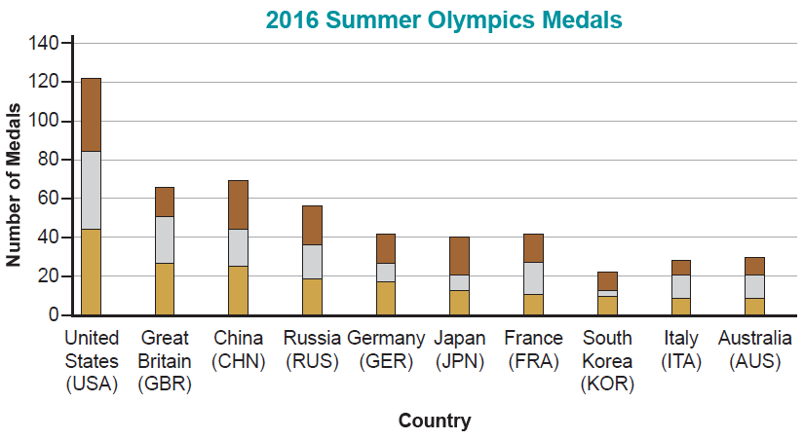
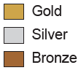
Stacked Bar Charts—Slide 2
Figure 8

Slide 22
Stacked Bar Charts—Slide 3
Using the stacked bar chart enables the reader to compare the total number of medals for each country as well as observe the number of each type of medal won.
Without the stacked bar chart, the reader would have to view either three different charts tallying medal counts for the 2016 Summer Olympics or a much “busier” chart plotting each medal on the horizontal axis above each country.

Slide 23
Stacked Bar Charts—Slide 4
Figure 9 is another example of a stacked bar chart. The chart displays the number of grandchildren by age group living with their grandparents based on which parent is in the household. From this chart we can see that the majority of grandchildren living with their grandparents live in the same household with their mother only. We can also see that it is fairly rare that grandchildren live in the same household with their grandparents and their father only. Stacked bar charts are useful when there are three components to the data (in this case the percentage of children, the age group, and the parents in the household).

Slide 24
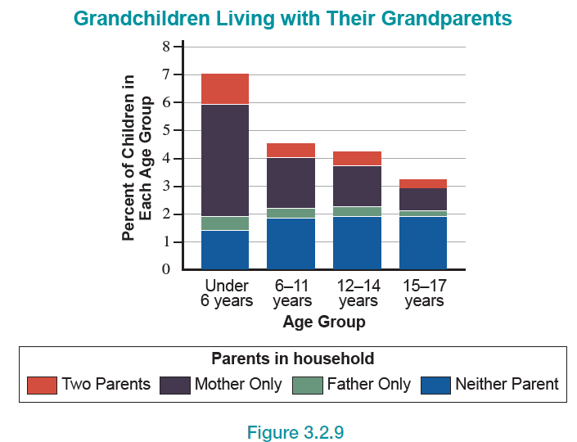
Stacked Bar Charts—Slide 5
Figure 9

Slide 25
3-D Bar Charts—Slide 1
Another interesting way of looking at the Olympic medal data is to plot a three-dimensional bar chart as shown in Figure 10. Using this graph, the totals for each type of medal are graphed for each country.

Slide 26
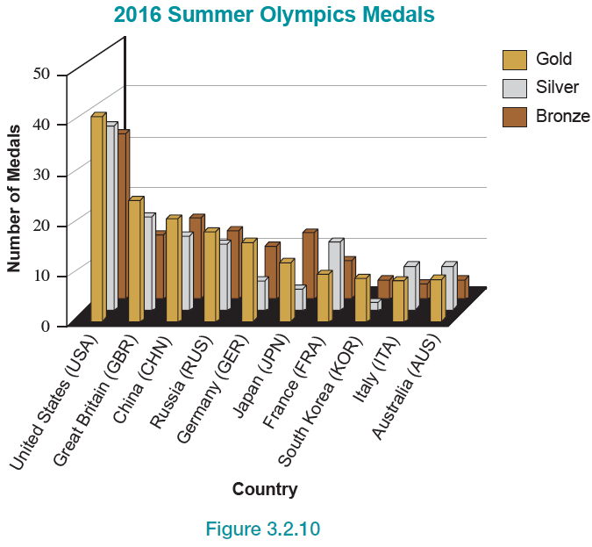
3-D Bar Charts—Slide 2
Figure 10

Slide 27
3-D Bar Charts—Slide 3
When constructing a 3-D graph there are a number of perspective issues that affect the visual quality of the graph. For example, in Figure 10, we are barely able to see the number of bronze medals won by Great Britain. All the major software packages permit you to spin and tilt the graph until you find a perspective you like, and that allows you to see all of the categories.

Slide 28
Pie Charts—Slide 1
We have just seen how bar charts are used as a means of expressing frequency distributions. Pie charts can perform the same function.
The circle represents the total “pie” available, and the slices are proportional to the amount in each category. Each slice of the pie represents the proportion of total observations belonging to the category. One of the advantages of the pie chart is the ability to easily compare the total in each of the classifications to the total number of observations.

Slide 29
Pie Charts—Slide 2
One common use of pie charts is to display how some set of assets is spent. The biggest asset pie in the world is the budget of the United States government. In 2019, government outlays were in the neighborhood of $4.4 trillion dollars. If the budget is split into six categories, the percentages spent in 2019 in each category are provided in Table 2. While the table provides the information, it is not visually interesting. A pie chart will enable you to improve the presentation of the information in Table 2.

Slide 30
Pie Charts—Slide 3
Oftentimes, the percentages in tables such as Table 2 will either sum to more than 100% or be slightly less than 100% due to rounding. Such is the case for this table.
Table 2 – Percentage Spent by the Federal Government in 2019
Category | Percentage Spent
Social Security | 23%
Safety Net Programs | 8%
Defense and International Security Assistance | 16%
Other Entitlements | 19%
Medicare and Medicaid | 25%
Interest on Debt | 8%

Slide 31
Pie Charts—Slide 4
The pie chart in Figure 11 tells an interesting story about how our tax dollars are spent. In a glance at the pie chart, your eyes are dawn to the biggest slice of the pie, the 25% spent on Medicare and Medicaid. If you would like to look at current information on how government monies are spent, go to www.whitehouse.gov/omb/budget.

Slide 32
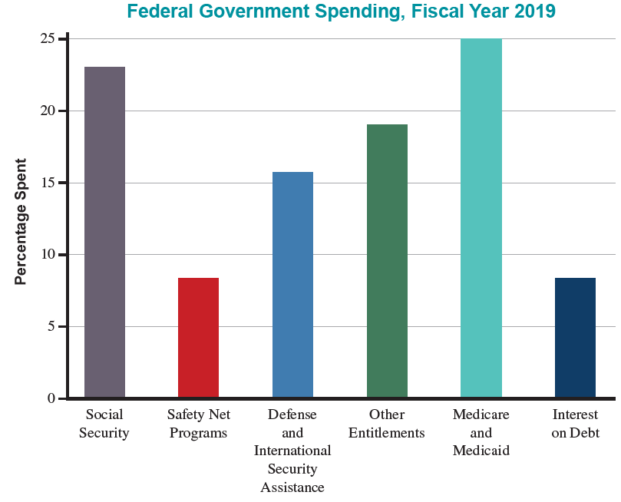
Pie Charts—Slide 5
Figure 11

Slide 33
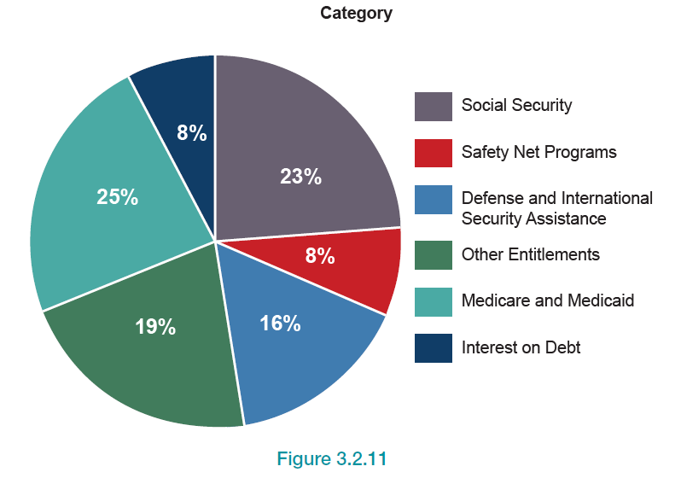
Pie Charts—Slide 6
Figure 12

Slide 34
Pie Charts—Slide 7
A three-dimensional version of the pie chart as shown in Figure 12 adds some spice to any presentation. If you are working with a computer application that can perform graphics, changing the image from a two-dimensional pie chart to a three-dimensional chart takes only a few mouse clicks. A 3-D pie chart of federal government spending is given in Figure 12.

Slide 35
Pie Charts—Slide 8
In order to determine from the pie chart how much was spent in a particular category, multiply the total amount by the proportion given for that category in the pie chart. For example, to find the dollar amount of government funds spent on Medicare and Medicaid, multiply the total amount of government expenditures ($4.4 trillion) by the proportion spent on Medicare and Medicaid. This means that $4.4(0.25) = $1.1 trillion of all government expenditures goes to Medicare and Medicaid.

Slide 36
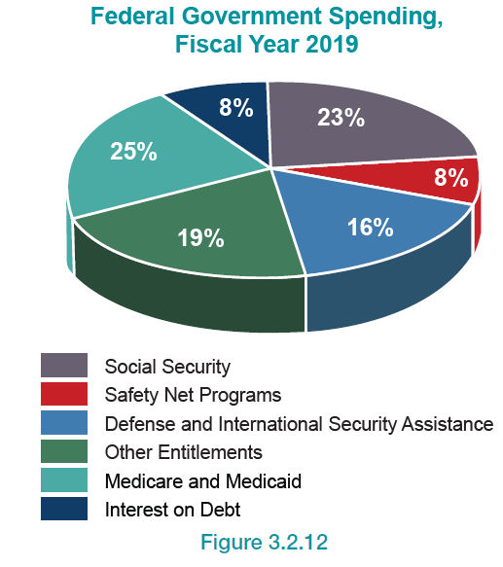
Pie Charts—Slide 9
Figure 13

