Slide 1
Section 3.3
Constructing Frequency Distributions for Quantitative Data

Slide 2
Example 1: Creating a Frequency Distribution of Companies' Revenues—Slide 1
A data set containing the revenues (in millions of dollars) of the top 100 companies on the Fortune 500 is listed in Table 1.

Slide 3
Example 1: Creating a Frequency Distribution of Companies' Revenues—Slide 2
Table 1 – Revenues of the Top 100 Companies on the Fortune 500 (Millions of Dollars)
116 | 408 | 31 | 26 | 25
29 | 77 | 99 | 118 | 35
72 | 66 | 45 | 36 | 71
37 | 32 | 49 | 53 | 100
25 | 105 | 45 | 31 | 30
36 | 25 | 38 | 44 | 96
45 | 115 | 27 | 50 | 27
41 | 43 | 87 | 80 | 99
140 | 107 | 61 | 65 | 31
47 | 28 | 108 | 45 | 44
25 | 164 | 62 | 157 | 41

Slide 4
Example 1: Creating a Frequency Distribution of Companies' Revenues—Slide 3
Table 1 – Revenues of the Top 100 Companies on the Fortune 500 (Millions of Dollars)
26 | 70 | 1 | 35 | 109
112 | 26 | 63 | 35 | 58
103 | 32 | 285 | 30 | 31
69 | 30 | 33 | 27 | 65
36 | 30 | 32 | 35 | 31
37 | 32 | 25 | 27 | 25
29 | 32 | 25 | 27 | 25
45 | 60 | 28 | 68 | 26
25 | 150 | 40 | 53 | 34

Slide 5
Example 1: Creating a Frequency Distribution of Companies' Revenues—Slide 4
Of course, looking at the raw numbers is not very revealing. Given the number of observations, it is difficult to get a good idea of the measurements. Instead of trying to examine or analyze all 100 values, a frequency distribution is given in Table 2 in the next slide. Examining the frequency distribution, an analyst can look at a table divided into ten categories and ten frequencies, thus reducing its complexity.

Slide 6
Example 1: Creating a Frequency Distribution of Companies' Revenues—Slide 5
Table 2 – Frequency Distribution
Revenue (Millions of Dollars) | Number of Companies
0 to 40 | 50
41 to 81 | 30
82 to 122 | 14
123 to 163 | 3
164 to 204 | 1
205 to 245 | 0
246 to 286 | 1
287 to 327 | 0
328 to 368 | 0
369 to 409 | 1

Slide 7
Example 1: Creating a Frequency Distribution of Companies' Revenues—Slide 6
With the frequency distribution, we are able to see the broader structure of the data. It is now easy to see that the overwhelming majority of revenues are between $0 and $122 million. Further, revenues of $164 million and above are uncommon. These conclusions would be considerably more difficult to establish without the organization that the frequency distribution provides.

Slide 8
Determining Class Width—Slide 1
After deciding on the desired number of classes, the next step is to specify the width of each class. Using classes that are of equal widths makes the frequency distribution or histogram easier to interpret. A good starting point for determining class width is to divide the difference between the largest and the smallest observations by the number of classes.

Slide 9
Determining Class Width—Slide 2
Suppose we wanted to create a frequency distribution from the revenue data in Example 1. If there are to be 10 classes, determine a class width.

Slide 10
Determining Class Width—Slide 3
Class endpoints with fractional values will make the graph slightly harder to understand. If possible, try to keep the width to an integer value (i.e., round up to the next largest integer). If the calculated class width is 40.7, you might try a class width of 41. An interval width of 41 is used for the revenue data in Example 1.

Slide 11
Determining Class Width—Slide 4
Generally, class widths should be equal. The lower class limit is the smallest number that can belong to a particular class and the upper class limit is the largest number that can belong to a class. Using the smallest observation, or a smaller number, as the lower limit of the first class is a good place to start.

Slide 12
Determining Class Width—Slide 5
However, you will need to use some judgment. You should choose the first lower limit of the first class, add the class width to it to find the lower limit of the second class, and continue until you have the desired number of lower class limits. The upper limit of each class is then determined such that the classes do not overlap.

Slide 13
Determining Class Width—Slide 6
Once you have created the class intervals, if there are any data values that fall outside the class limits, you must adjust either the class width or your choice of the lower class limit of the first interval.

Slide 14
Determining Class Width—Slide 7
In the example, we have selected the starting point as 0 because our smallest value is 1, and obviously we want the first interval to contain the smallest observation. Adding the class width to the lower class limit creates the next interval. If this pattern is followed, the result will be intervals that will not overlap and will capture all the data (i.e., the classes will be mutually exclusive and exhaustive).

Slide 15
Determining Class Width—Slide 8
The frequency distribution given in Table 2 in the previous slides is just one way of organizing the data. There are three other distributions that can be calculated from the frequency distribution: the relative frequency, cumulative frequency, and cumulative relative frequency distributions. Each gives a slightly different perspective on the data.

Slide 16
Relative Frequency Distribution—Slide 1
Relative frequency represents the proportion of the total observations in a given class. The relative frequency distribution enables the reader to view the number in each category in relation to the total number of observations. Relative frequency is a standardizing technique. Converting the frequency in each class to a proportion in each class enables us to compare data sets with different numbers of observations.

Slide 17
Formula: Relative Frequency
The relative frequency of any class is the number of observations in the class divided by the total number of observations.

Slide 18
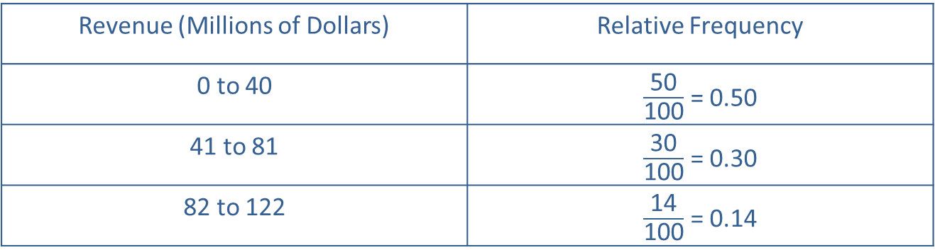
Relative Frequency Distribution—Slide 2
A relative frequency distribution of the revenue data from Example 1 is given in Table 3. Notice that the relative frequencies are obtained by dividing the frequencies in Table 2 by the total number of observations, which is 100.
Table 3 – Relative Frequency Distribution of Revenue Data
Revenue (Millions of Dollars) | Relative Frequency
0 to 40 | $\frac{\text{50}}{\text{100}}$ = 0.50
41 to 81 | $\frac{\text{30}}{\text{100}}$ = 0.30
82 to 122 | $\frac{\text{14}}{\text{100}}$ = 0.14

Slide 19
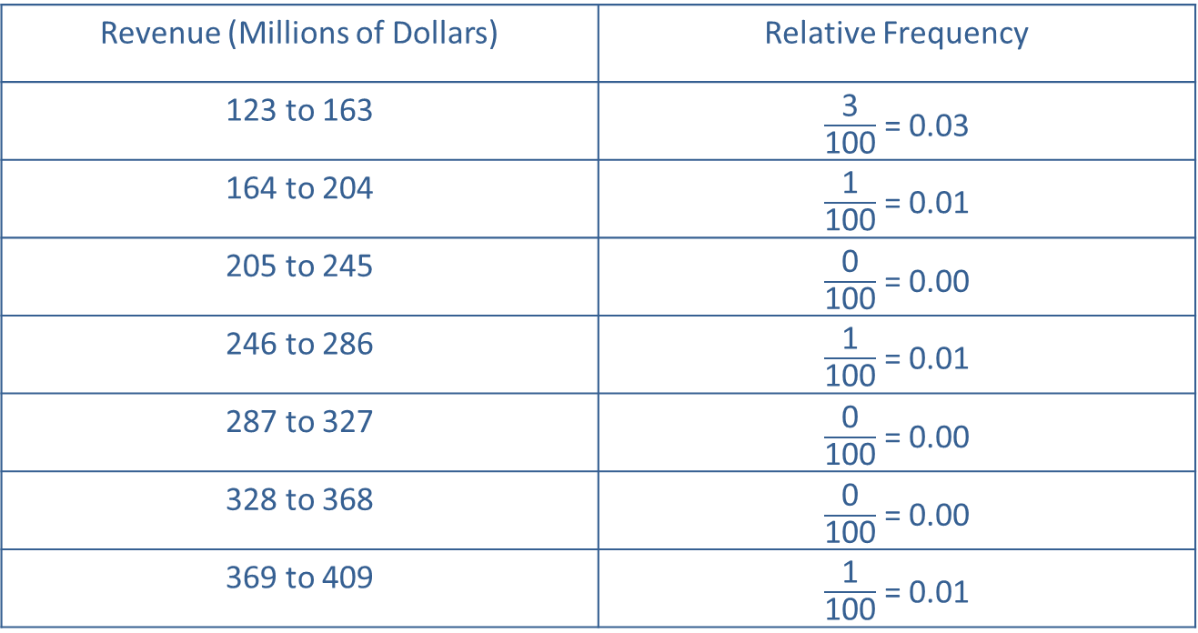
Relative Frequency Distribution—Slide 3
Table 3 – Relative Frequency Distribution of Revenue Data
Revenue (Millions of Dollars) | Relative Frequency
123 to 163 | $\frac{\text{3}}{\text{100}}$ = 0.03
164 to 204 | $\frac{\text{1}}{\text{100}}$ = 0.01
205 to 245 | $\frac{\text{0}}{\text{100}}$ = 0.00
246 to 286 | $\frac{\text{1}}{\text{100}}$ = 0.01
287 to 327 | $\frac{\text{0}}{\text{100}}$ = 0.00
328 to 368 | $\frac{\text{0}}{\text{100}}$ = 0.00
369 to 409 | $\frac{\text{1}}{\text{100}}$ = 0.01

Slide 20
Cumulative Frequency Distribution—Slide 1
The cumulative frequency distribution gives the reader an opportunity to look at any category and determine immediately the number of observations that belong to a particular category and all categories below it.

Slide 21
Definition: Cumulative Frequency
The cumulative frequency is the sum of the frequency of a particular class and all preceding classes.

Slide 22
Cumulative Frequency Distribution—Slide 2
Table 4 – Cumulative Frequency Distribution of Revenue Data
Revenue (Millions of Dollars) | Frequency | Cumulative Frequency
0 to 40 | 50 | 50
41 to 81 | 30 | 80
82 to 122 | 14 | 94
123 to 163 | 3 | 97
164 to 204 | 1 | 98
205 to 245 | 0 | 98
246 to 286 | 1 | 99
287 to 327 | 0 | 99
328 to 368 | 0 | 99
369 to 409 | 1 | 100
In this example, the reader can easily see in Table 4 that 97 out of 100 revenues are less than or equal to $163 million.

Slide 23
Definition: Cumulative Relative Frequency
The cumulative relative frequency is the proportion of observations in a particular class and all preceding classes.

Slide 24
Cumulative Relative Frequency—Slide 3
To obtain the cumulative relative frequency, add the relative frequencies of all preceding classes to the relative frequency of the current class.

Slide 25
Cumulative Relative Frequency—Slide 4
Table 5 – Cumulative Relative Frequency Distribution of Revenue Data
Revenue (Millions of Dollars) | Frequency | Relative Frequency | Cumulative Relative Frequency
0 to 40 | 50 | 0.50 | 0.50
41 to 81 | 30 | 0.30 | 0.80
82 to 122 | 14 | 0.14 | 0.94
123 to 163 | 3 | 0.03 | 0.97
164 to 204 | 1 | 0.01 | 0.98
205 to 245 | 0 | 0.00 | 0.98
246 to 286 | 1 | 0.01 | 0.99
287 to 327 | 0 | 0.00 | 0.99
328 to 368 | 0 | 0.00 | 0.99
369 to 409 | 1 | 0.01 | 1.00

Slide 26
Cumulative Relative Frequency—Slide 5
From the cumulative relative frequency in Table 5, it is easy to see that 97% of the revenues are less than or equal to $163 million.

