Slide 1
Section 3.4
Graphical Displays of
Quantitative Data

Slide 2
Histogram—Slide 1
A histogram is a common graphical method that reveals the distribution of the data. Histograms are often constructed based on frequency distributions of quantitative data. Histograms look similar to bar graphs but are used to analyze quantitative data rather than qualitative data.
Each of the classes in the frequency distribution is represented by a vertical bar whose height is proportional to the frequency of the interval. The horizontal boundaries of each vertical bar correspond to the class boundaries. Once the frequency distribution has been calculated, all the information necessary for plotting a histogram is available. In Figure 1, the histogram is created from the frequency distribution of the revenue data in Table 2.

Slide 3
Definition: Histogram
A histogram is a bar graph of a frequency or relative frequency distribution in which the height of each bar corresponds to the frequency or relative frequency of each class.

Slide 4
Histogram—Slide 2
Table 2 is displayed for reference.
Table 2 – Frequency Distribution
Revenue (Millions of Dollars) | Number of Companies
0 to 40 | 50
41 to 81 | 30
82 to 122 | 14
123 to 163 | 3
164 to 204 | 1
205 to 245 | 0
246 to 286 | 1
287 to 327 | 0
328 to 368 | 0
369 to 409 | 1

Slide 5
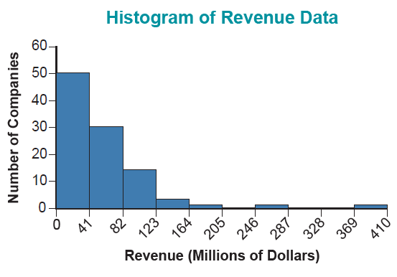
Histogram—Slide 3
Figure 1

Slide 6
Definition: Symmetric Distribution
A symmetric distribution is one in which, if a vertical line were drawn down the middle of the distribution, the two sides would mirror each other.

Slide 7
Definition: Skewed Distribution
A skewed distribution is one in which, if a vertical line were drawn down the middle of the distribution, it would have a long tail to the right or to the left.

Slide 8
Histogram—Slide 4
You will see many histograms throughout this course. When we look at a histogram. What features are important?

Slide 9

Histogram—Slide 5
1. Is the distribution symmetric or skewed (one tail is longer than the other)?
2. Is it bell-shaped?
3. Does the distribution have several peaks or modes?
4. Where is the center of distribution?
5. Are there outliers (data values that are very different from the others)?

Slide 10
Procedure: Constructing a Histogram—Slide 1
1. ​Determine the number of classes (or intervals) for the histogram. There isn't a rule of thumb for the number of classes to use, and most of the time the number of classes is determined by trial and error. However, a good starting point could be to use

Slide 11
Procedure: Constructing a Histogram—Slide 2
2. Determine the largest and the smallest observations. Depending on the size of the data set, it may be a good idea to sort the observations from smallest to largest. This will also make it easier later when trying to determine the interval in which an observation falls.

Slide 12
Procedure: Constructing a Histogram—Slide 3
3. Calculate the difference between the smallest and largest observations by subtracting the smallest observation from the largest observation. (Note that this measure is called the range, which will be discussed further in a later Chapter 4.)
4. Calculate the class width, using the following formula.

Slide 13
Procedure: Constructing a Histogram—Slide 4
5. ​Calculate the limits of the class intervals. Choose a starting value for the histogram such that the smallest observation will fall into your first class interval given the class width calculated in the previous step. Each subsequent interval can be found by adding the class width to the lower and upper class limits of the first class. The class intervals should be such that the first interval contains the smallest observation and the last interval contains the largest observation.

Slide 14
Procedure: Constructing a Histogram—Slide 5
6. Tally each observation to determine in which interval it should fall. This will give you the class frequency (denoted by f _{i}). which is the number of observations in each interval.
7. All of the information for a histogram can be displayed in a frequency distribution table or a relative frequency distribution table, as can be seen in the following example.

Slide 15
Procedure: Constructing a Histogram—Slide 6
8. Construct the histogram with the lower class limits on the horizontal axis and the frequency (or relative frequency) on the vertical axis. The heights of the bars will represent the class frequencies (or relative frequencies).

Slide 16
Example 1: Creating a Relative Frequency Distribution of Aptitude Scores—Slide 1
Suppose you are given a random sample of 28 applicants who took an examination designed to measure their aptitude for a job in sales. The following scores (measured in percentages) were obtained. Note that the observations are already sorted from smallest to largest.

Slide 17
Example 1: Creating a Relative Frequency Distribution of Aptitude Scores—Slide 2
Table 1 – Aptitude Scores (%)
38 | 49 | 53 | 56 | 58 | 58 | 60
62 | 66 | 67 | 69 | 69 | 71 | 74
75 | 76 | 77 | 77 | 77 | 78 | 78
81 | 82 | 83 | 84 | 87 | 88 | 88
Construct a relative frequency distribution table for the test scores using 6 class intervals, and construct a histogram.

Slide 18
Example 1: Creating a Relative Frequency Distribution of Aptitude Scores—Slide 3
Solution
To solve this problem, we will work through the 8-step procedure for constructing a histogram.
1. First, we need to determine the number of classes for the histogram. We are given that we want to construct a histogram using 6 intervals, so there will be 6 classes.

Slide 19
Example 1: Creating a Relative Frequency Distribution of Aptitude Scores—Slide 4
2. ​The second step is to identify the largest and the smallest observations in the data set. This is relatively straightforward in this case since the data are ordered from smallest to largest. From the data in Table 1, the smallest test score is 38 and the largest score is 88.

Slide 20
Example 1: Creating a Relative Frequency Distribution of Aptitude Scores—Slide 5
3. Next, we need to calculate the difference between the smallest and the largest observations. Subtracting the smallest score from the largest score, we have the following.
Largest Score − Smallest Score = 88 − 38 = 50

Slide 21
Example 1: Creating a Relative Frequency Distribution of Aptitude Scores—Slide 6
4. Now we need to calculate the class width. Given that the difference between the largest and smallest scores is 50, we have the following.
​For simplicity, if the class width is not an integer we round up to the next largest integer. Thus, we will use a class width of 9 when constructing the histogram.

Slide 22
Example 1: Creating a Relative Frequency Distribution of Aptitude Scores—Slide 7
5. ​The next step is to construct the class intervals. In general, we can use the smallest data value, a smaller value, or 0 as the lower limit of the first class. Again, judgment is required in setting up the first interval so that the first interval includes the smallest observation. The lower limit of the first class interval will not be 0 in this case, since the smallest score, 38, is much larger than the class width. Therefore, since the smallest observation is 38, we will arbitrarily use 36 as the lower limit of the first class interval. So, the first interval is
36 − 44, the second is 45 − 53, and so on. Thus, the class limits are determined to be the following.​

Slide 23
Example 1: Creating a Relative Frequency Distribution of Aptitude Scores—Slide 8
Table 2 – Class Limits
36 – 44
45 – 53
54 – 62
63 – 71
72 – 80
81 – 89

Slide 24
Example 1: Creating a Relative Frequency Distribution of Aptitude Scores—Slide 9
6. Tally each observation to determine the interval in which each observation falls. Remember that the observation falls in the interval if it is greater than or equal to the lower class limit and less than or equal to the upper class limit. This gives you the class frequencies, as seen in Table 3.​

Slide 25
Example 1: Creating a Relative Frequency Distribution of Aptitude Scores—Slide 10
Table 3 – Class Frequencies
Class | Frequency
36 – 44 | 1
45 – 53 | 2
54 – 62 | 5
63 – 71 | 5
72 – 80 | 8
81 – 89 | 7

Slide 26
Example 1: Creating a Relative Frequency Distribution of Aptitude Scores—Slide 11
​The relative frequency distribution table (Table 4) provides a summary of the data and allows the histogram to be constructed.​

Slide 27
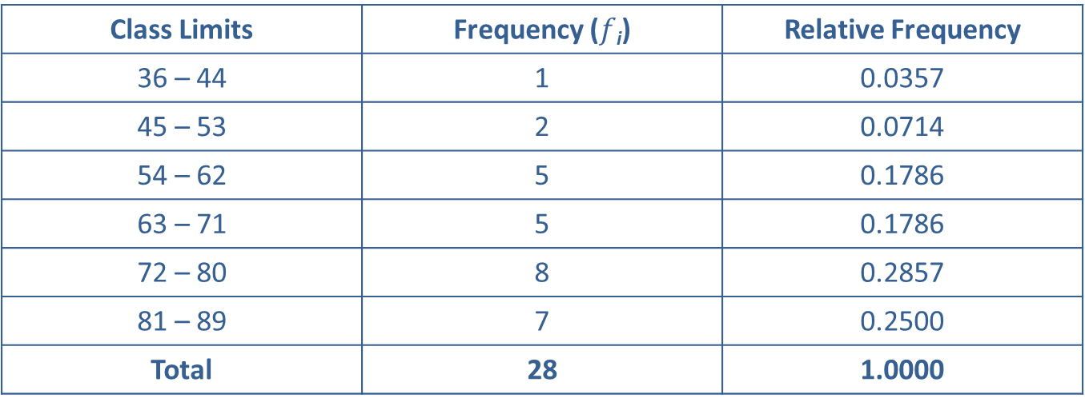
Example 1: Creating a Relative Frequency Distribution of Aptitude Scores—Slide 12
Table 4 – Relative Frequency Distribution
Class Limits | Frequency ($f$_{i}) | Relative Frequency
36 – 44 | 1 | 0.0357
45 – 53 | 2 | 0.0714
54 – 62 | 5 | 0.1786
63 – 71 | 5 | 0.1786
72 – 80 | 8 | 0.2857
81 – 89 | 7 | 0.2500
Total | 28 | 1.0000

Slide 28
Example 1: Creating a Relative Frequency Distribution of Aptitude Scores—Slide 13
​Keep in mind that the sum of the frequency column should be n, the total number of observations. Also, the sum of the relative frequency column should be equal to 1. If the sum of the relative frequency column is different from 1, but fairly close, it is likely due to rounding.

Slide 29
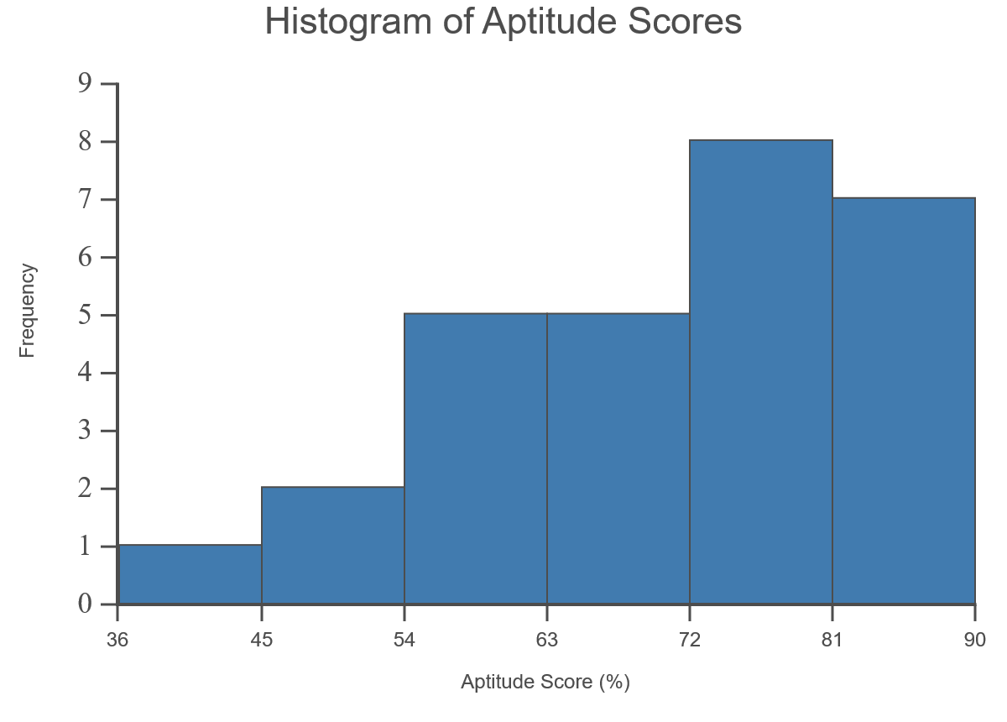
Example 1: Creating a Relative Frequency Distribution of Aptitude Scores—Slide 14
8. Finally, construct the histogram.​
Figure 2

Slide 30
Definition: Stem-And-Leaf Display
A stem-and-leaf display is a hybrid graphical method in which the raw data is used to both order and detect patterns in the data. Each data value is broken into two parts: a "stem" and a "leaf".

Slide 31
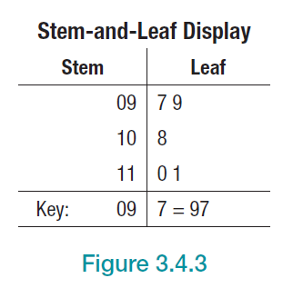
Stem-And-Leaf Display—Slide 1
Table 5 – Data, Stems, and Leaves
Data | Stem | Leaf
97 | 09 | 7
99 | 09 | 9
108 | 10 | 8
110 | 11 | 0
111 | 11 | 1
Figure 3

Slide 32
Stem-And-Leaf Display—Slide 2
If we are interested in the variation of the last two digits, the stems and leaves are shown in Table 6 and displayed in Figure 4. The leaves in this case are the last two digits and the stems are the hundreds digits. Again, all of the data values that have common stems are grouped together, and their leaves branch out from the common stem.

Slide 33
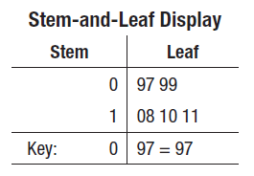
Stem-And-Leaf Display—Slide 3
Table 6 – Data, Stems, and Leaves
Data | Stem | Leaf
97 | 0 | 97
99 | 0 | 99
108 | 1 | 08
110 | 1 | 10
111 | 1 | 11
Figure 4

Slide 34
Stem-And-Leaf Display—Slide 4
Deciding which part to make the stem and which part to make the leaf depends on the focus of the analysis.

Slide 35
Example 2: Creating a Stem-and-Leaf Display of MSFT Closing Stock Prices—Slide 1
The closing stock prices for Microsoft Corporation from December 2000 through December 2019 are given in Table 7. Construct a stem-and-leaf display of the closing stock prices of Microsoft (rounded to the nearest dollar).

Slide 36
Example 2: Creating a Stem-and-Leaf Display of MSFT Closing Stock Prices—Slide 2
Table 7 – Closing Stock Prices of Microsoft Corporation (MSFT) December 2000 through December 2019
Period | Closing Price (Dollars)
December 2000 | 22
December 2001 | 33
December 2002 | 26
December 2003 | 27
December 2004 | 27
December 2005 | 26
December 2006 | 30
December 2007 | 36
December 2008 | 19
December 2009 | 30

Slide 37
Example 2: Creating a Stem-and-Leaf Display of MSFT Closing Stock Prices—Slide 3
Table 7 – Closing Stock Prices of Microsoft Corporation (MSFT) December 2000 through December 2019
Period | Closing Price (Dollars)
December 2010 | 28
December 2011 | 26
December 2012 | 27
December 2013 | 37
December 2014 | 46
December 2015 | 55
December 2016 | 62
December 2017 | 86
December 2018 | 102
December 2019 | 158

Slide 38
Example 2: Creating a Stem-and-Leaf Display of MSFT Closing Stock Prices—Slide 4
Solution
Using a stem of the tens unit will break the data into six classes, which seems reasonable. The stem-and-leaf display is given in Figure 5.

Slide 39
Example 2: Creating a Stem-and-Leaf Display of MSFT Closing Stock Prices—Slide 5
Stem-and-Leaf Display (MSFT)
Stem | Leaf
1 | 9
2 | 2 6 6 6 7 7 7 8
3 | 0 0 3 6 7
4 | 6
5 | 5
6 | 2
7
8 | 6
9
10 | 2
11
12
13
14
15 | 8
Key: 15 | 8 = $158
Figure 5

Slide 40
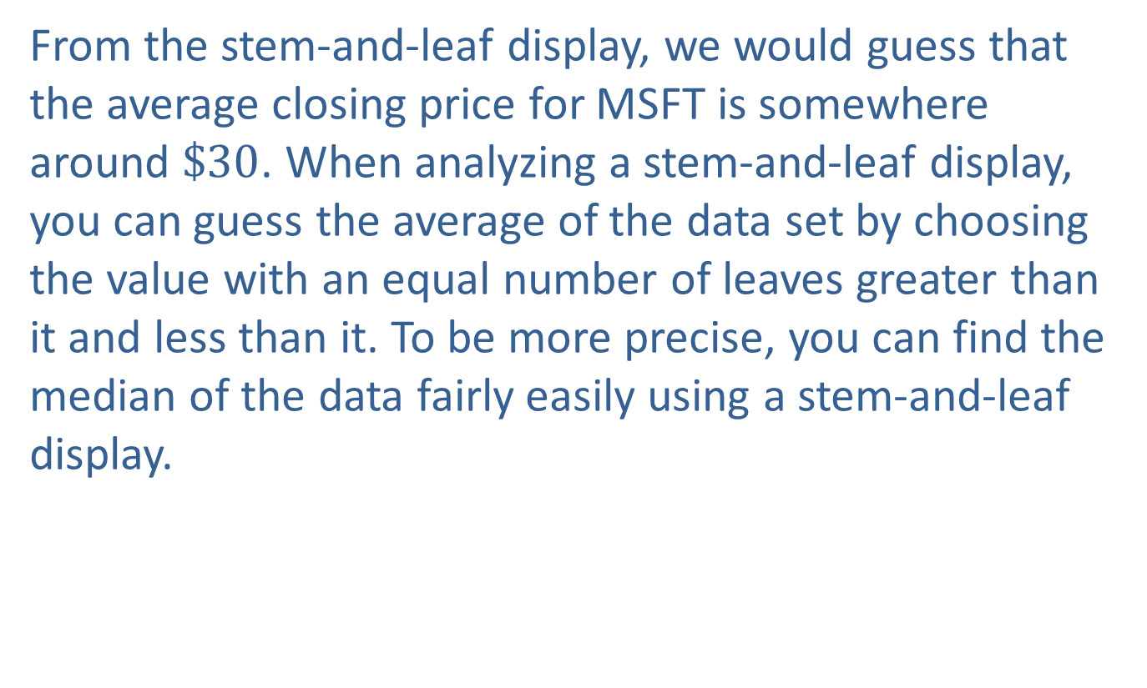
Example 2: Creating a Stem-and-Leaf Display of MSFT Closing Stock Prices—Slide 6
From the stem-and-leaf display, we would guess that the average closing price for MSFT is somewhere around $\$30$. When analyzing a stem-and-leaf display, you can guess the average of the data set by choosing the value with an equal number of leaves greater than it and less than it. To be more precise, you can find the median of the data fairly easily using a stem-and-leaf display.

Slide 41
Definition: Ordered Array
An ordered array is a listing of a data set in either increasing or decreasing order of magnitude.

Slide 42
Definition: Rank Order
Data listed in increasing order are said to be listed in rank order.

Slide 43
Definition: Reverse Rank Order
Data listed in decreasing order are said to be listed in reverse rank order.

Slide 44
Example 3: Creating An Ordered Array of Employee Ages—Slide 1
The personnel records for a clothing department store located in the local mall are examined, and the current ages for all employees are noted. There are 25 employees, and their ages are listed in the following table. It is desired that their ages be placed in rank order.

Slide 45
Example 3: Creating An Ordered Array of Employee Ages—Slide 2
Table 8 – Ages (Raw)
32 | 21 | 24 | 19 | 61 | 18 | 18 | 16 | 16 | 35 | 39 | 17 | 22
21 | 60 | 18 | 53 | 18 | 57 | 63 | 28 | 20 | 29 | 35 | 45

Slide 46
Example 3: Creating An Ordered Array of Employee Ages—Slide 3
Solution
Table 9 – Ages (Ordered)
16 | 16 | 17 | 18 | 18 | 18 | 18 | 19 | 20 | 21 | 21 | 22 | 24
28 | 29 | 32 | 35 | 35 | 39 | 45 | 53 | 57 | 60 | 61 | 63

Slide 47
Example 3: Creating An Ordered Array of Employee Ages—Slide 4
It is always a good idea to get a look at the ordered array of the data early in your analysis. Examining the ranked data produces a good intuitive sense for the data. Looking at the ordered array, it is evident that over half of the employees are younger than 25 and only three employees are within 5 years of retirement. We can also easily see that the youngest employee is 16 years old and the oldest employee is 63 years old. Ordering the data makes it possible to analyze the data quickly and easily.

Slide 48
Definition: Dot Plot
A graph where each data value is plotted as a dot above a horizontal axis is called a dot plot.

Slide 49
Example 4: Creating a Dot Plot of MSFT Closing Stock Prices—Slide 1
Construct a dot plot of the closing stock price on December 1 ^{st} for Microsoft Corporation from data presented earlier in the section. For convenience, the data are repeated below.

Slide 50
Example 4: Creating a Dot Plot of MSFT Closing Stock Prices—Slide 2
Table 10 – Closing Stock Prices of Microsoft Corporation (MSFT) December 2000 through December 2019
Period | Closing Price (Dollars)
December 2000 | 22
December 2001 | 33
December 2002 | 26
December 2003 | 27
December 2004 | 27
December 2005 | 26
December 2006 | 30
December 2007 | 36
December 2008 | 19
December 2009 | 30

Slide 51
Example 4: Creating a Dot Plot of MSFT Closing Stock Prices—Slide 3
Table 10 – Closing Stock Prices of Microsoft Corporation (MSFT) December 2000 through December 2019
Period | Closing Price (Dollars)
December 2010 | 28
December 2011 | 26
December 2012 | 27
December 2013 | 37
December 2014 | 46
December 2015 | 55
December 2016 | 62
December 2017 | 86
December 2018 | 102
December 2019 | 158

Slide 52

Example 4: Creating a Dot Plot of MSFT Closing Stock Prices—Slide 4
Solution
We plot each data value on the horizontal axis. For values where there are multiple entries, such as $\$26$. we stack the points on top of one another.

Slide 53
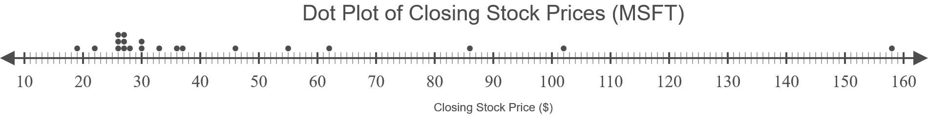
Example 4: Creating a Dot Plot of MSFT Closing Stock Prices—Slide 5
Figure 6

Slide 54
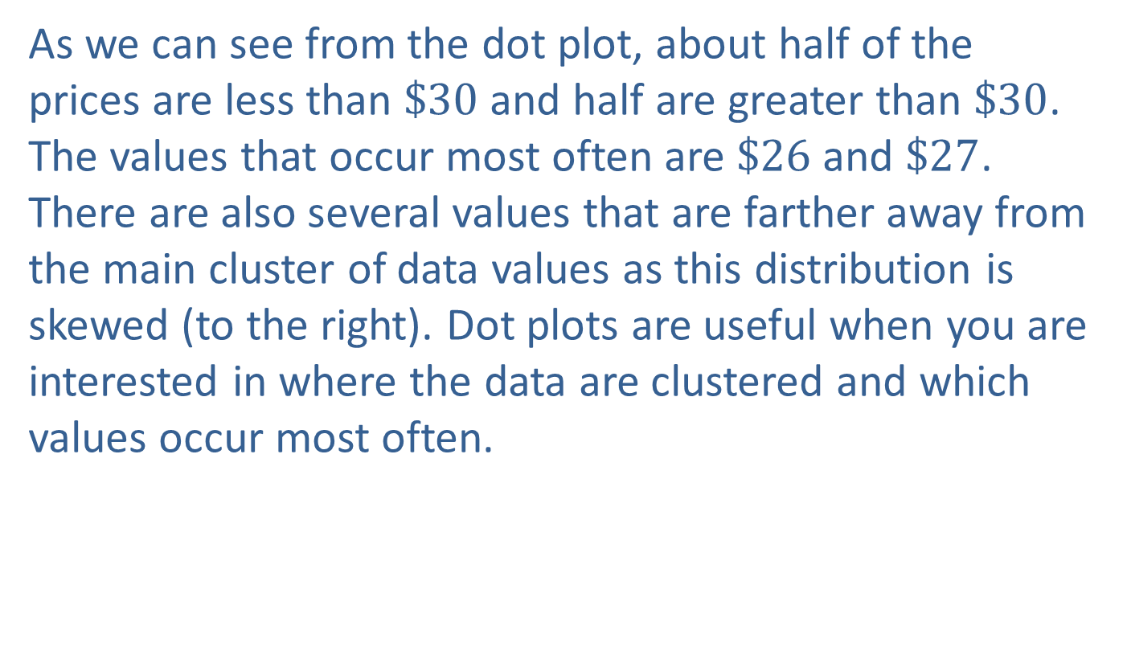
Example 4: Creating a Dot Plot of MSFT Closing Stock Prices—Slide 6
As we can see from the dot plot, about half of the prices are less than $\$30$ and half are greater than $\$30$. The values that occur most often are $\$26$ and $\$27$. There are also several values that are farther away from the main cluster of data values as this distribution is skewed (to the right). Dot plots are useful when you are interested in where the data are clustered and which values occur most often.

Slide 55
Time Series Plots—Slide 1
Table 11 – U.S. Census Data
Year | Population (Millions) | Year | Population (Millions)
1790 | 3.9 | 1910 | 92.2
1800 | 5.3 | 1920 | 106.0
1810 | 7.2 | 1930 | 123.2
1820 | 9.6 | 1940 | 132.2
1830 | 12.9 | 1950 | 151.3
1840 | 17.1 | 1960 | 179.3
1850 | 23.2 | 1970 | 203.3
1860 | 31.4 | 1980 | 226.5
1870 | 38.6 | 1990 | 248.7
1880 | 50.2 | 2000 | 281.4
1890 | 63.0 | 2010 | 308.7
1900 | 76.2

Slide 56
Time Series Plots—Slide 2
When looking at time series data, we are interested in whether the process is stationary or nonstationary. To determine whether a time series is stationary or nonstationary, we use a time series plot. A time series plot graphs data using time as the horizontal axis. Most often, a time series plot comes in the form of a line graph, which connects consecutive points over time with a line.

Slide 57
Time Series Plots—Slide 3
In a line graph, time is always labeled on the horizontal axis, with the variable being measured labeled on the vertical axis. Points are then plotted for each time period, and a line is drawn that connects each consecutive point.

Slide 58
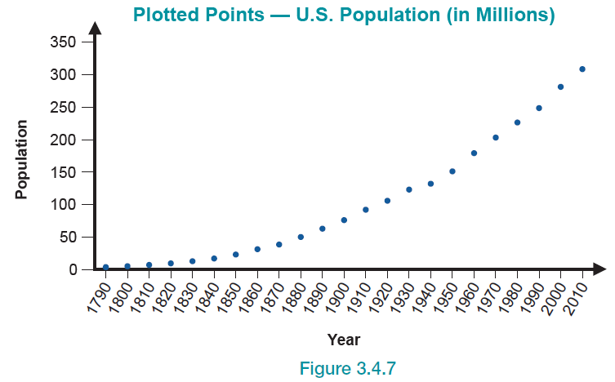
Time Series Plots—Slide 4
Figure 7

Slide 59
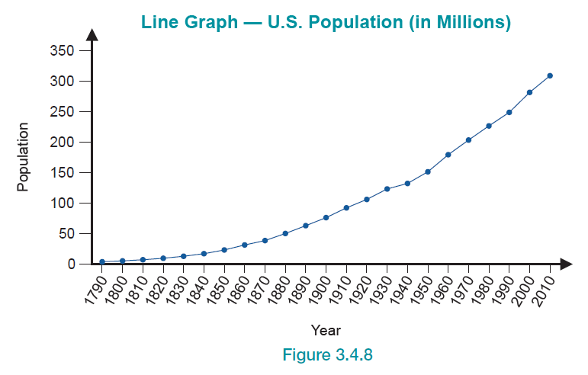
Time Series Plots—Slide 5
Figure 8

Slide 60
Time Series Plots—Slide 6
Line graphs can be analyzed with or without each point being visible. Another type of plot, called a ribbon plot, is another version of a line graph as shown in Figure 9 in the next slide.

Slide 61
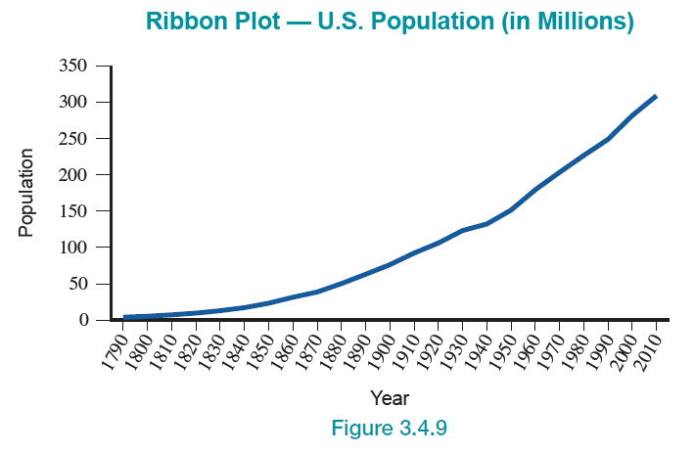
Time Series Plots—Slide 7
Figure 9

Slide 62
A Look at the Unemployment Rate—Slide 1
Another example of time series data is the unemployment rate in the United States. Civilian unemployment rate is defined as the number of unemployed people divided by the total size of the labor force. People who are jobless, looking for jobs, and available for work are considered unemployed. The labor force is made up of people that are either employed or unemployed. Figure 10 contains a time series plot of the civilian unemployment rate from August 2000 through December 2019.

Slide 63
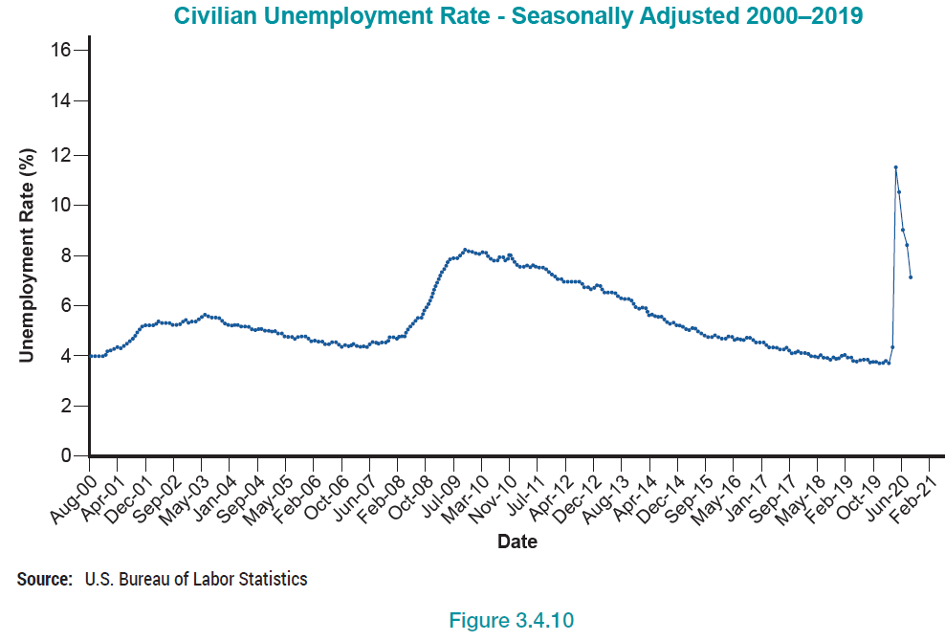
A Look at the Unemployment Rate—Slide 2
Figure 10

Slide 64
Geospatial Graphs—Slide 1
For centuries, humans have used maps to portray information about specific places or regions. Today, it is very common to see data that is associated with some type of geographic location such as zip codes, county codes, states, countries, or even specific longitudes and latitudes. This association allows us to layer the data values on top of a map of a certain area, or satellite image, ultimately providing us with a greater understanding of how different regions compare to one another based on a variety of different variables.

Slide 65
Geospatial Graphs—Slide 2
Choropleth maps are one type of geospatial graph that has become very popular, although their use dates back to the early 19th century. Choropleth maps utilize shades of color to measure a variable across several pre-defined areas, and those areas can be anywhere on a map as long as they are pre-defined and have data associated with them.

Slide 66
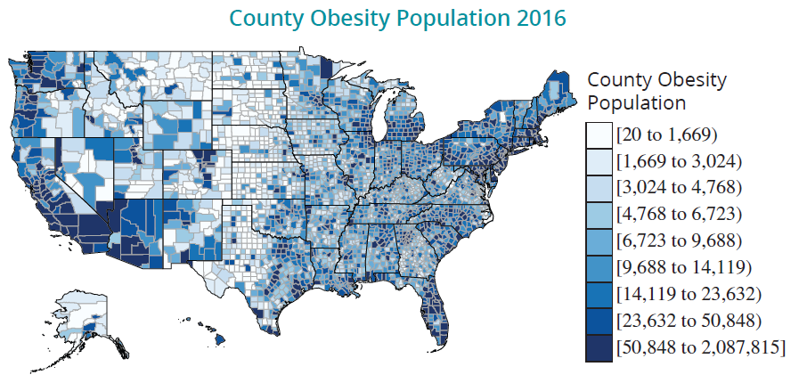
Geospatial Graphs—Slide 3
Figure 11

Slide 67
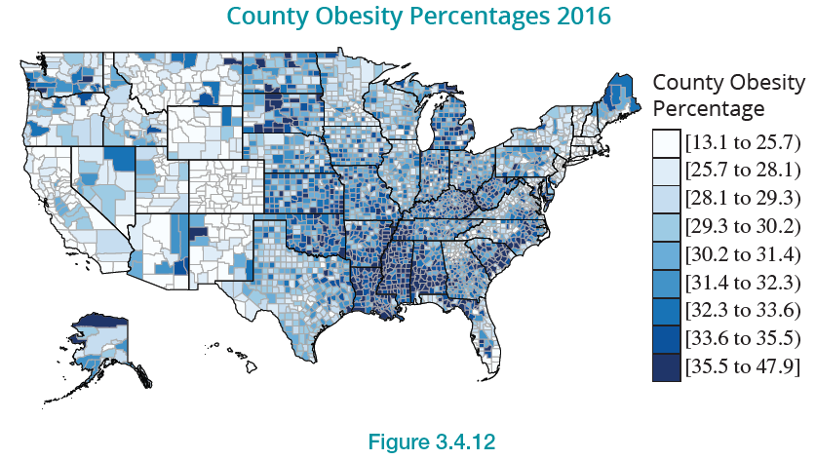
Geospatial Graphs—Slide 4
Using our new data, we generate the following map.
Figure 12

