Slide 1
Section 3.5
Analyzing Graphs

Slide 2
Graph Labeling—Slide 1
Every graph should be properly labeled with an appropriate title that tells you what type of information is being displayed. Also, if the graph has a horizontal and vertical axis, these should be labeled and should include the unit of measurement when necessary for the understanding of the data. For example, in Figure 1, the title does not provide enough information about the data.

Slide 3
Graph Labeling—Slide 2
It is also good practice to use the largest possible unit for the scale of an axis, which in this case is correctly chosen to be thousands.

Slide 4
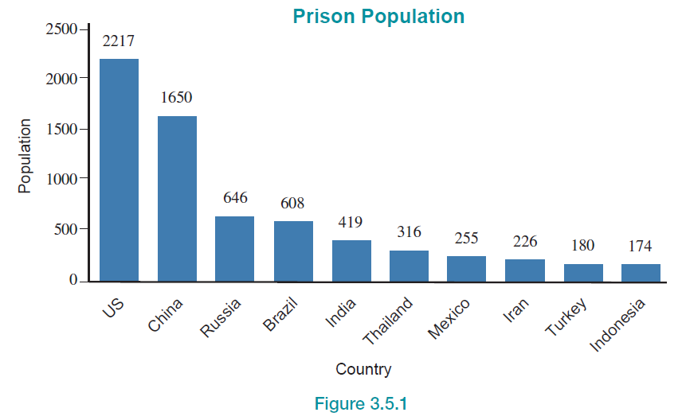
Graph Labeling—Slide 3
Figure 1

Slide 5
Appropriateness of a Graph—Slide 1
Throughout this chapter we have looked at a wide variety of graphs. What we want to consider now is the appropriateness of a graph. In other words, we want to be able to determine whether the type of graph being used is best suited for the data being displayed. For example, Section 3.4, we looked at the US population since 1790 and chose to display that data using a line graph. We could have just as easily used the bar graph shown in Figure 2 in the next slide.

Slide 6
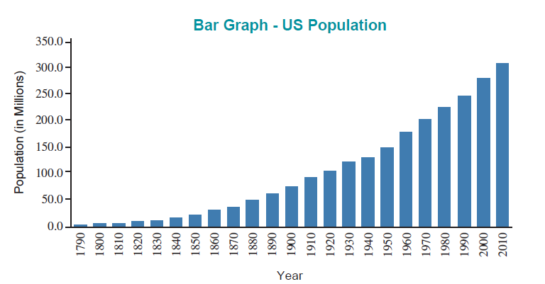
Appropriateness of a Graph—Slide 2
Figure 2

Slide 7
Appropriateness of a Graph—Slide 3
The bar graph also shows the increasing trend of the US population over time, but the trend is better seen using a line graph. The lengths and widths of the bars in the bar graph are somewhat distracting, and obscure the change in population from one time period to the next.

Slide 8
Appropriateness of a Graph—Slide 4
Bar graphs and pie charts are often interchangeable when displaying qualitative data, but if you want to accurately display the categories as parts of a whole, the pie chart will give the best representation, as it allows you to visually compare the slices of the “pie” very quickly. However, the pie chart becomes less effective as the number of categories increases.

Slide 9
Scaling of Graphs—Slide 1
Another important feature to keep in mind when analyzing graphs is whether a graph is scaled appropriately. If you stretch or shrink the scale on either axis, the shape of the graph can change dramatically, and thus affect the interpretation of the graph. For example, suppose that we change the scale for the bar graph in Figure 11 on federal government spending to range from 0% to 80% instead of 0% to 25%.

Slide 10

Scaling of Graphs—Slide 2
Figure 3

Slide 11
Scaling of Graphs—Slide 3
Note that Figure 3 now minimizes the differences among the five spending categories compared to the original graph. The large amount of “white space” in the graph is a good indicator that the scale may not be appropriate for the data. Therefore, when analyzing a graph make sure that the scale represents the data well.

Slide 12
Data Transformation—Slide 1
It is often useful to transform data by replacing a variable in the data set by a function of that variable so that the distribution is easier to work with or interpret. For example, if the data set contains a variable x, we can transform the distribution of the data by replacing x with some function of x, such as the square root of x or the logarithm of x.

Slide 13
Data Transformation—Slide 2
In this section, we will focus on another transformation, the log transformation, which is one of the most common transformations in statistics. The log transformation is often used to help “unclutter” data points for visualization purposes. When the data is tightly grouped together, it can be hard to visualize and make inferences about individual data points. Log transformations numerically “stretch” the portion of the axis closest to zero, and “compress” the portion of the axis farthest from zero.

Slide 14
Data Transformation—Slide 3
This allows us to better visualize each individual point while also maintaining the underlying relationship between the variables being graphed. The log transformation also allows us to visualize relative change as opposed to absolute change.
Figure 4 in the next slide shows the price per share of Amazon stock since its initial public offering (IPO) in May 1997. No transformation is applied to the data which means that the graph shows absolute change.

Slide 15
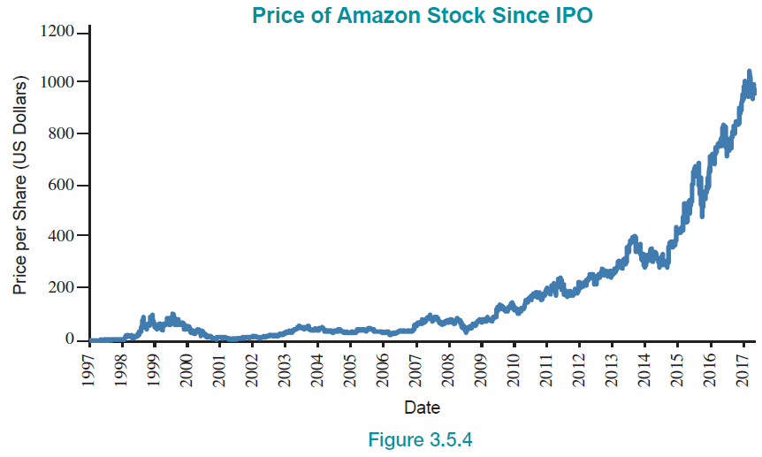
Data Transformation—Slide 4
Figure 4

Slide 16
Data Transformation—Slide 5
As you can see, Amazon has experienced massive success over the years. However, this graph seems to suggest that Amazon didn’t really hit its stride until about 2010.

Slide 17
Data Transformation—Slide 6
However, transforming our price variable by applying a log function will allow us to analyze Amazon’s yearly performance relative to the stock price for each year. After applying the log function to the y-axis of the previous graph, we generate Figure 5 in the next slide, which tells the story in a slightly different way.

Slide 18
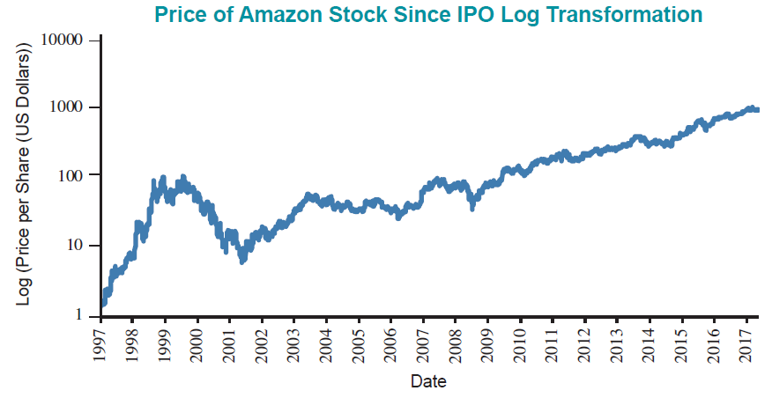
Data Transformation—Slide 7
Figure 5

Slide 19
Data Transformation—Slide 8
Notice that the y-axis of Figure 5 in the previous slide, now portrays the price variable in factors of 10 as opposed to a continuous unit scale. It turns out that Amazon experienced its most rapid period of relative growth in the years immediately following its IPO. However, notice that the stock price began to sharply decline in 1999. This was when the dot-com bubble “burst”. When the bubble burst, thousands of internet companies went out of business.

Slide 20
Data Transformation—Slide 9
Fortunately, Amazon’s business model was built for long-term growth, and it allowed the company to survive the downward economic trend. In 2001, Amazon turned its first profit and restored the confidence of investors. Since then, Figure 5 reveals that Amazon continues to experience steady year over year growth on the log scale.

Slide 21
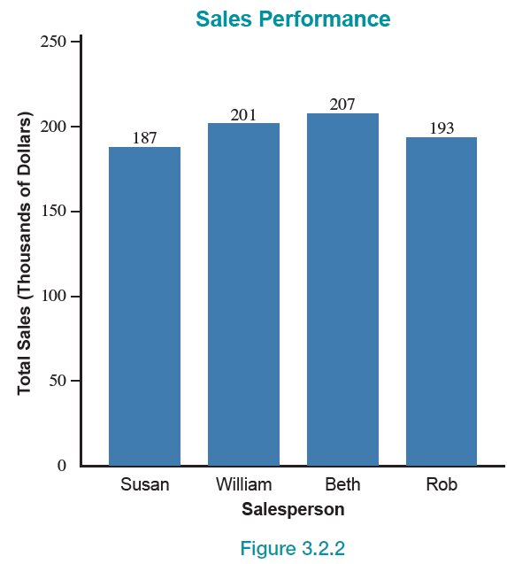
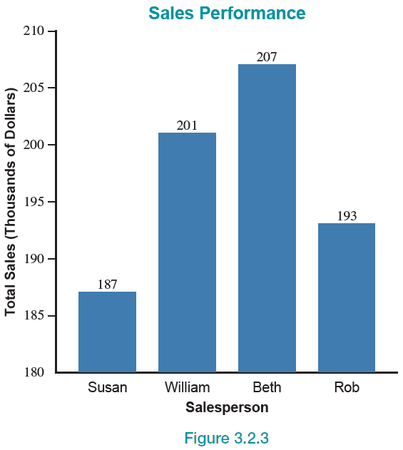
Misleading Graphs—Slide 1
An issue related to scaling that is often used to mislead readers is to start the vertical scale at some value other than zero. We saw this earlier with the sales performance data in Section 3.2. By starting the scale on the vertical axis at $180,000 and using increments of $5,000, the sales performance differences were exaggerated as shown in following figures.

Slide 22
Definition: Pictograph
A pictograph is a bar graph that uses images or symbols that are relevant to the data being graphed instead of bars.

Slide 23
Misleading Graphs—Slide 2
One type of graph commonly used in the media is a pictograph, because it is visually appealing and simple to understand. A pictograph is basically a bar graph that uses pictures of objects in place of the bars. For example, the graph on the left in Figure 6 in the next slide shows a potentially misleading pictograph of the top five countries ranked in order by the amount of forest area they contain.

Slide 24
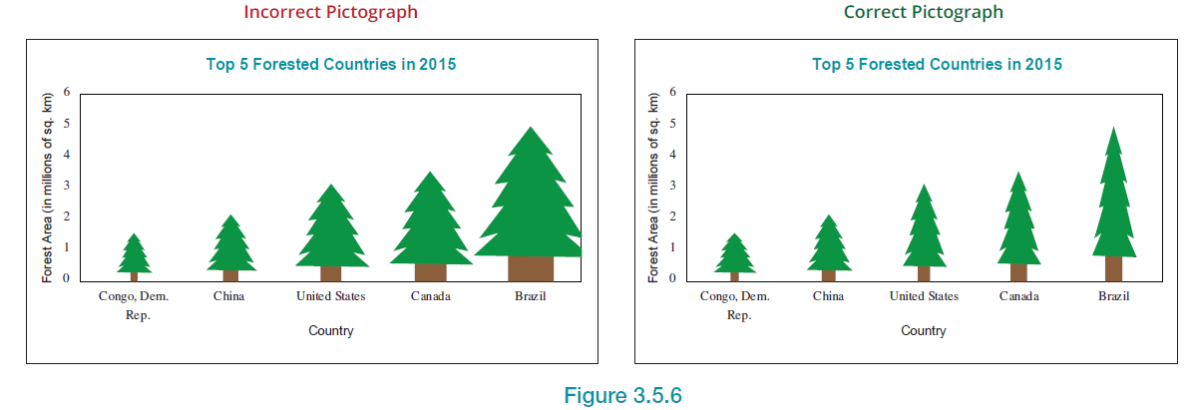
Misleading Graphs—Slide 3
Figure 6

