Slide 1
Section 4.1
Measures of Location

Slide 2
Introduction—Slide 1
Frequency distributions, bar charts, pie charts, and histograms can be informative visual tools for examining the big picture when analyzing data.
But suppose we say that one data set is more compact than another. This leads to the question, How much more compact is it? Graphical analysis is ill-equipped to answer that question precisely.

Slide 3
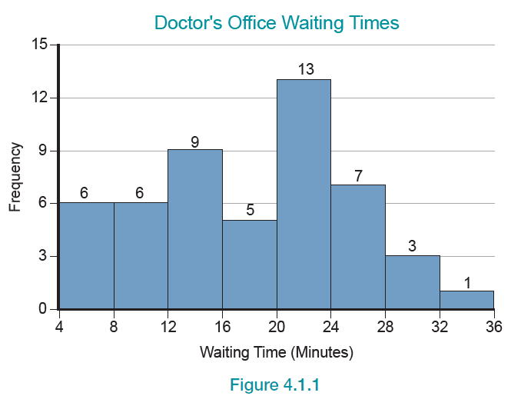
Introduction—Slide 2
Figure 1

Slide 4
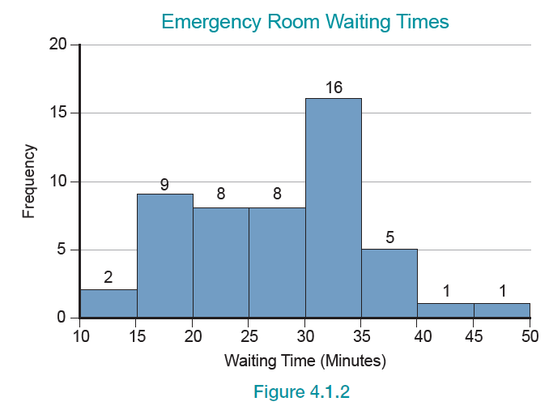
Introduction—Slide 3
Figure 2

Slide 5
Introduction—Slide 4
While the two histograms are similar, there is a clear difference in the underlying data. The range of waiting times for the doctor’s office is smaller than that of the emergency room.
To precisely describe the differences, we need summary measures to characterize specific data attributes.

Slide 6
Definition: Measures Of Location & Central Tendency
Statistical measures that tell us something about the location of the middle of a set of data are called measures of location or central tendency.

Slide 7
Definition: Numerical Descriptive Statistics
Numerical descriptive statistics are numerical summaries of data.

Slide 8
Definition: Parameters
Measures that apply to population data are called parameters.

Slide 9
Definition: Statistics
Measures that apply to sample data are called statistics.

Slide 10
Definition: Inferential Statistics
Inferential statistics is concerned with making conclusions about population parameters using sample statistics.

Slide 11
Inferential Statistics—Slide 1
Looking at a graph of the data (see Figure 3) is always a good first step. To learn more, we use statistical tools designed to reveal the data’s fundamental characteristics.
These statistical tools answer important questions, such as Where is the center of the data? and How dispersed are the data?

Slide 12
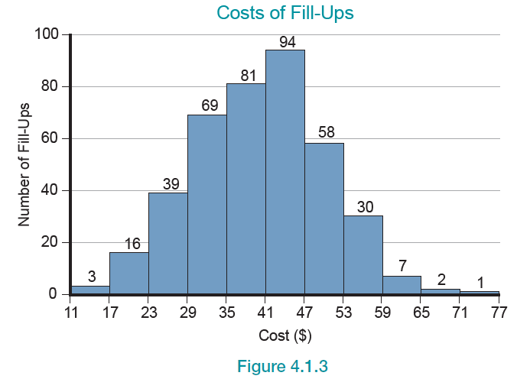
Inferential Statistics—Slide 2
Figure 3

Slide 13
Formula: Arithmetic Mean
Suppose there are n observations in a data set, consisting of the observations
then the arithmetic mean is defined to be

Slide 14
Example 1: Calculating a Sample Mean of Wait Times—Slide 1
Suppose the manager at a local automotive shop was observing the time customers spent in their waiting room while their vehicles were being serviced. Using the random sample of four customers’ wait times, calculate the sample mean of the wait times.
Wait times: 4, 10, 7, 15.

Slide 15
Example 1: Calculating a Sample Mean of Wait Times—Slide 2
Solution
Note that

Slide 16
Definition: Deviation
Given some point A and a data point x, then x − A represents how far x deviates from A. This difference is also called a deviation.

Slide 17
Definition: Outlier
An outlier is an extremely large or extremely small data value relative to other data values and can have a dramatic impact on the mean.

Slide 18
Definition: Resistant Measures
Statistical measures which are not affected by outliers are said to be resistant.

Slide 19
Formula: Weighted Mean
The weighted mean of a data set with values
is given by
Where w _{i} is the weight of observation x _{i} .

Slide 20
Example 2: Calculating a Weighted Mean of Unemployment Rates—Slide 1
The following table consists of the September 2020 unemployment rates and civilian labor force sizes for the Mid-Atlantic states.
Using the weighted mean, calculate the average unemployment rate for the Mid-Atlantic states.

Slide 21
Example 2: Calculating a Weighted Mean of Unemployment Rates—Slide 2
Table 4 – Unemployment Rates
Statex | Size of Civilian Labor Force (Thousands) | Unemployment Rate (%)
Delaware | 495.3 | 8.2
Maryland | 3067.8 | 7.2
New Jersey | 4394.4 | 6.7
New York | 9134.0 | 9.7
Pennsylvania | 6365.4 | 8.1
Virginia | 4279.5 | 6.2
District of Columbia | 396.8 | 8.7
West Virginia | 773.7 | 8.6
Source: U.S. Department of Labor, Bureau of Labor Statistics

Slide 22
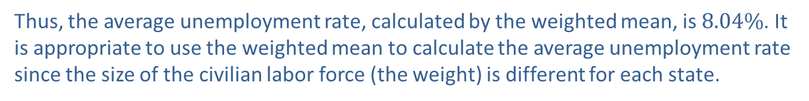
Example 2: Calculating a Weighted Mean of Unemployment Rates—Slide 3
Solution
The average unemployment rate is calculated as follows.
Thus, the average unemployment rate, calculated by the weighted mean, is $8.04\%$. It is appropriate to use the weighted mean to calculate the average unemployment rate since the size of the civilian labor force (the weight) is different for each state.

Slide 23
Definition: Trimmed Mean
The trimmed mean is a modification of the arithmetic mean which ignores an equal percentage of the highest and lowest data values in calculating the mean.

Slide 24
Example 3: Calculating a Trimmed Mean for Admission Applications—Slide 1
1616 1818 2020 2121 2323 2323 2424 3232 3636 42
Suppose that the following sample size of 10 represents the number of applications for admission from local high schools within 50 miles of State University.
16, 18, 20, 21, 23, 23, 24, 32, 36, 42
mean = 25.5
Find the 10% trimmed mean.

Slide 25
Example 3: Calculating a Trimmed Mean for Admission Applications—Slide 2
Solution
Since there are 10 observations, removing the highest 10% and the lowest 10% means removing only one observation from each end of the data.
That is,
Note that the data are already sorted. If the mean is calculated without including the values of 16 and 42, the resulting measure is called the 10% trimmed mean.
If there had been 100 observations, the largest 10% and the smallest 10% (a total of 20 data values) would have been removed before the mean was calculated.

Slide 26
Definition: Median
The median of a set of observations is the data value in the middle of an ordered array. The same number of data values is on either side of the median value.

Slide 27
Example 4: Calculating the Median Number of Calls—Slide 1
Suppose that the data below represent a random sample of the number of 911 calls to a police station over the past 30 days. Given the following eleven observations, find the median.
2, 4, 0, 3, 0, 1, 8, 5, 1, 5, 9

Slide 28
Example 4: Calculating the Median Number of Calls—Slide 2
Solution
First, the data set must be ordered.
0, 0, 1, 1, 2, 3, 4, 5, 5, 8, 9
The number of observations, n = 11.
Next, calculate the median location,
Therefore, the median is the 6th ordered observation, which is 3.

Slide 29
Example 5: Calculating the Median Test Score—Slide 1
Consider the following ten test scores on an aptitude test for a marketing position.
65, 98, 76, 83, 94, 79, 88, 72, 90, 85
Find the median.

Slide 30
Example 5: Calculating the Median Test Score—Slide 2
Solution
The number of observations, n = 10.
The median location,
If there is an even number of observations, average the two center values in the ordered array. The median is the average of the
and 6th ordered observations.
Thus, we find the median as follows.

Slide 31
Example 6: Calculating the Median and Trimmed Mean of Product Returns—Slide 1
a. ​Consider the following data which represent a random sample of the number of product returns each month for the last 10 months from March to December.
​16, 18, 20, 21, 23, 23, 24, 32, 36, 42
​mean = 25.5
​Find the median and 10% trimmed mean.
​Solution
​First, find the median.
​The number of observations, n = 10.
​The median location,

Slide 32
Example 6: Calculating the Median and Trimmed Mean of Product Returns—Slide 2
​
​
​
If there is an even number of observations, average the two center values in the ordered array.
The median is the average of the
and 6th ordered observations.

Slide 33
Example 6: Calculating the Median and Trimmed Mean of Product Returns—Slide 3
Now find the 10% trimmed mean.
​Since there are 10 observations, removing the highest 10% and the lowest 10% means removing only one observation from each end of the data.
​
​
If the mean is calculated without including the values 16 and 42 in the data, the resultant measure is the 10% trimmed mean.

Slide 34
Example 6: Calculating the Median and Trimmed Mean of Product Returns—Slide 4
b. ​Consider the same data set, except the last data value is replaced with an outlier (490). Compare the mean, median, and 10% trimmed mean for this data set to the mean, median, and 10% trimmed mean of the original data set.
​16, 18, 20, 21, 23, 23, 24, 32, 36, 490
Mean = 70.3, median = 23, 10% trimmed mean = 24.625
​Solution
​The median and 10% trimmed mean are not affected by the addition of the outlier, while the mean increases dramatically. This illustrates why the median and 10% trimmed mean are said to be resistant measures while the arithmetic mean is not.

Slide 35
Definition: Mode
The mode of a data set is the most frequently occurring value.

Slide 36
Example 7: Determining the Mode of Paint Defects—Slide 1
Find the mode of the following data set which represents the number of paint chips found in a random sample of vehicles after production.
0, 1, 4, 3, 9, 8, 10, 0, 1, 3, 0

Slide 37
Example 7: Determining the Mode of Paint Defects—Slide 2
Solution
Since the value of 0 occurs more than any other value, it is the mode. In this instance the modal value is not a particularly appealing choice.
However, the mode is the only measure of location that can be applied to nominal data. Thus, for nominal measurements like color preferences, it would be perfectly reasonable to discuss the modal color.

Slide 38
Definition: Bimodal
A data set that has two modes is said to be bimodal.

Slide 39
Definition: Multimodal
A data set that has more than two modes is said to be multimodal.

Slide 40
Definition: No Mode
A data set is said to have no mode if all observations occur with the same frequency.

Slide 41
Definition: Skewed To The Right & Positively Skewed
If the distribution of a data set has a long tail on the right, it is said to be skewed to the right or positively skewed.

Slide 42
Definition: Skewed To The Left & Negatively Skewed
If the distribution of a data set has a long tail on the left, it is said to be skewed to the left or negatively skewed.

Slide 43
Definition: Moving Average
A moving average is obtained by adding consecutive observations for a number of periods and dividing the result by the number of periods included in the average.

