Slide 1
Section 4.3
Measures of Relative Position

Slide 2
Definition: P ^{th} Percentile
Given a set of data
the P ^{th} percentile is a value, say x, such that approximately P percent of the data is less than or equal to x and approximately (100 − P) percent of the data is greater than or equal to x.

Slide 3
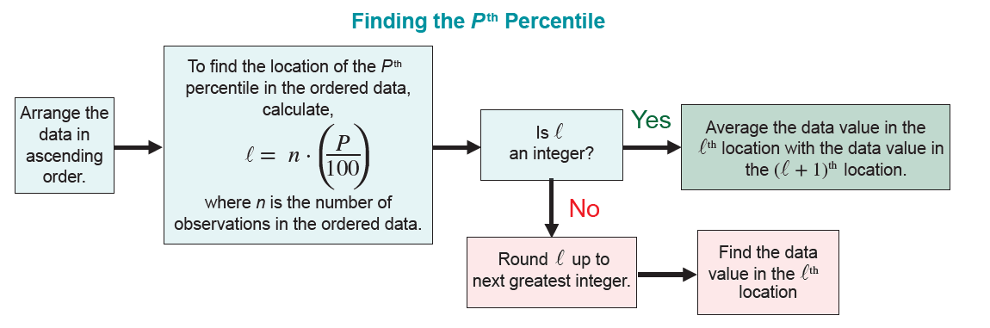
Finding the P ^{th} Percentile
To determine the P ^{th} percentile, perform the following steps.

Slide 4
Procedure: Finding the P ^{th} Percentile—Slide 1
Finding the P ^{th} Percentile
1. ​Form an ordered array by placing the data in order from smallest to largest.
2.​ To find the location of the P ^{th} percentile in the ordered array, let
​
​
where n is the number of observations in the ordered data.

Slide 5
Procedure: Finding the P ^{th} Percentile—Slide 2
3.​ If l is not an integer, then round l up to the next greatest integer. For example, if l = 7.1, then round l up to 8 and find the data value in the l ^{th} location. If l is an integer value, then average the data value in the l ^{th} location with the data value in the (l + 1) ^{th} location.

Slide 6
Example 1: Determining Percentiles of Scanning Errors—Slide 1
The grocery store manager wanted to know if the new bar code scanner had improved in its ability to scan products without error. The data below represent the number of scanning errors found in a random sample taken from the scanner. Find the 50th percentile for the following data set.
3, 5, 0, 1, 9, 2, 7

Slide 7
Example 1: Determining Percentiles of Scanning Errors—Slide 2
Solution
The number of observations, n = 7.
The percentile, P = 50.
The location of the percentile,
Since the location of the percentile is not an integer, the value is rounded up to 4.

Slide 8
Example 1: Determining Percentiles of Scanning Errors—Slide 3
Thus, the fourth observation in the ordered array is the 50th percentile.
Therefore, the median value (which is the 50th percentile) is 3.

Slide 9
Interpreting Percentiles
When students take the SAT, they receive a copy of their scores as well as the percentile they fall into.
If a student receives a score of 620 on the Reading Test, they might fall into the 84th percentile. This means that they received a higher score than 84 percent of the students. The same score on the Math Test might place the student into the 80th percentile.
Receiving a score of 800 on the Reading Test or the Math Test will put the student in the 99th percentile. This means that less than 1 percent of the students taking the SAT had the same score.

Slide 10
Example 2: Determining Percentiles of Screening Test Scores—Slide 1
Suppose the 40 members of your company are given a screening test for a new position. These scores are reported in Table 1. To inform potential employees of their screening test performance you may wish to report various percentiles for the test scores. Find the 10th and 88th percentiles for the test.

Slide 11
Example 2: Determining Percentiles of Screening Test Scores—Slide 2
Table 1 – Test Scores
67 | 45 | 18 | 82
45 | 54 | 61 | 55
63 | 47 | 21 | 31
58 | 46 | 43 | 49
35 | 71 | 69 | 56
54 | 80 | 73 | 77
27 | 70 | 41 | 29
66 | 32 | 44 | 33
21 | 64 | 52 | 81
48 | 55 | 57 | 62

Slide 12
Example 2: Determining Percentiles of Screening Test Scores—Slide 3
Table 2 – Ordered Test Scores
18 | 43 | 54 | 66
21 | 44 | 55 | 67
21 | 45 | 55 | 69
27 | 45 | 56 | 70
29 | 46 | 57 | 71
31 | 47 | 58 | 73
32 | 48 | 61 | 77
33 | 49 | 62 | 80
34 | 52 | 63 | 81
41 | 54 | 64 | 82

Slide 13
Example 2: Determining Percentiles of Screening Test Scores—Slide 4
Solution
In order to calculate the percentiles, the data must be placed in an ordered array (Table 2). To compute the 10th percentile, its position in the ordered array must be determined.
The number of observations, n = 40.
The percentile, P = 10.
The location of the percentile,
Since l is an
integer, the 4th and 5th observations in the array must be averaged. Since the fourth data value is 27 and the fifth data value is 29, then the 10th percentile is calculated as follows.

Slide 14
Example 2: Determining Percentiles of Screening Test Scores—Slide 5
To determine the 88th percentile, first calculate its location in the ordered array.
Since the location is not an integer, its value is rounded up to 36. The 36th observation in the ordered array will correspond to the 88th percentile. The 36th value is 73 in Table 2, so 73 is the 88th percentile.

Slide 15
Formula: Percentile
The percentile of some data value x is given by:

Slide 16
Definition: Quartiles
Quartiles are the 25th, 50th, and 75th percentiles. They divide the data into four equal parts and are denoted as Q₁, Q₂, and Q₃.

Slide 17
Formula: Interquartile Range
The interquartile range is a measure of dispersion which describes the range of the middle fifty percent of the data.
I Q R = Q₃ − Q₁

Slide 18
Definition: Box Plot
A box plot is a graphical summary of the data that has a box-like shape and displays the central tendency, the spread, the skewness, and the potential existence of outliers in the data.

Slide 19
Box Plot – Graphing with Quartiles—Slide 1
A very important use of quartiles is in the construction of box plots. Box plots are graphical summaries of the central tendency, the spread, the skewness, and the potential existence of outliers in the data.
Figure 1 displays a box plot of the screening test data from Example 2:

Slide 20
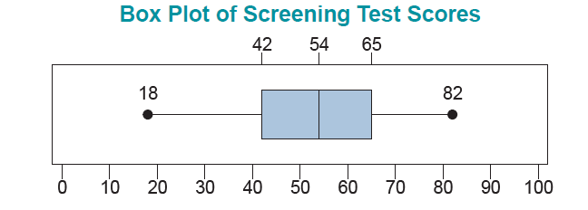
Box Plot – Graphing with Quartiles—Slide 2
Figure 1

Slide 21
Box Plot – Graphing with Quartiles—Slide 3
The box plot is constructed from five summary measures: the largest data value, the smallest data value, the 25th percentile, the 75th percentile, and the median.
The lower boundary of the box is the 25th percentile. The upper boundary of the box is the 75th percentile. The median is marked with a line through the box.
The box itself represents the middle 50% of the data, and the length of the box is the interquartile range.

Slide 22
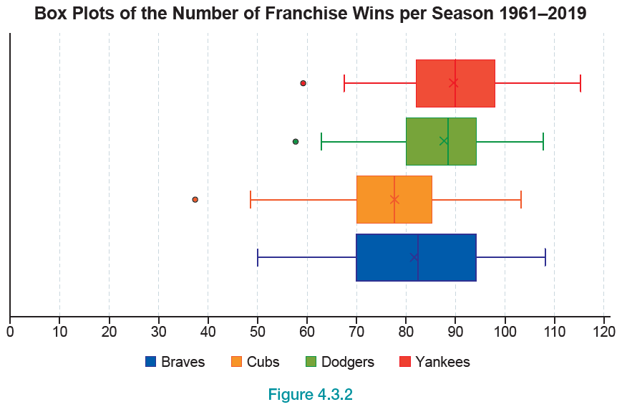
Box Plot – Graphing with Quartiles—Slide 4
Figure 2

Slide 23
Box Plot – Graphing with Quartiles—Slide 5
In Figure 1, a line is drawn from the 25th percentile to the smallest test score of 18, and another line is drawn from the 75th percentile to the largest score of 82.
These lines are often referred to as whiskers and the box plot is often referred to as the box and whisker plot.

Slide 24
Definition: Outlier
A data point is considered an outlier if it is 1.5 times the interquartile range above the 75th percentile or 1.5 times the interquartile range below the 25th percentile.

Slide 25
Detecting Outliers—Slide 1
The concept of an outlier is arbitrary. What you consider an outlier and what someone else considers an outlier may not be the same thing. However, one definition of an outlier which has gained some acceptance is developed in the context of a box plot.
If there is an outlier in the data set, the whiskers are drawn to the largest or smallest data value which is within 1.5 times the interquartile range from the box, and the outliers are marked with an open circle. For example, suppose test scores of 110 and 2 were added to the screening test data:

Slide 26
Detecting Outliers—Slide 2
Table 3 – Ordered New Test Scores
2 | 43 | 55 | 69
18 | 44 | 55 | 70
21 | 45 | 56 | 71
21 | 45 | 57 | 73
27 | 46 | 58 | 77
29 | 47 | 61 | 80
31 | 48 | 62 | 81
32 | 49 | 63 | 82
33 | 52 | 64 | 110
34 | 54 | 66
41 | 54 | 67

Slide 27
Detecting Outliers—Slide 3
For the new screening test data, the 25th percentile is 41 and the 75th percentile is 66, meaning that the interquartile range is 66 − 41 = 25. A value is considered an outlier if the data value is:
larger than the 75th percentile + 1.5 times the interquartile range.
66 + 1.5 ⋅ 25 = 103.5
smaller than the 25th percentile − 1.5 times the interquartile range.
41 − 1.5 ⋅ 25 = 3.5
Since 110 is larger than 103.5, it is considered an outlier. Since 2 is smaller than 3.5, it is also considered an outlier. Figure 3 shows the box plot of the screening test data with the outliers incorporated. Notice that the whiskers did not change because 82 and 18 are still the largest and smallest observations within 1.5 times the interquartile range from the box.

Slide 28
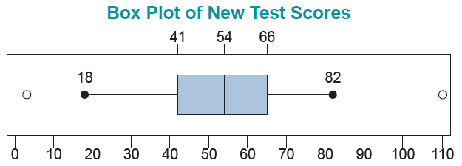
Detecting Outliers—Slide 4
Figure 3

Slide 29
Formula: z-Score
The z-score transforms a data value into the number of standard deviations that value is from the mean.

Slide 30
Example 3: Calculating a z-Score for Test Scores—Slide 1
Suppose you scored an 86 on your marketing test and a 94 on your management test. The mean and standard deviations of the two tests are given below.

Slide 31
Example 3: Calculating a z-Score for Test Scores—Slide 2
Table 4 – Test Scores
Course | Mean | Standard Deviation
Marketing | 74 | 10
Management | 82 | 11
What are the z-scores for your two tests? On which of the tests did you perform relatively better?

Slide 32
Example 3: Calculating a z-Score for Test Scores—Slide 3
Solution
The z-score for the marketing test is
The z-score for the management test is
On the marketing test you scored 1.20 standard deviations above the mean, compared to only 1.09 standard deviations above the mean for the management test.

Slide 33
Example 3: Calculating a z-Score for Test Scores—Slide 4
Even though the raw score on the management test is larger than the raw score on the marketing test, relative to the means of the data sets, the performance on the marketing test was slightly better. Once again, changing the scale of the data has beneficial effects. It enables the comparison of two measurements that are drawn from different populations.

