Slide 1
Section 4.4
Data Subsetting

Slide 2
Data Subsetting—Slide 1
Data subsetting is used to provide more clarity and structure to the data. The histogram on the next slide depicts the same data in Example 6 but has more intervals to give us a better spread of the data. Due to the large number of observations between $3,750 and $5,000, the histogram appears to be right-skewed. Were the histogram bell-shaped, it would be easier to identify the center of the data. Thus, it is sometimes prudent to separate the tuition data (i.e., data subsetting) into two groups—tuition for two-year institutions and tuition for four-year institutions.

Slide 3
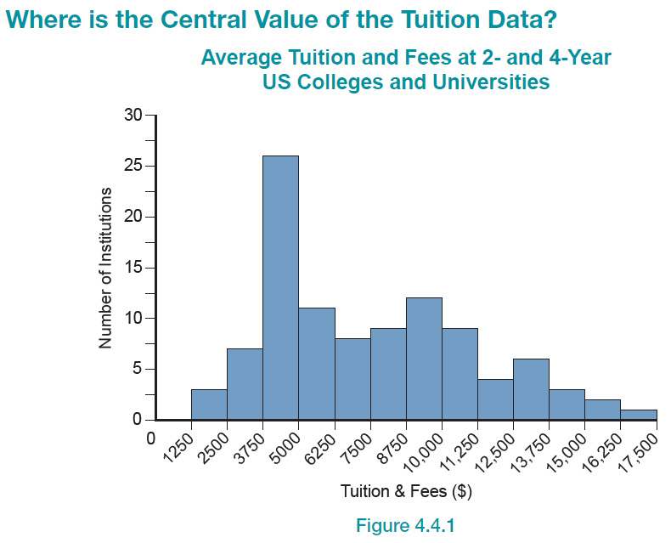
Data Subsetting—Slide 2
Figure 1

Slide 4
Data Subsetting—Slide 3
There are several measurements that can be used to describe the location or central value of the tuition and fees data. The mode is not considered because the data are quantitative and because there are many observations. Moreover, the mode is not a very informative measure of central tendency.
Since the median of the data ($7,098) is a bit smaller than the mean ($7,498) and smaller than the trimmed mean ($7,206), the choice will make a difference.
Which one of the three candidate measurements should be considered as the central value of the data?

Slide 5
Data Subsetting—Slide 4
The choice is not easy. You are justified in selecting any of the three statistical measures (median, mean, or trimmed mean). Reporting two measures (the mean and median) would not be a bad idea.
If only one measure is reported, identify the measure as the mean or the median rather than the average. The term “average” is a bit too ambiguous in current usage.

Slide 6
Describing Dispersion of the Tuition Data—Slide 1
Several measurements which assess variation have been discussed, including variance, standard deviation, mean absolute deviation, and percentiles. Since the variance and standard deviation are different forms of the same measurement, usually only the standard deviation is reported.
For the tuition data, a reasonable description of dispersion for the 101 values would be given by the following statistics.

Slide 7
Describing Dispersion of the Tuition Data—Slide 2
Table 1 – Tuition Data
Measure of Location | Value
Mean | $7498
Median | $7098
10% Trimmed Mean | $7206
Standard Deviation: $3,639,
Minimum: $1,428,
First Quartile (Q₁): $4,471,
Median (Q₂): $7,098,
Third Quartile (Q₃): $9,984,
Maximum: $17,186

Slide 8
Describing Dispersion of the Tuition Data—Slide 3
Table 2 – Tuition Data Percentiles
Percentile | Value
100th (Max) | $17,186
90th | $13,244
75th (Q₃) | $9,984
50th (Q₂) | $7,098
25th (Q₁) | $4,471
10th | $3,600
0 (Min) | $1,428

Slide 9
Describing Dispersion of the Tuition Data—Slide 4
The histogram in Figure 1 reveals that there appears to be a bundle of data between $0 and $5,000. What might be the reason for this? We could be looking at the difference between two-year and four-year institutions. This supposition could be checked rather easily if the data are divided (subsetted) into two-year and four-year schools.
The structure of a batch of data is often exposed by using another variable to break the data into smaller groups. This is called subsetting. A natural structuring of the tuition data is a grouping of two-year and four-year institutions.

Slide 10
Definition: Subsetting—Slide 1
Subsetting occurs when a variable is used to break up the data into smaller groups to show more structure in the data.

Slide 11
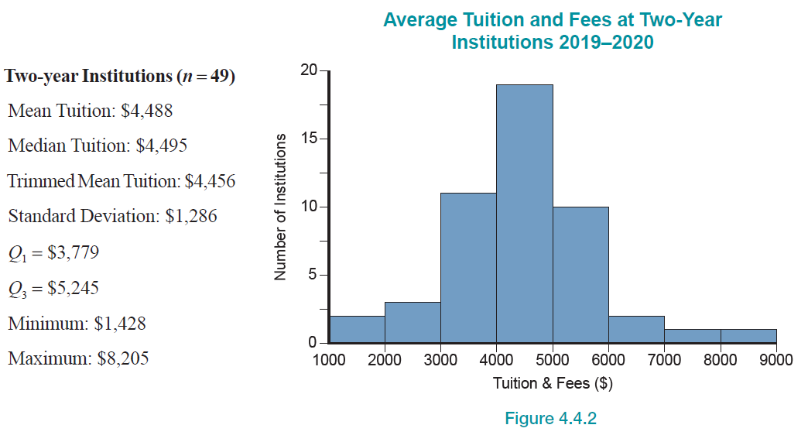
Subsetting—Slide 2
Figure 2

Slide 12
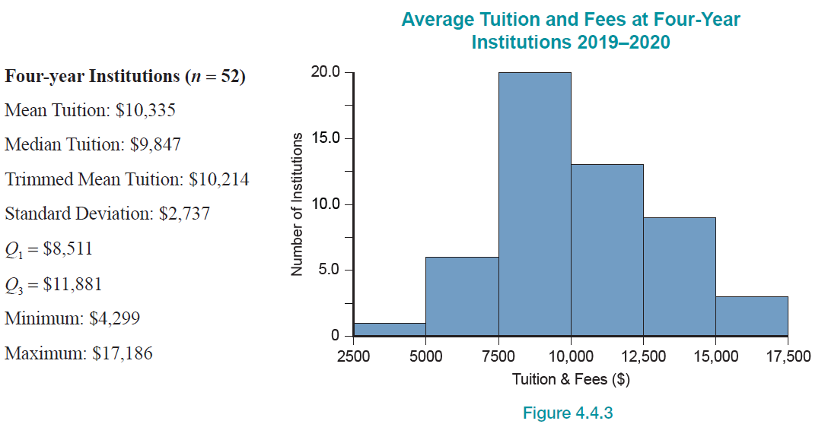
Subsetting—Slide 3
Figure 3

Slide 13
Subsetting—Slide 4
The data subsetting suggests that the data cluster between $0 and $5,000 revealed in the histogram in Figure 1 is the result of merging data from different kinds of educational institutions. Once the data are subsetted, the cluster at the lower end of the data disappears.

Slide 14
Example 1: An Example of Simpson's Paradox—Slide 1
A few years ago, a discrimination lawsuit was filed against the California Department of Developmental Services (DDS). The California DDS provides funding for developmentally-disabled individuals within the state. The lawsuit claimed that White Non-Hispanics were receiving more funding than Hispanics. If this was true, the DDS would face some serious legal and financial ramifications, so they hired several statisticians to analyze the data behind the issue. Were these claims of discrimination by a state department actually true?

Slide 15
Example 1: An Example of Simpson's Paradox—Slide 2
Solution
First, we will create box plots to visualize how the lawsuit arose. We will look at the relationship between ethnicity and expenditure by plotting expenditure grouped by the different ethnicities.

Slide 16
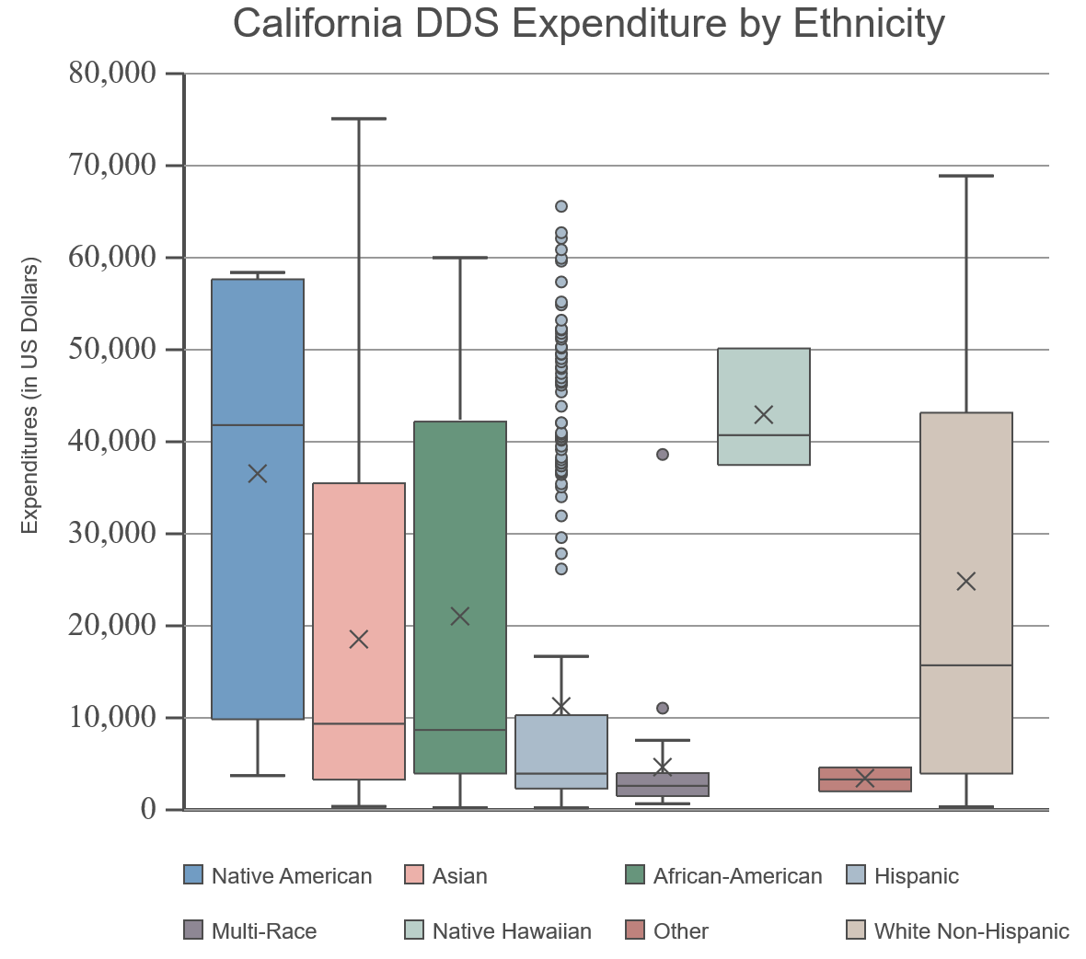
Example 1: An Example of Simpson's Paradox—Slide 3
Figure 4

Slide 17
Example 1: An Example of Simpson's Paradox—Slide 4
If the data are examined on a purely ethnic basis, then the figure above suggests that there is discrimination towards multiple different ethnic groups. But we need to think about any variables that could be confounding this picture.
The statisticians discovered that age played a massive role in the expenditure per person, because more costs are associated with caring for older developmentally-disabled individuals.

Slide 18
Example 1: An Example of Simpson’s Paradox—Slide 5
To account for the variation in expenditure between different ages, the statisticians decided to subset the whole data set into six different age groups, and then examine the expenditure by ethnicity within each age group to see if the discrimination claim still held true. The box plots in the following figures illustrate their findings.

Slide 19
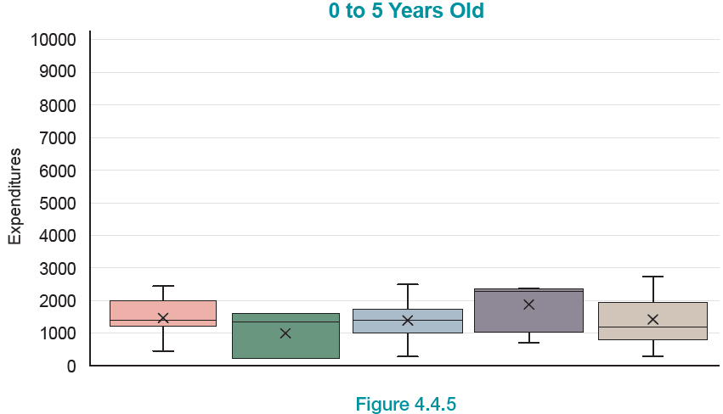
Example 1: An Example of Simpson’s Paradox—Slide 6
Figure 5

Slide 20
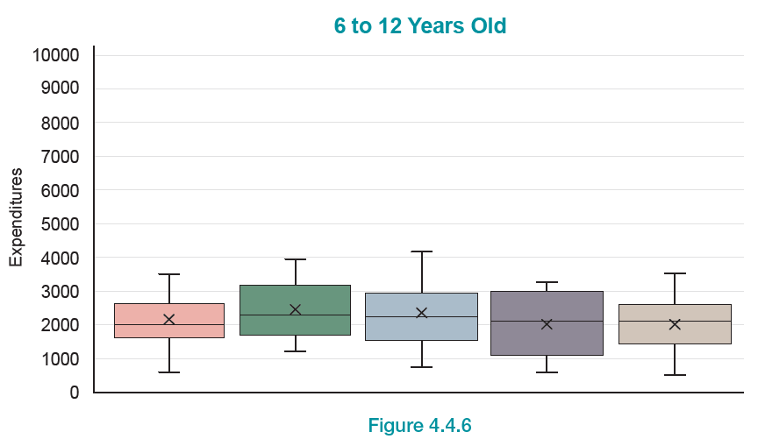
Example 1: An Example of Simpson’s Paradox—Slide 7
Figure 6

Slide 21
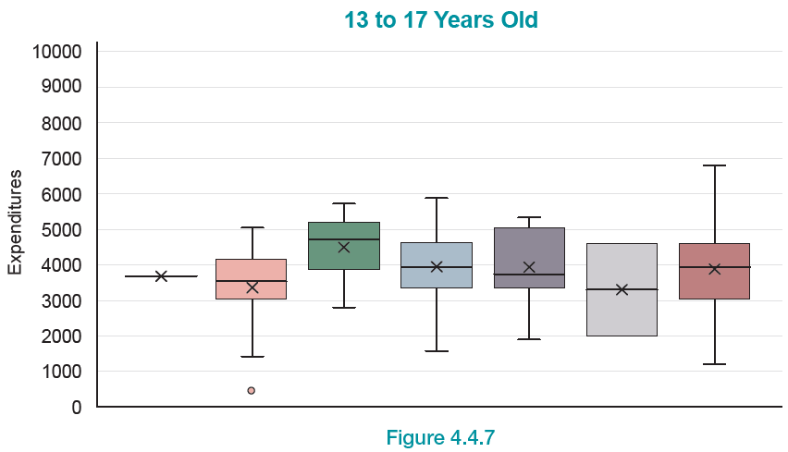
Example 1: An Example of Simpson’s Paradox—Slide 8
Figure 7

Slide 22
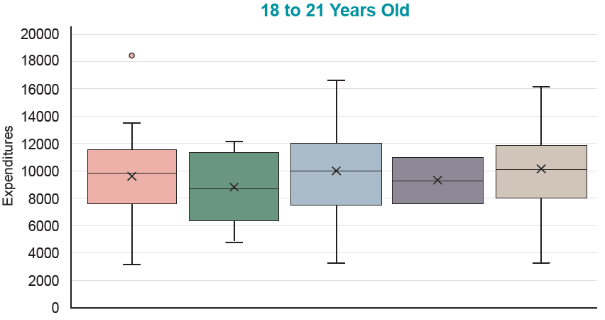
Example 1: An Example of Simpson’s Paradox—Slide 9
Figure 8

Slide 23
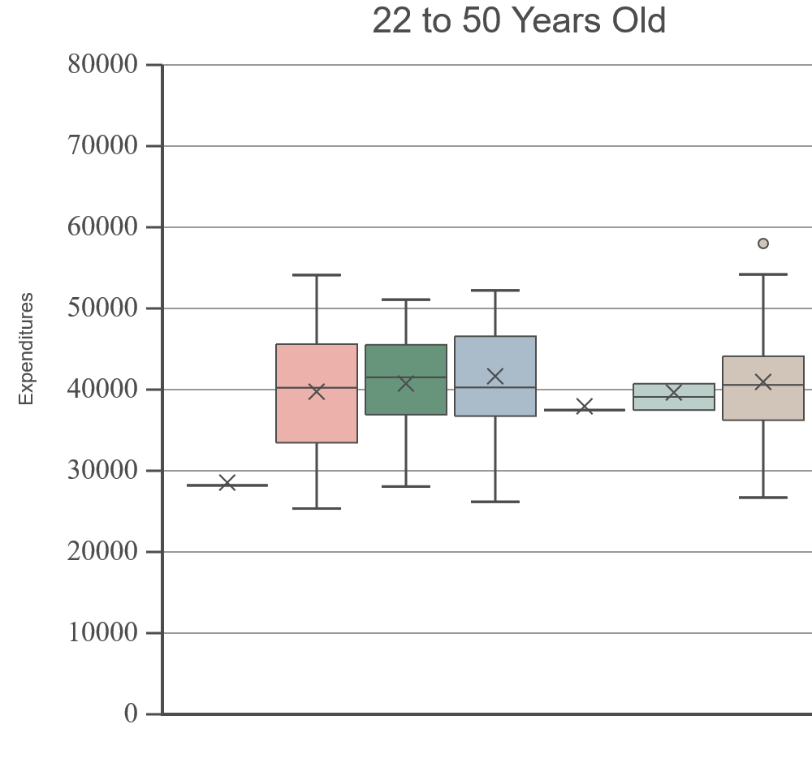
Example 1: An Example of Simpson's Paradox—Slide 10
Figure 9

Slide 24
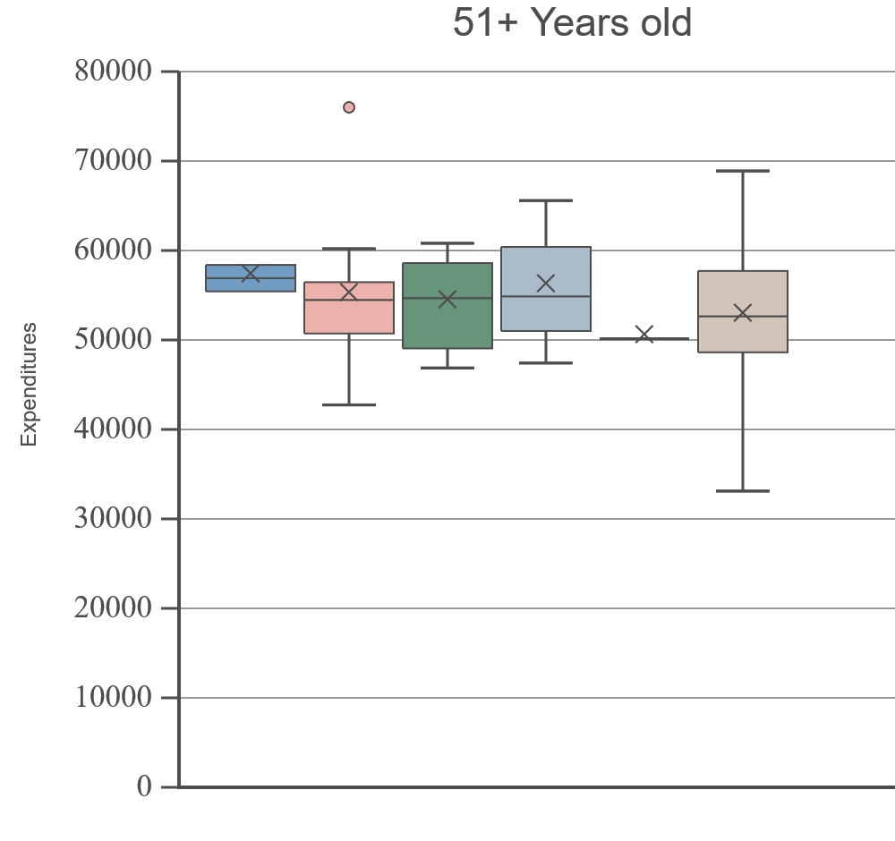
Example 1: An Example of Simpson's Paradox—Slide 11
Figure 10

Slide 25
Example 1: An Example of Simpson's Paradox—Slide 12
To the surprise of many involved, the box plots were roughly the same for each ethnic group once age was considered. There was no evidence of discrimination once the confounding variable "age" was accounted for.
This is a classic example of Simpson's paradox, which states that the perceived association between two variables (ethnicity and expenditures per person in this case) can be drastically affected by a third variable.

Slide 26
Example 1: An Example of Simpson’s Paradox—Slide 13
When the data are partitioned by the third variable (age in our case) the "alleged" relationship may not exist or be just the opposite.
When analyzing data, it is good to keep in mind Oscar Wilde’s cautionary quote, "the truth is rarely pure, and never simple". We must always be very cautious when attributing causation.

