Slide 1
Section 4.5
Analyzing Grouped Data

Slide 2
Definition: Grouped Data
Data that are presented as frequency distributions are called grouped data.

Slide 3
Formula: Mean of Grouped Data—Slide 1
The population mean of grouped data is given by
where
f _{i} = the number of observations in the i ^{th} class,
N = the total number of observations in all classes,
and
M _{i} = the midpoint of the i ^{th} class.

Slide 4
Formula: Mean of Grouped Data—Slide 2
The sample mean of grouped data is given by
where n is the number of observations in the sample.

Slide 5
Formula: Variance of Grouped Data
The population variance of grouped data is given by the following expression.
The corresponding formula for the sample variance is as follows.
where n equals the total number of observations in the sample.

Slide 6
Formula: Computational Formulas for the Variance of Grouped Data
The computational formulas for the population and sample variances of grouped data are as follows.

Slide 7
Example 1: Calculating the Mean and Variance of Grouped Data—Slide 1
Table 1 presents, in grouped form, the amount of cash on hand for 45 technology companies in the business software and services industry. Compute the mean and variance for these data.

Slide 8
Example 1: Calculating the Mean and Variance of Grouped Data—Slide 2
Table 1 – Cash on Hand for Technology Companies
Cash on Hand (Millions of Dollars) | Frequency
0–10 | 10
10–20 | 7
20–30 | 7
30–40 | 7
40–50 | 1
50–60 | 4
60–70 | 2
70–80 | 2
80–90 | 2
90–100 | 3

Slide 9
Example 1: Calculating the Mean and Variance of Grouped Data—Slide 3
Solution
To compute the mean and variance, the midpoints of each interval must be calculated. The class midpoint is determined as follows.
The midpoints as well as the other required calculations are presented in Table 2.

Slide 10
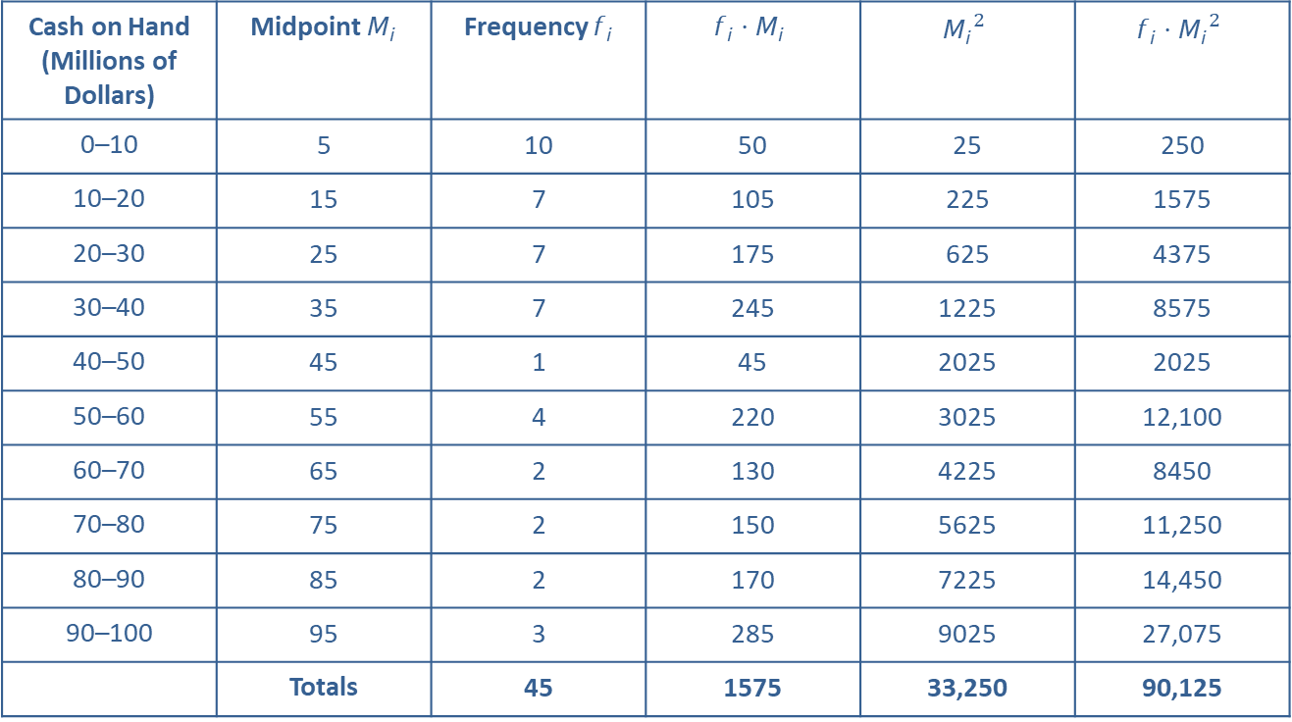
Example 1: Calculating the Mean and Variance of Grouped Data—Slide 4
Table 2 – Midpoints and Other Required Calculations
Cash on Hand (Millions of Dollars) | Midpoint $M_{i}$ | Frequency $f_{i}$ | $$f_{i}⋅M_{i}$$ | $${M_{i}}^{2}$$ | $$f_{i}⋅{M_{i}}^{2}$$
0–10 | 5 | 10 | 50 | 25 | 250
10–20 | 15 | 7 | 105 | 225 | 1575
20–30 | 25 | 7 | 175 | 625 | 4375
30–40 | 35 | 7 | 245 | 1225 | 8575
40–50 | 45 | 1 | 45 | 2025 | 2025
50–60 | 55 | 4 | 220 | 3025 | 12,100
60–70 | 65 | 2 | 130 | 4225 | 8450
70–80 | 75 | 2 | 150 | 5625 | 11,250
80–90 | 85 | 2 | 170 | 7225 | 14,450
90–100 | 95 | 3 | 285 | 9025 | 27,075
 | Totals | 45 | 1575 | 33,250 | 90,125

Slide 11
Example 1: Calculating the Mean and Variance of Grouped Data—Slide 5
Assuming the data in Table 1 are population data, the mean cash on hand for the 45 companies is calculated as follows.
The variance of the grouped data is calculated as follows.

Slide 12
Example 1: Calculating the Mean and Variance of Grouped Data—Slide 6
If the data are sample data, then the variance is:

