Slide 1
Section 4.7
Measures of Association Between Two Variables

Slide 2
Definition: Univariate Data
Univariate data are measurements collected on one variable.

Slide 3
Definition: Bivariate Data
Bivariate data are measurements collected on two variables.

Slide 4
Bivariate Data—Slide 1
Previously, all the statistical summary measurements, like the mean, variance, and proportions, described univariate data (measurements of one variable). To understand the relationship between two variables, data on both variables need to be collected. This type of data is called bivariate data. With bivariate data, two observations are recorded from some entity.
Table 1 contains 60 bivariate data points of monthly rent and vacancy rates for various locations in the southeastern part of the United States.

Slide 5
Bivariate Data—Slide 2
Table 1 – Monthly Rents and Vacancy Rates for Various Locations
Location | Monthly Rent ($) | Vacancy Rent (%)
Accomack | 639.00 | 9.0
Airport | 752.00 | 17.3
Albemarle | 717.00 | 11.7
Anson | 589.00 | 9.4
Appomattox | 605.00 | 14.5
 | …
York | 672.00 | 7.2

Slide 6
Definition: Scatterplot
A scatterplot is a graphical method used to display bivariate data by plotting the paired data on a set of coordinate axes.

Slide 7
Scatterplot—Slide 1
Looking for Patterns in the Data
Detecting a relationship between two variables often begins with a graph. In the case of bivariate data, a scatterplot (or scatter diagram) is the traditional graphical method used to display the relationship between two variables. In a scatterplot, measurements are plotted in pairs with one variable plotted on each axis. When examining a scatterplot we are trying to draw conclusions concerning the overall pattern of the data. Does the pattern roughly follow a straight line? Is the pattern upward sloping or downward sloping? Are the data values tightly clustered in the pattern or widely dispersed? Are there significant deviations from the pattern?

Slide 8
Scatterplot—Slide 2
A number of different scatterplots are shown in the following figures. In the first two scatterplots (Figures 1 and 2) the data are strongly related and, in fact, fall on a straight line. In Figure 1 the slope of the relationship is positive, that is, as the x-variable increases the y-variable also increases.

Slide 9
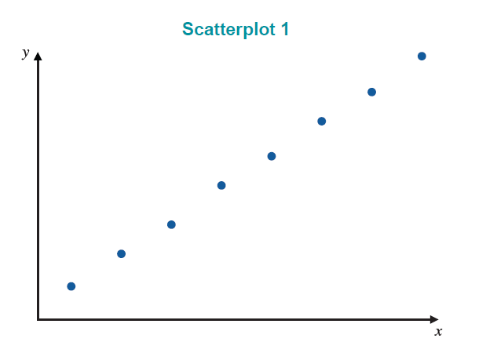
Scatterplot—Slide 3
Figure 1

Slide 10
Definition: Inverse Relationship
An inverse relationship is a relationship between two variables in which as one variable increases, the other variable decreases.

Slide 11
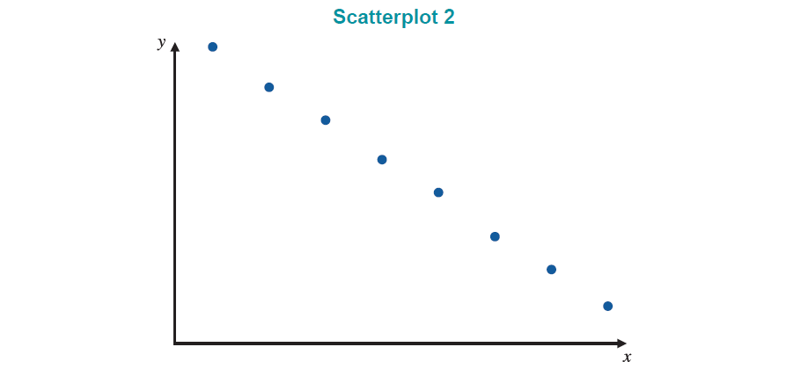
Inverse Relationship—Slide 1
In Figure 2 the relationship is negative; as the x-variable increases, the y-variable decreases. This is also called an inverse relationship
Figure 2

Slide 12
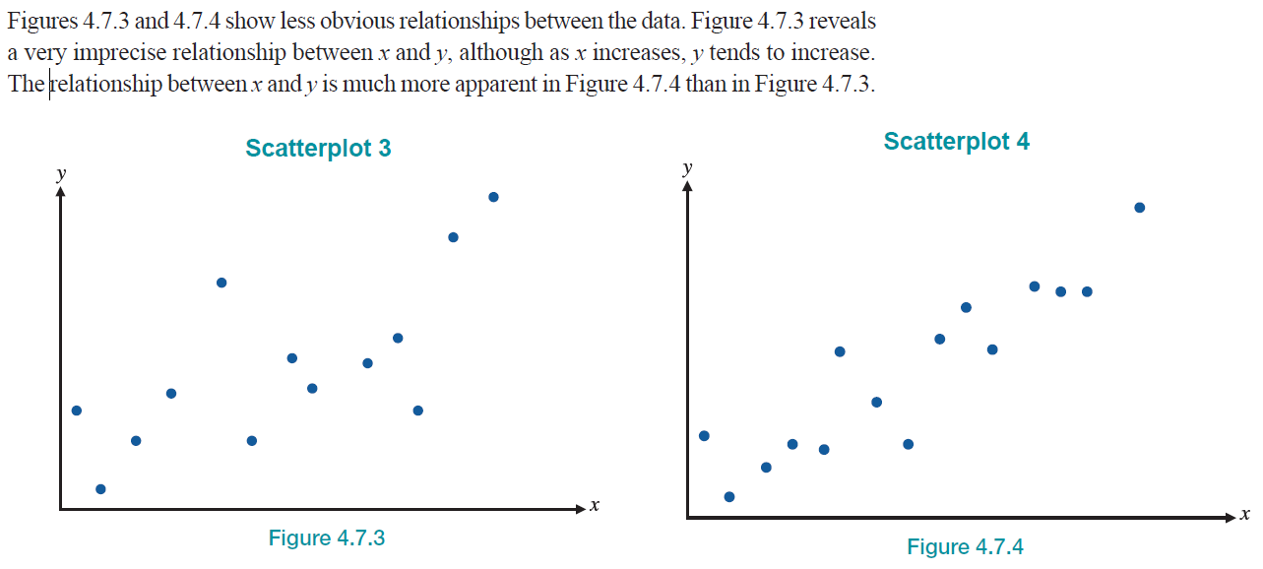
Inverse Relationship—Slide 2
Figure 3 and 4 show less obvious relationships between the data. Figure 3 reveals a very imprecise relationship between x and y, although as x increases, y tends to increase. The relationship between x and y is much more apparent in Figure 4 than in Figure 3.
Figure 3
Figure 4

Slide 13
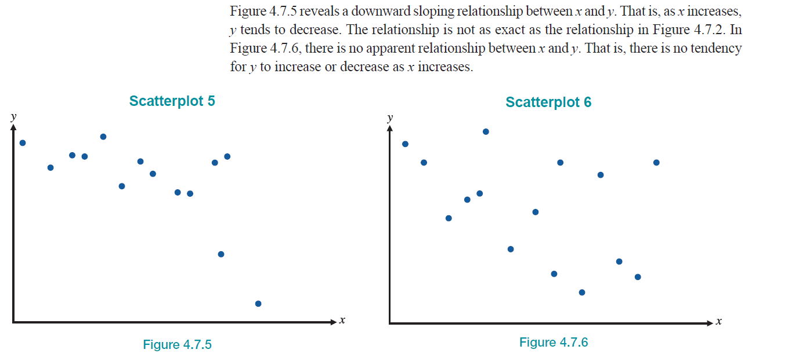
Inverse Relationship—Slide 3
Figure 5 reveals a downward sloping relationship between x and y. That is, as x increases, y tends to decrease. The relationship is not as exact as the relationship in Figure 2. In Figure 6, there is no apparent relationship between x and y. That is, there is no tendency for y to increase or decrease as x increases.
Figure 5
Figure 6

Slide 14
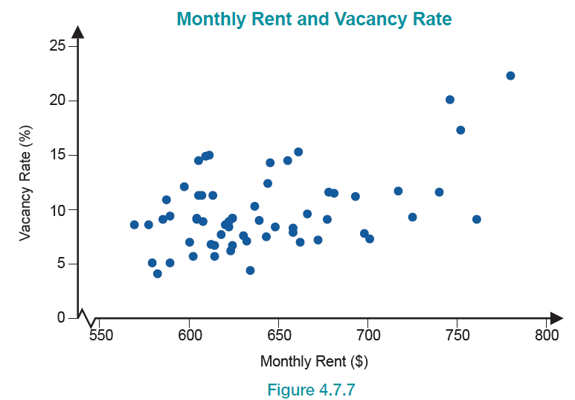
Inverse Relationship—Slide 4
Figure 7

Slide 15
Formula: Correlation Coefficient
The correlation coefficient is an index number used to summarize the strength of a linear relationship.

Slide 16
Formula: Computational Formula for the Correlation Coefficient
The computational formula for the correlation coefficient is as follows.

Slide 17
Example 1: Calculating a Correlation Coefficient—Slide 1
Table 2 contains the age and the annual maintenance costs of a certain model compact vehicle. Calculate the correlation coefficient to determine if a relationship exists between the age and annual maintenance cost of that model.

Slide 18
Example 1: Calculating a Correlation Coefficient—Slide 2
Table 2 – Vehicle Age and Maintenance Cost
Observation | Age | Annual Maintenance Cost (Dollars)
1 | 2 | 225
2 | 4 | 400
3 | 5 | 475
4 | 7 | 650
5 | 9 | 800
6 | 12 | 1175

Slide 19
Example 1: Calculating a Correlation Coefficient—Slide 3
Solution
To calculate the correlation coefficient, we will use the following computational formula.
Some useful summary statistics needed to calculate r are as follows.

Slide 20
Example 1: Calculating a Correlation Coefficient—Slide 4
Using the summary statistics, we get the following calculation for the correlation coefficient.
Given the large magnitude of r, one can say that there is a strong, positive, linear relationship between the age of the vehicle and the annual maintenance cost. That is, as the vehicle gets older, one can expect to spend more money on annual maintenance.

Slide 21
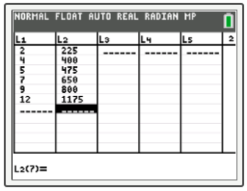
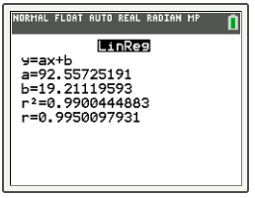
Technology
For technology instructions to calculate the correlation coefficient, visit stat.hawkeslearning.com and navigate to Discovering Business Statistics, Second Edition → Technology Instructions → Regression → Correlation Coefficient.

Slide 22
Properties: Correlation Coefficient—Slide 1
The correlation coefficient r, measures the degree of linear relationship, i.e., how well the data cluster around a line.
​The value of r is always between −1 and +1.
​A value of r near −1 or +1 means the data are tightly bundled around a line.
​A value of r near −1 or +1 means that we have a very strong negative relationship or positive relationship, respectively, such that predictions within the scope of the data are very reliable.

Slide 23
Properties: Correlation Coefficient—Slide 2
Positive association is indicated by r > 0 and an upward sloping relationship.
​Negative association is indicated by r < 0 and a downward sloping relationship.
​A value of r near zero means there is no linear relationship between x and y.
​It does not matter whether you correlate y with x or x with y; you will still get the same value for r.

Slide 24
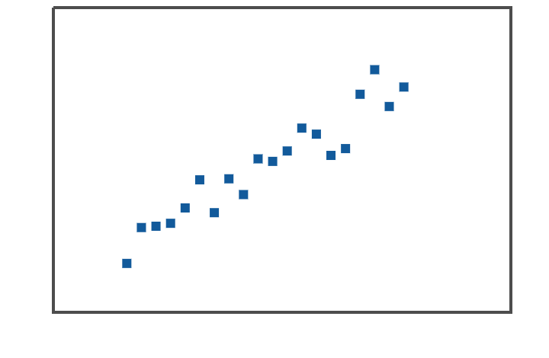
Correlation Coefficients—Slide 1
r = 0.95

Slide 25
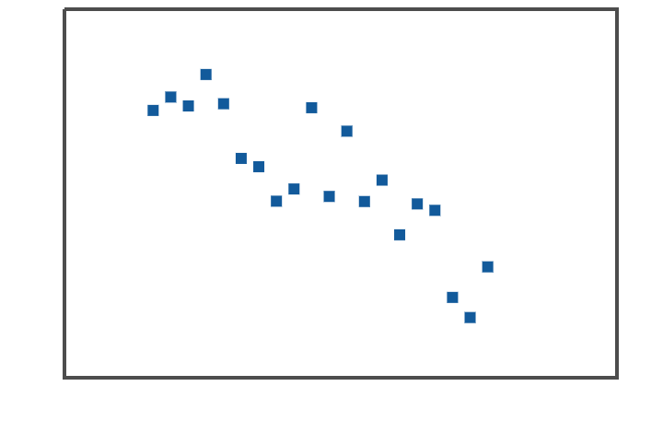
Correlation Coefficients—Slide 2
r = −0.86

Slide 26
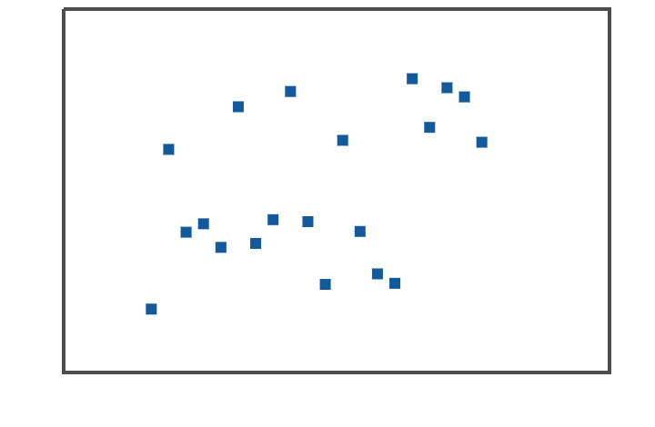
Correlation Coefficients—Slide 3
r = −0.05

Slide 27
Definition: Quadratic Relationship
A quadratic relationship is a relationship between two variables in which the relationship when plotted exhibits a curve and not a line.

Slide 28
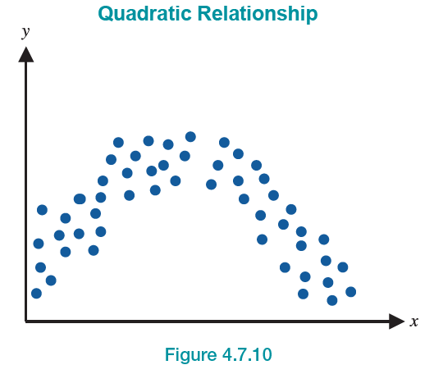
Quadratic Relationship
Figure 10

Slide 29
Definition: Confounding
Confounding occurs when more than one variable affects the dependent variable, and the effects of the variables are indistinguishable from one another.

Slide 30
Definition: Spurious Correlation
A spurious correlation is a correlation where unrelated variables have a high correlation.

Slide 31
Spurious Correlation—Slide 1
Sometimes unrelated variables are highly correlated. When this occurs the variables are said to have a spurious correlation. For example, over a short period of time daily car sales and the number of penguins in Antarctica might be related. However, it is doubtful that a significant change in the penguin population will cause a change in car sales, or vice versa.
The following graphs display some interesting spurious correlations that have been discovered.

Slide 32
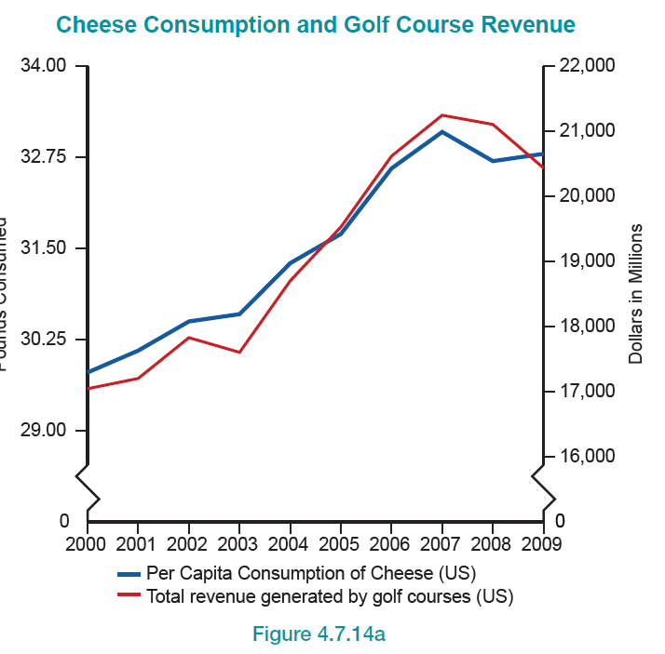
Spurious Correlation—Slide 2
Figure 14a

Slide 33
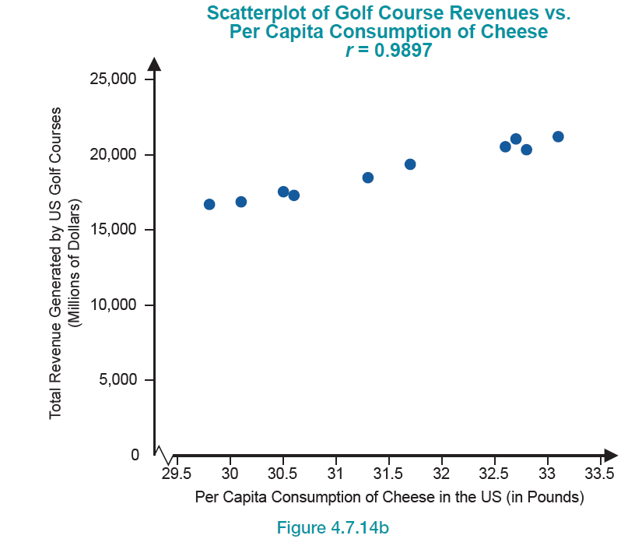
Spurious Correlation—Slide 3
Figure 14b

Slide 34
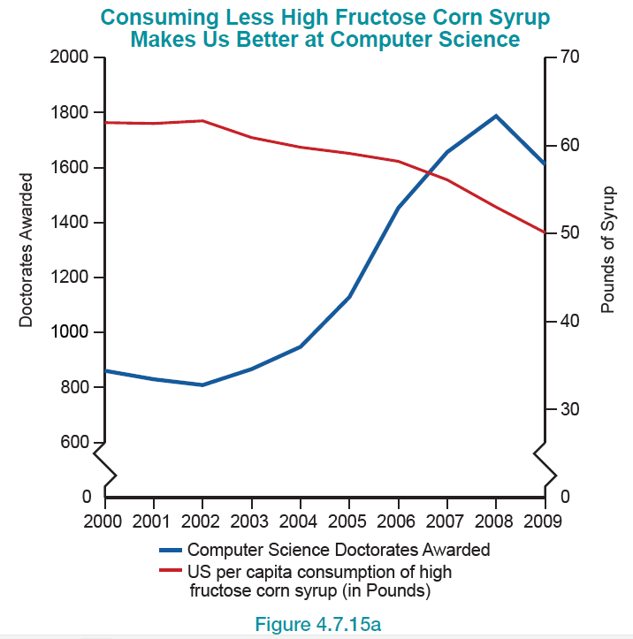
Spurious Correlation—Slide 4
Figure 15a

Slide 35
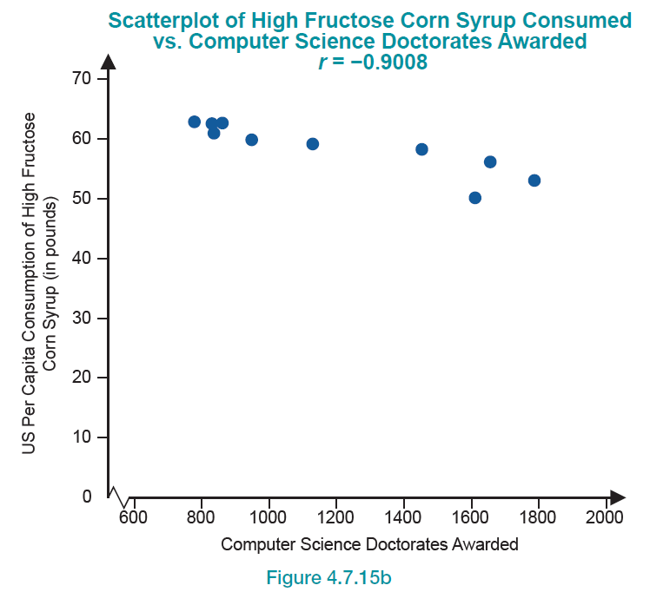
Spurious Correlation—Slide 5
Figure 15b

Slide 36
Anscombe’s Quartet—Slide 1
The Anscombe Quartet is a famous set of four data sets presented in 1973 by the statistician Francis Anscombe. In all four data sets (shown in Table 3 and labeled
all the x variables have the same mean (9) and sample variance (11). All the y variables have the same mean (7.5) and sample variance (4.125). In addition, the correlation between x and y is the same in each of the four data sets (0.816).

Slide 37
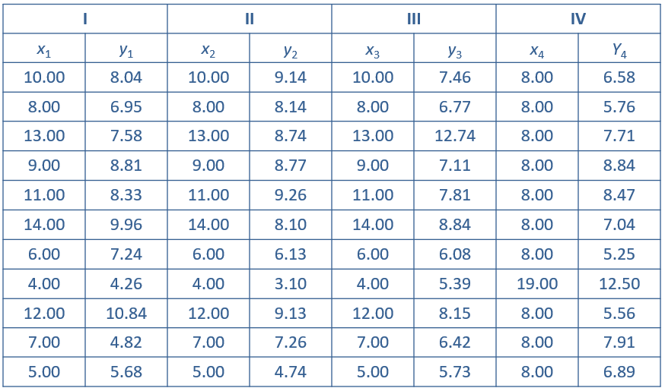
Anscombe’s Quartet—Slide 2
Table 2 – Anscombe’s Quartet

Slide 38
Anscombe’s Quartet—Slide 3
By examining the summary statistics of the four data sets in Table 4, a data analyst might conclude that the data sets were quite similar. However, if we look at the scatterplots of the four data sets in Figure 16 to 19, we observe four quite different structures in the x and y variables as well as in the relationship between the x and y variables.

Slide 39
Anscombe’s Quartet—Slide 4
Table 4 – Summary Statistics
Property | Value | Accuracy
Mean of x | 9 | exact
Sample variance of x | 11 | exact
Mean of y | 7.50 | To 2 decimal places
Sample variance of y | 4.125 | +/−0.003
Correlation between x and y | 0.816 | to 3 decimal places
Linear regression line | Y = 3.000 + 0.500x | to 3 decimal places

Slide 40
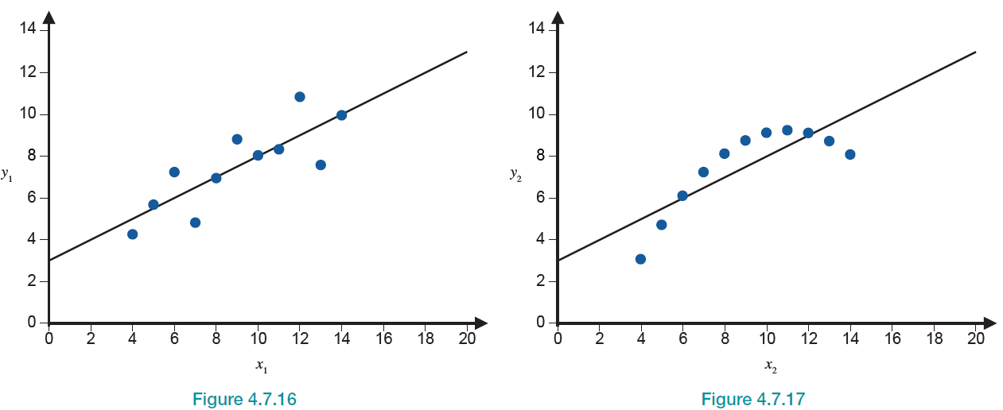
Anscombe’s Quartet—Slide 5
Figure 16
Figure 17

Slide 41
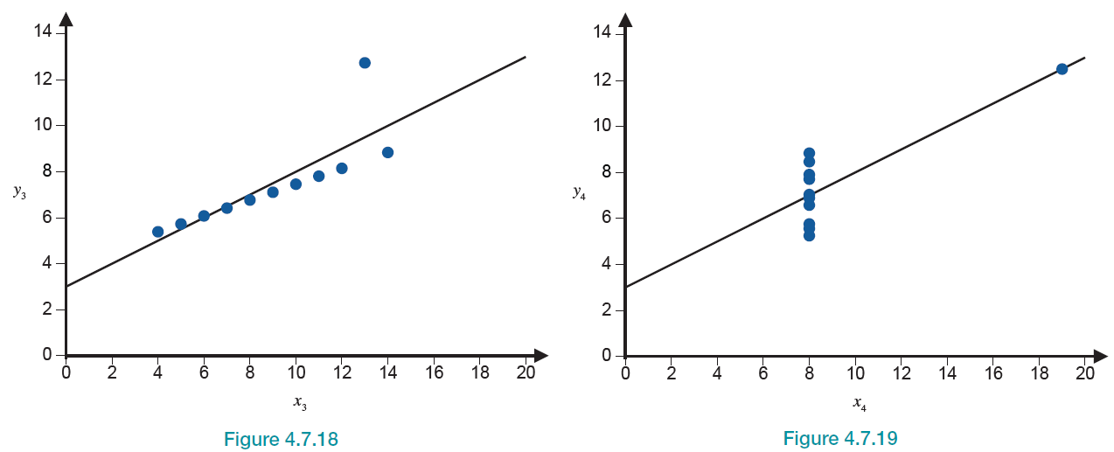
Anscombe’s Quartet—Slide 6
Figure 18
Figure 19

Slide 42
Anscombe’s Quartet—Slide 7
The Anscombe Quartet brings out an important data analytic principle. No matter what kind of numeric data is being analyzed, it is critically important to plot it before making any conclusions. For single variables, an analyst should at least be looking at histograms and box plots. When we begin to look for relationships in bivariate or multivariate data, creating scatterplots to display the relationship between the variables is more important than calculating summary measures of linear relationship, i.e., the correlation coefficient.

