Slide 1
Section 5.1
Introduction to Probability

Slide 2
Definition: Probability
Probability is the likelihood of occurrence of an event.

Slide 3
Definition: Randomness
Randomness is said to occur when the outcome of an event cannot be predicted with certainty.

Slide 4
Definition: Random Experiment
A random experiment is defined as any activity or phenomenon that meets the following conditions.
​There is one distinct outcome for each trial of the experiment.
​The outcome of the experiment is uncertain.
​The set of all distinct outcomes of the experiment can be specified and is called the sample space, denoted by S.

Slide 5
Definition: Outcome
An outcome is any member of the sample space.

Slide 6
Definition: Event
An event is a set of outcomes.

Slide 7
Definition: Subjective Probability
One’s personal belief about the occurrence of a specific event is referred to as subjective probability.

Slide 8
Definition: Objective Probability
The likelihood of the occurrence of a particular event based on recorded outcomes is called objective probability.

Slide 9
Formula: Relative Frequency
If an experiment is performed n times, under identical conditions, and the event A happens k times, the relative frequency of A is given by the following expression.

Slide 10
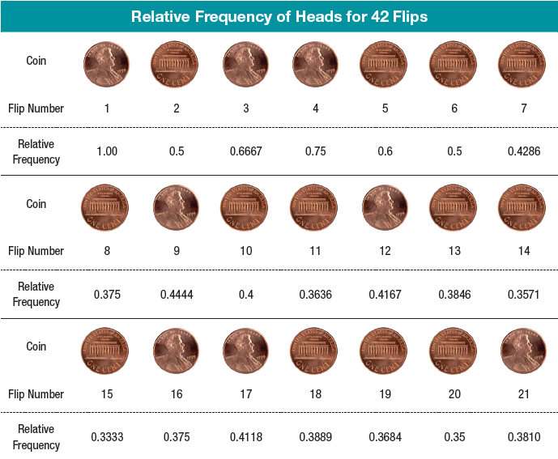
Relative Frequency—Slide 1

Slide 11
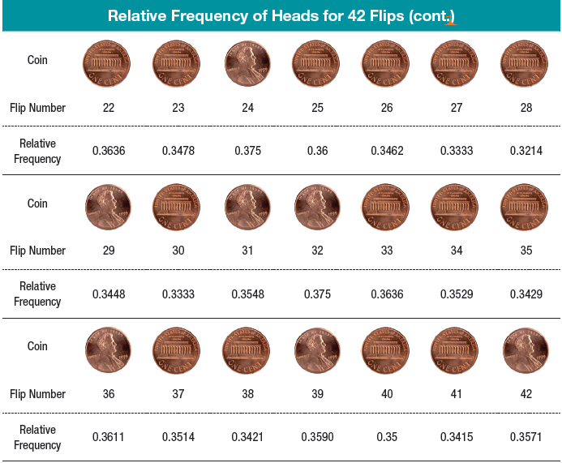
Relative Frequency—Slide 2
Relative Frequency of Heads for 42 Flips

Slide 12
Relative Frequency—Slide 3
In Figure 1, you can see that the proportion of heads is very unstable during the first 15 flips. The proportion of heads begins to stabilize at around flip 20, although there is still some fluctuation in its value. Looking at the first 42 flips makes you wonder whether this is a “fair” coin, since heads is occurring only
In Figure 2, which starts at about 200 flips, the proportion of heads becomes very stable. By flip number 296, there are 141 heads and 155 tails which equate to (approximately) a 0.4764 probability (or relative frequency) of heads. Although this is slightly less than the expected 0.5 for a “fair” coin, such a proportion is reasonable considering the randomness of the coin toss.

Slide 13
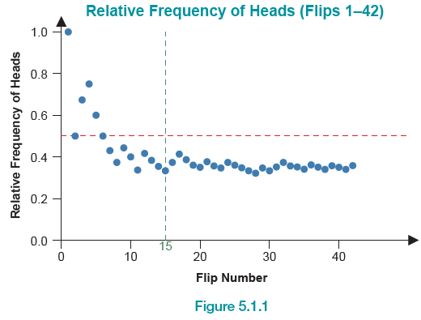
Relative Frequency—Slide 4
Figure 1

Slide 14
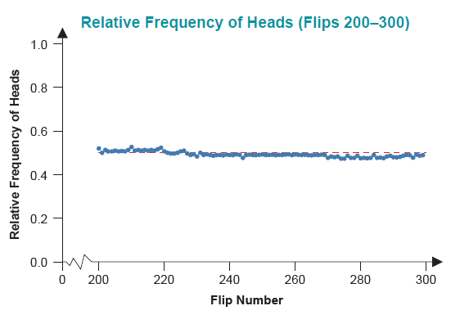
Relative Frequency—Slide 5
Figure 2

Slide 15
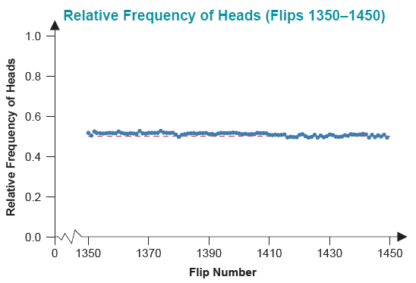
Relative Frequency—Slide 6
Figure 3

Slide 16
Relative Frequency—Slide 7
As can be seen in Figure 2 and Figure 3, the proportion of heads converges on some point which is close to 0.5. Figure 3 starts at 1350 flips. As you can see, the proportion of heads remains very stable. At flip number 1450 there are 718 heads and 732 tails which (approximately) equate to a 0.4952 probability (or relative frequency) of heads.
What is the relative frequency of a head on our coin? Our best available guess is 0.4952, since it is the observed relative frequency of heads using all 1450 tosses.

Slide 17
Relative Frequency—Slide 8
How good is this guess for the relative frequency of heads? Since the coin has been tossed a large number of times and the observed frequency is very stable, the guess should be very good.
Will the observed relative frequency ever reach 0.5? No mathematical or physical law requires the observed relative frequency to ever reach some predetermined level. But if the probability of observing a head was really 0.5, the observed relative frequency should closely approach this value after a large number of flips.

Slide 18
Definition: A Summary
The experiment: Toss a coin and observe which side of the coin appears on top.
Duration of the experiment: Toss the coin 1450 times. n = 1450
Observe the event "getting a head": The event was observed 718 times. k = 718
Relative frequency of the event "getting a head":

Slide 19
Definition: Statistical Regularity
The belief that random events will exhibit regularity (i.e., when repeated enough times that the number of outcomes of the experiment will approximate the true number of outcomes) is referred to as statistical regularity.

Slide 20
Example 1: Drawing a Card in Monopoly—Slide 1
Suppose in the standard game of Monopoly, you have 16 Community Chest cards. Ten of these cards pay (or have the player collect) money if chosen, four have the player pay money if chosen, and two are associated with jail (either a "Go to Jail" or a "Get Out of Jail Free" card). Suppose a player lands on the Community Chest square when playing Monopoly and has to draw a card from the well-shuffled deck of 16 cards. Have we met the conditions of a random experiment?

Slide 21
Example 1: Drawing a Card in Monopoly—Slide 2
Solution
1. ​There will be only one outcome.
2. ​The type of card will be unknown since the card will be drawn at random.
3. ​The sample space consists of the 16 cards associated with the deck of Community Chest cards.
This experiment meets the conditions of a random experiment.

Slide 22
Example 2: Drawing Numbers without Replacement—Slide 1
Suppose we perform an experiment drawing three numbers, one number at a time, without replacement, from an urn containing 64 numbers. Have we met the conditions of a random experiment?

Slide 23
Example 2: Drawing Numbers without Replacement—Slide 2
Solution
1. For each draw from the urn, there will be only one outcome.
2. ​The number (or numbers) that will be drawn will be unknown and drawn at random.
3. The initial sample space consists of 64 numbers. After the first number is drawn (and not placed back into the deck), the sample space changes; and will change again after the second number is drawn.

Slide 24
Example 2: Drawing Numbers without Replacement—Slide 3
Thus, this experiment is not a random experiment. The reason it is not a random experiment is because it cannot be repeated under the same conditions. That is, as each number is selected, it is not returned to the urn prior to the subsequent selection, thus decreasing the amount of numbers remaining in the urn. For this reason, the experiment is different for each number drawn and cannot be considered a random experiment.

Slide 25
Formula: Classical Probability
Using the classical approach to probability, the probability of an event A, denoted P(A), is given by

Slide 26
Example 3: Determining Classical Probability with Coins—Slide 1
In experiment number 2, a coin was tossed three times and the number of heads was observed. The sample space consists of 8 outcomes {TTT, TTH, T H T, THH, HTT, H T H, HHT, HHH}. Let A be the event of getting at least one head. What is P(A)?

Slide 27
Example 3: Determining Classical Probability with Coins—Slide 2
Solution
Since the event A consists of 7 outcomes, {TTH, T H T,
T H T, THH, THH, HTT, H T H, HHT, HHH}, and there are 8 equally likely outcomes in the sample space,

Slide 28
Example 4: Determining Classical Probability with Cards—Slide 1
In experiment number 4, let A be the event of drawing a heart. What is P(A)?

Slide 29
Example 4: Determining Classical Probability with Cards—Slide 2
Solution
Since there are 13 outcomes in A (i.e., 13 hearts in a deck of cards) and 52 outcomes in the sample space (i.e., 52 cards in the deck) the probability of event A is as follows.

Slide 30
Example 5: Formulating the Sample
Space—Slide 1
In experiment number 2, a coin was tossed three times and the number of heads was observed. The outcomes in the sample space were as follows.
S = {TTT, TTH, T H T, THH, HTT, H T H, HHT, HHH}
Could the sample space in this experiment have been formulated differently? Could, for example, the outcomes be defined as the number of heads in three tosses, S = {0, 1, 2, 3}?

Slide 31
Example 5: Formulating the Sample Space—Slide 2
Solution
Using the classical definition of probability requires that the outcomes be equally likely. Since the sample space S = {0, 1, 2, 3} does not contain equally likely events, the classical definition of probability is not applicable.

Slide 32
Definition: Statistical Inference
The process of making judgments about population parameters is called statistical inference.

