Slide 1
Section 5.2
Laws of Probability

Slide 2
Definition: Probability Law 1
A probability of zero means the event cannot happen.

Slide 3
Definition: Probability Law 2
A probability of one means the event must happen.

Slide 4
Definition: Probability Law 3
All probabilities must be between zero and one, inclusively. That is,

Slide 5
Definition: Probability Law 4
The sum of the probabilities of all outcomes in a sample space must equal one. That is, if P(A _{i}) is the probability of outcome A _{i}, and there are n such outcomes, then

Slide 6
Definition: Compound Event
A compound event is an event that is defined by combining two or more events.

Slide 7
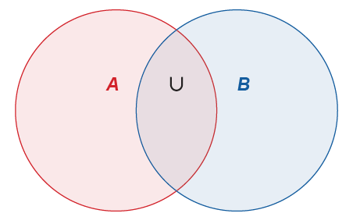
Definition: Union
The union of the events A and B is the set of outcomes that are included in A or B or both, and is denoted
Figure 2

Slide 8
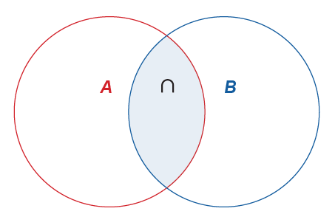
Definition: Intersection
The intersection of the events A and B is the set of all outcomes that are included in both A and B. Symbolically, the intersection of A and B is denoted
A ∩ B and is read "A intersect B."
Figure 3

Slide 9
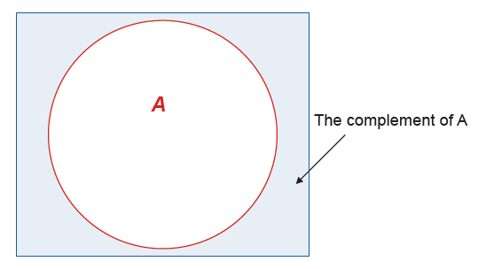
Definition: Complement
The complement of an event A is the set of all outcomes in the sample space that are not in A.
Figure 4

Slide 10
Definition: Probability Law 5
The probability of

Slide 11
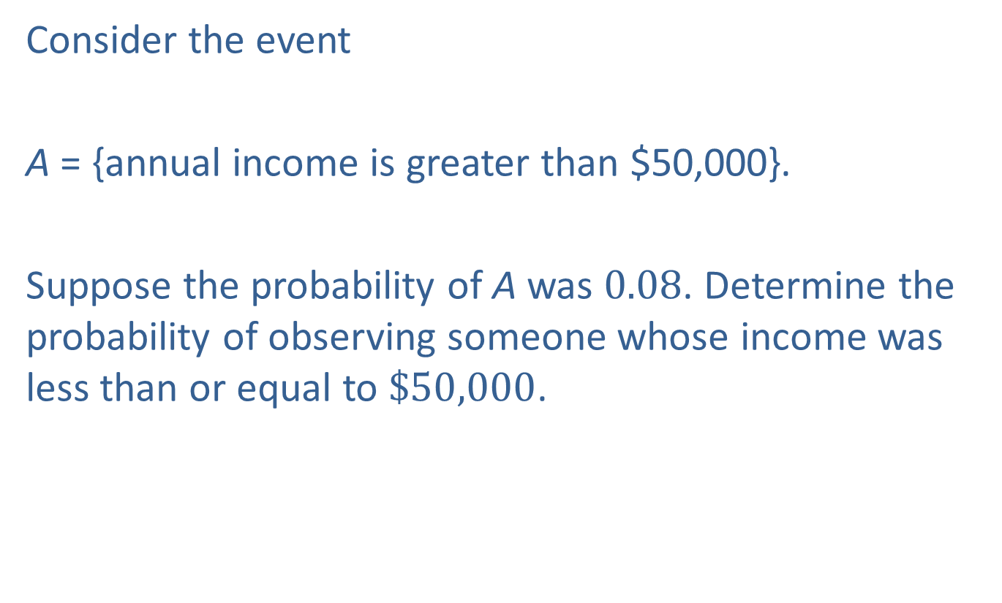
Example 1: Finding the Probability of the Complement—Slide 1
Consider the event
A = {annual income is greater than $50,000}.
Suppose the probability of A was 0.08. Determine the probability of observing someone whose income was less than or equal to $\$50,000$.

Slide 12
Example 1: Finding the Probability of the Complement—Slide 2
Solution

Slide 13
Example 2: Finding a Probability Using the Complement—Slide 1
Consider an experiment to see how many tosses of a coin will be required to obtain the first head. The first head could be observed on the first toss or the second toss but there is no upper limit on the number of tosses that could be required.
Therefore, the sample space for this experiment is the set of positive integers
Not only is the sample space infinitely large, but there is another problem: the outcomes are not equally likely.

Slide 14
Example 2: Finding a Probability Using the Complement—Slide 2
Let’s make matters slightly worse. Suppose we want to know the probability that it will require at least two tosses to get the first head. That is, we want to know the probability of getting the first head in two or more tosses of the coin.

Slide 15
Example 2: Finding a Probability Using the Complement—Slide 3
Solution
The problem becomes rather trivial by determining the complement of the event and computing its probability. The complement of obtaining the first head in two or more tosses is getting a head on the first toss. The probability of getting a head on the first toss is 0.5, assuming the coin is fair. Therefore, we have the following.

Slide 16
Example 2: Finding a Probability Using the Complement—Slide 4
As shown in this example, when you see the key words "at least" in a probability problem, you will often want to use the complement to find the appropriate probability.

Slide 17
Formula: Odds
The odds in favor of the occurrence of an event A is
given by
The odds against the occurrence of an event A is given
by

Slide 18
Example 3: Determining the Odds of Winning the NBA Championship—Slide 1
Having won the 2020 NBA Championship, the Los Angeles Lakers are favored to win the 2021 championship with 2:1 odds due to many off-season player acquisitions of several all-star players.
​What is the probability that the Lakers will win the 2021 NBA Championship based on those odds?
​Suppose that the consensus of many other NBA analysts is that there is a 60% chance that the Lakers will win the 2021 NBA Championship. What are the odds of the Lakers winning the championship?

Slide 19
Example 3: Determining the Odds of Winning the NBA Championship—Slide 2
Solution
a. ​The probability that the Lakers will win the championship is given by
there is a 67% chance that the Lakers will win the 2021 NBA Championship.
b. Given the probability that the Lakers will win the championship is 60%, we can calculate the odds by
Therefore, the odds of the Lakers winning the 2021 NBA Championship is 1.5 to 1.

Slide 20
Definition: Mutually Exclusive
Two events are mutually exclusive if they have no outcomes in common.

Slide 21
Mutually Exclusive—Slide 1
Two events are mutually exclusive if they cannot occur at the same time.
For example, if you were to select one card from a standard deck, the two outcomes:
The card is a Jack
The card is a Seven
are mutually exclusive, because you cannot select a card that is both a Jack and a Seven.

Slide 22
Mutually Exclusive—Slide 2
However, the two outcomes
The card is a Jack
The card is a Club
are not mutually exclusive, because you can select a card that is both a Jack and a Club.

Slide 23
Definition: Probability Law 6: Union of Mutually Exclusive Events
If the events A and B and are mutually exclusive, then

Slide 24
Definition: Probability Law 7: Intersection of Mutually Exclusive Events
If the events A and B are mutually exclusive, the

Slide 25

Example 4: Calculating the Probability of the Union of Mutually Exclusive Events—Slide 1
Suppose P(A) = 0.27 and P(B) = 0.19. If A and B are mutually exclusive, what is the probability of A $∪$ B?

Slide 26
Example 4: Calculating the Probability of the Union of Mutually Exclusive Events—Slide 2
Solution
Since these are mutually exclusive events,

Slide 27
Definition: Probability Law 8: The Addition Rule
For any two events A and B,

Slide 28
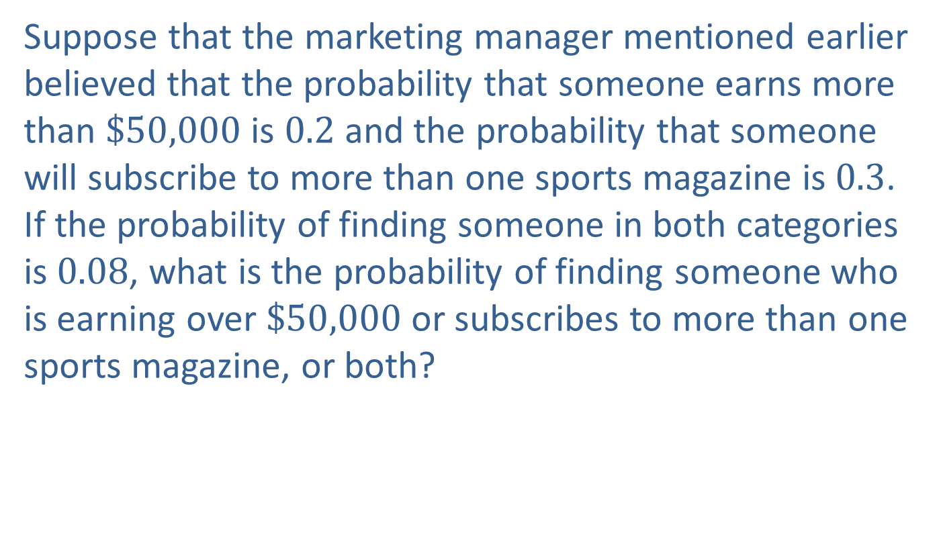
Example 5: Calculating the Probability of the Union of Two Events—Slide 1
Suppose that the marketing manager mentioned earlier believed that the probability that someone earns more than $\$50,000$ is 0.2 and the probability that someone will subscribe to more than one sports magazine is 0.3. If the probability of finding someone in both categories is 0.08, what is the probability of finding someone who is earning over $\$50,000$ or subscribes to more than one sports magazine, or both?

Slide 29
Example 5: Calculating the Probability of the Union of Two Events—Slide 2
Solution
The problem involves the union of two events. Let us define the events as follows.
A = {the event that someone earns more than $50,000}
B = {the event that someone will subscribe to more than one sports magazine}
From the problem statement, we know P(A) = 0.2, P(B) = 0.3, and P(A and B) = 0.08.

Slide 30

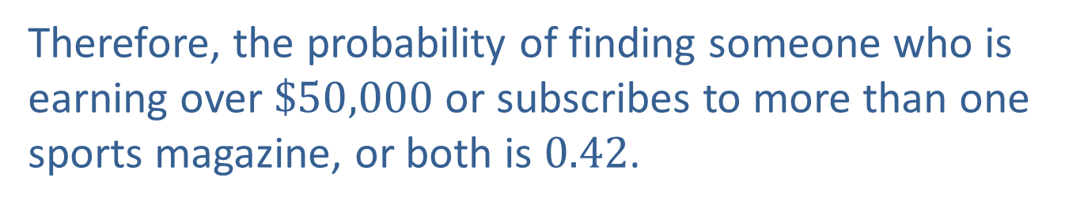
Example 5: Calculating the Probability of the Union of Two Events—Slide 3
We want to know the probability of event $A$ or event $B$ or both. Thus, the desired probability is the union of the two events given by
Therefore, the probability of finding someone who is earning over $\$50,000$ or subscribes to more than one sports magazine, or both is 0.42.

