Slide 1
Section 5.3
Conditional Probability

Slide 2
Definition: Conditional Probability
The probability that one event will occur given that some other event has occurred is a conditional probability.

Slide 3
Definition: Probability Law 9: Conditional Probability—Slide 1
The conditional probability of A, given that B has occurred, is
is read as the probability of A
given the occurrence of B. The vertical bar within a probability statement will always mean given.
Note that since we are finding the conditional probability of A, given that B has occurred,

Slide 4
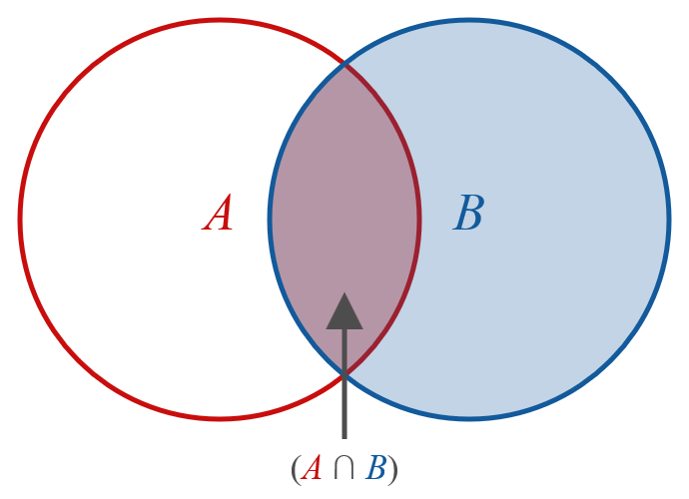
Probability Law 9: Conditional Probability—Slide 2
Figure 1

Slide 5
Example 1: Calculating a Conditional Probability—Slide 1
Suppose a marketing research firm has surveyed a panel of consumers to test a new product and produced the following cross tabulation indicating the number of panelists that liked the product, the number that did not like the product, and the number that were undecided.

Slide 6
Example 1: Calculating a Conditional Probability—Slide 2
Table 1 – Market Research Survey
Age | Like | Not Like | Undecided | Total
18–34 | 213 | 197 | 103 | 513
35–50 | 193 | 184 | 67 | 444
Over 50 | 144 | 219 | 83 | 446
Total | 550 | 600 | 253 | 1403

Slide 7
Example 1: Calculating a Conditional Probability—Slide 3
If an individual is between 35 and 50 years old, what is the probability he or she will like the product?

Slide 8
Example 1: Calculating a Conditional Probability—Slide 4
Solution
Let the events
A = {like the product}, and
B = {age between 35 and 50}.
Then the desired probability can be formulated as

Slide 9
Example 1: Calculating a Conditional Probability—Slide 5
The P(A ∩ B) is called a joint probability since it is the probability of the occurrence of more than one event. To compute P(A ∩ B) use the empirical approach.

Slide 10
Example 1: Calculating a Conditional Probability—Slide 6
Similarly, P(B) can be computed as
Note that this answer could have also been obtained by simply dividing 193 by 444.

