Slide 1
Section 5.4
Independence

Slide 2
Definition: Independent Events
Two events are said to be independent if the occurrence of one event does not affect the occurrence of the other event.

Slide 3
Definition: Dependent Events
Two events are said to be dependent if the occurrence of one event does affect the occurrence of the other event.

Slide 4
Example 1: Determining the Independence of Events—Slide 1
Experiment: roll a fair die two times. Consider the two events:
A = {rolling a six on the first roll of a fair die} and,
B = {rolling a four on the second roll of a fair die}.
Are these two events independent?

Slide 5
Example 1: Determining the Independence of Events—Slide 2
Solution
Since knowledge of the outcome of the first roll does not help one make an inference of the outcome of the second roll, events A and B are independent.

Slide 6
Formula: Independent Events
Two events, A and B, are independent if and only if

Slide 7
Probability Law 10: Multiplication Rule for Independent Events—Slide 1
If two events, A and B, are independent, then
If n events, A ₁, A ₂, ⋯, A _{n}, are independent, then

Slide 8
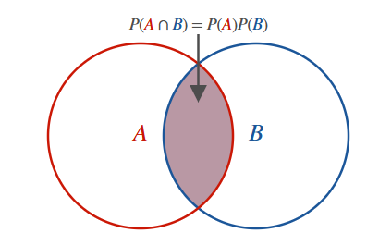
Probability Law 10: Multiplication Rule for Independent Events—Slide 2
Figure 1
The multiplication rule for independent events (Probability Law 10) is sometimes called the product rule. The rule simply states that the probability of the joint occurrence of independent events is the product of their probabilities.

Slide 9
Example 2: Finding the Probability of Independent Events—Slide 1
A coin is flipped, a die is rolled, and a card is drawn from a deck of 52 cards. Find the probability of getting tails on the coin, a five on the die, and a Jack of clubs from the deck of cards.

Slide 10
Example 2: Finding the Probability of Independent Events—Slide 2
Solution
Since the three events (flipping a coin, rolling a die, and selecting a card) are independent, we can use the product rule.
We know the following.
Therefore, we can calculate the probability as follows using the product rule.

Slide 11
Example 2: Finding the Probability of Independent Events—Slide 3
So the probability of getting tails on the coin, rolling a five on the die, and then selecting the Jack of clubs from the deck of cards is approximately 0.0016.

Slide 12
Example 3: Using the Probability of Independent Events in a Court Case—Slide 1
This is an actual case that stirred up quite a controversy.
People v. Collins (1968)
On June 18, 1964, at about 11:30 AM, Mrs. Juanita Brooks was assaulted and robbed while walking through an alley in the San Pedro area of Los Angeles. Mrs. Brooks described her assailant as a young woman with a blonde pony tail. At about the same time John Bass was watering his lawn and witnessed the assault. He described the assailant as a Caucasian woman with dark-blonde hair. As she ran from the alley she jumped into a yellow automobile driven by a black man with a mustache and a beard.

Slide 13
Example 3: Using the Probability of Independent Events in a Court Case—Slide 2
Several days later the police arrested two individuals based on the descriptions provided by the assailant and the witness. The two suspects were eventually charged with the crime. During the trial the prosecution called a professor of mathematics to testify. The prosecutor set forth the following probabilities for the characteristics of the assailants:

Slide 14
Example 3: Using the Probability of Independent Events in a Court Case—Slide 3
Table 1 – Assailant Characteristics Data
Characteristic | Probability
Yellow automobile | 0.10
Man with mustache | 0.25
Girl with ponytail | 0.10
Girl with blonde hair | 0.33
Black man with beard | 0.10
Interracial couple in a car | 0.001

Slide 15
Example 3: Using the Probability of Independent Events in a Court Case—Slide 4
How did the prosecution use these probabilities to argue its case?

Slide 16
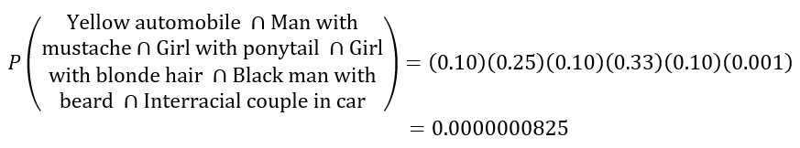
Example 3: Using the Probability of Independent Events in a Court Case—Slide 5
Solution
If the events are assumed to be independent, then the product rule can be used to calculate the likelihood of observing their joint occurrence.

Slide 17
Example 3: Using the Probability of Independent Events in a Court Case—Slide 6
Based on the product rule, the mathematician testified that there was about a 1 in 12 million chance that a couple selected at random would possess these characteristics. The prosecution added that the probability was the chance that "any other couple possessed the distinctive characteristics of the defendants." The jury convicted the defendants. On appeal, the Supreme Court of California reversed the decision, based on two main points.

Slide 18
Example 3: Using the Probability of Independent Events in a Court Case—Slide 7
First there was no proof offered that the probabilities used in the probability calculation were correct and there was no evidence that the events were independent. Second, the prosecution's evidence pertaining to a randomly selected couple was not pertinent to the problem of the existence of any other couple possessing the same characteristics.

Slide 19
Example 4: Calculating the Probability of Defective Work—Slide 1
In a production process, a product is assembled by using four independent parts (A, B, C, and D). In order for the product to operate properly, each part must be free of defects. The probability that each part is defect-free is given by P(A) = 0.9, P(B) = 0.7, P(C) = 0.8, and P(D) = 0.9.
a. What is the probability that all four parts have defects?
b. What is the probability that the product does not work?

Slide 20
Example 4: Calculating the Probability of Defective Work—Slide 2
Solution
a. Since there are four parts with the probability of each part working (i.e., being defect-free) given to be P(A) = 0.9, P(B) = 0.7, P(C) = 0.8, and P(D) = 0.9. for all parts to have defects, we need the complement for each of the parts. That is,

Slide 21
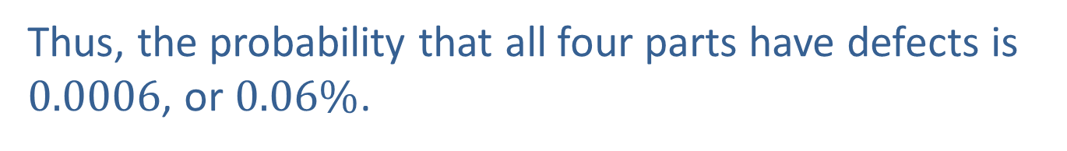
Example 4: Calculating the Probability of Defective Work—Slide 3
Since each part operates independently of the others, the probability that all four parts have defects is the product of the probabilities of each part's complement.
Thus, the probability that all four parts have defects is 0.0006, or $0.06\%$.

Slide 22
Example 4: Calculating the Probability of Defective Work—Slide 4
b. The probability that the product does not work is the probability that at least one of the parts does not work (since each part must be defect-free for the product to work).

Slide 23

Example 4: Calculating the Probability of Defective Work—Slide 5
Thus, given the above probabilities, there is nearly a $55\%$ chance that the product will not work.

Slide 24
Probability Law 11: Multiplication Rule for Dependent Events
If two events, A and B, are dependent, then

Slide 25
Example 5.4.5: Calculating the Probability of Dependent Events—Slide 1
Suppose that it is known that 30% of college students have an American Express charge card. It is also known that if a college student already has an American Express charge card, he/she also has a Citi credit card with a probability of 80%. What is the probability that a college student will have both an American Express charge card and a Citi credit card?

Slide 26

Example 5.4.5: Calculating the Probability of Dependent Events—Slide 2
Solution
Let A = {college student has an American Express charge card}
Let C = {college student has a Citi credit card}
We know that P(A) = 0.30 and we know that
Using the Multiplication Rule for Dependent Events, we
want to find
Thus, we know that $24\%$ of the college students hold both an American Express charge card and a Citi credit card.

