Slide 1
Section 5.5
Bayes' Theorem

Slide 2
Theorem: Bayes' Theorem
where B _{i} is the i ^{th} event of k mutually exclusive and collectively exhaustive events.

Slide 3
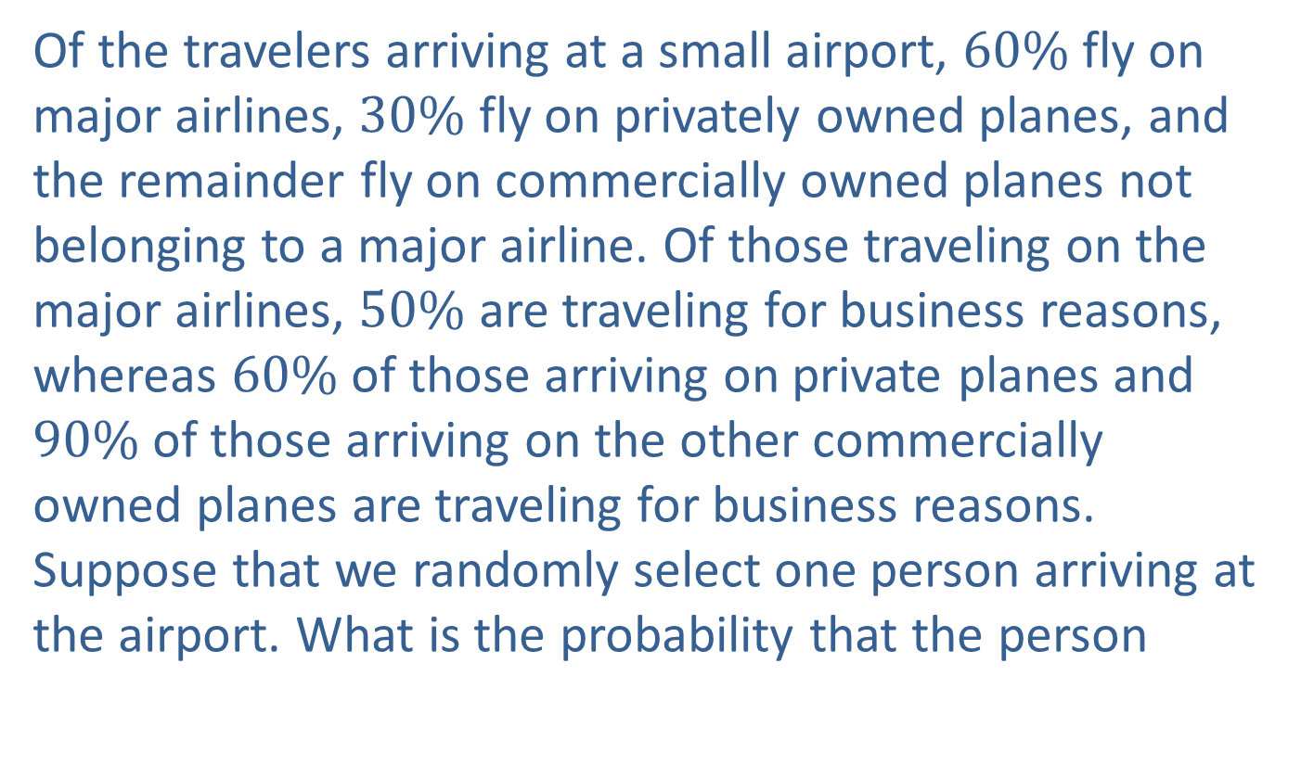
Example 1: Using Bayes' Theorem to Calculate Probabilities—Slide 1
Of the travelers arriving at a small airport, $60\%$ fly on major airlines, $30\%$ fly on privately owned planes, and the remainder fly on commercially owned planes not belonging to a major airline. Of those traveling on the major airlines, $50\%$ are traveling for business reasons, whereas $60\%$ of those arriving on private planes and $90\%$ of those arriving on the other commercially owned planes are traveling for business reasons. Suppose that we randomly select one person arriving at the airport. What is the probability that the person

Slide 4
Example 1: Using Bayes' Theorem to Calculate Probabilities—Slide 2
a. ​is traveling on business?
b. ​is traveling for business on a privately owned plane?
c. arrived on a privately owned plane given that the person is traveling for business reasons?

Slide 5
Example 1: Using Bayes' Theorem to Calculate Probabilities—Slide 3
Solution
First of all, we should define the events associated with this problem. Once we have defined the events, we can then note the probabilities that are given to us.
Let
M = Major Airline
P = Private Plane
C = Commercial Airline
B = Travel for Business Reasons.

Slide 6
Example 1: Using Bayes' Theorem to Calculate Probabilities—Slide 4
In the context of Bayes’ theorem, k = 3 for this example, since major airline, private plane, and commercial airline are the only ways in which travelers can arrive at the airport, and a particular passenger cannot arrive on more than one type of airplane (thus M, P, and C are mutually exclusive and exhaustive events). When we apply the theorem,

Slide 7
Example 1: Using Bayes' Theorem to Calculate Probabilities—Slide 5
a. The first question asks what the probability is that a randomly selected person is traveling on business. We know that a person is traveling on business if they are traveling on business via any of the flight methods. Thus we have

Slide 8

Example 1: Using Bayes' Theorem to Calculate Probabilities—Slide 6
Thus, there is a $57\%$ chance that the randomly selected traveler will be traveling for business.

Slide 9

Example 1: Using Bayes' Theorem to Calculate Probabilities—Slide 7
b. To determine if the traveler is traveling for business on a privately owned plane, we want to find
So, there is an $18\%$ chance that the traveler will be traveling for business on a privately owned plane.
c. This part of the problem wants us to determine the probability that the person arrived on a privately owned plane, given that he or she is traveling for business reasons. We can write this probability statement as

Slide 10
Example 1: Using Bayes' Theorem to Calculate Probabilities—Slide 8
​By the definition of conditional probability, we can write
From the items calculated in parts a. and b., we know

Slide 11
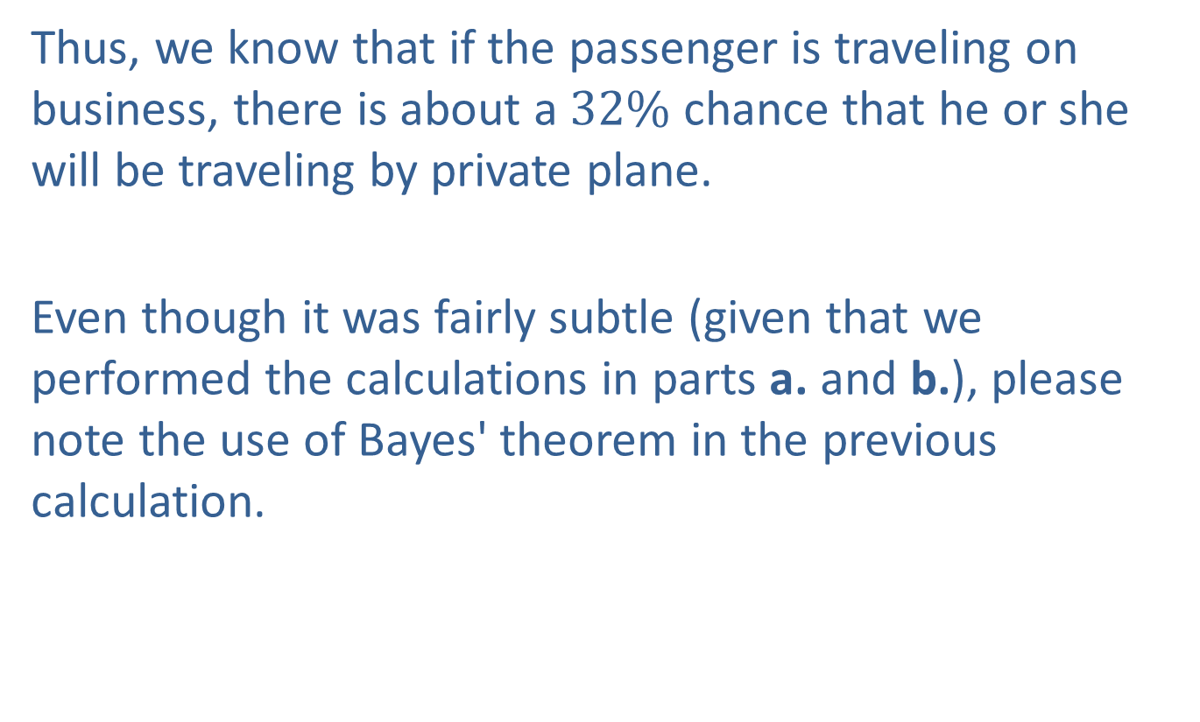
Example 1: Using Bayes' Theorem to Calculate Probabilities—Slide 9
Thus, we know that if the passenger is traveling on business, there is about a $32\%$ chance that he or she will be traveling by private plane.
Even though it was fairly subtle (given that we performed the calculations in parts a. and b.), please note the use of Bayes' theorem in the previous calculation.

