Slide 1
Section 5.6
Counting Techniques

Slide 2
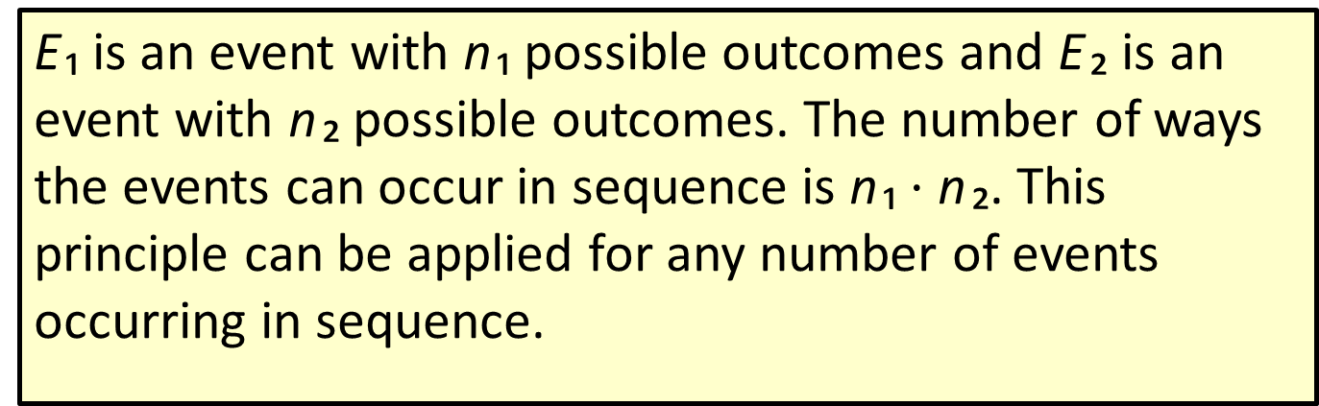
Theorem: Fundamental Counting Principle
E ₁ is an event with n ₁ possible outcomes and E ₂ is an event with n ₂ possible outcomes. The number of ways the events can occur in sequence is n ₁ $⋅$ n ₂. This principle can be applied for any number of events occurring in sequence.

Slide 3
Example 1: Using the Fundamental Counting Principle to Count Employees
A local bank has three branches. Each branch has four departments and each department has two employees. How many employees does the bank have?
Solution
Thus, the bank has 24 total employees.

Slide 4
Example 2: Using the Fundamental Counting Principle to Count License Plates—Slide 1
Nonpersonalized license plates in the state of Utah consist of three numbers followed by three letters (excluding I, O, and Q). How many license plates are possible?

Slide 5

Example 2: Using the Fundamental Counting Principle to Count License Plates—Slide 2
Solution
There are ten digits ($0–9$) possible for each of the first three characters. Likewise, there are 23 letters possible for the last three characters. Therefore, we have the following.

Slide 6
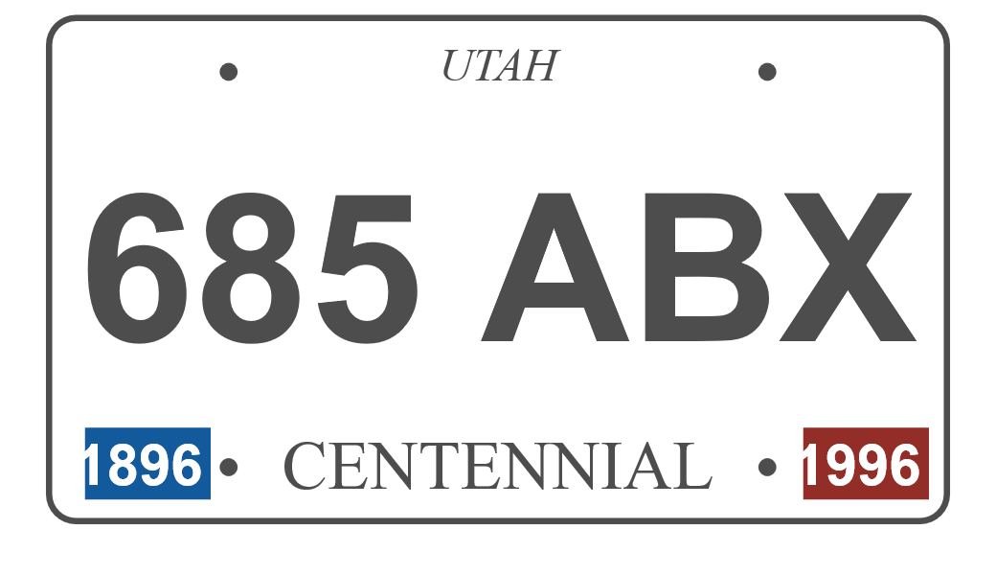
Example 2: Using the Fundamental Counting Principle to Count License Plates—Slide 3
Therefore, there are 12,167,000 possible nonpersonalized license plates in the state of Utah.

Slide 7
Example 3: Using the Fundamental Counting Principle to Count Arrangements—Slide 1
You have a stack of 5 textbooks: English, History, Statistics, Geology, and Psychology. How many ways can you arrange these textbooks on a shelf?

Slide 8
Example 3: Using the Fundamental Counting Principle to Count Arrangements—Slide 2
Solution
Because you can put each book on the bookshelf only once, you have five possible choices for the first book. Similarly, there are four possible choices for the second book, three possible choices for the third book, two possible choices for the fourth book, and only one book left for the fifth book. Using the Fundamental Counting Principle, we have

Slide 9
Formula: Factorial
Suppose n is a positive whole number. Then,

Slide 10
Definition: Combination
A combination is a collection or grouping of objects where the order is not important.

Slide 11
Formula: Combination
The number of combinations of n unique objects taken k at a time is:
Note that some alternate notations for combinations
that you may see are
All of these
denote the number of combinations of n objects taken k at a time.

Slide 12
Example 4: Using Combinations to Find the Probability of Winning the Lottery—Slide 1
In the Mega Millions lottery, a player selects five different numbers from 1 to 70 (inclusive) and then another (a sixth number, called the Mega Ball) from 1 to 25 (inclusive). If the first five numbers match the player's numbers in any order along with the Mega Ball number, the player wins the jackpot.
a. What is the total number of winning combinations?
b. What is the probability of winning?

Slide 13
Example 4: Using Combinations to Find the Probability of Winning the Lottery—Slide 2
Solution
a. First, we have to determine the number of ways of selecting 5 numbers from 70. Then, we have to multiply the number of combinations of choosing 5 numbers from 70 by 25, the number of ways you can select the Mega Ball. Thus, we have the following.

Slide 14
Example 4: Using Combinations to Find the Probability of Winning the Lottery—Slide 3
So, the total number of winning combinations is
b. The probability of winning with any one combination is
which is approximately 0.0000. The actual probability is 0.000000003305.

Slide 15
Definition: Permutation
A permutation is a specific order or arrangement of objects in a set.
There are
permutations of n unique objects.

Slide 16
Example 5: Using Permutations to Find the Number of Different Sequences—Slide 1
To complete your holiday shopping, you need to go to the bakery, department store, grocery store, and toy store. If you are going to visit the stores in sequence, how many different sequences exist?

Slide 17
Example 5: Using Permutations to Find the Number of Different Sequences—Slide 2
Solution
This is a permutation problem because order matters. By the permutation definition there are

Slide 18
Example 6: Using Permutations to Find the Number of Different Codes—Slide 1
At a local fast food restaurant, the door to the kitchen is secured by a five-button lock, labeled 1, 2, 3, 4, 5. To open the door, the correct three-digit code must be pushed but each button can only be pushed once. How many different codes are possible?

Slide 19
Example 6: Using Permutations to Find the Number of Different Codes—Slide 2
Solution
This is a permutation problem of 5 objects, but we are taking only 3 at a time. There are 5 buttons available for the first character in the code, 4 for the second, and 3 for the third. Therefore, there are

Slide 20
Formula: Permutations
The number of permutations of n unique objects taken k at a time is
Note that some alternate notations for permutations
that you may see are
All of these
denote the number of permutations of n objects taken k at a time.

Slide 21
Example 7: Using Permutations to Find the Number of Ways Bids are Selected—Slide 1
Seven bids are placed for a commercial construction job and three will be selected in order of quality. How many ways can the bids be selected in first, second, and third place?

Slide 22
Example 7: Using Permutations to Find the Number of Ways Bids are Selected—Slide 2
Solution
Because we have seven bids and the order (first, second, third) is important, we need to find the number of permutations of 7 objects taken 3 at a time.

Slide 23
Formula: Distinguishable Permutations
If given n objects, with
then the number of distinguishable permutations of all n objects is

Slide 24
Example 8: Finding the Number of Distinguishable Permutations—Slide 1
How many distinguishable permutations can be made from the word Mississippi?

Slide 25
Example 8: Finding the Number of Distinguishable Permutations—Slide 2
Solution
There are 11 letters in the word Mississippi, one M, four I's, four S's, and two P's. So, there are
distinguishable permutations of the letters in Mississippi.

