Slide 1
Section 6.2
Discrete Random Variables

Slide 2
Definition: Discrete Probability Distribution
A discrete probability distribution consists of all possible values of the discrete random variable along with their associated probabilities.

Slide 3
Properties of Discrete Probability Distributions
1. The sum of all the probabilities must equal 1. That is,
2. The probability of any value must be between 0 and 1, inclusively. That is,
3. The probabilities are additive. That is,

Slide 4
Example 1: Determining the Probability Distribution of Three Coin Tosses—Slide 1
Consider the random phenomenon of tossing a fair coin three times and counting the number of heads. Since the coin is assumed to be fair, P(H) = P(T) = 0.5. What is the probability distribution for the number of heads observed in three tosses of a coin?

Slide 5
Example 1: Determining the Probability Distribution of Three Coin Tosses—Slide 2
Solution
The random variable is X = the number of heads in three tosses of a coin.

Slide 6
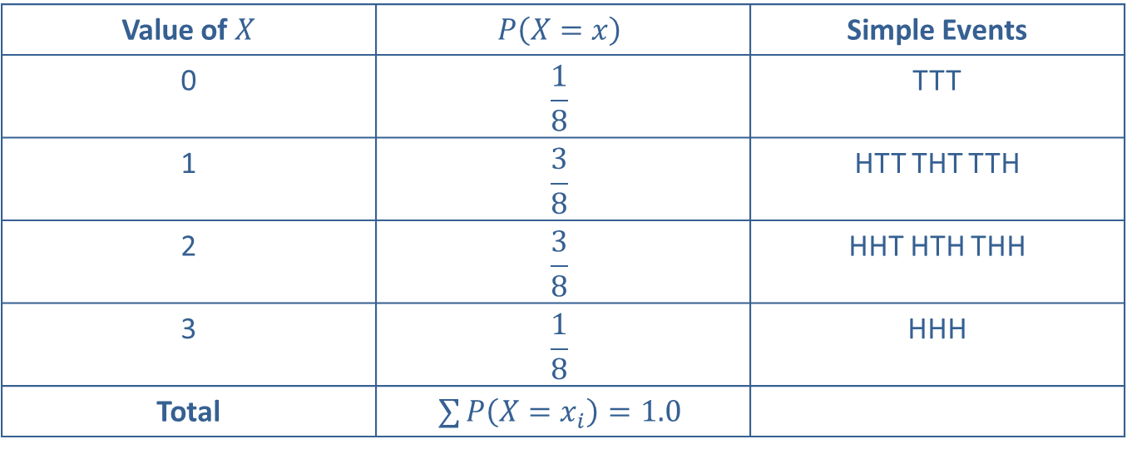
Example 1: Determining the Probability Distribution of Three Coin Tosses—Slide 3
Table 1 – Tossing a Coin
Value of $X$ | $$P\left(X=x\right)$$ | Simple Events
0 | $$\frac{1}{8}$$ | TTT
1 | $$\frac{3}{8}$$ | HTT THT TTH
2 | $$\frac{3}{8}$$ | HHT HTH THH
3 | $$\frac{1}{8}$$ | HHH
Total | $$∑P\left(X=x_{i}\right)=1.0$$
The probabilities given in Table 1 can be deduced using the classical approach to probability.

Slide 7
Example 2: Determining the Probability Distribution of Daily Sales—Slide 1
K. J. Johnson is a computer salesperson. During the last year he has kept records of his computer sales for the last 200 days. He recognizes that his daily sales constitute a random process and he wishes to determine the probability distribution for daily sales. Then, from the probability distribution, he would like to know what the probability is that he will sell
a. at least 2 computers each day
b. at most two computers each day.

Slide 8
Example 2: Determining the Probability Distribution of Daily Sales—Slide 2
Solution
The random variable is X = the number of computers sold each day.
Table 2 – Frequency Distribution
Sales | Frequency
0 | 40
1 | 20
2 | 60
3 | 40
4 | 40

Slide 9
Example 2: Determining the Probability Distribution of Daily Sales—Slide 3
The probabilities for this random variable are computed in Table 3 based upon 200 days of sales data obtained from Mr. Johnson's records using the relative frequency approach.

Slide 10
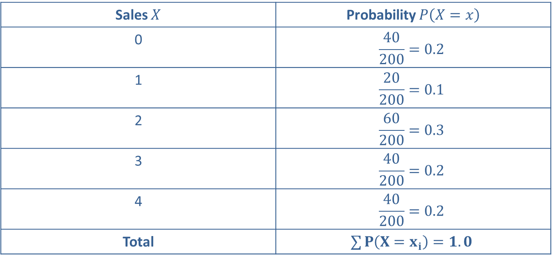
Example 2: Determining the Probability Distribution of Daily Sales—Slide 4
Table 3 – Probability Distribution
Sales $X$ | Probability $P\left(X=x\right)$
0 | $$\frac{40}{200}=0.2$$
1 | $$\frac{20}{200}=0.1$$
2 | $$\frac{60}{200}=0.3$$
3 | $$\frac{40}{200}=0.2$$
4 | $$\frac{40}{200}=0.2$$
Total | $$∑P\left(X=x_{i}\right)=1.0$$

Slide 11
Example 2: Determining the Probability Distribution of Daily Sales—Slide 5
a. The probability that Mr. Johnson will sell at least 2 computers each day is calculated as follows.
​b. ​To find the probability that Mr. Johnson will sell at most 2 computers each day, the calculation is as follows.

Slide 12
Example 3: Determining the Probability Distribution of Callers Placing an Order—Slide 1
Phone operators of a TV shopping network usually receive about three calls per minute from interested shoppers. Suppose we are interested in the next three telephone calls and the number of callers that place an order. The probability distribution was created based on historical data. Given the probability distribution, what is the probability that at least one caller will purchase something each minute?
X = the number of callers that place an order

Slide 13
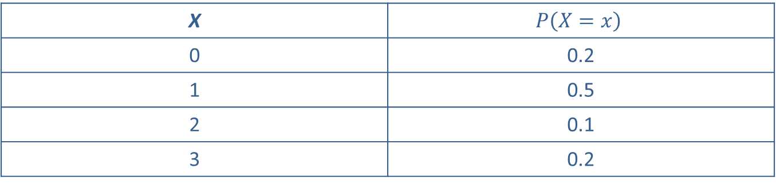
Example 3: Determining the Probability Distribution of Callers Placing an Order—Slide 2
Table 4 – Caller Data
X | $$P\left(X=x\right)$$
0 | 0.2
1 | 0.5
2 | 0.1
3 | 0.2

Slide 14

Example 3: Determining the Probability Distribution of Callers Placing an Order—Slide 3
Solution
The probability that at least one caller will purchase something is:
Thus, the probability that at least one caller will purchase an item is $80\%$.

Slide 15
Definition: Probability Distribution Function
A probability distribution function assigns a probability to each value of a random variable.

Slide 16
Example 4: Evaluating a Probability Distribution Given as a Function—Slide 1
The following function is a discrete probability distribution function.
Summarize the probability distribution for this function.
Summarize the probability distribution for this function.

Slide 17
Example 4: Evaluating a Probability Distribution Given as a Function—Slide 2
Solution
To determine the probability for a value, use the value as the argument to the function. For example, to determine the probability that X = 3, calculate the following.
The probability that X = 4 can be computed in the same way.

Slide 18
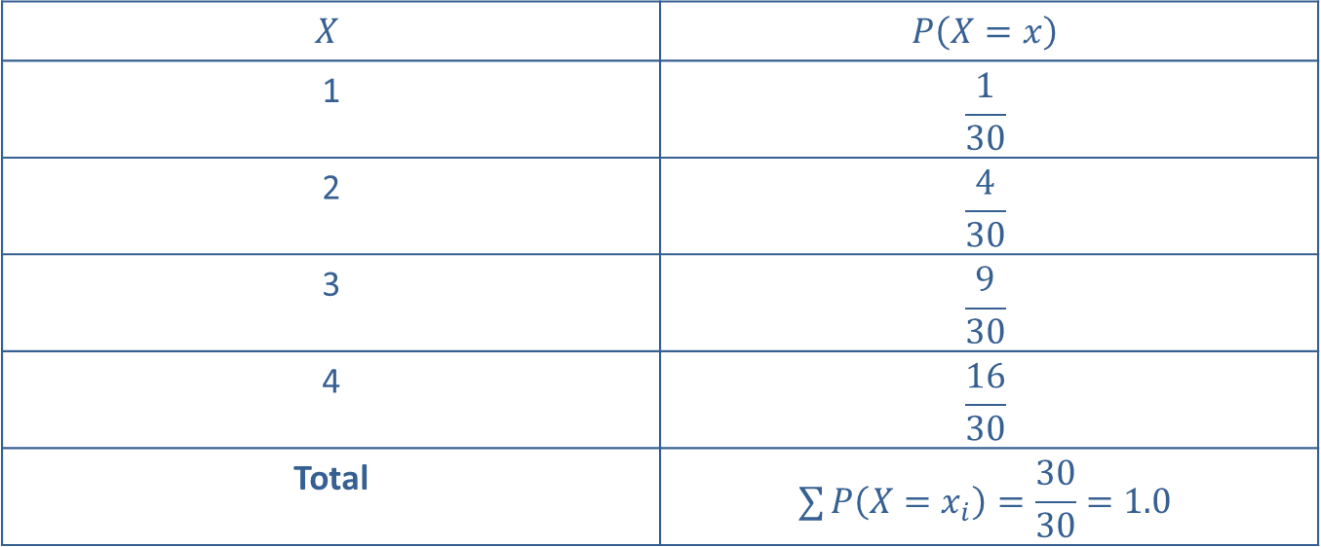
Example 4: Evaluating a Probability Distribution Given as a Function—Slide 3
The resulting probability distribution is summarized in Table 5.
Table 5 – Probability Distribution
$$X$$ | $$P\left(X=x\right)$$
1 | $$\frac{1}{30}$$
2 | $$\frac{4}{30}$$
3 | $$\frac{9}{30}$$
4 | $$\frac{16}{30}$$
Total | $$∑P\left(X=x_{i}\right)=\frac{30}{30}=1.0$$

Slide 19
Example 4: Evaluating a Probability Distribution Given as a Function—Slide 4
Note that the distribution possesses the essential properties of all probability distributions; that is, the probabilities sum to one, and all the probabilities are between 0 and 1.

Slide 20
Formula: Expected Value
The expected value of a discrete random variable X is the mean of the random variable X. It is denoted E(X) and is given by computing the expression

Slide 21
Expected Value—Slide 1
Essentially the expected value is a weighted average, in which each possible value of the random variable is weighted by its probability.
Table 6 – Calculating K.J. Johnson's Expected Number of Sales per Day
X | p(X) | xp(X)
0 | 0.2 | 0
1 | 0.1 | 0.1
2 | 0.3 | 0.6
3 | 0.2 | 0.6
4 | 0.2 | 0.8
 | Total | E(X) = 2.1

Slide 22
Expected Value—Slide 2
The expected value of the probability distribution given in Example 2 is computed in Table 6. In the long run, K.J. Johnson will average 2.1 sales per day, which is the expected value of the probability distribution of K.J. Johnson’s daily sales. That is, the expected value of a distribution can be considered the long run average of that distribution.

Slide 23
Example 5: Comparing Alternatives Using Expected Values—Slide 1
Suppose you are confronted with two investment alternatives that possess uncertain outcomes described by the probability distributions given in Table 7.

Slide 24
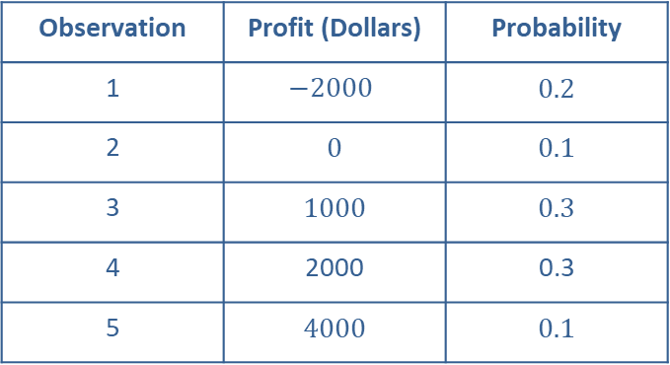
Example 5: Comparing Alternatives Using Expected Values—Slide 2
Solution
Table 7 – Investment Alternatives – Option A
Observation | Profit (Dollars) | Probability
1 | $$−2000$$ | 0.2
2 | 0 | 0.1
3 | 1000 | 0.3
4 | 2000 | 0.3
5 | 4000 | 0.1

Slide 25
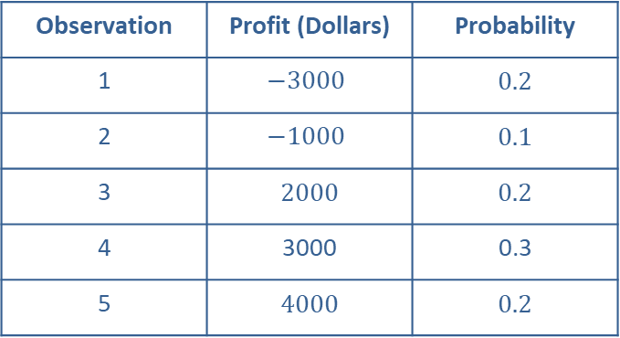
Example 5: Comparing Alternatives Using Expected Values—Slide 3
Table 7 – Investment Alternatives – Option B
Observation | Profit (Dollars) | Probability
1 | $$−3000$$ | 0.2
2 | $$−1000$$ | 0.1
3 | 2000 | 0.2
4 | 3000 | 0.3
5 | 4000 | 0.2

Slide 26
Example 5: Comparing Alternatives Using Expected Values—Slide 4
Because of the randomness of the profit variable, it is difficult to evaluate the investments by merely eyeballing the two distributions. However, by calculating the expected values of the two alternatives the information in each distribution is condensed to a single point. This point characterizes the center of the distribution and facilitates comparison. The expected values of Options A and B are $900 and $1400, respectively. Thus, in the long run Option B would be $500 more profitable.

Slide 27
Variance of a Discrete Random Variable—Slide 1
In Example 5, while Option B has a greater expected value, it may differ in risk from Option A. Option B offers a greater chance of making a substantial gain, but it also has the potential for significant loss. The expected value of a distribution measures only one dimension of the random variable, namely its central value.
To gauge the variability of a random variable we need another measure similar to the variance measure previously constructed, but which accounts for the difference in probabilities of the variable.

Slide 28
Formula: Variance
The variance of a discrete random variable X is given by the following formula.

Slide 29
Variance of a Discrete Random Variable—Slide 2
Once again, the variance can be considered an average. In this case it is the weighted average of the squared deviations about the mean. This is very similar to the computations for the sample variance (s²) and population variance (σ²) given by
respectively. The larger the variance, the more variability in the outcomes.
To manually compute the variance of the random variable, it’s often a good idea to construct a table.

Slide 30
Example 6: Calculating the Variance of a Random Variable—Slide 1
The calculation of the variances of the random variables described in Example 5 are given in Tables 8 and 9.

Slide 31
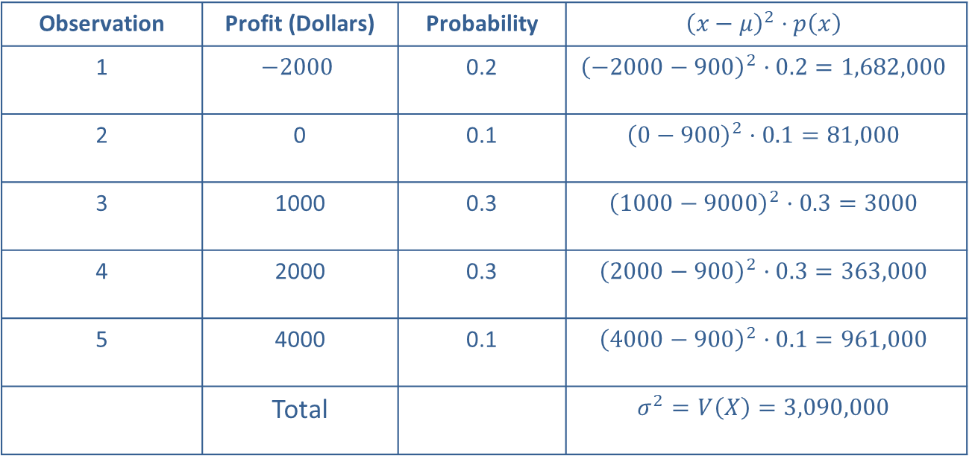
Example 6: Calculating the Variance of a Random Variable—Slide 2
Solution
Table 8 – Variance of Option A
Observation | Profit (Dollars) | Probability | $${\left(x−μ\right)}^{2}⋅p\left(x\right)$$
1 | $$−2000$$ | 0.2 | $${\left(−2000−900\right)}^{2}·0.2=1,682,000$$
2 | 0 | 0.1 | $${\left(0−900\right)}^{2}·0.1=81,000$$
3 | 1000 | 0.3 | $${\left(1000−9000\right)}^{2}·0.3=3000$$
4 | 2000 | 0.3 | $${\left(2000−900\right)}^{2}·0.3=363,000$$
5 | 4000 | 0.1 | $${\left(4000−900\right)}^{2}·0.1=961,000$$
 | Total |  | $$σ^{2}=V\left(X\right)=3,090,000$$

Slide 32
Example 6: Calculating the Variance of a Random Variable—Slide 3
The standard deviation is computed by taking the square root of the variance. In this instance, the standard deviation of Option A is given by

Slide 33
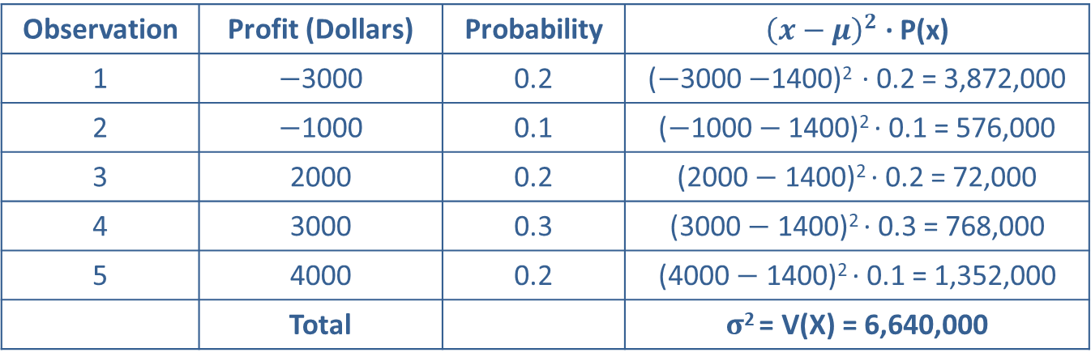
Example 6: Calculating the Variance of a Random Variable—Slide 4
Table 9 – Variance of Option B
Observation | Profit (Dollars) | Probability | ${\left(x−μ\right)}^{2}$ · P(x)
1 | $−$3000 | 0.2 | ($−$3000 $−$1400)² · 0.2 = 3,872,000
2 | $−$1000 | 0.1 | ($−$1000$−$ 1400)² · 0.1 = 576,000
3 | 2000 | 0.2 | (2000 $−$ 1400)² · 0.2 = 72,000
4 | 3000 | 0.3 | (3000 $−$ 1400)² · 0.3 = 768,000
5 | 4000 | 0.2 | (4000 $−$ 1400)² · 0.1 = 1,352,000
 | Total |  | $σ$² = V(X) = 6,640,000
the standard deviation of Option B is given by

Slide 34
Example 6: Calculating the Variance of a Random Variable—Slide 5
A larger standard deviation reflects greater variability in profits and increased risk. When risk is considered, the decision becomes more difficult. The option with the largest expected value (Option B) is also the option with the greatest risk. Hence, the decision maker must subjectively evaluate the trade-off between greater expected return and increased risk.

Slide 35
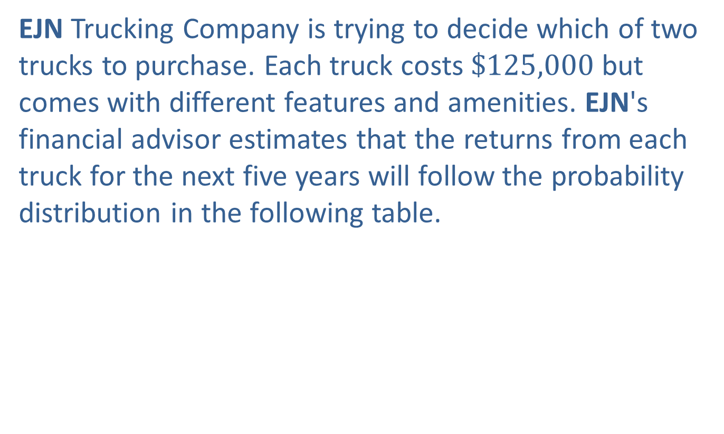
Example 7: Determining Which Truck to Purchase—Slide 1
EJN Trucking Company is trying to decide which of two trucks to purchase. Each truck costs $\$125,000$ but comes with different features and amenities. EJN's financial advisor estimates that the returns from each truck for the next five years will follow the probability distribution in the following table.

Slide 36
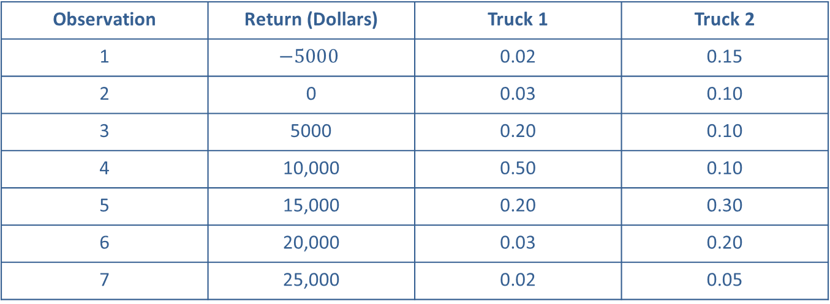
Example 7: Determining Which Truck to Purchase—Slide 2
Table 10 – Return on Truck Purchase
Observation | Return (Dollars) | Truck 1 | Truck 2
1 | $$−5000$$ | 0.02 | 0.15
2 | 0 | 0.03 | 0.10
3 | 5000 | 0.20 | 0.10
4 | 10,000 | 0.50 | 0.10
5 | 15,000 | 0.20 | 0.30
6 | 20,000 | 0.03 | 0.20
7 | 25,000 | 0.02 | 0.05

Slide 37
Example 7: Determining Which Truck to Purchase—Slide 3
Calculate the expected return and standard deviation for each truck and recommend which truck to purchase.

Slide 38
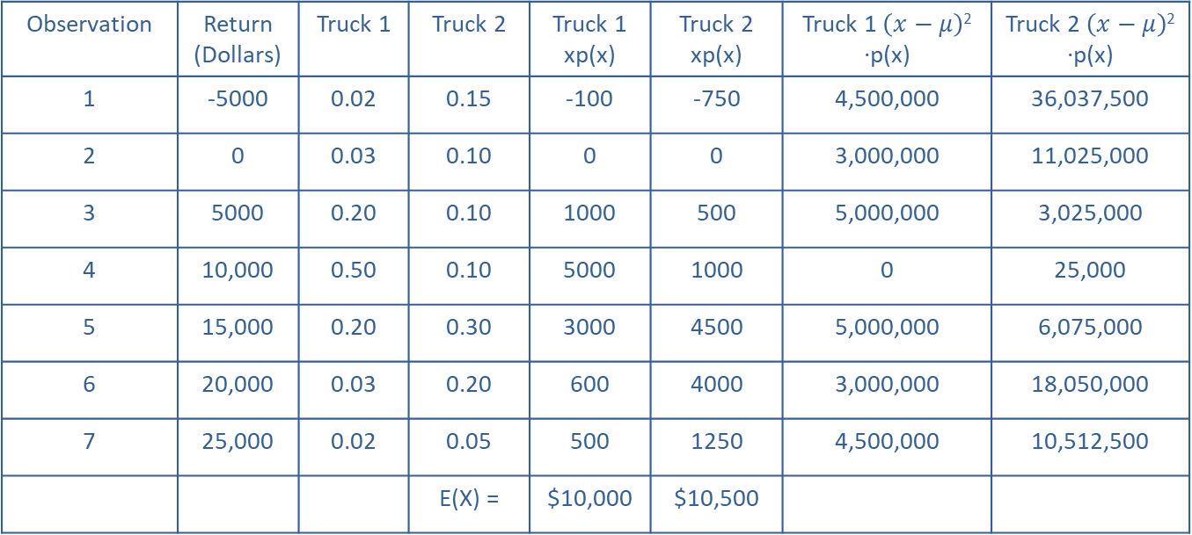
Example 7: Determining Which Truck to Purchase—Slide 4
Table 11 - Calculations
Observation | Return (Dollars) | Truck 1 | Truck 2 | Truck 1 xp(x) | Truck 2 xp(x) | Truck 1 $\left(x−μ\right)$² ·p(x) | Truck 2 $\left(x−μ\right)$² ·p(x)
1 | -5000 | 0.02 | 0.15 | -100 | -750 | 4,500,000 | 36,037,500
2 | 0 | 0.03 | 0.10 | 0 | 0 | 3,000,000 | 11,025,000
3 | 5000 | 0.20 | 0.10 | 1000 | 500 | 5,000,000 | 3,025,000
4 | 10,000 | 0.50 | 0.10 | 5000 | 1000 | 0 | 25,000
5 | 15,000 | 0.20 | 0.30 | 3000 | 4500 | 5,000,000 | 6,075,000
6 | 20,000 | 0.03 | 0.20 | 600 | 4000 | 3,000,000 | 18,050,000
7 | 25,000 | 0.02 | 0.05 | 500 | 1250 | 4,500,000 | 10,512,500
 |  |  | E(X) = | $10,000 | $10,500

Slide 39
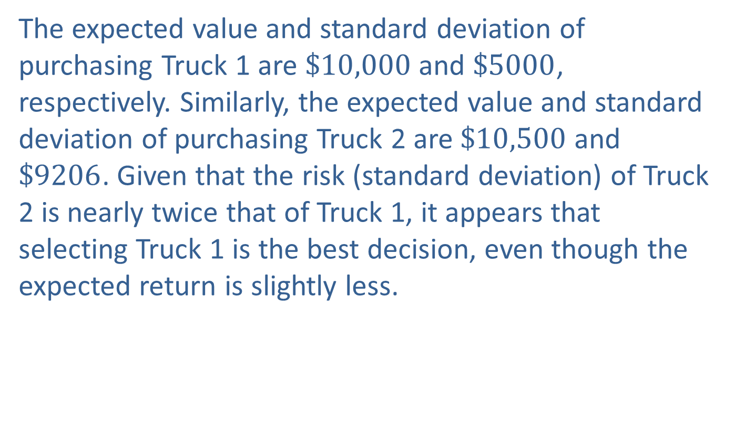
Example 7: Determining Which Truck to Purchase—Slide 5
The expected value and standard deviation of purchasing Truck 1 are $\$10,000$ and $\$5000$, respectively. Similarly, the expected value and standard deviation of purchasing Truck 2 are $\$10,500$ and $\$9206$. Given that the risk (standard deviation) of Truck 2 is nearly twice that of Truck 1, it appears that selecting Truck 1 is the best decision, even though the expected return is slightly less.

