Slide 1
Section 6.3
The Discrete Uniform Distribution

Slide 2
Definition: Discrete Uniform Probability Distribution Function
Mathematically, the discrete uniform probability distribution function is given by
where n = the number of values that the random variable may assume.

Slide 3
Example 1: Determining the Probability Distribution of Throwing a Die—Slide 1
What is the probability distribution for the outcome of the throw of a single six-sided die?

Slide 4
Example 1: Determining the Probability Distribution of Throwing a Die—Slide 2
Solution
If the die is fair, then each of the outcomes is equally likely, and thus we have a discrete uniform distribution in which all probabilities equal
The probability
distribution is given in Table 1.

Slide 5
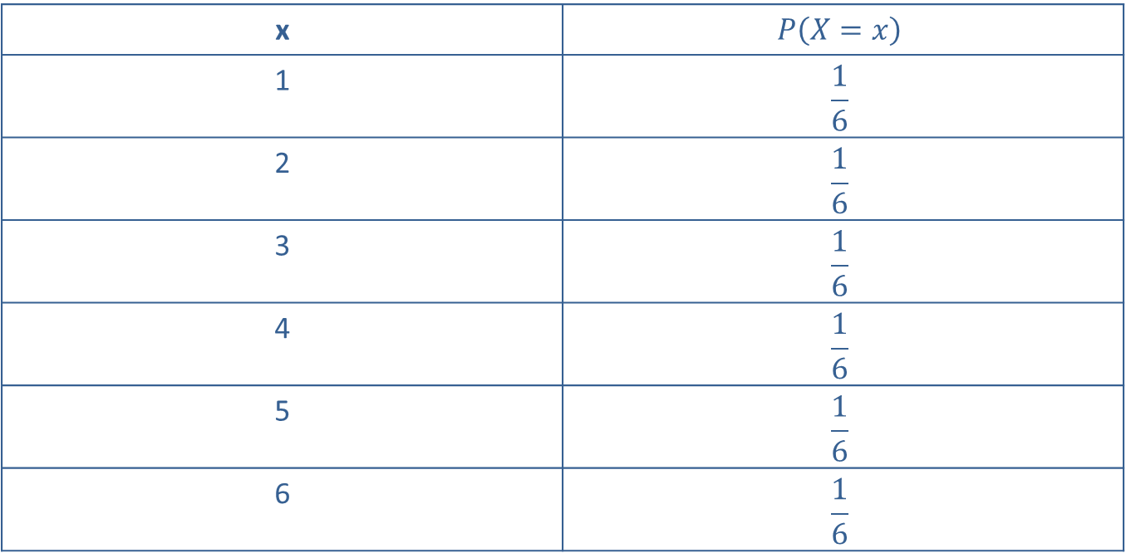
Example 1: Determining the Probability Distribution of Throwing a Die—Slide 3
Table 1 – Throwing a Die
x | $$P\left(X=x\right)$$
1 | $$\frac{1}{6}$$
2 | $$\frac{1}{6}$$
3 | $$\frac{1}{6}$$
4 | $$\frac{1}{6}$$
5 | $$\frac{1}{6}$$
6 | $$\frac{1}{6}$$

Slide 6
Example 2—Slide 1
In many college and professional sports, athletes are randomly selected to undergo drug testing. Cameron is on a college basketball team that has 12 players which will randomly select one player to undergo drug testing. What is the chance that Cameron will be chosen to be tested?

Slide 7
Example 2—Slide 2
Solution
Since the players are chosen at random, the chance of any player being selected is
Thus, Cameron's chance
of being selected to undergo drug testing is

Slide 8
Example 3: Determining the Probability Distribution of Delivery Time—Slide 1
Suppose a purchasing agent has just received a pricing and delivery schedule from a new vendor. The delivery schedule was quoted as 1 to 4 weeks.
a. Construct the probability distribution for the time until delivery.
b. Calculate the expected value and standard deviation of delivery time.

Slide 9
Example 3: Determining the Probability Distribution of Delivery Time—Slide 2
Solution
a. The probabilities of the random variable X = the number of weeks until delivery are given in Table 2.
​

Slide 10
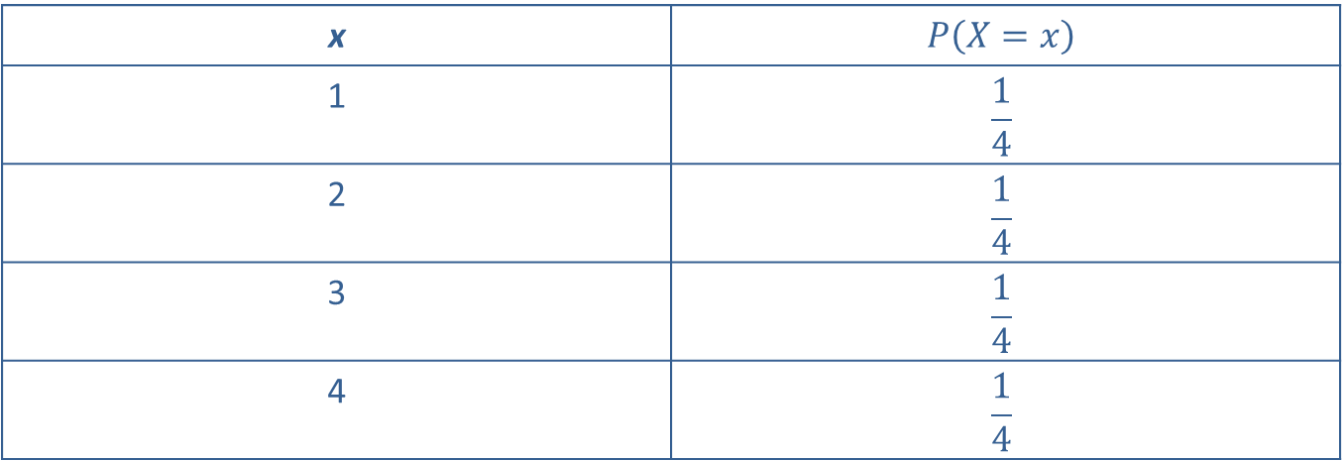
Example 3: Determining the Probability Distribution of Delivery Time—Slide 3
Table 2 – Delivery Distribution
x | $$P\left(X=x\right)$$
1 | $$\frac{1}{4}$$
2 | $$\frac{1}{4}$$
3 | $$\frac{1}{4}$$
4 | $$\frac{1}{4}$$

Slide 11
Example 3: Determining the Probability Distribution of Delivery Time—Slide 4
​Without any prior information, the agent believes any time frame is as likely as any other. Hence, the number of weeks until delivery will be assumed to have a discrete uniform distribution. Over time the purchasing agent will undoubtedly revise the distribution as more information is gathered about the company's delivery schedule.

Slide 12
Example 3: Determining the Probability Distribution of Delivery Time—Slide 5
b. The expected value is calculated as follows.

Slide 13
Example 3: Determining the Probability Distribution of Delivery Time—Slide 6
​The variance is calculated as follows.
Therefore, the standard deviation is

Slide 14
Example 3: Determining the Probability Distribution of Delivery Time—Slide 7
Example 3 illustrates an important principle in the application of the discrete uniform distribution. That is, when there is little or no information concerning the outcome of a random variable, the discrete uniform distribution may be a reasonable initial alternative.

