Slide 1
Section 6.4
The Binomial Distribution

Slide 2
Definition: Binomial Experiment
A binomial experiment is a random experiment which satisfies all of the following conditions.
1. ​There are only two outcomes in each trial of the experiment. (One of the outcomes is usually referred to as a success, and the other as a failure.)
2. ​The experiment consists of n identical trials as described in Condition 1.
3. ​The probability of success on any one trial is denoted by p and does not change from trial to trial. (Note that the probability of a failure is (1 − p) and also does not change from trial to trial.)
4. ​The trials are independent.
5. ​The binomial random variable is the count of the number of successes in n trials.

Slide 3
Example 1: Identifying a Binomial Random Variable—Slide 1
Toss a coin 4 times and record the number of heads. Is the number of heads in 4 tosses a binomial random variable?

Slide 4
Example 1: Identifying a Binomial Random Variable—Slide 2
Solution
1. There are only two outcomes, heads or tails.
2. The experiment will consist of 4 tosses of a coin. (Hence, n = 4.)
3. ​The probability of getting a head (success) is
and does not
change from trial to trial.
4. The outcome of one toss will not affect other tosses.
5. The variable of interest is the count of the number of heads in 4 tosses.
All the conditions of a binomial experiment are met, so the number of heads in 4 tosses of a coin is a binomial random variable.

Slide 5
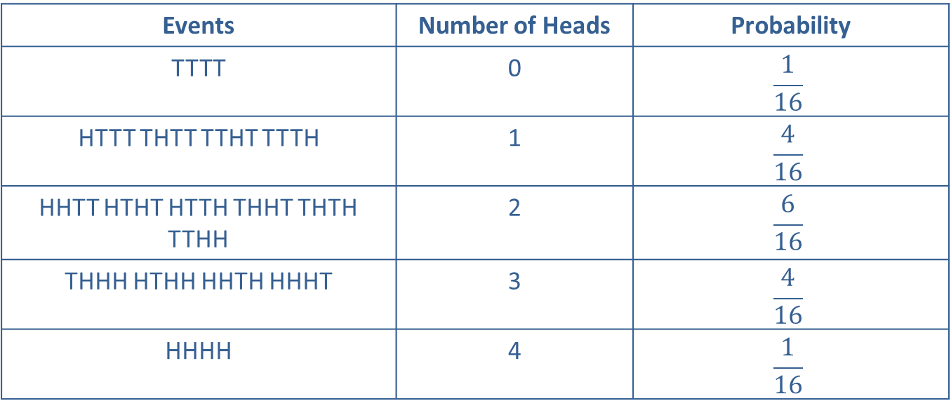
Example 1: Identifying a Binomial Random Variable—Slide 3
The probability distribution for this experiment is given in the following table.
Table – Tossing a Coin
Events | Number of Heads | Probability
TTTT | 0 | $$\frac{1}{16}$$
HTTT THTT TTHT TTTH | 1 | $$\frac{4}{16}$$
HHTT HTHT HTTH THHT THTH TTHH | 2 | $$\frac{6}{16}$$
THHH HTHH HHTH HHHT | 3 | $$\frac{4}{16}$$
HHHH | 4 | $$\frac{1}{16}$$

Slide 6
Binomial Probability Distribution—Slide 1
Instead of tossing the coin 4 times, suppose the coin is tossed 10 times in the experiment. The number of simple events for an experiment with 10 tosses would be 1024, and an experiment with 20 tosses would require listing a staggering 1,048,576 simple events.
Fortunately, there is a far simpler method of obtaining the probability distribution. The binomial probability distribution function provides a relatively simple method of calculating binomial probabilities.

Slide 7
Binomial Probability Distribution—Slide 2
To calculate a binomial probability, the parameters of the distribution (n and p) as well as the value of the random variable must be specified. For example, to determine the probability of 3 heads in 4 tosses of a coin, you would
substitute the values X = 3, n = 4, and
binomial probability distribution function as follows.

Slide 8
Binomial Probability Distribution—Slide 3
The probability that 2 heads would be computed in a similar manner.
The complete distribution can be computed by substituting the remaining values of the random variable into the probability distribution function.

Slide 9
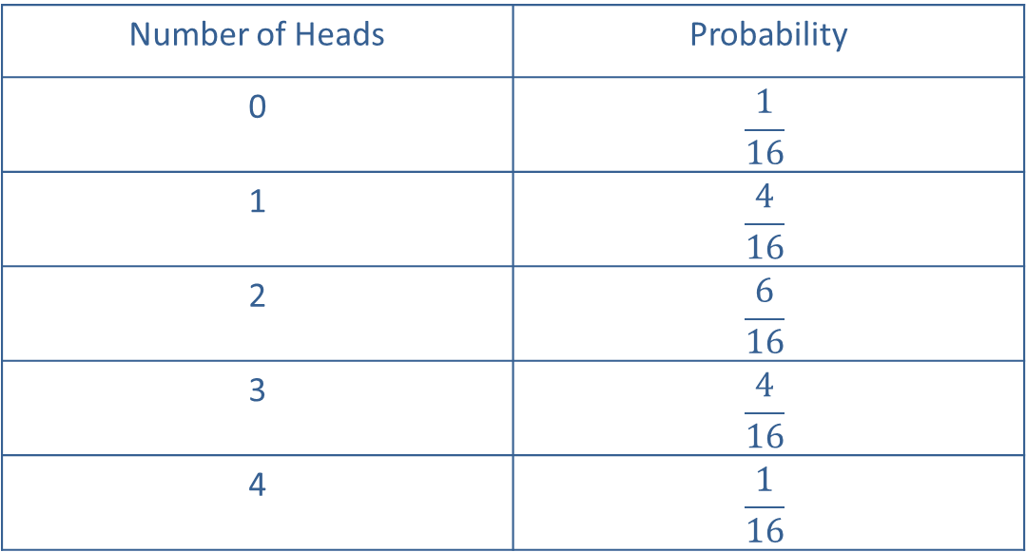
Binomial Probability Distribution—Slide 4
Table 2 – Tossing a Coin
Number of Heads | Probability
0 | $$\frac{1}{16}$$
1 | $$\frac{4}{16}$$
2 | $$\frac{6}{16}$$
3 | $$\frac{4}{16}$$
4 | $$\frac{1}{16}$$

Slide 10
Binomial Probability Distribution—Slide 5
The coin toss is a classical binomial experiment easily related to the rules of a binomial experiment. In many instances the relationship of an experiment to the binomial definition is not as clear.

Slide 11
Formula: Binomial Probability Distribution Function
The binomial probability distribution function is
represents the number of possible
combinations of n objects taken x at a time (without replacement) and is given by
n = the number of trials,
p = the probability of a success, and
x = the number of successes in n trials.

Slide 12
Example 2: Constructing the Probability Distribution for a Binomial Random Variable—Slide 1
Roll a single six-sided die 4 times and record the number of sixes observed. Does the number of sixes rolled in 4 tosses of a die meet the conditions required of a binomial random variable? Construct the probability distribution for this experiment.

Slide 13
Example 2: Constructing the Probability Distribution for a Binomial Random Variable—Slide 2
Solution
1. The experiment either produces a six or does not, and thus satisfies the two outcome requirement. (At first glance, there appears to be a problem. There are six sides to a die and there would appear to be six possible outcomes rather than the two required for a single trial of a binomial experiment.)
2. The experiment is repeated 4 times. (Hence, n = 4.)
3. The probability remains constant from trial to trial. (One roll of the die does not affect other rolls.)

Slide 14
Example 2: Constructing the Probability Distribution for a Binomial Random Variable—Slide 3
4. ​If X is the number of sixes in 4 rolls, then it has a binomial distribution. To obtain the probability distribution for X, use the binomial probability distribution function with parameters n = 4 and

Slide 15
Example 2: Constructing the Probability Distribution for a Binomial Random Variable—Slide 4
Table 2 – Throwing a Die
Number of Sixes, x | Probability
0 | 0.4823
1 | 0.3858
2 | 0.1157
3 | 0.0154
4 | 0.0008

Slide 16
Example 2: Constructing the Probability Distribution for a Binomial Random Variable—Slide 5
The calculations required to produce the distribution were reasonably simple in this case. Note that given we have an equation for P(X = x) we can tabulate, i.e., form a table of P(X = x) for all possible x’s given p and n as shown in Example 2.
However, if there had been forty rolls rather than four, the determination of the probabilities would have been rather burdensome, at best. Binomial tables containing a large collection of binomial distributions have been constructed in order to avoid tedious calculations. The tables consist of cumulative probabilities (i.e., P(X ≤ x)) for various values of n, p, and x.

Slide 17
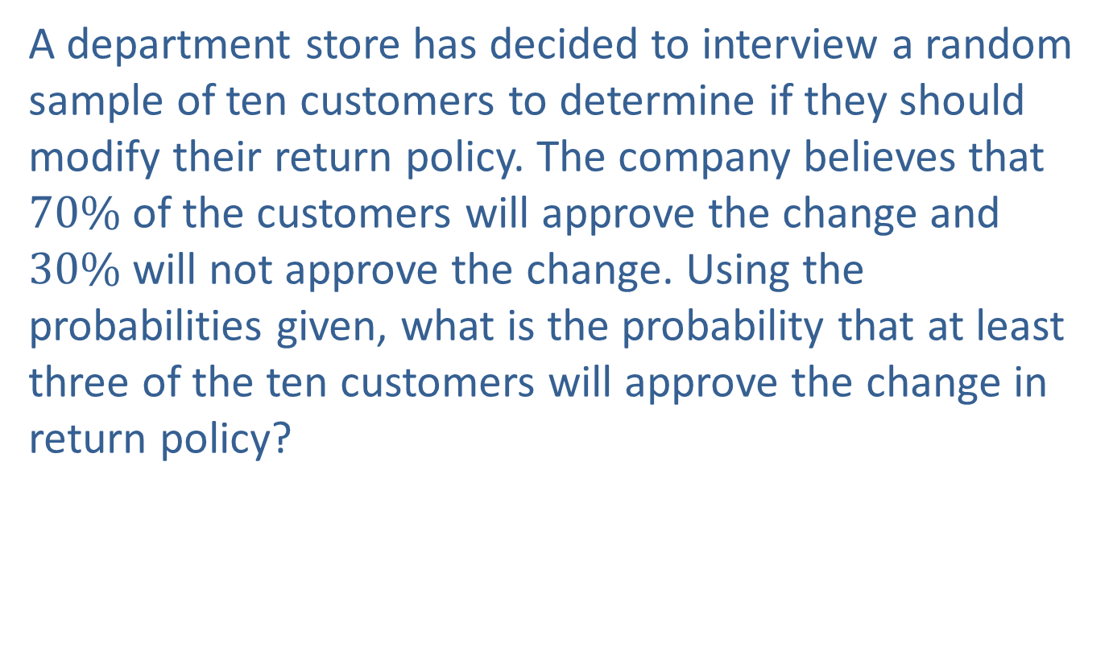
Example 3: Determining a Probability Using the Binomial Distribution—Slide 1
A department store has decided to interview a random sample of ten customers to determine if they should modify their return policy. The company believes that $70\%$ of the customers will approve the change and $30\%$ will not approve the change. Using the probabilities given, what is the probability that at least three of the ten customers will approve the change in return policy?

Slide 18
Example 3: Determining a Probability Using the Binomial Distribution—Slide 2
Solution
Instead of laboriously computing the distribution, use the binomial tables in Appendix A, Table E. A portion of Appendix A, Table E can be found in Table 4. Note that the table, which shows the cumulative distribution for X, is for a sample size of n = 8, 9, and 10. Suppose that we let X equal the number of customers that will approve the change.

Slide 19
Example 3: Determining a Probability Using the Binomial Distribution—Slide 3
Table 4 – Cumulative Binomial Probabilities
p
n | x | 0.1 | 0.2 | 0.3 | 0.4 | 0.5 | 0.6 | 0.7 | 0.8 | 0.9
10 | 0 | 0.3487 | 0.1704 | 0.0282 | 0.0060 | 0.0010 | 0.0001 | 0.0000 | 0.0000 | 0.0000
 | 1 | 0.7361 | 0.3758 | 0.1493 | 0.0464 | 0.0107 | 0.0017 | 0.0001 | 0.0000 | 0.0000
 | 2 | 0.9298 | 0.6778 | 0.3828 | 0.1673 | 0.0547 | 0.0123 | 0.0016 | 0.0001 | 0.0000
 | 3 | 0.9872 | 0.8791 | 0.6496 | 0.3823 | 0.1719 | 0.0548 | 0.0106 | 0.0009 | 0.0000
 | 4 | 0.9984 | 0.9672 | 0.8497 | 0.6331 | 0.3770 | 0.1662 | 0.0473 | 0.0064 | 0.0001
 | 5 | 0.9999 | 0.9936 | 0.9527 | 0.8338 | 0.6230 | 0.3669 | 0.1503 | 0.0328 | 0.0016
 | 6 | 1.0000 | 0.9991 | 0.9894 | 0.9452 | 0.8281 | 0.6177 | 0.3504 | 0.1209 | 0.0128
 | 7 | 1.0000 | 0.9999 | 0.9984 | 0.9877 | 0.9453 | 0.8327 | 0.6172 | 0.3222 | 0.0702
 | 8 | 1.0000 | 1.0000 | 0.9999 | 0.9983 | 0.9893 | 0.9536 | 0.8507 | 0.6242 | 0.2639
 | 9 | 1.0000 | 1.0000 | 1.0000 | 0.9999 | 0.9990 | 0.9940 | 0.9718 | 0.8926 | 0.6513
 | 10 | 1.0000 | 1.0000 | 1.0000 | 1.0000 | 1.0000 | 1.0000 | 1.0000 | 1.0000 | 1.0000

Slide 20
Example 3: Determining a Probability Using the Binomial Distribution—Slide 4
With n = 10 and p = 0.7 the probability that at least three customers will approve the change is equal to
Note that
can be read directly from Table 4.
To find the probability, locate 0.7 at the top of the table (i.e., p = 0.7), then find 2 (under n = 10), and find the intersection between 2 and 0.7 in the table to yield 0.0016.
Therefore, it's almost certain that at least three customers will approve the change in return policy.

Slide 21
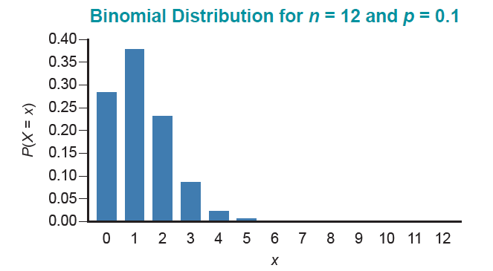
The Shape of a Binomial Distribution—Slide 1
Figure 1

Slide 22
The Shape of a Binomial Distribution—Slide 2
Binomial distributions have taken various shapes in the previous problems. The shape of the distribution depends upon the parameters n and p. If p is small the distribution tends to be skewed with a tail on the right (i.e., there are more successes when x is smaller) as shown in Figure 1 in the previous slide.

Slide 23
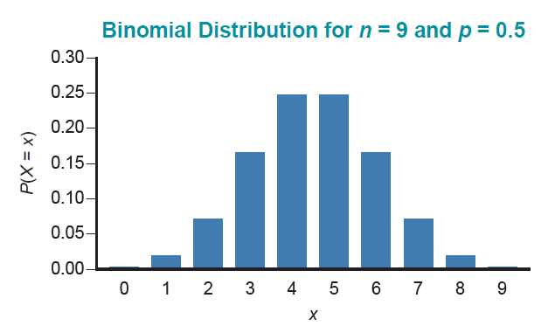
The Shape of a Binomial Distribution—Slide 3
Figure 2
If p is near 0.5 the distribution is symmetrical. The graph in Figure 2 displays the probabilities for n = 9 and p = 0.5.

Slide 24
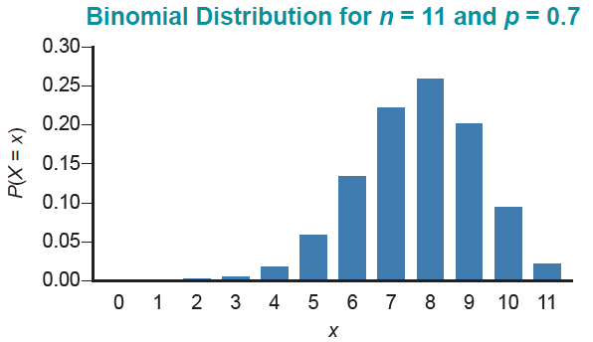
The Shape of a Binomial Distribution—Slide 4
If p is large the distribution tends to be skewed with a long tail on the left (i.e., there are more successes when x is larger). The graph in Figure 3 displays the binomial probabilities for n = 11 and p = 0.7.
Figure 3

Slide 25
Expected Value and Variance—Slide 1
To calculate the expected value of a binomial random variable, such as in Example 3, would require a substantial number of arithmetic operations. Fortunately, you can avoid this calculation by utilizing a special characteristic of the binomial distribution.

Slide 26
Formula: Expected Value
The expected value of a binomial random variable can be computed using the expression
Where n and p are the parameters of the binomial distribution.

Slide 27
Expected Value and Variance—Slide 2
It is important to remember that this formula is only valid for binomial random variables. Also, there is a simple method for obtaining the variance for a binomial random variable.

Slide 28
Formula: Variance and Standard Deviation
To find the variance of a binomial random variable, use the expression
Thus, the standard deviation of a binomial random variable is given by

Slide 29
Example 4: Calculating the Expected Value and Variance of a Binomial Random Variable—Slide 1
Compute the expected value and the variance of the number of customers that will approve the change in return policy in Example 3.

Slide 30
Example 4: Calculating the Expected Value and Variance of a Binomial Random Variable—Slide 2
Solution
Since the random variable is binomial, we can use the shortcuts
Since n = 10 and p = 0.7, the expected value is given by the following expression.
The variance is
which implies that the standard deviation is
Thus, if 10 randomly selected customers are polled, we would expect 7 of the 10 to approve the change in return policy, and the standard deviation would be 1.4491 customers.

