Slide 1
Section 6.5
The Poisson Distribution

Slide 2
Definition: Poisson Random Variable
In order to qualify as a Poisson random variable an experiment must meet two conditions.
1. Successes occur one at a time. (That is, two or more successes cannot occur at exactly the same point in time or exactly at the same point in space.)
2. The occurrence of a success in any interval is independent of the occurrence of a success in any other interval.

Slide 3
Definition: Poisson Probability Distribution Function
The Poisson probability distribution function is given by:
where e = 2.71828 …, and
λ = the mean number of successes.

Slide 4
Poisson Probability Distribution Function—Slide 1
The Poisson distribution has only one parameter, λ, pronounced lambda. One peculiar feature of the distribution is that the variance of the distribution is equal to the mean (lambda). That is, μ = σ ² = λ.
The shape of the distribution varies dramatically with the parameter λ. If λ is small, say 0.3, then the corresponding distribution is found in Table 1 and displayed in Figure 1.

Slide 5
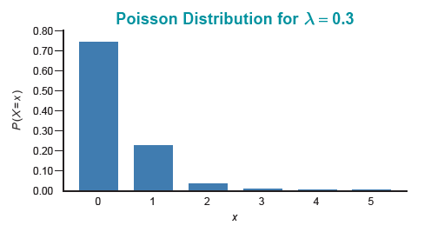
Poisson Probability Distribution Function—Slide 2
Figure 1

Slide 6
Poisson Probability Distribution Function—Slide 3
Table 1: λ = 0.3
x | P (X = x)
0 | 0.7408
1 | 0.2222
2 | 0.0333
3 | 0.0033
4 | 0.0003
5 | 0.000
As λ increases to 3, as shown in Table 2, the distribution in Figure 2 exhibits a mound shape with skewness.

Slide 7
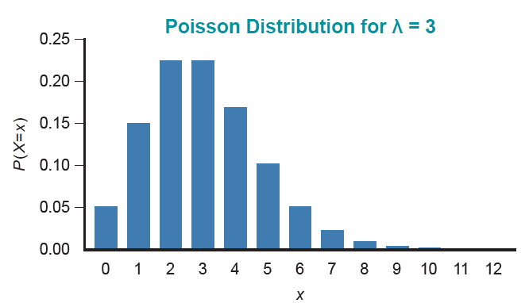
Poisson Probability Distribution Function—Slide 4
Figure 2

Slide 8
Poisson Probability Distribution Function—Slide 5
Table 2: λ = 3
x | P (X = x)
0 | 0.0498
1 | 0.1494
2 | 0.2240
3 | 0.1680
4 | 0.1008
5 | 0.0504
6 | 0.0216
7 | 0.0081
8 | 0.0027
9 | 0.0027
10 | 0.0008
11 | 0.0002
12 | 0.0001

Slide 9
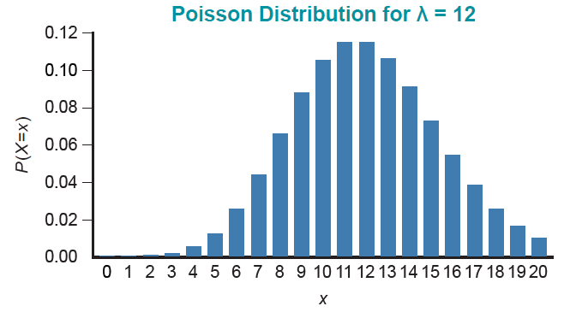
Poisson Probability Distribution Function—Slide 6
As λ becomes even larger, say λ = 12, the distribution begins to closely resemble a bell-shaped distribution.
Figure 3

Slide 10
Poisson Random Variables for Time
Most Poisson applications relate to the number of occurrences of some event in a specific duration of time.

Slide 11
Example 1: Calculating Probabilities Using the Poisson Distribution—Slide 1
Suppose a bank has one automatic teller machine. Customers arrive at the machine at a rate of 20 per hour and according to a Poisson pattern.
a. What is the probability that no one will arrive in a 15-minute interval?
b. What is the probability that in a 15-minute period at least 3 persons will use the automated teller machine?

Slide 12
Example 1: Calculating Probabilities Using the Poisson Distribution—Slide 2
Solution
a. ​Let X = number of arrivals in a 15-minute period.
​ This problem contains one of the standard techniques used in working with Poisson random variables, that is, translating the arrival rate to correspond to the desired time interval. In this problem, the rate is given at 20 per hour which corresponds to a rate of 5 per
(15 minutes). Thus, λ = 5 and the desired probability is

Slide 13
Example 1: Calculating Probabilities Using the Poisson Distribution—Slide 3
Solution
To find the probability that in a 15-minute period at least 3 persons will use the automated teller machine, we are interested in
This probability statement can be rewritten in terms of a cumulative probability so that we can use Appendix A, Table F. That is,

Slide 14
Example 1: Calculating Probabilities Using the Poisson Distribution—Slide 4
Note that
can be read directly from
Appendix A, Table F. Locate λ across the top of Table F and then locate the appropriate value of x in the leftmost column (in this case, 2) and then find the value in the table that is the intersection between λ = 5 and 2 (which is 0.1247). ​

Slide 15
Poisson Random Variables for Length or Space
Instead of counting the number of successes in a time interval, there are a number of applications of the Poisson distribution that measure the number of successes in some area or length. The average number of successes in the area or length will define the parameter of the Poisson random variable.

Slide 16
Example 2: Calculating a Probability Using the Poisson Distribution—Slide 1
The telephone company is considering purchasing optical cable from Optica, Inc. The company wishes to replace approximately 100,000 feet of conventional cable with optical fiber. Since optical fiber is very difficult to repair, it is important that the number of optical cable defects are minimized. Optica claims that on average there is one defect per 200,000 feet of cable. What is the probability that the replaced cable will contain no defects?

Slide 17
Example 2: Calculating a Probability Using the Poisson Distribution—Slide 2
Solution
Let λ = the number of defects in 100,000 feet of optical cable.
Based on previous experience, we assume that the number of defects is approximated by a Poisson distribution with Poisson parameter
(average number of defects per 100,000 ft of cable).
Using the tables provided in Appendix A, Table F,

