Slide 1
Section 7.1
The Uniform Distribution

Slide 2
Definition: Continuous Random Variable
A continuous random variable is a random variable whose measurements can assume any one of a countless number of values in an interval.

Slide 3
The Uniform Distribution—Slide 1
There are two types of uniform distributions, discrete and continuous. Recall that for the discrete uniform distribution, we assign the same probability to each possible value of the random variable.
Conceptually, both distributions distribute probability evenly across a sample space. For the continuous uniform distribution, the probability is spread out over some range from a to b, as shown in Figure 1.

Slide 4
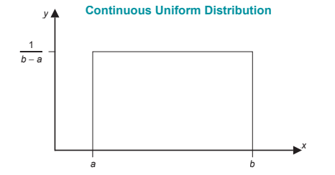
Continuous Uniform Distribution
Figure 1

Slide 5
The Uniform Distribution—Slide 2
Continuous random variables do not have probability distribution functions. Instead, they have probability density functions, which are denoted by f(x).
The probability density function is used to calculate probabilities for continuous random variables. The probability density function for the uniform random variable, its expected value (mean), and its standard deviation are given in the following formula. The parameters of the probability density function are the minimum and maximum values of the uniform random variable, and are referred to as a and b, respectively.

Slide 6
Formula: Uniform Probability Density Function
The uniform probability density function is as follows.
The mean and standard deviation are given by the following expressions.

Slide 7
Uniform Probability Density Function
When the uniform probability density function is graphed, it produces a rectangle or square. The probability of observing a random variable in some interval is expressed as the area under the density function associated with the interval. Since the density function for the uniform distribution produces a rectangle, calculating the probability of an interval is as simple as calculating the area of a rectangle, which does not require complicated geometry.

Slide 8
Example 1: Calculating Probability, Expected Value, and Standard Deviation of a Continuous Uniform Probability Density Function—Slide 1
The Blacksburg Bus Company is interested in the wait time of its passengers between 8:00 AM and 8:00 PM. Suppose that the wait time follows a uniform distribution with the minimum wait time being one minute and the maximum wait time 15 minutes.
a. ​What is the probability that a passenger will wait between 10 and 15 minutes?
b. What is the expected wait time between 8:00 AM and 8:00 PM?
c. What is the standard deviation of the wait time between 8:00 AM and 8:00 PM?

Slide 9
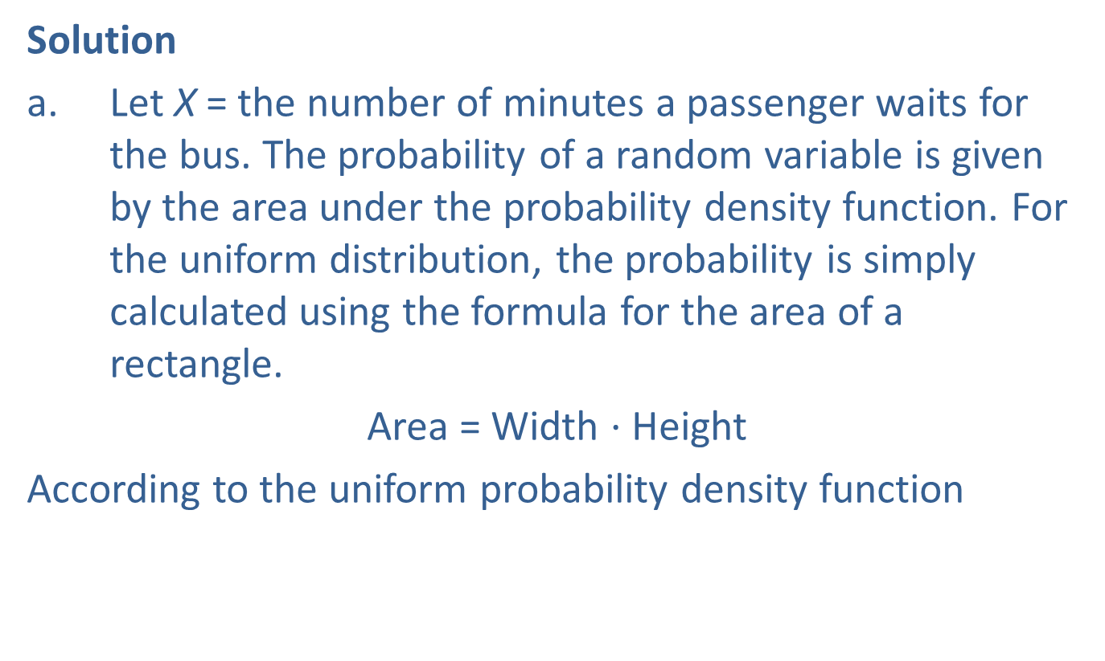
Example 1: Calculating Probability, Expected Value, and Standard Deviation of a Continuous Uniform Probability Density Function—Slide 2
Solution
a. ​Let X = the number of minutes a passenger waits for the bus. The probability of a random variable is given by the area under the probability density function. For the uniform distribution, the probability is simply calculated using the formula for the area of a rectangle.
​Area = Width $⋅$ Height
​According to the uniform probability density function

Slide 10
Example 1: Calculating Probability, Expected Value, and Standard Deviation of a Continuous Uniform Probability Density Function—Slide 3
​We are interested in the probability that a passenger will wait between 10 and 15 minutes for the bus, so
Width = 15 − 10 = 5, and​
​​

Slide 11
Example 1: Calculating Probability, Expected Value, and Standard Deviation of a Continuous Uniform Probability Density Function—Slide 4
Since the probability of observing a uniform random variable is the area under the density function associated with the interval, we calculate the probability of a passenger waiting between 10 and 15 minutes as shown in the following Figure 2.

Slide 12
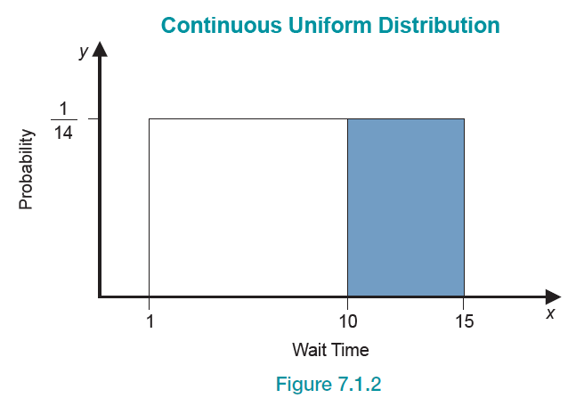
Example 1: Calculating Probability, Expected Value, and Standard Deviation of a Continuous Uniform Probability Density Function—Slide 5
Figure 2

Slide 13
Example 1: Calculating Probability, Expected Value, and Standard Deviation of a Continuous Uniform Probability Density Function—Slide 6
b. The expected value of a continuous uniform random variable is given by
​Therefore, the expected wait time for a passenger is 8 minutes.
c. The standard deviation of a continuous uniform random variable is given by
​Therefore, the standard deviation for the wait time of a passenger for a bus operated by the Blacksburg Bus Company is 4.0415 minutes.

Slide 14
What Do Data from a Uniform Random Variable Look Like?—Slide 1
While the density function for the uniform distribution has a flat top, a histogram of data from a uniformly distributed random process will not be perfectly flat. Suppose that we generated 100 observations from a random process that was uniformly distributed between 2 and 15.
Clearly, the frequency of each category is not identical as shown in the following Figure 3

Slide 15
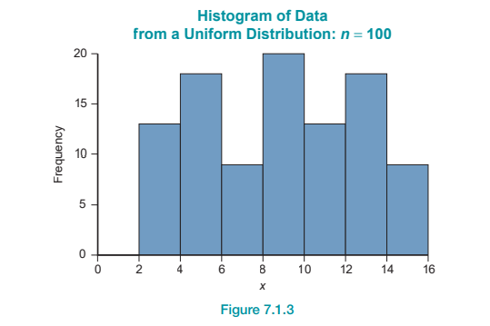
What Do Data from a Uniform Random Variable Look Like?—Slide 2
Figure 3

Slide 16
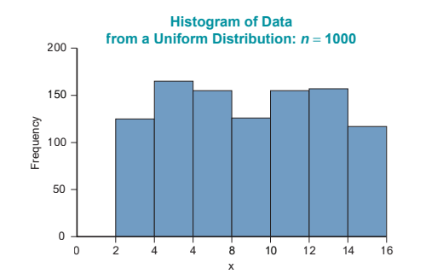
What Do Data from a Uniform Random Variable Look Like?—Slide 3
However, if we were to generate 1000 observations, the distribution would begin to level as shown in the following Figure 4.
Figure 4

