Slide 1
Section 7.2
The Normal Distribution

Slide 2
The Normal Distribution—Slide 1
The normal distribution, originally called the Gaussian distribution, was named after Karl Gauss who published a work in 1833 describing the mathematical definition of the distribution. Gauss developed this distribution to describe the error in predicting the orbits of planets. Normal distributions are all bell-shaped, but the bells come in various shapes and sizes.
Since all normal distributions are symmetric, the mean, median, and mode are all equal.

Slide 3
The Normal Distribution—Slide 2
Although normally distributed random variables can range in value from negative infinity to positive infinity, values that are a great distance from the mean rarely occur. You may recall that when we discussed box plots, these values were called outliers.

Slide 4
Properties of the Normal Distribution
1. The normal distribution is symmetric. That is, the curve's shape to the left of the mean is the mirror image of the curve's shape to the right of the mean.
2. The highest point on the normal curve is located at the mean, which is also the location of the median and the mode of the distribution.
3.​ The area under the curve of the normal distribution equals 1.
4. Due to symmetry, the area to the right of the mean equals the area to the left of the mean, and each of these areas equals 0.5.
5. ​The shape of the normal distribution is defined by its two parameters, the mean (μ) and the standard deviation (σ).

Slide 5
The Normal Distribution—Slide 3
In Figure 1 the shaded area represents the probability of being within ±1σ of the mean. Regardless of the values of the mean and standard deviation of the normal distribution, the area under the curve and the probability of being within one standard deviation (±1σ) of the mean equals 0.6826.

Slide 6
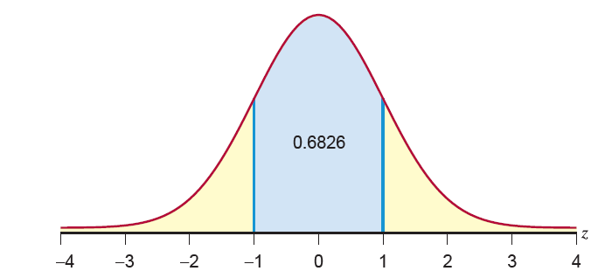
The Normal Distribution—Slide 4
Figure 1

Slide 7
The Normal Distribution—Slide 5
Figure 2 illustrates the area under the curve within two standard deviations of the mean. The probability of being within ±2σ of the mean equals 0.9544 for every normal distribution.

Slide 8
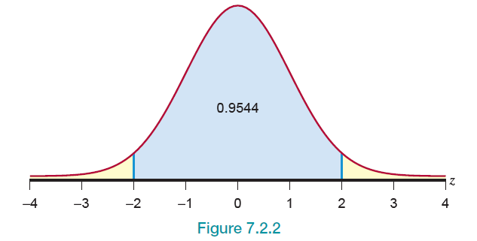
The Normal Distribution—Slide 6
Figure 2

Slide 9
The Normal Distribution—Slide 7
Figure 3 illustrates the area under the curve within three standard deviations of the mean. As you can see, virtually all of the area under the curve is within three standard deviations of the mean. The probability of being within ±3σ of the mean equals 0.9974.
Since the empirical rule given in Chapter 4 is based on the normal distribution, these results are identical to the empirical rule frequencies.

Slide 10
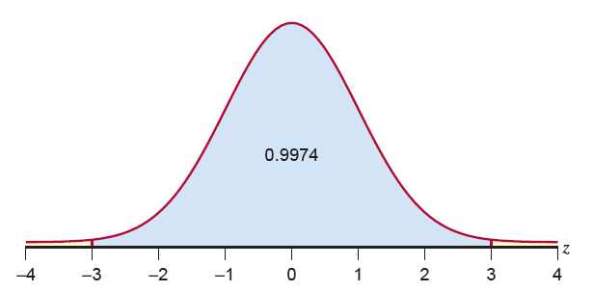
The Normal Distribution—Slide 8
Figure 3

Slide 11
The Normal Distribution—Slide 9
Although a normal distribution has a bell shape, a bell shape does not imply a normal distribution. A number of non-normal distributions with bell shapes will be introduced in later chapters. In fact the word normal can be somewhat misleading. The name suggests that the distribution is a fact of nature. It is not. However, many variables seem to possess a shape that resembles the normal distribution.

Slide 12
The Normal Distribution—Slide 10
The normal distribution is the preeminent distribution used in the statistical theory we will examine. Many statistical inference procedures, either directly or indirectly, have been developed based on the normal distribution. These procedures usually assume that the population from which a random sample is drawn is normally distributed.
Like other theoretical distributions, a normal distribution is completely defined by its probability density function.

Slide 13
Formula: Normal Probability Density Function
The normal probability density function is given by:

Slide 14
Normal Probability Density Function—Slide 1
At first glance, this function does not look very normal! The distribution has two parameters, m and s, which are the mean and standard deviation, respectively. The mean defines the location, and the standard deviation determines the dispersion. Figure 4 illustrates three normal distributions with identical standard deviations. The only difference in the distributions is the central location, the mean.

Slide 15
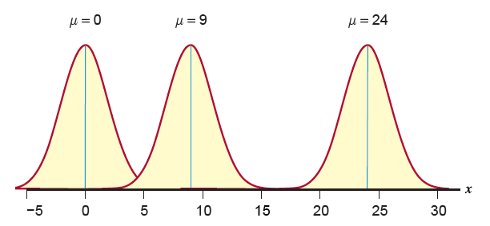
Normal Probability Density Function—Slide 2
Figure 4

Slide 16
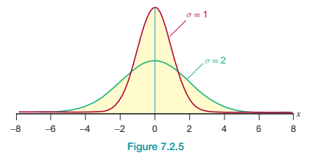
Normal Probability Density Function—Slide 3
In Figure 5, there are two distributions with identical means, but with different standard deviations. Changing the standard deviation parameter can have rather significant effects on the shape of the distribution.
Figure 5

Slide 17
Looking at Data from Normal Distributions—Slide 1
The normal distribution is a theoretical construct with a bell shape. Therefore, it would not be unreasonable to expect data drawn from a normal population to exhibit the bell-shaped characteristic. In two small samples taken from a normal population, shown in Figures 6 and 7, the data do show a faint resemblance of a bell shape. But as you can see, the shapes of the histograms developed from these small samples are somewhat unpredictable, even though the bell-shaped pattern is to some extent apparent.

Slide 18
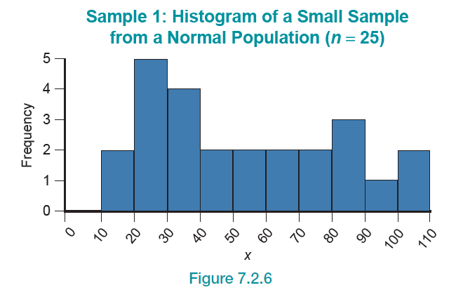
Looking at Data from Normal Distributions—Slide 2
Figure 6

Slide 19
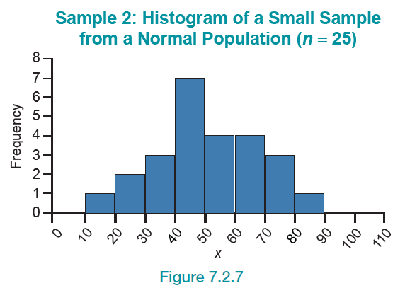
Looking at Data from Normal Distributions—Slide 3
Figure 7

Slide 20
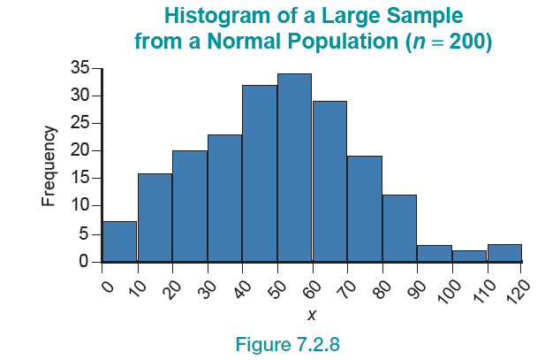
Looking at Data from Normal Distributions—Slide 4
For large samples, the representation of the bell curve is usually more visible. While the large sample (n = 200) certainly is not a perfect bell curve, it is recognizable (see Figure 8).
Figure 8

Slide 21
Looking at Data from Normal Distributions—Slide 5
Using the probability density function to determine the probability of some interval would be complicated. Fortunately, there is an easier way. A special normal distribution, called the standard normal, can be used to determine probabilities for any normal random variable. The standard normal distribution will be discussed in Section 7.3.

