Slide 1
Section 7.3
Assessing Normality Graphically

Slide 2
Box Plot—Slide 1
The box plot is another way to assess the normality of a data set. Recall the box plot from Chapter 4 which provided a graphical summary of the central tendency, the spread, the skewness, and the potential existence of outliers. The box plot (see Figure 1) shows the median as a vertical line inside the box, the interquartile range (IQR), which is the range between the first and third quartile, and the whiskers (lines extending from the left and right of the box) which represent the minimum and maximum values of the data.

Slide 3
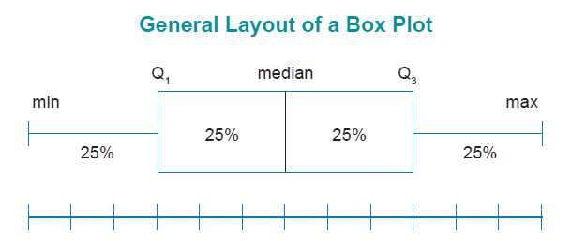
Box Plot—Slide 2
Figure 1

Slide 4
Box Plot—Slide 3
When an observation is more than 1.5 times the IQR from either end of the box (i.e., Q ₁ − 1.5 ⋅ IQR or Q ₃ + 1.5 ⋅ IQR) it is called an outlier. If an observation is more than three times the IQR outside the box, it is called an extreme outlier.
A box plot that is symmetric, with the median line at approximately the center of the box and with symmetric whiskers, tends to indicate that the data may have come from a normal distribution. If many outliers are present in the data, either the outliers should be removed or the data should not be treated as normally distributed.

Slide 5
Normal Probability Plot—Slide 1
The normal probability plot is a plot of the z-scores (i.e., the normal scores) against the actual data. When analyzing the normal probability plot to assess normality, if the data follow a diagonal line this implies that you have normally distributed data. If the data are skewed (right or left) and do not follow a linear pattern then it's likely that you do not have normally distributed data. With a normal probability plot, it's relatively easy to see the individual observations that don't fit a normal distribution.

Slide 6
Normal Probability Plot—Slide 2
Figure 2 shows a general normal probability plot. The line represents the theoretical line for normally distributed data. The dots represent the real, empirical data that we are checking for normality. If all of the dots roughly follow the line, we can be confident that the data follow a normal distribution. However, if the data deviates significantly from the line, the assumption of normality may not hold.

Slide 7
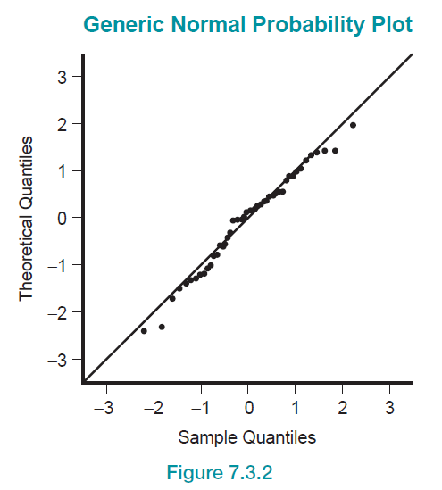
Normal Probability Plot—Slide 3
Figure 2

Slide 8
Procedure: Creating a Normal Probability Plot by Hand
1. Arrange the data values in ascending order.
data value in the ordered list and n is the number of observations in the data set.
3. Find the z-score for each value of f _{i}.
4. Plot the x-values on the horizontal axis and the corresponding z-score on the vertical axis.

Slide 9
Creating a Normal Probability Plot by Hand
The normal probability plot is rarely drawn by hand because the exact normal z-scores used for the plot can't be looked up in a table. Thus, we use software packages such as JMP, Excel, or Minitab to create normal probability plots.

Slide 10
Example 1: Assessing Normality of Sales Revenue for CWK Consulting—Slide 1
Cindy, the President and CEO of CWK Consulting, a midsize accounting firm, conducted a brief survey of her salespeople to analyze their annual sales revenue for 2019. She took a random sample of the sales revenue of 25 employees and the summary statistics are provided in Table 1. Determine if the sales revenue data follow a normal distribution using a histogram, box plot, and normal probability plot.

Slide 11

Example 1: Assessing Normality of Sales Revenue for CWK Consulting—Slide 2
Solution
The summary statistics of the sales revenue data can be found in Table 1. Note that the mean is $\$51,728.36$ and the standard deviation is $\$1,061.47$.
Table 1: Summary Statistics of the Sales Revenue Data
Mean | 51,728.36
Std Dev | 5307.3679
Std Err Mean | 1061.4736
Upper 95% Mean | 53919.134
Lower 95% Mean | 49537.586
N | 25

Slide 12
Example 1: Assessing Normality of Sales Revenue for CWK Consulting—Slide 3
Using JMP, the histogram of the sales revenue data is shown in Figure 3. The histogram appears to be somewhat bell-shaped. Additionally, Figure 4 has a smooth curve drawn on it which resembles a bell-shaped curve. It's fairly safe to conclude by looking at both Figures 3 and 4 that the sales revenue data are normally distributed.

Slide 13
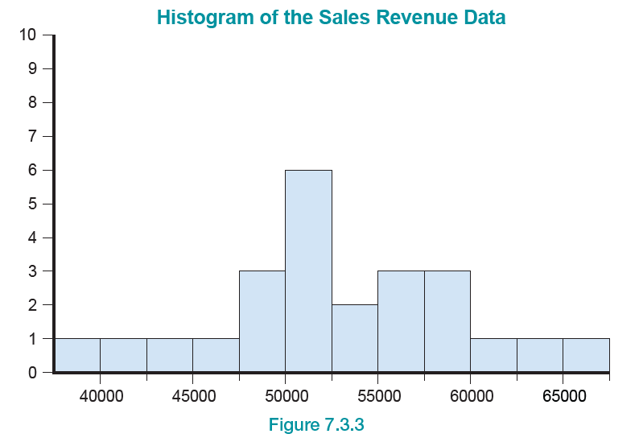
Example 1: Assessing Normality of Sales Revenue for CWK Consulting—Slide 4
Figure 3

Slide 14
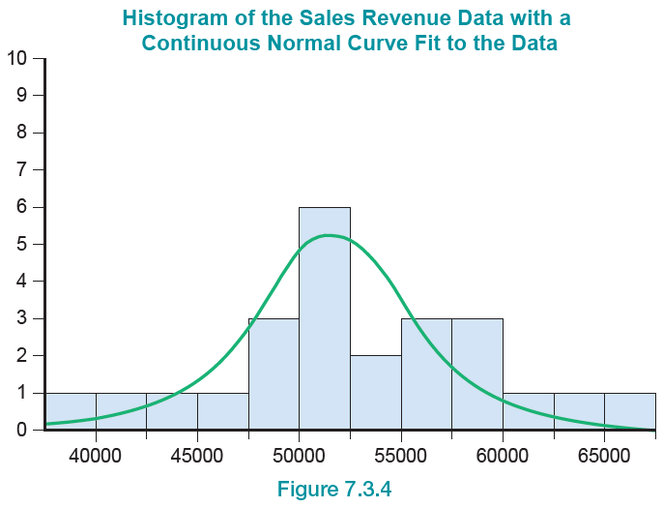
Example 1: Assessing Normality of Sales Revenue for CWK Consulting—Slide 5
Figure 4

Slide 15
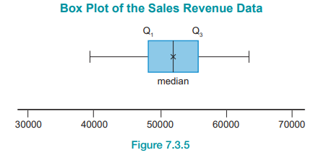
Example 1: Assessing Normality of Sales Revenue for CWK Consulting—Slide 6
A box plot of the sales revenue data is presented in Figure 5. You can see that Q ₁ and Q ₃ are approximately equidistant from the median of the data. The whiskers also appear to be equidistant from Q ₁ and Q ₃, respectively. The box plot is yet another graphical display that supports that the data follow a normal distribution.
Figure 5

Slide 16
Example 1: Assessing Normality of Sales Revenue for CWK Consulting—Slide 7
Lastly, the normal probability plot is displayed in Figure 6. The solid line represents the theoretical normal data and we can see that the actual data do not stray too far from the line. Again, the normal probability plot supports that the data follow a normal distribution.

Slide 17
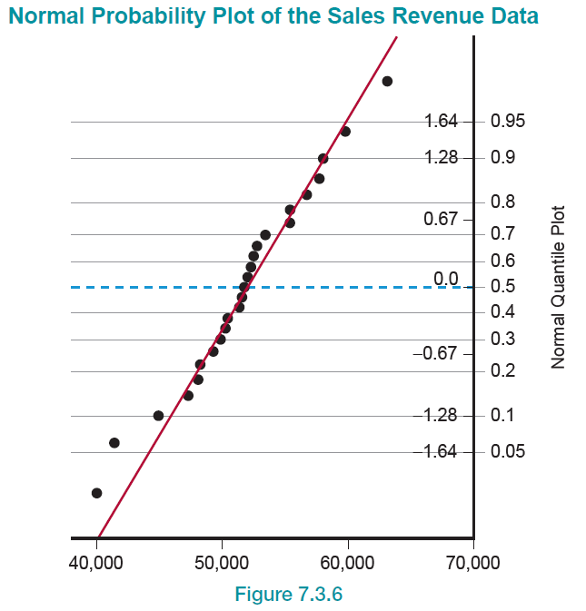
Example 1: Assessing Normality of Sales Revenue for CWK Consulting—Slide 8
Figure 6

Slide 18
Example 1: Assessing Normality of Sales Revenue for CWK Consulting—Slide 9
Given that all three graphical displays used in the example tend to support that the data follow a normal distribution, it is safe to continue with any analysis based on the assumption that the data are normally distributed.
More formal and precise tests are available which calculate the probability that a sample is collected from a normal population. To name a few, these tests are the Anderson- Darling Test, Kolmogorov-Smirnov Test, and Shapiro-Wilk W Test.

Slide 19
Example 1: Assessing Normality of Sales Revenue for CWK Consulting—Slide 10
These tests have the advantage of allowing the analyst to make an objective judgement of normality. However, the primary disadvantage is that these tests are sensitive to small sample sizes.
What if the data do not follow a normal distribution? You can still analyze the data but first you must perform some type of transformation on the data or use nonparametric procedures.

Slide 20
Example 1: Assessing Normality of Sales Revenue for CWK Consulting—Slide 11
Keep in mind that if you use nonparametric procedures, they have less power than the classical parametric procedures. Lastly, parametric tests are robust to violations of normality when you have large sample sizes.

