Slide 1
Section 7.4
The Standard Normal Distribution

Slide 2
Definition: Standard Normal Distribution
The standard normal distribution is a normal distribution with a mean of zero and a standard deviation of one.
μ = 0 and σ = 1

Slide 3
Standard Normal Distribution—Slide 1
Given that the normal distribution is a function of two continuous parameters μ and σ, there are an infinite number of combinations for μ and σ, and thus, an infinite number of normal distributions. The standard normal distribution in Figure 1 is a special version of the normal distribution.

Slide 4
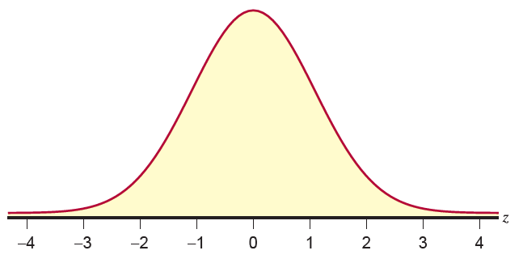
Standard Normal Distribution—Slide 2
Figure 1

Slide 5
Standard Normal Distribution—Slide 3
The standard normal distribution, also called the z-distribution, provides a basis for computing probabilities for all normal distributions. The technique used to convert any normal random variable into a standard normal random variable is called "standardizing" the random variable and was discussed earlier in Chapter 4.
Appendix A, Tables A and B provide the probability that a standard normal random variable will be less than a specified value. For example, to compute the probability that a standard normal random variable will be less than 1 (see Figure 2), look up the value 1.00 in Table B. The table value of 0.8413 is the area under the curve between negative infinity and 1, which is also the probability that the random variable will assume a value in that interval.

Slide 6
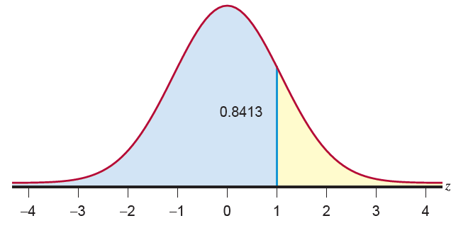
Standard Normal Distribution—Slide 4
Figure 2

Slide 7
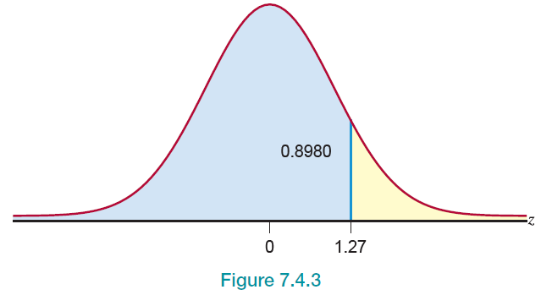
Example 1: Calculating a Probability Using the Standard Normal Distribution—Slide 1
Compute the probability that a standard normal random variable is less than 1.27.
Solution : Drawing a picture, even when the problem is rather simple, is a good idea. Remember that the probability is represented by the area under the standard normal curve.
Figure 3

Slide 8
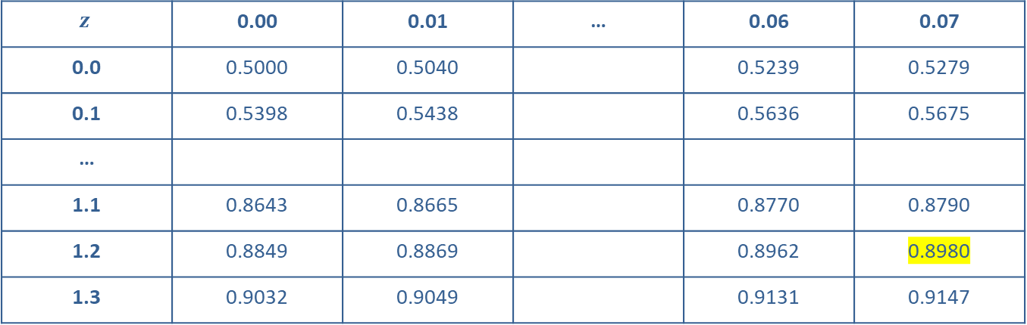
Example 1: Calculating a Probability Using the Standard Normal Distribution—Slide 2
$$z$$ | 0.00 | 0.01 | … | 0.06 | 0.07
0.0 | 0.5000 | 0.5040 |  | 0.5239 | 0.5279
0.1 | 0.5398 | 0.5438 |  | 0.5636 | 0.5675
…
1.1 | 0.8643 | 0.8665 |  | 0.8770 | 0.8790
1.2 | 0.8849 | 0.8869 |  | 0.8962 | 0.8980
1.3 | 0.9032 | 0.9049 |  | 0.9131 | 0.9147

Slide 9
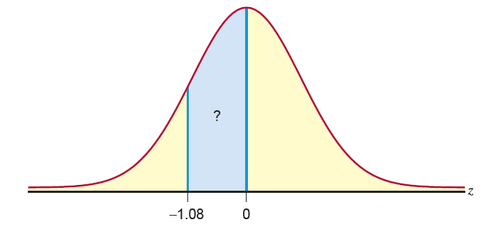
Example 2: Calculating a Probability Using the Standard Normal Distribution—Slide 1
Determine the probability that a standard normal random variable is between −1.08 and 0.
Solution
First, draw a picture.
Figure 4

Slide 10
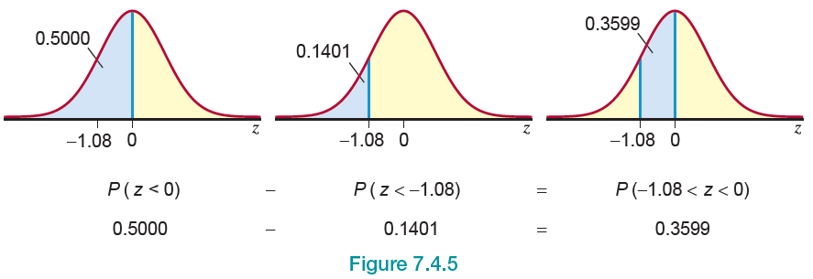
Example 2: Calculating a Probability Using the Standard Normal Distribution—Slide 2
Figure 5

Slide 11
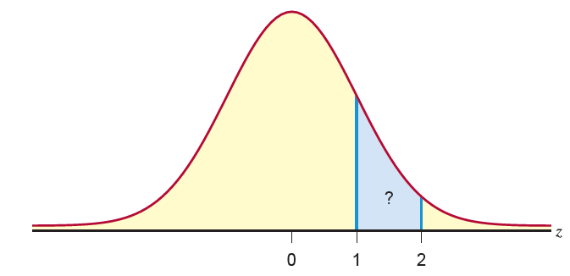
Example 3: Calculating a Probability Using the Standard Normal Distribution—Slide 1
What is the probability that a standard normal random variable will be between 1 and 2?
Solution
Again, first draw a Figure 6.
Figure 6

Slide 12
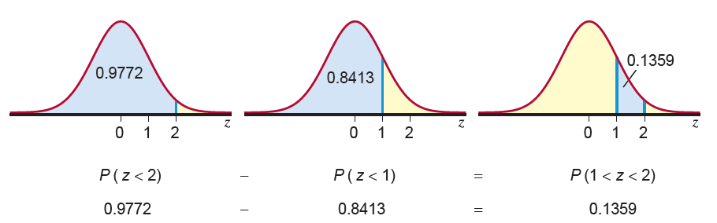
Example 3: Calculating a Probability Using the Standard Normal Distribution—Slide 2
Figure 7

Slide 13
Example 4: Determining the z-Value that corresponds to an Area Under the Standard Normal Distribution—Slide 1
Given that z is a standard normal random variable, find the value of z for each situation.
a. ​The area to the left of z is 0.9147.
b. The area between 0 and z is 0.3665.
c. ​The area to the left of z is 0.1469.
d. The area to the right of z is 0.7967.

Slide 14
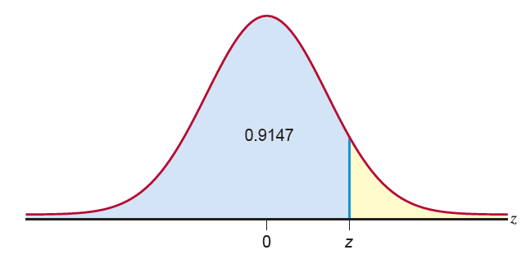
Example 4: Determining the z-Value that corresponds to an Area Under the Standard Normal Distribution—Slide 2
Solution
a. ​The area to the left of z is 0.9147.
First, draw a picture.
​
Figure 8

Slide 15
Example 4: Determining the z-Value that corresponds to an Area Under the Standard Normal Distribution—Slide 3
​In this example, you are given a probability and asked to find the corresponding value of z. Recall that Appendix A, Table B gives you the cumulative probability of the area less than some value of z.
​In order to find the value of z, look in the body of Appendix A, Table B and find the probability value 0.9147. Once you've found the value (the probability), determine the corresponding value of z. In this case, the value of z is 1.37. So,​
​
and the value of z is 1.37 with the area to the left of it being 0.9147.

Slide 16
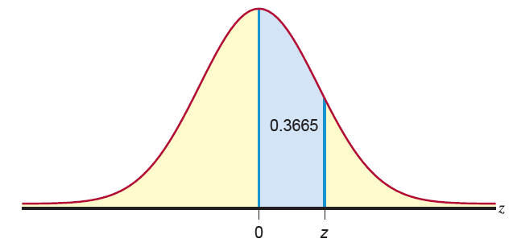
Example 4: Determining the z-Value that corresponds to an Area Under the Standard Normal Distribution—Slide 4
b. The area between 0 and z is 0.3665.
Again, draw a picture.
​
Figure 9

Slide 17
Example 4: Determining the z-Value that corresponds to an Area Under the Standard Normal Distribution—Slide 5
​Recall that the table gives us cumulative probabilities. Since the area between 0 and z is 0.3665, if we write this as a cumulative probability, we need to add the area to the left of 0. Thus, the area to the left of z is 0.8665. This is the probability (less than some value of z) that is provided in Table B. Therefore, find 0.8665 in the body of Table B and locate the corresponding value of z. In this case,
​​
So, the value of z with the area 0.3665 between 0 and z is 1.11.

Slide 18
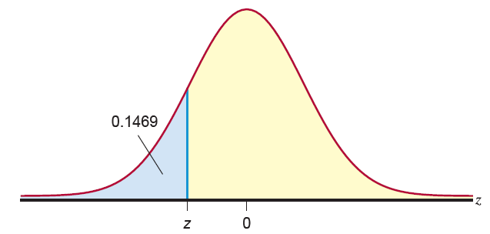
Example 4: Determining the z-Value that corresponds to an Area Under the Standard Normal Distribution—Slide 6
c. The area to the left of z is 0.1469.
Just as in parts a. and b., a picture can be helpful.
​
Figure 10

Slide 19
Example 4: Determining the z-Value that corresponds to an Area Under the Standard Normal Distribution—Slide 7
​Note that the value of z is to the left of 0. Thus, the value of z is going to be negative. Note that the area to the left of z represents the cumulative probability (in Figure 10). So, to find the value of z, we only need to find 0.1469 in the body of Appendix A, Table A. The value of z with the area 0.1469 to the left of it is −1.05. That is,

Slide 20
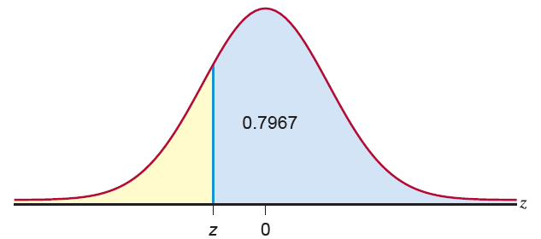
Example 4: Determining the z-Value that corresponds to an Area Under the Standard Normal Distribution—Slide 8
d. The area to the right of z is 0.7967.
​Once again, a picture can be very helpful.
​
Figure 11

Slide 21
Example 4: Determining the z-Value that corresponds to an Area Under the Standard Normal Distribution—Slide 9
Note that from the picture, we have the area to the right of z. However, we know that the total area under the curve is 1. Thus, if the area to the right of z is 0.7967, then the area to the left of z is 1 − 0.7967, = 0.2033. From the picture, it is clear that if we find 0.2033 in the body of Appendix A, Table A, the corresponding value of z is the value we are interested in. This value of z is −0.83. Therefore, the value of z with the area 0.7967 to the right is −0.83.

Slide 22
Formula: Standardizing a Normal Random Variable
The following formula can transform any normal random variable into a standard normal random variable, z.
where x is a normal random variable with mean μ and standard deviation σ.

Slide 23
Standardizing a Normal Random Variable—Slide 1
If we look at the individual pieces, exactly how the transformation works is not very mysterious. First, the numerator, x − μ, centers the z-distribution around zero. By subtracting the mean of the random variable from each data value, the mean of the resulting random variable will be zero. A short example illustrates this point. Suppose that a population contained the following data values shown in Table 1.

Slide 24
Standardizing a Normal Random Variable—Slide 2
Table 1
Data Set A | Data Set A − 6
1 | 1 − 6 = −5
5 | 5 − 6 = −1
6 | 6 − 6 = 0
12 | 12 − 6 = 6
Mean = 6 | Mean = 0

Slide 25
Standardizing a Normal Random Variable—Slide 3
Data Set A has a mean of 6. If 6 is subtracted from each of the data values, the resulting deviations are shown in the second column of the table. The deviations have a mean of zero. Essentially the location of the data set has been shifted to zero. The interrelationship of the data points to one another has not changed.

Slide 26
Standardizing a Normal Random Variable—Slide 4
The standard deviation of Data Set A is approximately 3.9370. Let's standardize each data value in Data Set A (see Table 2). The resulting z-values indicate how far the data values in Table 1 are from the mean, measured in standard deviation units. The first z-value in Table 2 indicates that 1 is −1.27 standard deviation units from the mean. The mean and standard deviation of the transformed values in Table 2 are zero and one, respectively.

Slide 27
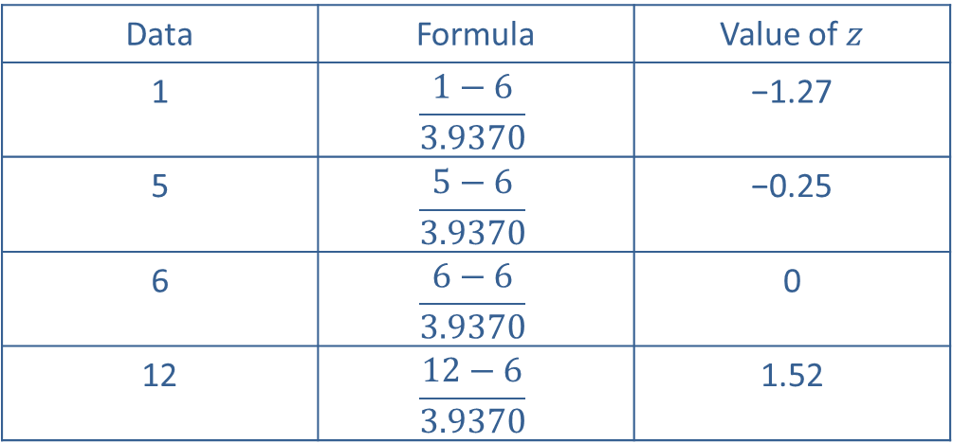
Standardizing a Normal Random Variable—Slide 5
Table 2 – Standardizing Data Set A
Data | Formula | Value of $z$
1 | $$\frac{1−6}{3.9370}$$ | −1.27
5 | $$\frac{5−6}{3.9370}$$ | −0.25
6 | $$\frac{6−6}{3.9370}$$ | 0
12 | $$\frac{12−6}{3.9370}$$ | 1.52

Slide 28
Example 5: Calculating the Probability of Payroll Processing Time Using the Standard Normal Distribution—Slide 1
Suppose that the times it takes for an accountant to process payroll are normally distributed with a mean of 10 minutes and a standard deviation of 20 minutes. Find the probability that the payroll processing time on a randomly selected payroll date will take between 10 minutes and 40 minutes.

Slide 29
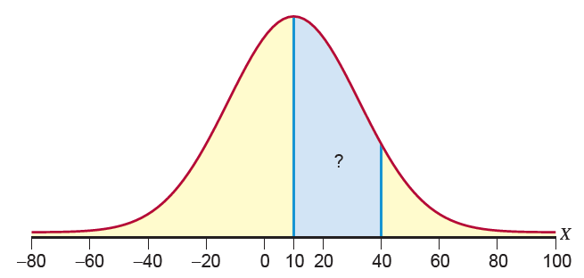
Example 5: Calculating the Probability of Payroll Processing Time Using the Standard Normal Distribution—Slide 2
Figure 12

Slide 30
Example 5: Calculating the Probability of Payroll Processing Time Using the Standard Normal Distribution—Slide 3
Solution
Suppose X, the payroll processing time, is a normally distributed random variable with a mean of 10 minutes and a standard deviation of 20 minutes.
Standardizing the random variable X yields the following.

Slide 31
Example 5: Calculating the Probability of Payroll Processing Time Using the Standard Normal Distribution—Slide 4
We find the probability that z is less than 1.5 and subtract 0.5 (the probability that z is less than 0) as follows.
Thus, the probability that the payroll processing time on a randomly selected payroll date will take between 10 and 40 minutes is 0.4332.

Slide 32
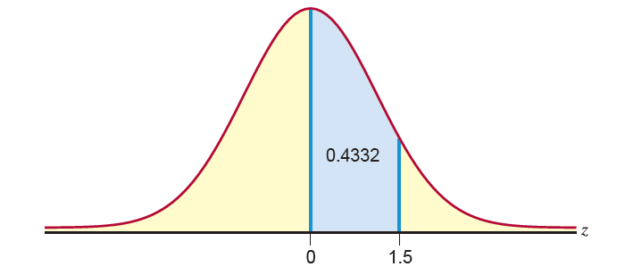
Example 5: Calculating the Probability of Payroll Processing Time Using the Standard Normal Distribution—Slide 5
Figure 13

Slide 33
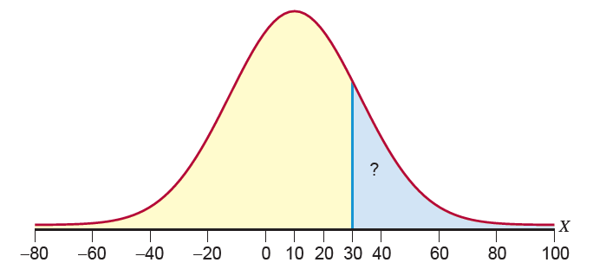
Example 6: Calculating the Probability of Payroll Processing Time Using the Standard Normal Distribution—Slide 1
Continuing Example 5, find the probability that the payroll on a randomly selected payroll date will take more than 30 minutes to process by the accountant.
Figure 14

Slide 34
Example 6: Calculating the Probability of Payroll Processing Time Using the Standard Normal Distribution—Slide 2
Solution
Suppose X, the payroll processing time, is a random variable with a mean of 10 minutes and a standard deviation of 20 minutes. Standardizing the random variable, we have the following.

Slide 35
Example 6: Calculating the Probability of Payroll Processing Time Using the Standard Normal Distribution—Slide 3
To find the probability that the accountant will take more than 30 minutes to process the payroll, we need to find the probability that the accountant will take less than 30 minutes, and subtract this from 1. Using Appendix A, Table B, we have the following.

Slide 36
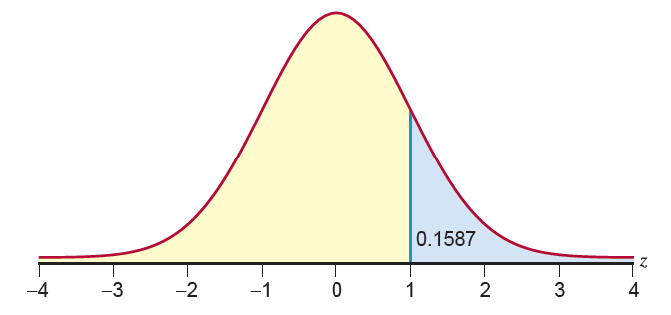
Example 6: Calculating the Probability of Payroll Processing Time Using the Standard Normal Distribution—Slide 4
Figure 15
Note that the X-value of 30 transformed into the z-value of 1. In other words, 30 is one standard deviation away from the mean.

Slide 37
Example 7: Calculating the Probability of Exceeding a Test Score Using the Standard Normal Distribution—Slide 1
Suppose that a national testing service gives a test in which the results are normally distributed with a mean of 400 and a standard deviation of 100. If you score a 644 on the test, what percentage of the students taking the test exceeded your score?
Solution
Let X = a student's score on the test.

Slide 38
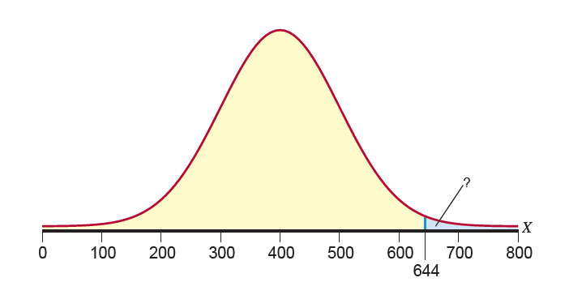
Example 7: Calculating the Probability of Exceeding a Test Score Using the Standard Normal Distribution—Slide 2
Figure 16

Slide 39
Example 7: Calculating the Probability of Exceeding a Test Score Using the Standard Normal Distribution—Slide 3
The first step is to standardize the random variable. Then, using Appendix A, Table B, find the appropriate probability.

Slide 40
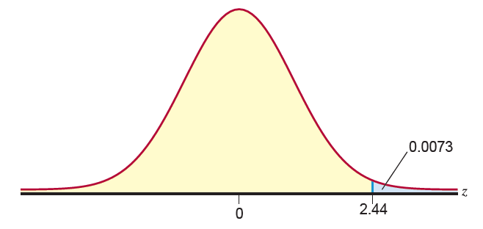
Example 7: Calculating the Probability of Exceeding a Test Score Using the Standard Normal Distribution—Slide 4
Figure 17
Thus, only 0.73% of the students scored higher than your score of 644.

Slide 41
Example 8: Calculating the Test Score Needed for a Specific Percentile—Slide 1
Using the information provided in Example 7, what score must a student get to be in the 90th percentile?
Solution
Recall that X = a student's score on the test follows a normal distribution with a mean of 400 and a standard deviation of 100. As with the examples before, a picture can be very helpful.

Slide 42
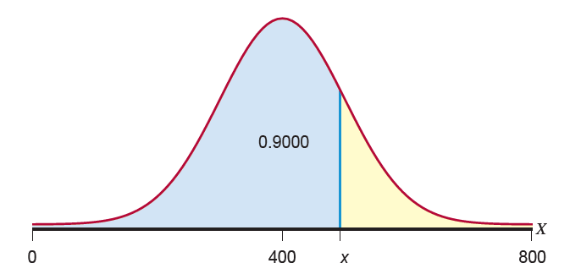
Example 8: Calculating the Test Score Needed for a Specific Percentile—Slide 2
Figure 18

Slide 43

Example 8: Calculating the Test Score Needed for a Specific Percentile—Slide 3
From the picture above, it can be seen that we want to find the value of X (the student's score) that represents the 90th percentile (i.e., the student scored the same or better than $90\%$ of other students taking the test). We would write
If we standardize the probability statement, we get the following.

Slide 44
Example 8: Calculating the Test Score Needed for a Specific Percentile—Slide 4
Next, substitute the values for the mean and standard deviation to get the following.
Note that we can rewrite the above probability statement as

Slide 45
Example 8: Calculating the Test Score Needed for a Specific Percentile—Slide 5
Therefore, we need to find the value of z with the area 0.90 to the left of it. To do this, we look in the body of the standard normal table (Table B in Appendix A) for the value 0.9000. It's not often that we can find the exact probability in the body of the table. When this is the case, we find the closest probability along with the corresponding value of z. In this case, the value of z = 1.28.
Thus,
Solving for x, we get x = 528.
Therefore, a student who scores 528 on the test will be in the 90th percentile.

Slide 46
Example 9: Calculating the Probability of Shuttle Flight Duration Using the Standard Normal Distribution—Slide 1
Suppose that for 132 space shuttle missions, the flight duration follows a normal distribution with a mean of 234 hours and a standard deviation of 94 hours. If you just read in the newspaper that a space shuttle will be launched tomorrow, what is the probability that the duration of the flight will be between 100 and 150 hours?

Slide 47
Example 9: Calculating the Probability of Shuttle Flight Duration Using the Standard Normal Distribution—Slide 2
Solution
Let X = the duration of a space shuttle flight. We are interested in the probability that X is between 100 and 150 hours. Writing this probability statement and then standardizing the random variable X, we have the following.

Slide 48
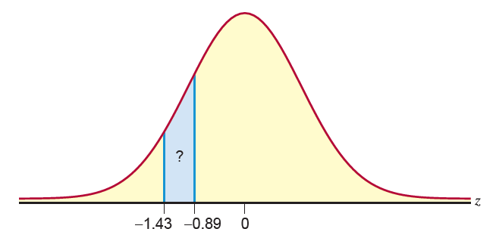
Example 9: Calculating the Probability of Shuttle Flight Duration Using the Standard Normal Distribution—Slide 3
Figure 19

Slide 49

Example 9: Calculating the Probability of Shuttle Flight Duration Using the Standard Normal Distribution—Slide 4
To find the probability that $z$ is between −1.43 and −0.89, we will need to find the probability that z is less than −0.89 and subtract the probability that z is less than −1.43. Using Table A in Appendix A, we have the following:
Thus, there is approximately an 11% chance that the flight will last between 100 and 150 hours.

