Slide 1
Section 7.5
Approximations to Other Distributions

Slide 2
The Binomial Distribution—Slide 1
Calculating binomial probabilities can be quite time consuming if n is large. For example, suppose that you intend to sample 2000 subjects for a marketing research survey. If 50 percent of the population believes your product is superior to the competition's, what is the probability of obtaining 600 or fewer subjects who believe your company's product is superior?

Slide 3
The Binomial Distribution—Slide 2
Determining the appropriate probability using the binomial distribution would require the calculation of 601 individual probabilities, many of which would have extremely large combinations such as the following.
The normal distribution is useful in approximating binomial probabilities. The larger the binomial parameter, n, the more accurate the approximation.

Slide 4
The Binomial Distribution—Slide 3
Recall that the normal distribution is a function of two parameters, the mean and the standard deviation. Thus, if the normal distribution is used to approximate the binomial distribution, it seems reasonable that the mean and standard deviation of the normal should be the same as the mean and standard deviation of the binomial that is being approximated. Specifically, let

Slide 5
The Binomial Distribution—Slide 4
To approximate a binomial with n = 20 and p = 0.5 would require a normal distribution with
In this example, the shapes of the distributions are quite similar and consequently the approximation will be good.

Slide 6
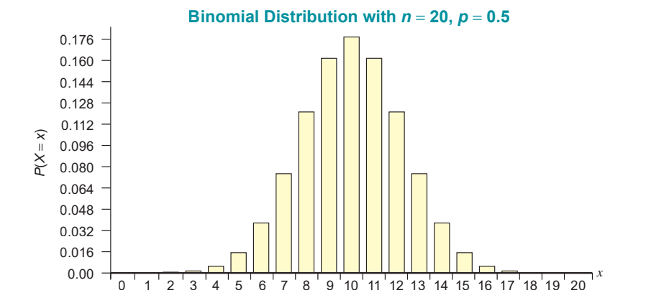
The Binomial Distribution—Slide 5
Figure 1

Slide 7
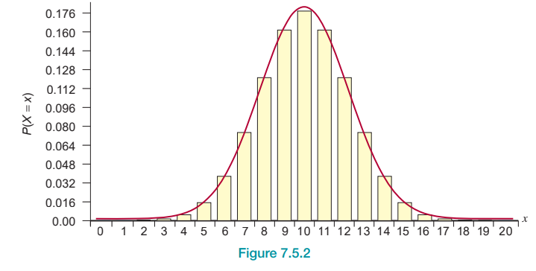
The Binomial Distribution—Slide 6
Normal Approximation to the Binomial Distribution with n = 20, p = 0.5
Figure 2

Slide 8
The Binomial Distribution—Slide 7
So, when should the normal distribution be used to approximate the binomial distribution?
Generally, the approximation is reasonable when the mean of the binomial, np, is greater than or equal to 5
is greater than or equal to 5. The
approximation becomes quite good when np is greater than or equal to 10 and
Is greater than or equal to 10.
The normal approximation to the binomial can be improved by using continuity correction.

Slide 9
The Binomial Distribution—Slide 8
Suppose that you wished to determine the probability that a binomial random variable (n = 20 and p = 0.5) is equal to 5. Recall that for a continuous random variable X, the probability that X is equal to some specific value is equal to zero since there is no area under the curve for a single point, say X = 5. Therefore, to approximate the probability using the normal would be equivalent to approximating the area of the shaded region given in Figure 3. To approximate the area of the region using the normal would require finding the area under the curve between 4.5 and 5.5.

Slide 10
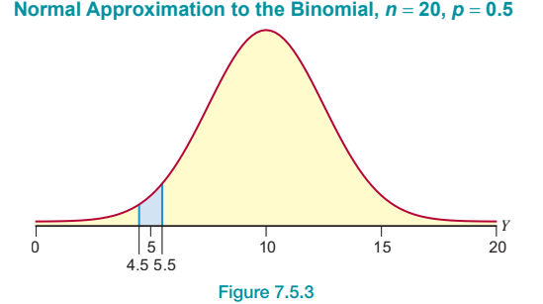
The Binomial Distribution—Slide 9
Figure 3
The continuity correction should be used whenever the normal distribution is used to approximate the binomial distribution. The following examples will illustrate how to approximate the binomial distribution using the normal distribution with continuity correction.

Slide 11
Definition: Continuity correction
Continuity correction is used when a discrete distribution is approximated using a continuous distribution. To apply continuity correction, subtract or add 0.5 (depending on the question at hand) to a selected value in order to find the desired probability.

Slide 12
Example 1: Using a Normal Distribution to Approximate a Binomial Probability—Slide 1
a. ​Assuming n = 20 and p = 0.5, use the normal distribution to approximate the probability that a binomial random variable is 5 or less.
b. ​Find the probability that the same random variable from part a. is greater than 4.

Slide 13
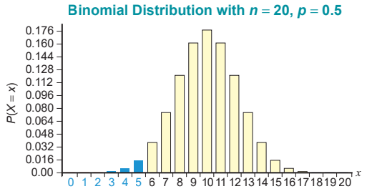
Example 1: Using a Normal Distribution to Approximate a Binomial Probability—Slide 2
Solution
a. ​This implies finding the area of the rectangles for 0, 1, 2, 3, 4, and 5.
Figure 4

Slide 14
Example 1: Using a Normal Distribution to Approximate a Binomial Probability—Slide 3
​Instead of using the normal approximation P (Y ≤ 5), use the continuity correction P (Y ≤ 5.5) in order to accumulate all of the probabilities under the normal curve that correspond to the region associated with the point 5.
​Using the normal distribution, Y, to approximate the binomial using continuity correction,

Slide 15
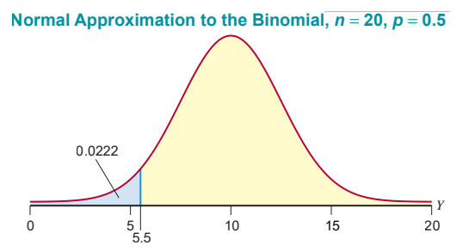
Example 1: Using a Normal Distribution to Approximate a Binomial Probability—Slide 4
Figure 5
Thus, the probability that the random variable is 5 or less is 0.0222.

Slide 16
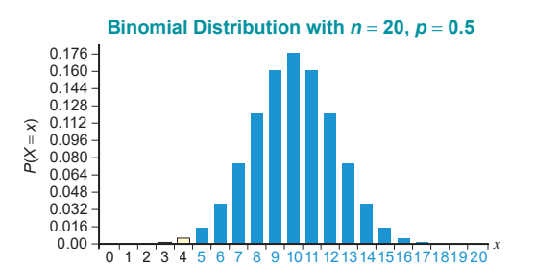
Example 1: Using a Normal Distribution to Approximate a Binomial Probability —Slide 5
b.​
Figure 6

Slide 17
Example 1: Using a Normal Distribution to Approximate a Binomial Probability—Slide 6
​We are interested in the probability that a binomial random variable, X, is greater than 4. Since this is a discrete distribution, the probability that X is greater than 4 is equal to the probability that X is greater than or equal to 5. Thus, when using the normal approximation, we need to apply continuity correction and consider the probability that the normal random variable is greater than or equal to 4.5.

Slide 18
Example 1: Using a Normal Distribution to Approximate a Binomial Probability—Slide 7
​​Using the normal distribution, Y, with a mean of 10 and a standard deviation of 2.2361 to approximate the binomial using continuity correction,

Slide 19
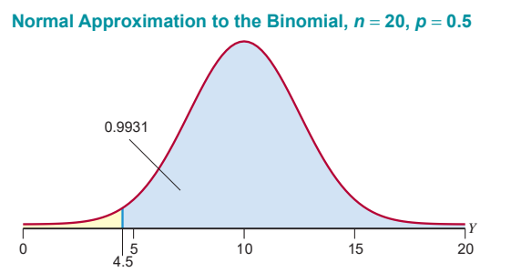
Example 1: Using a Normal Distribution to Approximate a Binomial Probability—Slide 8
Figure 7
​Thus, the probability that the random variable is greater than 4 is 0.9931.

Slide 20
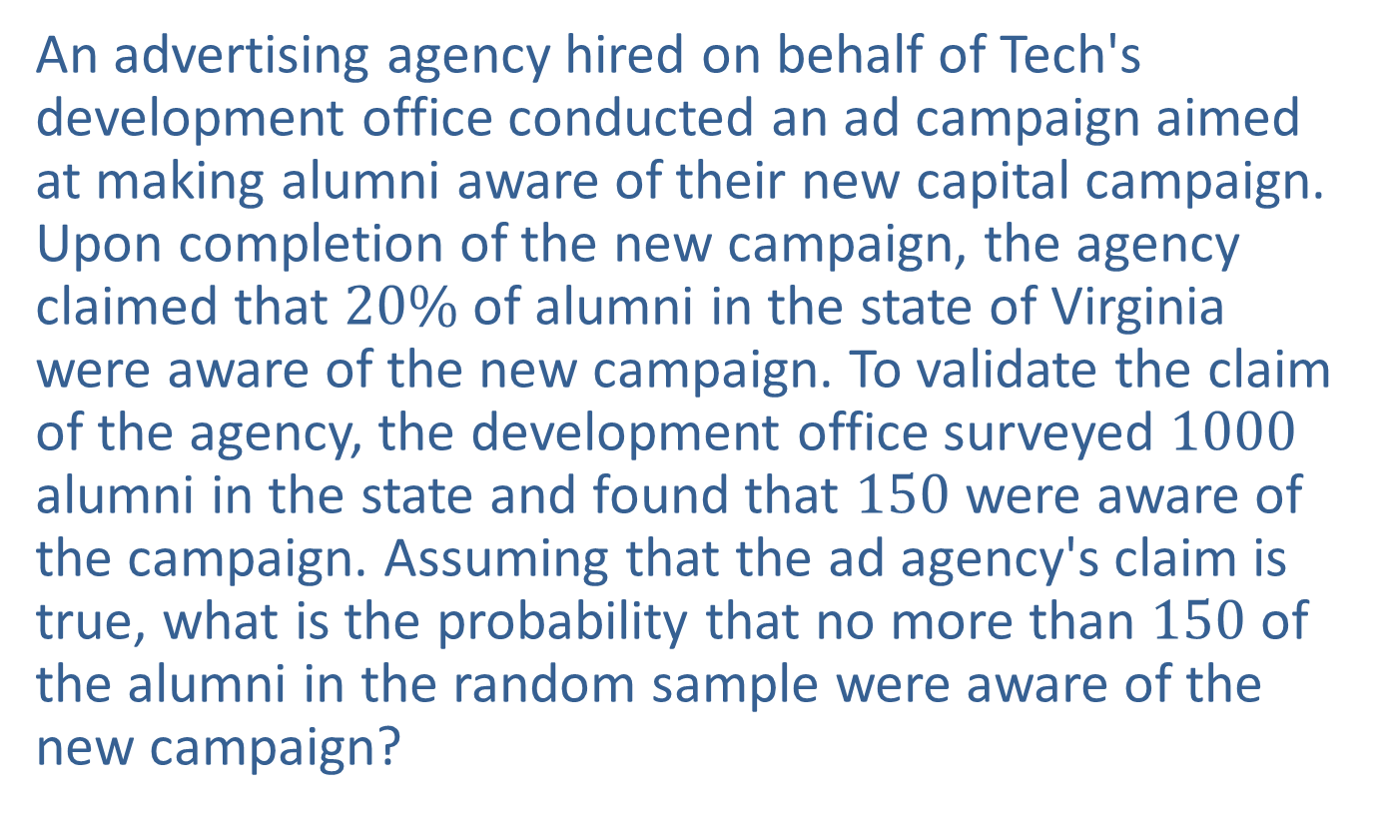
Example 2: Using a Normal Distribution to Approximate a Binomial Probability about Campaign Awareness—Slide 1
An advertising agency hired on behalf of Tech's development office conducted an ad campaign aimed at making alumni aware of their new capital campaign. Upon completion of the new campaign, the agency claimed that $20\%$ of alumni in the state of Virginia were aware of the new campaign. To validate the claim of the agency, the development office surveyed 1000 alumni in the state and found that 150 were aware of the campaign. Assuming that the ad agency's claim is true, what is the probability that no more than 150 of the alumni in the random sample were aware of the new campaign?

Slide 21
Example 2: Using a Normal Distribution to Approximate a Binomial Probability about Campaign Awareness—Slide 2
Solution :
Let X = the number of alumni that were aware of the campaign.
X is a binomial random variable with n = 1000 and p = 0.20.
Therefore, the normal distribution is appropriate to use as an approximation to the binomial distribution.
The mean is μ = np = 200 and the standard deviation is
We are interested in the probability that no more than 150 of the alumni in the sample were aware of the campaign, or
However, since we are using the normal distribution to approximate the binomial, continuity correction must be applied.

Slide 22

Example 2: Using a Normal Distribution to Approximate a Binomial Probability about Campaign Awareness—Slide 3
Let $Y$ be a normally distributed random variable with a mean of 200 and a standard deviation of 12.6491. Applying continuity correction, we are interested in the following probability.
Thus, if the marketing agency's claim is true, the probability that 150 or fewer alumni are aware of the campaign is practically zero. This would lead the development office to believe that the agency's claim is false.

Slide 23
Example 2: Using a Normal Distribution to Approximate a Binomial Probability about Campaign Awareness—Slide 4
The smaller the sample size, the more the binomial distribution deviates from the normal distribution. For this reason, continuity correction is especially useful for small sample sizes. Example 3 illustrates the difference that continuity correction makes when using the normal distribution to approximate the binomial.

Slide 24
Example 3: Using a Normal Distribution to Approximate a Binomial Probability about Restaurant No-Shows—Slide 1
A popular restaurant near Tech's campus accepts 200 reservations on Saturdays, the day of a Tech football game. Given that many of the reservations are made weeks in advance of game day, the restaurant expects that about eight percent will be no-shows. What is the probability that the restaurant will have no more than 20 no-shows on the next Saturday of a football weekend?

Slide 25
Example 3: Using a Normal Distribution to Approximate a Binomial Probability about Restaurant No-Shows—Slide 2
Solution
Let X = the number of no-shows.
X is a binomial random variable with n = 200 and
p = 0.08.
are both greater than 5, the normal distribution can be used to approximate the binomial probability.
For the binomial,

Slide 26
Example 3: Using a Normal Distribution to Approximate a Binomial Probability about Restaurant No-Shows—Slide 3
Using the normal distribution, Y, with a mean of 16 and a standard deviation of 3.8367, to approximate the binomial without continuity correction results in
Using continuity correction,

Slide 27
Example 3: Using a Normal Distribution to Approximate a Binomial Probability about Restaurant No-Shows—Slide 4
Thus, using the normal approximation and continuity correction, the probability that the restaurant will have no more than 20 no-shows is 0.8790. Notice that the continuity correction has a significant impact on the accuracy of the approximation. Using the binomial distribution, the exact probability is 0.8775.

Slide 28
The Poisson Distribution—Slide 1
Approximating the Poisson distribution with the normal distribution is similar to approximating the binomial distribution. To use this approximation, the mean and standard deviation of the normal should be set to the mean and standard deviation of the Poisson. Since the mean and variance of the Poisson are both λ, the appropriate mean, variance, and standard deviation for the normal would be as follows.

Slide 29
The Poisson Distribution—Slide 2
Just as with the binomial distribution, when using the normal distribution to approximate the Poisson distribution, continuity correction should be applied for the best possible approximation. This is because we are using a continuous distribution to approximate a discrete distribution. The approximation becomes increasingly accurate as the mean becomes larger. However, it is not very accurate when the mean of the Poisson distribution is less than 5.

Slide 30
Example 4: Using a Normal Distribution to Approximate a Poisson Probability about Customer Arrivals—Slide 1
The manager of a sporting goods store wants to determine the best method of staffing employees without being wasteful. The problem that is often encountered is having too many employees and too few customers, and vice versa. The manager realized that during the initial kick-off of certain sports seasons such as football, baseball, and basketball, the store attracts, on average, 30 customers per hour. On some days, the number is higher, on others, the number is lower. The manager would like to determine the probability of at least 40 customers arriving in a given hour. Use the normal approximation to the Poisson distribution to find the probability.

Slide 31
Example 4: Using a Normal Distribution to Approximate a Poisson Probability about Customer Arrivals—Slide 2
Solution
Let X = the number of customers that enter the store in a given hour.
Notice that since we are counting the number of customers in a specific time interval, X has a Poisson distribution with

Slide 32
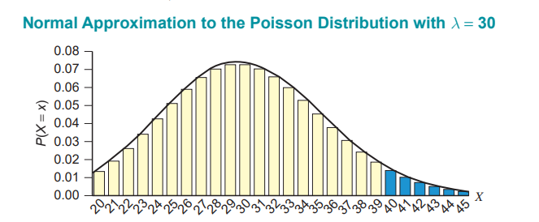
Example 4: Using a Normal Distribution to Approximate a Poisson Probability about Customer Arrivals—Slide 3
Figure 8

Slide 33
Example 4: Using a Normal Distribution to Approximate a Poisson Probability about Customer Arrivals—Slide 4
If Y represents the normal random variable with a mean of 30 and a standard deviation of 5.4772, it should be a good approximation to the Poisson. We are interested in the probability that at least 40 customers arrive in a given hour, or
Because we are using the normal distribution to approximate the Poisson distribution, we must use continuity correction. Thus, we are interested in the following probability.

Slide 34
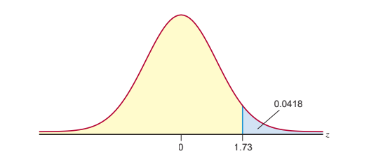
Example 4: Using a Normal Distribution to Approximate a Poisson Probability about Customer Arrivals—Slide 5
Figure 9
Thus, using the normal approximation to the Poisson, the probability that at least 40 customers arrive in a given hour is 0.0418.

