Slide 1
Section 8.2
The Distribution of the Sample Mean and the Central Limit Theorem

Slide 2
The Distribution of the Sample Mean and the Central Limit Theorem—Slide 1
Sample means vary because sample data vary from sample to sample. As an illustration, suppose that an automobile manufacturer wished to determine the average miles per gallon (mpg) of a specific vehicle model that it manufactures. Since determining the mpg of each vehicle is very time consuming, the manufacturer has decided to select two vehicles from a batch of six. Suppose that the actual mpg of the six vehicles are given in Table 1.

Slide 3
The Distribution of the Sample Mean and the Central Limit Theorem—Slide 2
Table 1 – Miles per Gallon
Car | MPG
A | 25
B | 27
C | 40
D | 29
E | 28
F | 30
Mean | 29.8
Variance | 23.14
Standard Deviation | 4.81

Slide 4
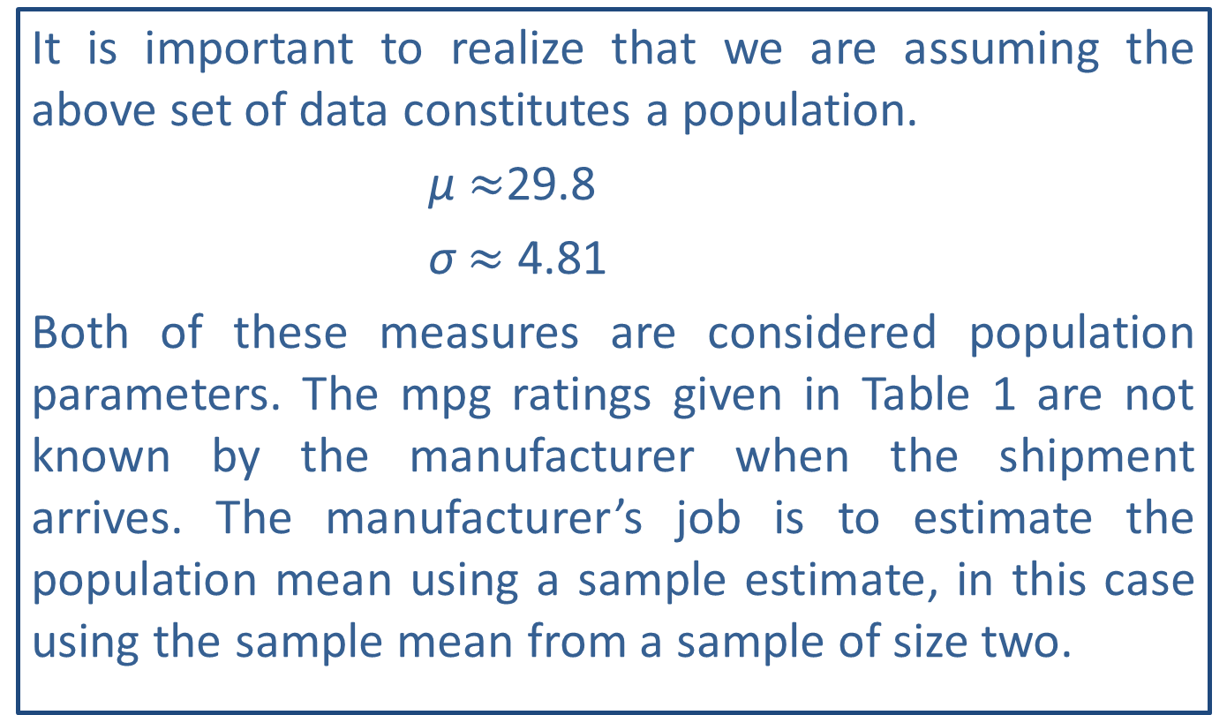
The Distribution of the Sample Mean and the Central Limit Theorem—Slide 3
It is important to realize that we are assuming the above set of data constitutes a population.
μ $≈$29.8
σ $≈$ 4.81
Both of these measures are considered population parameters. The mpg ratings given in Table 1 are not known by the manufacturer when the shipment arrives. The manufacturer’s job is to estimate the population mean using a sample estimate, in this case using the sample mean from a sample of size two.

Slide 5
The Distribution of the Sample Mean and the Central Limit Theorem—Slide 4
How many different samples of size two can be drawn? Assuming no replacement, there would be 15 possible samples of size two if order does not matter. A list of all possible samples and the resulting sample means is given in Table 2.

Slide 6
The Distribution of the Sample Mean and the Central Limit Theorem—Slide 5
Table 2 - MPG Sample Measurements (n = 2)
Sample Number | Car 1 | Car 2 | First Observation | Second Observation | Mean, x̄
1 | A | B | 25 | 27 | 26.0
2 | A | C | 25 | 40 | 32.5
3 | A | D | 25 | 29 | 27.0
4 | A | E | 25 | 28 | 26.5
5 | A | F | 25 | 30 | 27.5
6 | B | C | 27 | 40 | 33.5
7 | B | D | 27 | 29 | 28.0
8 | B | E | 27 | 28 | 27.5

Slide 7
The Distribution of the Sample Mean and the Central Limit Theorem—Slide 6
Table 2 - MPG Sample Measurements (n = 2)
Sample Number | Car 1 | Car 2 | First Observation | Second Observation | Mean, x̄
9 | B | F | 27 | 30 | 28.5
10 | C | D | 40 | 29 | 34.5
11 | C | E | 40 | 28 | 34.0
12 | C | F | 40 | 30 | 35.0
13 | D | E | 29 | 28 | 28.5
14 | D | F | 29 | 30 | 29.5
15 | E | F | 28 | 30 | 29.0

Slide 8
The Distribution of the Sample Mean and the Central Limit Theorem—Slide 7
The sample means in Table 2 vary and when something varies there are at least three questions to ask:
1. What is the central value of the variable?
2. What is the variability of the variable?
3. Is there a pattern (distribution) to the variability?

Slide 9
Definition: Unbiased
If the average value of an estimator equals the population parameter being estimated, the estimator is said to be unbiased.

Slide 10
What is the Central Value of x bar? —Slide 1
Intuitively, you would expect the sample mean to be larger than μ some of the time and smaller than μ some
of the time. For large samples, the distribution of
will be relatively symmetrical, and consequently,
should be larger than μ about 50% of the time and smaller than μ about 50% of the time. But for small samples, the distribution of the sample mean may not be symmetrical. Generally, however, the sample means should be near the population mean, or symbolically,
should be near μ. It can be shown theoretically that the mean of the

Slide 11
What is the Central Value of x bar? —Slide 2
Estimators are similar to marksmen. When you shoot, you want to hit what you are shooting at.
When you estimate, you want to get as close as possible to the population characteristic you are estimating. But, bullets do not always land exactly where the marksman aims. If the gun sights are properly adjusted, then the shots will be dispersed around the middle of the target area.

Slide 12
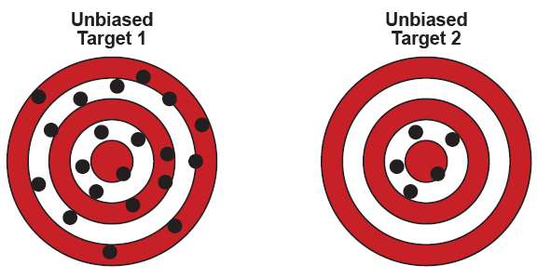
What is the Central Value of x bar? —Slide 3
Figure 1

Slide 13
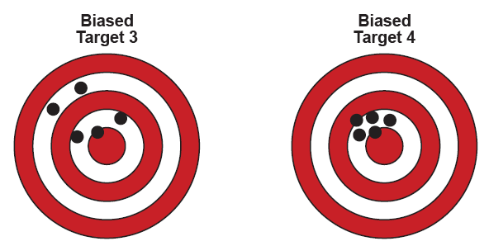
What is the Central Value of x bar? —Slide 4
Figure 2

Slide 14
What is the Central Value of x bar? —Slide 5
An estimator which produces estimates centered around the true value is said to be unbiased.
Unbiasedness is desirable property for an estimator to possess. Just as the ideal target rifle is one that would hit in exactly the same place every shot, the ideal estimator is one that is unbiased. Since the mean of
is always equal to μ,
is an unbiased estimator of μ.

Slide 15
What is the Central Value of x bar? —Slide 6
If an estimator is unbiased, its variability determines its reliability. If an unbiased estimator is extremely variable, then the individual estimates it produces may not be as close to the parameter being estimated as estimates produced by a biased estimator with little variability. This is why it is important to not only consider the central value, but also the variability of a random variable, in this case the sample mean.

Slide 16
Properties: Unbiased Estimators
1. The sample mean,
is an unbiased estimator of μ.
2. The sample proportion,
is an unbiased estimator p.
3. The sample variance, s², is an unbiased estimator of σ².

Slide 17
Formula: Standard Deviation of the Sample Mean: Infinite Population
It can be shown that for a population of infinite size, the standard deviation of
denoted as
where σ is the population standard deviation and n is the sample size.

Slide 18
What is the Variability of x bar? —Slide 1
The variability of an estimator reveals a great deal about the quality of that estimator. In order to assess how well the sample mean estimates the population mean, the standard deviation of the sample means must be determined.
We refer to
as the standard error of the mean,
generally called the standard error, which is the standard deviation of a point estimator. We will use the standard error of the mean to indicate how far the sample mean is from the population mean.

Slide 19
What is the Variability of x bar? —Slide 2
Suppose, for example, you were drawing a sample from a population whose standard deviation is 4.81. The standard deviation of the sample means for samples of size n = 2 would be:
If the population is finite, as in Table 1, then the
finite population correction factor
must be applied to the calculation of the standard deviation of the sample mean.

Slide 20
What is the Variability of x bar? —Slide 3
Correcting for the finite population represented in Table 1, the standard deviation of the sample means for samples of size 2 would be
Examining the formula for
we notice that as the
size of the sample, n, increases, the variability of the sample mean decreases. The possibility of changing the variability of an estimator means the accuracy of the estimator can be manipulated.

Slide 21
What is the Variability of x bar? —Slide 4
For example, suppose that instead of using a sample of size two, the manufacturer decides to use a sample of size three.
Six items chosen three at a time could produce 20 samples of size three. The standard deviation of the sample means for n = 3 in Table 3 is approximately 2.15, using the finite population correction factor.
For both samples (n = 2 and n = 3), the mean of the sample means is approximately 29.8, which equals the population mean. But the standard deviation of the sample means for samples of size three is 2.15, which is smaller than the standard deviation for samples of size two.

Slide 22
What is the Variability of x bar? —Slide 5
Table 3 MPG Sample Measurements (n = 3)
Sample Number | Car 1 | Car 2 | Car 3 | First Observation | Second Observation | Third Observation | Mean, x̄
1 | A | B | C | 25 | 27 | 40 | 30.67
2 | A | B | D | 25 | 27 | 29 | 27.00
3 | A | B | E | 25 | 27 | 28 | 26.67
4 | A | B | F | 25 | 27 | 30 | 27.33
5 | A | C | D | 25 | 40 | 29 | 31.33
6 | A | C | E | 25 | 40 | 28 | 31.00
7 | A | C | F | 25 | 40 | 30 | 31.67
8 | A | D | E | 25 | 29 | 28 | 27.33
9 | A | D | F | 25 | 29 | 30 | 28.00
10 | A | E | F | 25 | 28 | 30 | 27.67

Slide 23
What is the Variability of x bar? —Slide 6
Table 3 MPG Sample Measurements (n = 3)
Sample Number | Car 1 | Car 2 | Car 3 | First Observation | Second Observation | Third Observation | Mean, x̄
11 | B | C | D | 27 | 40 | 29 | 32.00
12 | B | C | E | 27 | 40 | 28 | 31.67
13 | B | C | F | 27 | 40 | 30 | 32.33
14 | B | D | E | 27 | 29 | 28 | 28.00
15 | B | D | F | 27 | 29 | 30 | 28.67
16 | B | E | F | 27 | 28 | 30 | 28.33
17 | C | D | E | 40 | 29 | 28 | 32.33
18 | C | D | F | 40 | 29 | 30 | 33.00
19 | C | E | F | 40 | 28 | 30 | 32.67
20 | D | E | F | 29 | 28 | 30 | 29.00

Slide 24
What is the Variability of x bar? —Slide 7
Since both estimators are unbiased and are centered around the population mean, the standard deviation of the estimator is a measure of how close the estimator (in this case the sample mean) is to the population mean. In other words, the lower
is, the better the estimator is.
Greater accuracy can be achieved by taking a larger sample, but larger samples normally cost more to collect and examine.

Slide 25
What is the Variability of x bar? —Slide 8
Suppose a population had a mean of 43,660 and a standard deviation of 2500. The distributions in Figure 3 are the distributions of the sample mean for samples of size 25, 100, and 200, respectively, from this population. Based on the graphs in Figure 3, it seems that the estimator shown for n = 200 would be preferred. Because it has less variability, the estimates of μ
from samples of n = 200 should be closer (on average) to μ.

Slide 26
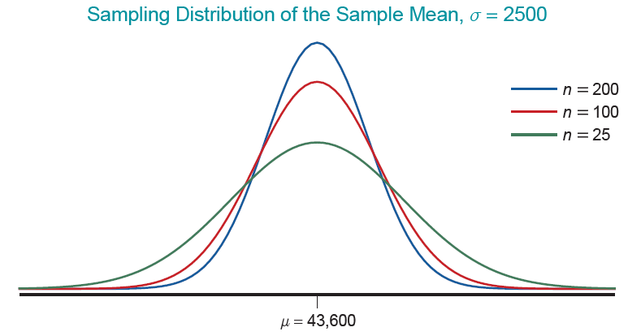
What is the Variability of x bar? —Slide 9
Figure 3

Slide 27
Note
For most of the populations you will encounter, the assumption is made that the population is infinite.

Slide 28
Formula: Standard Deviation of the Sample Mean: Finite Population
For a finite population the standard deviation of
where N = the size of the population and n = the size of the sample.

Slide 29
Properties: Characteristics of the Sample Mean
If an estimate of the population mean is required, the sample mean possesses two desirable characteristics.
1. ​The mean of the sample means is the population mean. Another way of expressing this concept is to say that the expected value of
​
is equal to the population mean.
Symbolically, this can be expressed as
2. If the sample size is increased, the standard error of the sample mean decreases. This implies that the quality of the estimator tends to improve as the sample size increases.

Slide 30

Theorem: Central Limit Theorem
If a sufficiently large random sample (i.e., n$≥30$) is drawn from a population with mean μ and standard deviation σ, the distribution of the sample mean will have the following characteristics.
1. An approximately normal distribution regardless of the distribution of the underlying population.
The mean of the sample means equals the population mean.
The standard deviation of the sample means
equals the standard deviation of the population divided by the square root of the sample size.

Slide 31
Is There a Familiar Pattern to the
Variability?—Slide 1
The Central Limit Theorem is a very important theorem that summarizes the distribution of the sample mean. The distribution of the sample mean becomes closer to a normal distribution as the sample size becomes larger, regardless of the distribution of the population from which the sample is drawn.
The most important feature of the Central Limit Theorem is that it can be applied to any population. Because the theorem does not have any distributional assumptions, it is widely applicable and is one of the cornerstones of statistical inference. Many of the statistical techniques discussed in subsequent chapters will have their theoretical basis in this theorem.

Slide 32
Is There a Familiar Pattern to the
Variability?—Slide 2
The only restrictive feature of the theorem is that the sample size must be sufficiently large for the theorem to be applicable. Even if the distribution of the population deviates substantially from the normal distribution, a sample size of at least 30 will be sufficiently large to produce a sampling distribution for
that is approximately normal.
Additionally, points 2. and 3. are true even for small samples when it can be shown that the samples are drawn from a population that is normally distributed. If the population is known to be normally distributed, then the sampling distribution of
will be normally distributed for any sample size.

Slide 33
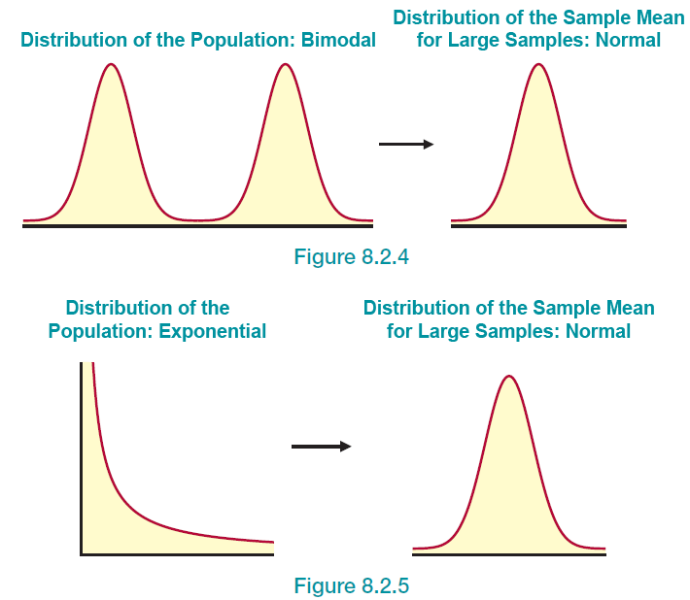
Is There a Familiar Pattern to the
Variability?—Slide 3
Figure 4
Figure 5

Slide 34
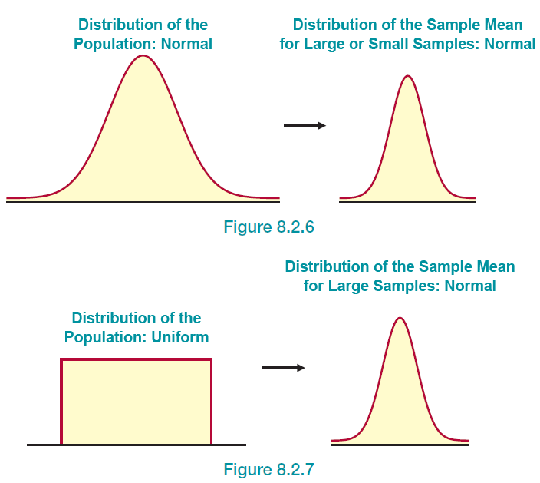
Is There a Familiar Pattern to the
Variability?—Slide 4
Figure 6
Figure 7

Slide 35
Is There a Familiar Pattern to the
Variability?—Slide 5
If we are dealing with samples that are sufficiently large, once we have determined that the Central Limit Theorem applies and that the sampling distribution of the sample means is approximately normally distributed, we can standardize any sample mean to find probabilities that we are interested in. Thus, we can adapt the z-score formula as follows.

Slide 36
Example 1: Calculating a Probability Using the Central Limit Theorem—Slide 1
A recycling plant compresses aluminum cans into bales. The weights of the resulting bales are known to have a mean of 100 pounds and a standard deviation of 8 pounds. A simple random sample of 50 bales is taken. What is the probability that the bales will weigh, on average, less than 104 pounds?

Slide 37

Example 1: Calculating a Probability Using the Central Limit Theorem—Slide 2
Solution
The information provided in the problem is as follows:
μ $=100$ pounds, σ $=8$ pounds, and n $=50$ bales.
Let X be a random variable that represents the weight of a bale.
By the Central Limit Theorem (since n $≥30$), the distribution of
will be approximately normal with a
mean equal to the population mean, 100, and a
standard error given by

Slide 38
Example 1: Calculating a Probability Using the Central Limit Theorem—Slide 3
Thus, to find the probability that the bales weigh, on average, less than 104 pounds, we are interested in the following probability.

Slide 39
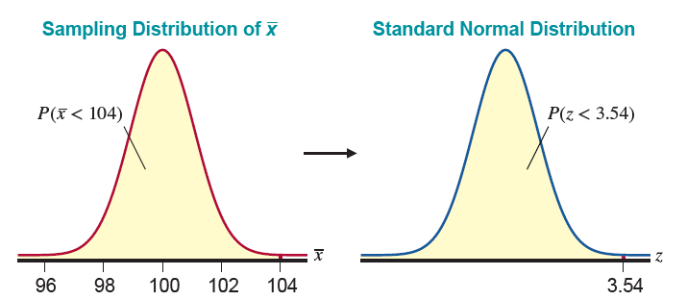
Example 1: Calculating a Probability Using the Central Limit Theorem—Slide 4
Figure 8

Slide 40
Example 1: Calculating a Probability Using the Central Limit Theorem—Slide 5
Since
is a normal random variable, the probability that
is less than 104 pounds is determined using a
z-transformation.
Since Table B’s largest value is 3.49, yielding a probability of 0.9998, we say that the probability is approximately 1.

Slide 41
Definition: Error of Estimation
In general, the error of estimation is the difference between a sample statistic and the parameter that it is estimating.

Slide 42
Example 2: Using the Error of Estimation to Calculate a Probability—Slide 1
Suppose that a population has an unknown mean and a standard deviation of 5. A sample of size 100 is drawn from the population. If the sample mean is used as an estimate of the population mean, what is the probability that the sample mean will be within one unit of the true mean?

Slide 43
Example 2: Using the Error of Estimation to Calculate a Probability—Slide 2
Solution
Since the error of estimation is defined to be the difference between the sample statistic and the parameter that it is estimating, for this problem the error of estimation is one. In the problem at hand, the error is given by
​
since we will be using
to estimate μ.
However, we are just as interested in negative errors as positive errors. Thus, to satisfy the condition that an error of less than one unit has been made, we are interested in the following probability.
Standardizing, we obtain the following.

Slide 44
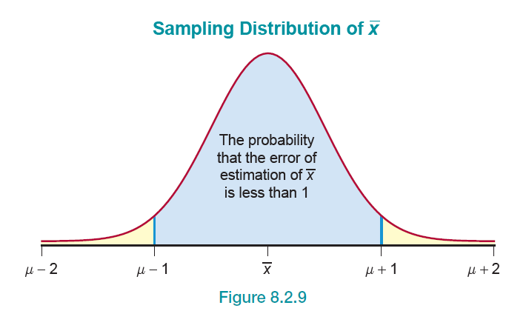
Example 2: Using the Error of Estimation to Calculate a Probability—Slide 3
Figure 9

Slide 45
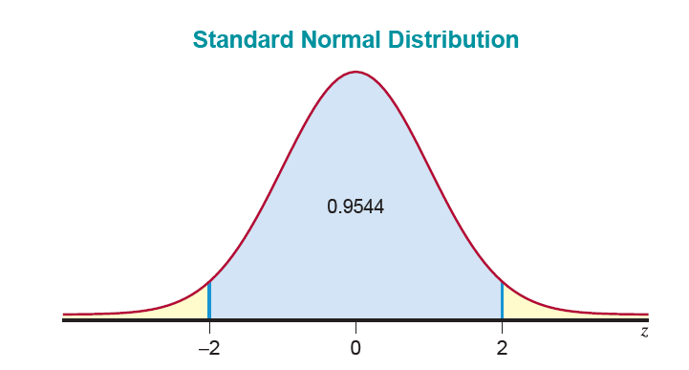
Example 2: Using the Error of Estimation to Calculate a Probability—Slide 4
Figure 10

Slide 46
Example 2: Using the Error of Estimation to Calculate a Probability—Slide 5
Thus, if a sample size of 100 is drawn from the population given, the probability that the sample mean will be within one unit of the population mean is 0.9544.
In this problem, we were able to determine the probability of making an error of less than one unit without knowing the mean of the population. This probability (0.9544) tells us a lot about the quality of the estimate
The estimate of μ obtained from a sample of size 100 is more than just an estimate now, it is an estimate with a “level of confidence” in its quality.

Slide 47
Example 3: Calculating the Standard Deviation Given a Probability—Slide 1
The lifetime of a certain type of micro transistor is normally distributed with a mean of 156 hours. It is known that 1.5 percent of the transistors have a lifetime greater than 167 hours.
​What is the standard deviation of the distribution of the lifetimes of the transistors?
​Using the standard deviation calculated in part a., what is the probability that the average lifetime of a sample of 25 transistors is at least 155 hours?

Slide 48
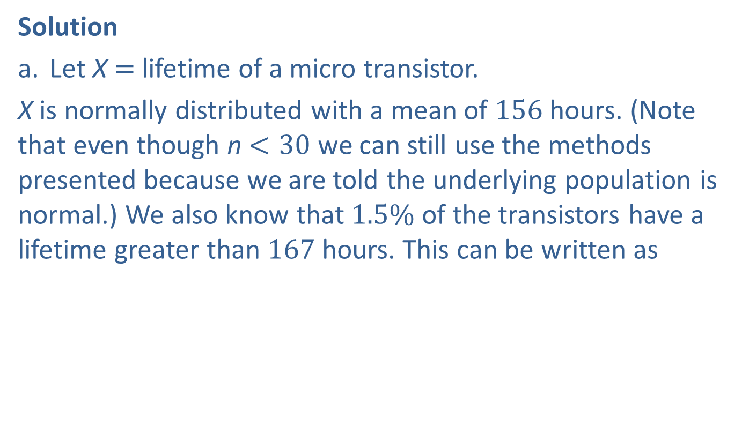
Example 3: Calculating the Standard Deviation Given a Probability—Slide 2
Solution
a. Let X$=$ lifetime of a micro transistor.
X is normally distributed with a mean of 156 hours. (Note that even though n $<30$ we can still use the methods presented because we are told the underlying population is normal.) We also know that $1.5\%$ of the transistors have a lifetime greater than 167 hours. This can be written as
​​
​Since is σ is unknown, we can find σ using $\left(1\right)$ such that

Slide 49
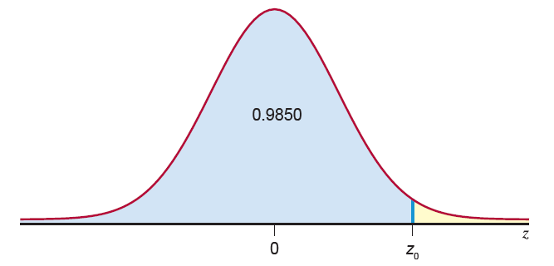
Example 3: Calculating the Standard Deviation Given a Probability—Slide 3
Figure 11

Slide 50

Example 3: Calculating the Standard Deviation Given a Probability—Slide 4
and
where
Finding the value 0.9850 in Table B, we see that
Thus,
and solving for $σ$, we get

Slide 51
Example 3: Calculating the Standard Deviation Given a Probability—Slide 5
Since X is normally distributed, then
is also normally distributed. Thus,

Slide 52
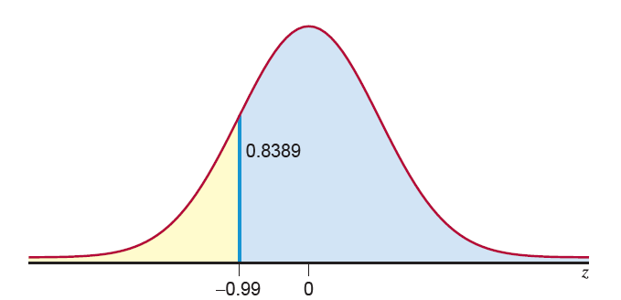
Example 3: Calculating the Standard Deviation Given a Probability—Slide 6
Figure 12
Thus, the probability that the average lifetime of a sample of 25 transistors is at least 155 hours is 0.8389.

