Slide 1
Section 8.3
The Distribution of the Sample Proportion

Slide 2
Definition: Sample Proportion
The sample proportion is given by
where x is the number of observations in the sample possessing the characteristic of interest and n is the total number of observations in the sample.

Slide 3
Determining the Sample Proportion, p hat—Slide 1
Suppose you are trying to determine the fraction of manufacturing components that are defective. If you select 120 components at random and 38 components are defective, then
In general, when calculating a proportion, the number in the sample that possess the characteristic of interest goes in the numerator, and the size of the sample is placed in the denominator.

Slide 4
Determining the Sample Proportion, p hat—Slide 2
Just as the sample mean was a good estimate of the population mean, the sample proportion is a good estimate of the population proportion. Also, recall that the sample mean varied depending on the sample selected. The sample proportion varies in the same manner.
Since
varies, three familiar questions must be examined.
1. What is the central value?
2. What is the variability?
3. Is there a pattern to the variability?

Slide 5
Definition: Standard Deviation of the Sample Proportion
The standard deviation of
is given by
where p is the population proportion and n is the sample size.

Slide 6
What is the Central Value of p hat?—Slide 1
The expected value of the sample proportion,
is the population proportion, p. Symbolically, this is expressed as
Since the expected value of the estimator
is equal to p,
is an unbiased estimator of p.

Slide 7
What is the Central Value of p hat?—Slide 2
is affected by the values of p and n.
Note that
The standard deviation of
decreases as n becomes
larger. Also, the numerator reaches a maximum when p = 0.5 and declines as you move away from that figure. So for a fixed value of n,
has its greatest standard
deviation when the population proportion equals 0.5. If the population proportion is unknown (which is usually the case), p can be estimated by
, and the
standard deviation of the sample proportion is estimated as

Slide 8
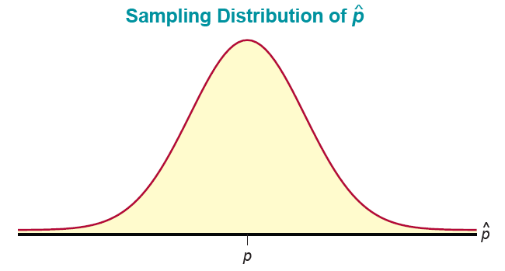
Is There a Familiar Pattern to the Variability of p hat?—Slide 1
approaches normality as
The sampling distribution of
n becomes sufficiently large. The sample size is generally considered “sufficiently large”
Figure 1
The sampling distribution of
is summarized below,
for both finite and infinite populations.

Slide 9
Properties: Sampling Distribution of the Sample Proportion—Slide 1
If the population is infinite and the sample is sufficiently large
the distribution of
has the following characteristics.
1. ​An approximately normal distribution.
(The mean of the sample proportions equals the population proportion.)

Slide 10
Properties: Sampling Distribution of the Sample Proportion—Slide 2
If the population is finite and the sample is sufficiently large, the distribution of
has the following characteristics.
1. An approximately normal distribution.
where N is the size of the population.

Slide 11
Is There a Familiar Pattern to the Variability of p hat?—Slide 2
is a good estimator of p, one of the natural
Since
questions to ask is, can limits be established for the error of estimation? Since the sampling distribution of
is known, probabilities for various errors of estimation can be determined.

Slide 12
Example 1: Calculating a Probability for the Proportion of Switches—Slide 1
A series of tests conducted by the company Switches, We Got'em indicates that a particular type of switch manufactured by the company will operate correctly 95% of the time. If 200 switches are selected at random, what is the probability that less than 90% of the switches will operate correctly?

Slide 13
Example 1: Calculating a Probability for the Proportion of Switches—Slide 2
Solution
The information given in the problem is summarized below.
We want to determine the probability that less than 90% of the switches in the sample will operate correctly. This translates to

Slide 14
Example 1: Calculating a Probability for the Proportion of Switches—Slide 3
Since
the sample size is sufficiently large, and we can assume that the sample proportion is approximately normally distributed with

Slide 15
Example 1: Calculating a Probability for the Proportion of Switches—Slide 4
Therefore, we can standardize the distribution of the sample proportion as follows.

Slide 16
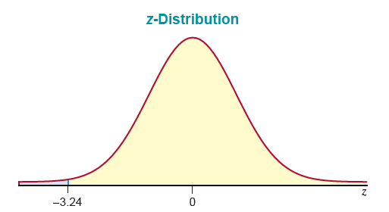
Example 1: Calculating a Probability for the Proportion of Switches—Slide 5
Figure 2

Slide 17
Example 1: Calculating a Probability for the Proportion of Switches—Slide 6
Thus, the probability that
is 0.0006.
With the information we have developed thus far, we can begin to draw conclusions (i.e., make inferences about the population proportion). If it is true that this particular type of switch works 95% of the time, then it is unlikely that we would observe a sample proportion of less than 90% in a sample of 200 switches.

Slide 18
Example 2: Calculating a Probability for the Proportion who Prefer Pepsi—Slide 1
Suppose a sample of 400 people is used to perform a taste test. If the true proportion of the population that prefers Pepsi is 0.5, what is the probability that less than 44% of the persons in the sample will prefer Pepsi?

Slide 19
Example 2: Calculating a Probability for the Proportion who Prefer Pepsi—Slide 2
Solution
Assume the population from which the sample is drawn is extremely large and the finite population correction factor is not applicable. The distribution of
would then be normal with
The probability that the sample proportion is less than 0.44 is given by

Slide 20
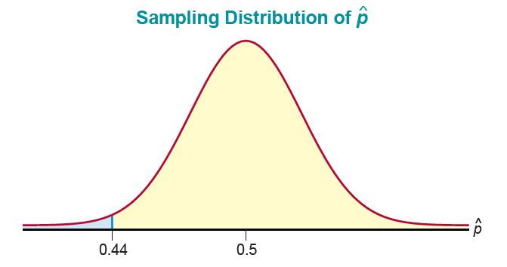
Example 2: Calculating a Probability for the Proportion who Prefer Pepsi—Slide 3
Figure 3

Slide 21
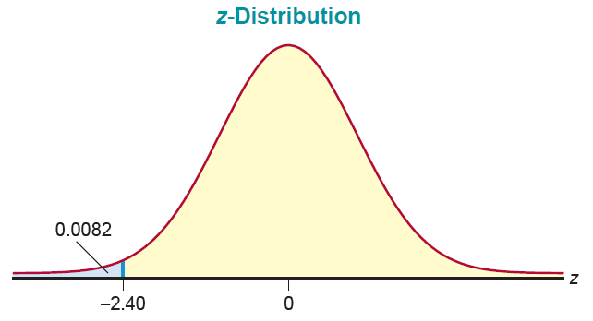
Example 2: Calculating a Probability for the Proportion who Prefer Pepsi—Slide 4
Figure 4

Slide 22
Example 2: Calculating a Probability for the Proportion who Prefer Pepsi—Slide 5
If the true proportion of people in the population who prefer Pepsi is 0.5, it is extremely unlikely (0.0082 is less than 1 in 100) to observe a sample proportion as low as 0.44. Suppose that you had to make a decision as to whether cola drinkers were indifferent between Pepsi and Coke. If they were indifferent, the proportion who prefer Pepsi should be around 0.5. If you used a sample of 400 people and observed a sample proportion of 0.438 that preferred Pepsi, which of the conclusions would you believe?

Slide 23
Example 2: Calculating a Probability for the Proportion who Prefer Pepsi—Slide 6
Conclusion A: Cola drinkers are indifferent between Pepsi and Coke. Stated another way, the proportion of persons that favor Pepsi is about 0.5.
Conclusion B: Cola drinkers are not indifferent between Pepsi and Coke. In other words, people prefer one brand of cola over the other.
The likelihood of observing a sample with
less than
0.44 is very rare (0.0082) given that the true proportion who prefer Pepsi is P = 0.5. This leads us to doubt Conclusion A, and select Conclusion B.

Slide 24
Example 3: Calculating a Probability Concerning the Error of Estimation—Slide 1
Suppose a sample of 150 is used to estimate the proportion of U.S. citizens over 18 that favors expanding government regulation of major financial institutions. If the proportion that favors expanding government regulation is really 0.6, what is the probability that the error of estimation will be less than five percentage points?

Slide 25
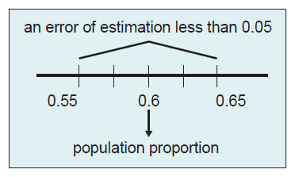
Example 3: Calculating a Probability Concerning the Error of Estimation—Slide 2
Solution
Since the true value of the population proportion is 0.6, the value of
must fall between 0.55 and 0.65 in order
for the error of estimation to be less than 0.05.
Figure 5

Slide 26
Example 3: Calculating a Probability Concerning the Error of Estimation—Slide 3
In order to determine the probability that
will fall in this
interval, its distribution must be determined. Since the
distribution of
is approximately normal for large samples
the distribution of will be
approximately normal with
To find the probability that
is within 0.05 of the true
proportion, we must find

Slide 27
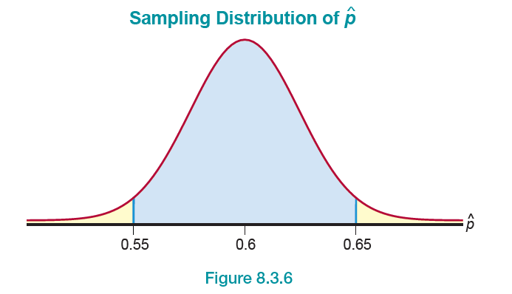
Example 3: Calculating a Probability Concerning the Error of Estimation—Slide 4
Figure 6

Slide 28
Example 3: Calculating a Probability Concerning the Error of Estimation—Slide 5
Using the z-transformation,

Slide 29
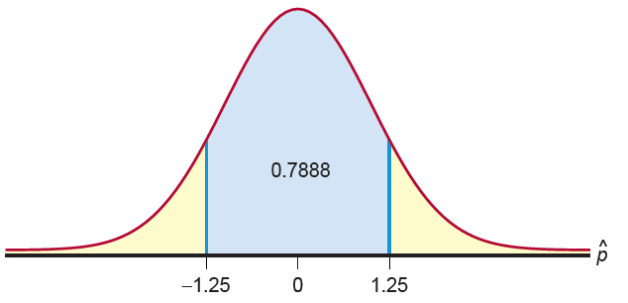
Example 3: Calculating a Probability Concerning the Error of Estimation—Slide 6
Figure 7
Therefore, for a sample of 150 U.S. citizens over 18 years of age, it is likely (0.7888) that the error of estimation will be less than five percentage points.

