Slide 1
Section 8.4
Sampling Methods

Slide 2
Definition: Probability Sample
A probability sample is a sample used to estimate a population parameter that has known errors, allowing a statement about the reliability of the estimate to be made.

Slide 3
Definition: Non-Probability Sample
A non-probability sample is a convenient sample used to estimate a population parameter in which no statement about the estimate's reliability can be made.

Slide 4
Definition: Judgement Sample
A judgement sample is a sample collected by an expert in a specific field of study. The quality of the sample depends on the competence of the expert.

Slide 5
Definition: Convenience Sample
A convenience sample is a non-probability sample that can be easily collected but may not be representative of the population.

Slide 6
Definition: Systematic sampling
Systematic sampling involves including every k^{th} member of the population in the sample.

Slide 7
Systematic sampling—Slide 1
One type of sampling technique, the systematic sample, does not belong to the probability or non-probability sample categories.
For example, suppose a sample of 1000 names is to be selected from a mailing list that contains 80,000 names. If every 80th person in the mailing list is selected for inclusion in the sample, the result will be a sample of 1000 names. If the names are in random order, then the systematic sample will produce a random sample. Unfortunately, it is difficult to be sure that the list does not possess some pattern that would bias the sample. Still systematic samples are regularly used in sampling mailing lists. They are also used in controlling production quality. Production-oriented quality control plans frequently call for the inspection (sample) of every k^{th} item on an assembly line. A sample using this technique is often called an “almost random sample.”

Slide 8
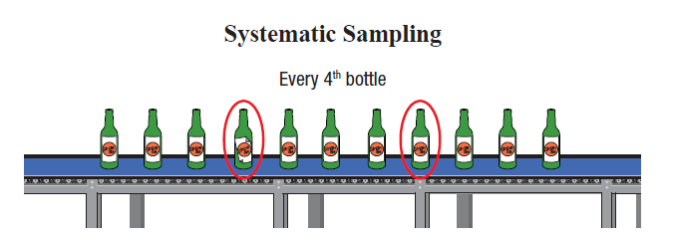
Systematic sampling—Slide 2
Systematic samples are generally good samples. But if there is some pattern in the sampling frame that corresponds to the sampling pattern, an unrepresentative sample can result. For example, suppose you wished to sample a list containing total daily sales. If you sampled every 7th item, the result would be a sample that contained sales from only one day of the week.
Figure 2

Slide 9
Definition: Cluster Sampling
Cluster sampling involves dividing the population into clusters, and randomly selecting a sample of clusters to represent the population

Slide 10
Cluster Sampling—Slide 1
Although simple random sampling may be feasible, the traveling cost required to obtain the sample information may be prohibitive. Suppose McDonald’s wishes to perform quality control inspection on its franchises. If a random sample of 500 is drawn from the 31,000 McDonald’s restaurants scattered throughout the world, the quality inspection team could be in for quite a bit of traveling. Instead of selecting the stores individually, suppose we divide the world into 200 regions. Then we could select 20 of these regions and inspect every store in those regions. This technique is called cluster sampling. Using this technique, an inspector would be required to travel much less and a substantial reduction in cost would result.

Slide 11
Cluster Sampling—Slide 2
Clusters are not always geographic. Suppose you were interested in soliciting student opinion regarding bookstore prices. If everyone in the college had a 9:00 AM class, one reasonable method of clustering would be to use each class as a cluster. Randomly select a set of clusters (classes) and interview each member of the selected cluster.
Cluster sampling can be as effective as simple random sampling if the clusters are as heterogeneous as the population. Unfortunately, clusters are almost never as diverse as the population. If the clusters are geographic, people in the same geographic area tend to be less diverse than the population. If the clusters are not heterogeneous, cluster sampling is less efficient than simple random sampling for a given sample size. Generally, smaller cluster sizes will result in more representative samples.

Slide 12
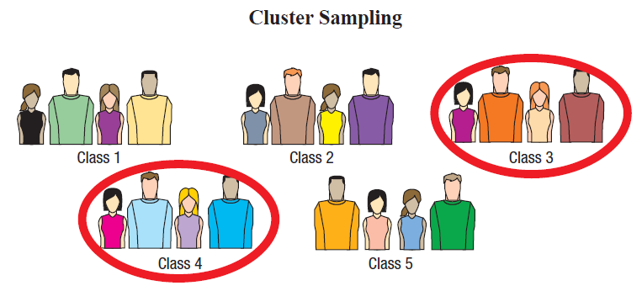
Cluster Sampling—Slide 3
In simple random sampling, constructing the sampling frame is frequently cumbersome. Cluster sampling simplifies the task, since the initial frame is composed only of clusters. Only those clusters selected as part of the sample must be completely enumerated and sampled.
Cluster sampling is a good alternative to simple random sampling when the population’s geographic area is spread out over a large area or when the sampling frame for a simple random sample is difficult to construct.
Figure 3

Slide 13
Definition: Stratified Sampling
In stratified sampling, the population is divided into strata, which are sub-populations. Subjects are then chosen from each stratum in order to accurately represent the population. A stratum can be any identifiable characteristic that can be used to classify the population. If the population consists of people, then strata could be sex, income, political party, religion, education, race, and location.

Slide 14
Stratified Sampling—Slide 1
The fundamental goal of sampling is to obtain a sample that is representative of the population. Representative means that characteristics of the population are proportionally represented in the sample. For example, if a population contained 60% females and 30% with blood type A, then it would be desirable for the sample to have 60% females and 30% with blood type A. Simple random samples make no guarantees regarding the constituency of the sample. If a random sample could be taken such that it was assured that population characteristics were properly represented, the resulting samples would tend to be more representative of the population. This is precisely the objective of stratified sampling.

Slide 15
Stratified Sampling—Slide 2
Suppose you wished to estimate the average profit of companies on the New York Stock Exchange (NYSE). Given that all companies are not the same size, it would be best to stratify the companies by some characteristic such as market capitalization or number of employees. For example, if companies were classified in intervals based on market cap, stratification would mean that a fixed percentage of the companies would come from each interval (stratum), thus, giving us a representative sample of the population of companies on the NYSE. The mean and standard deviation from each stratum would be calculated separately and combined to form an estimate of the population parameters. The standard deviation of each subgroup should be smaller than the standard deviation of the population. When these standard deviations are combined to form an estimate of the population standard deviation, the resulting standard deviation will be smaller than if a simple random sample had been used.

Slide 16
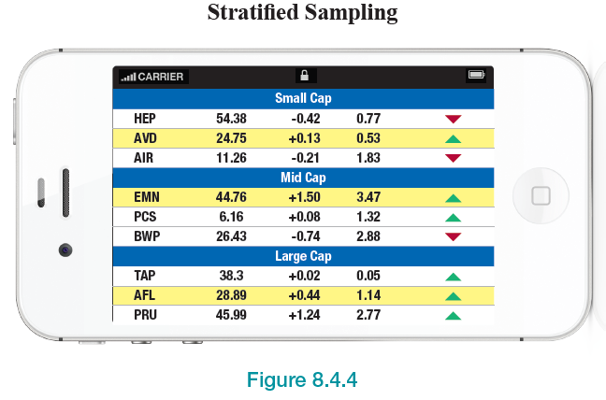
Stratified Sampling—Slide 3
In summary, stratified sampling can provide greater accuracy if the population is heterogeneous, and sub-populations of the population can be identified that are relatively homogeneous.
Figure 4

Slide 17
Example 1: Sampling College Students to Determine Grade Point Average—Slide 1
Suppose we want to determine (or estimate) the average grade point average for students at Tech University by year (i.e., freshman, sophomore, juniors, and seniors).
a.​ What is the population of interest?
b. ​What variable will be measured?
c.​ Discuss the best method of sampling for this scenario.

Slide 18
Example 1: Sampling College Students to Determine Grade Point Average—Slide 2
Solution
a.​ The population of interest is all students at Tech University.
b. ​The grade point average for students that are included in the sample.

Slide 19
Example 1: Sampling College Students to Determine Grade Point Average—Slide 3
c. ​Stratified random sampling may be the best approach given that we have "built-in" strata (the class year of the student). Therefore, one would stratify the data by class year (freshman, sophomore, juniors, and seniors). Once you have your strata, obtain an estimate of the size of each stratum and sample so that you have a good representation of the population. That is, if you have a total of 15,000 students and 5,000 are freshmen, you would want
of your sample to be from freshman students.

Slide 20
Example 2: Sampling a Large City to Determine Average Household Income—Slide 1
Suppose we are interested in determining the average household income for a large city.
a.​ What is the population of interest?
b.​ What variable will be measured?
c.​ Discuss how we would use each of the following sampling methods?
i.​ Simple random sampling?
ii.​ Cluster sampling?
iii.​ Stratified sampling

Slide 21
Example 2: Sampling a Large City to Determine Average Household Income—Slide 2
Solution
a.​ The population of interest is all households in the city.
b.​ Household income.
c. While there may be a right way to do sampling, time and costs are often a major consideration. For this scenario, let's discuss how we could perform the sampling techniques mentioned above.

Slide 22
Example 2: Sampling a Large City to Determine Average Household Income—Slide 3
i.​​ We can use simple random sampling but would need a sampling frame (i.e., a list of all houses in the city) and then randomly select from the frame. This could be time-consuming and costly. Also, you may not get a fair representation of the population if you are going from door-to-door to collect your data.
ii. To use cluster sampling for this situation, we could divide the city into blocks or neighborhoods and then randomly select a number of clusters (i.e., blocks) and then randomly sample data from each selected cluster.
iii. To use stratified sampling, we would also need a sampling frame to separate into strata and then sample from each stratum.

Slide 23
Example 3: Determining if a Sample is Random—Slide 1
City officials sample the opinions of homeowners in a community about the possibility of raising taxes to improve the quality of local schools. A directory of all homes in the city is used; a computer generates random numbers to identify the addresses to be sampled. An interviewer visits each home between the hours of 3 pm and 5 pm on weekdays. If no one is home, the address is eliminated from the sample and replaced by another randomly chosen address. Does this process approximate random sampling?

Slide 24
Example 3: Determining if a Sample is Random—Slide 2
Solution
This is NOT random sampling. The 3-5 pm timeframe is indicative that this is not random sampling because we have not made it such that each homeowner in the community has the same likelihood of being selected. For example, if a homeowner works from 9 am to 5 pm, they will not have a chance to participate in this study.

