Slide 1
Section 9.1
Estimating the Population Mean, Sigma Known

Slide 2
Definition: Statistical Inference
Using properly drawn sample data to draw conclusions about a population is called statistical inference.

Slide 3
Definition: Estimator and Estimate
An estimator is a strategy or rule that is used to estimate a population parameter.
If the strategy or rule is applied to a specific set of data, the result is an estimate.

Slide 4
Definition: Point Estimator
A point estimator is an estimator that uses a single point (or value) to estimate a population parameter.

Slide 5
Definition: Interval Estimate
An interval estimate is an interval with an upper and lower boundary that hopefully contains the population parameter of interest.

Slide 6
Definition: Mean Squared Error
An estimator's average squared distance from the true parameter is referred to as its mean squared error (MSE). The mean squared error for the sample mean is given by

Slide 7
Estimating the Population Mean, σ Known—Slide 1
What is meant by the terms estimator and estimate?
The sample mean is an estimator of the population mean. A specific sample mean,
such as 103.4,
is an estimate of the population mean (μ).
There are two different kinds of estimators, point and interval. A point estimator uses a single point (or value) to estimate a population parameter. For example, is a point estimator of a population mean
is a point estimate of a population mean).

Slide 8
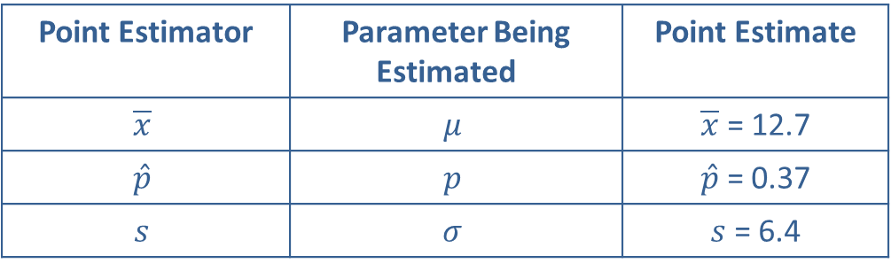
Estimating the Population Mean, σ Known—Slide 2
Table 1 – Point Estimators
Point Estimator | Parameter Being Estimated | Point Estimate
$$\overline{x}$$ | $$μ$$ | $\overline{x}$ = 12.7
$$\hat{p}$$ | $$p$$ | $\hat{p}$ = 0.37
$$s$$ | $$σ$$ | $s$ = 6.4
An interval estimate defines an upper and lower boundary for an interval that will hopefully contain the population parameter. Oftentimes, the interval estimate for a parameter is a function of the point estimate of that parameter.
The value of drawing random samples resides in the ability to assess the reliability of sample inference.

Slide 9
Point Estimation of the Population Mean—Slide 1
Like other statistical inference methods, estimation begins with the collection of data. Two important questions come to mind.
1. How should the data be used to estimate the population mean?
2. How can you tell a good estimator from a bad one?
Good estimators conform to the rules of horseshoes: the closer, the better. If the objective is to estimate a population mean, closeness is measured in terms of the distance the estimate is from the actual population mean.

Slide 10
Point Estimation of the Population Mean—Slide 2
One of the more puzzling questions is, how can you judge the accuracy of your estimate without knowing the true value of the population parameter? It's like shooting an arrow at a bull's-eye without being able to see it. If you can't see the bull's-eye, how do you know how close you are?
A perfect estimator would have a mean squared error of zero, but there is no such thing as a perfect estimator. Since statistical estimators depend on data that is randomly drawn, estimates are random variables and will seldom be equal to the true population characteristic.

Slide 11
Point Estimation of the Population Mean—Slide 3
The goal is to find an estimator whose average squared error is the smallest. Unfortunately, there are a number of different estimators, and without restricting the kinds of estimators that will be considered, very little progress can be made. One desirable restriction is unbiasedness. As was discussed in Chapter 8, to be an unbiased estimator, the expected value of the estimator must be equal to the parameter that is being estimated. For example,
is an unbiased estimator of the population mean since

Slide 12
Point Estimation of the Population Mean—Slide 4
Unfortunately, there are a number of estimators that are unbiased estimators of the population mean, including the sample mean, sample median, or any single sample value. Among unbiased estimators of the population mean, the sample mean has the smallest mean squared error. There is no other unbiased estimator that can consistently do a better job of estimating the population mean.
The fact that the sample mean is a good estimator of the population mean should not be surprising, since you would expect most sample statistics to be reasonably good estimators of their population counterparts. One of the exceptions is the sample range, which is a poor estimate of the population range. In short, the best estimate is the one that is unbiased with the smallest mean squared error.

Slide 13
Interval Estimation of the Population
Mean—Slide 1
Rarely will a point estimate of the population mean result in a value that exactly matches the population mean, μ. In fact, the probability that a point estimate for the population mean exactly equals the population mean is zero for data drawn from continuous distributions. Yet, if an estimate is used for decision making, it is desirable that there be some indication of its potential error. One of the significant limitations of simply reporting a point estimate is the lack of information concerning the estimator's accuracy.

Slide 14
Interval Estimation of the Population
Mean—Slide 2
Interval estimates, however, are constructed to provide additional information about the precision of the estimate. An interval estimator is made by developing an upper and lower boundary for an interval that will hopefully contain the population parameter. It would be easy to construct an interval estimator that would always contain the population parameter: for example, the interval from negative infinity to positive infinity. But this particular estimator would not contain any useful information about the location of the population parameter. In interval estimation, the narrower the width of the interval for a given level of confidence, the better the estimator.

Slide 15
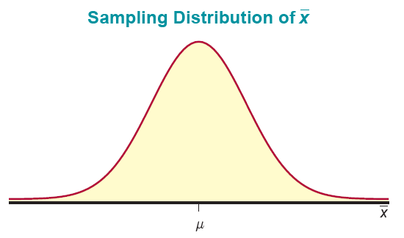
Interval Estimation of the Population
Mean—Slide 3
The foundations of a good interval estimator for the population mean can be found in Chapter 8, which defined how
should vary.
Recall that if the sample size is reasonably large
the Central Limit Theorem ensures that
has an approximately normal distribution with mean μ and
standard deviation
Figure 1

Slide 16
Interval Estimation of the Population
Mean—Slide 4
The sampling distribution can be used to develop an interval estimator. For a standard normal random variable, we know that.
Since
can be transformed into a standard normal random
variable by using the z-transformation,
then by substitution,
and with some algebraic manipulation we obtain

Slide 17
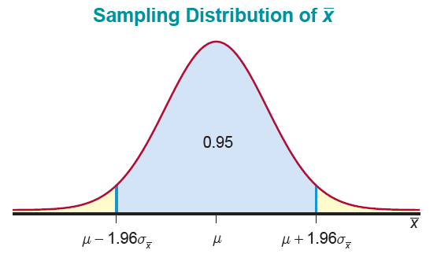
Interval Estimation of the Population
Mean—Slide 5
If the sample size is greater than or equal to 30, then by the Central Limit Theorem there is a 0.95 probability that the sample mean will be within 1.96 standard deviations of the population mean before a particular sample is selected.
Figure 2

Slide 18
Interval Estimation of the Population
Mean—Slide 6
Since we discussed the sampling distribution of the sample mean in Chapter 8, the idea of defining the probability that the sample mean should fall within some specified distance of the population mean is not a new one. The expression does suggest a specific form for the interval since it provides an interval and the associated probability that the population mean will fall within the interval:

Slide 19
Interval Estimation of the Population
Mean—Slide 7
However, the provision before a particular sample is selected modifies the interpretation of the interval for a specific sample. After the sample is selected, the sample mean is no longer a random variable. Suppose a sample has been drawn from a population with a standard deviation of 200, and the following characteristics have been observed:

Slide 20

Interval Estimation of the Population
Mean—Slide 8
Remember,
The resulting interval would be
150 ± 1.96(20).
That is,

Slide 21

Interval Estimation of the Population
Mean—Slide 9
Is the population mean, μ, inside this interval? If not, what fraction of the time will μ be inside the interval? Even though the interval is calculated using a technique that captures the population mean 95% of the time, it would not be appropriate from a relative frequency point of view, to state that
Wrong Interpretation
since the population mean is an unknown but constant quantity. Either μ will always be inside the interval or will always be outside the interval. If this is true, then what information do we have about the interval?

Slide 22
Interval Estimation of the Population Mean—Slide 10
We say that this interval was constructed with a confidence level of 95% (i.e., 100 (1 − α)%) or a confidence coefficient of 0.95 (i.e., 1 − α). Hence, the term confidence interval is used to describe the method of construction rather than a particular interval.
In summary, a 95% confidence interval can be interpreted to mean that if all possible samples of a given size are taken from a population, 95% of the samples would produce intervals that captured the true population mean and 5% would not. In Figure 3 we have plotted, as line segments, the confidence intervals from 20 random samples. All but one of the intervals, number 5, capture the mean, μ.

Slide 23
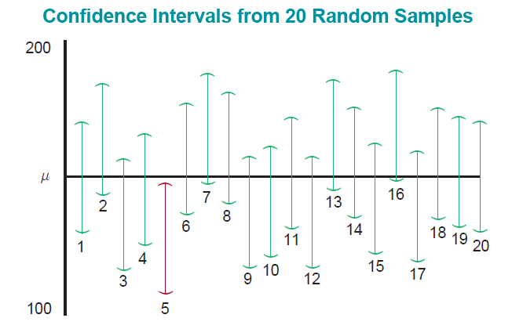
Interval Estimation of the Population Mean—Slide 11
Figure 3

Slide 24
Interval Estimation of the Population Mean—Slide 12
So far we have examined only the 95% confidence interval, yet the idea is a general one and can be extended to any specified degree of confidence.
In a practical sense, the selection of the degree of confidence depends upon the importance of the decision for which the confidence interval will be utilized. If we are launching a space vehicle, we would want to be very certain that the vehicle would have sufficient fuel to return safely. For other decisions, we might be willing to accept an 80% confidence of correctly estimating the population mean, especially if the cost of gathering additional data is large.
The expression
creates the "generalized" confidence interval.

Slide 25
Definition: Confidence Interval
A confidence interval is an interval estimate for a population parameter that is associated with a certain confidence level (or confidence coefficient).

Slide 26
Formula: Confidence Interval for the Population Mean, σ Known
A 100(1 − α)% confidence interval for the population mean when σ is known is given by
if either of the following conditions are true:
1. n ≥ 30 or
2. the data are collected from a normal distribution.

Slide 27

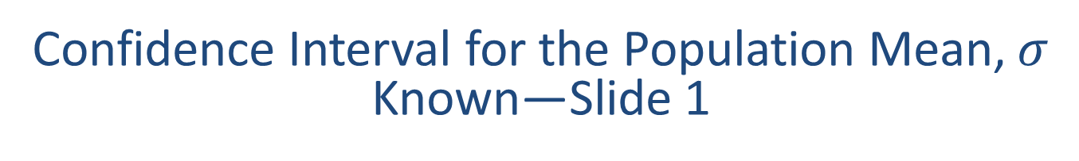
Confidence Interval for the Population Mean, $σ$ Known—Slide 1
The term
represents the z-value required to obtain an area of
in the right tail under the standard normal curve.
The z-values for obtaining various 1 − α areas centered under the standard normal curve are given in Table 2 and graphed in Figure 4.

Slide 28
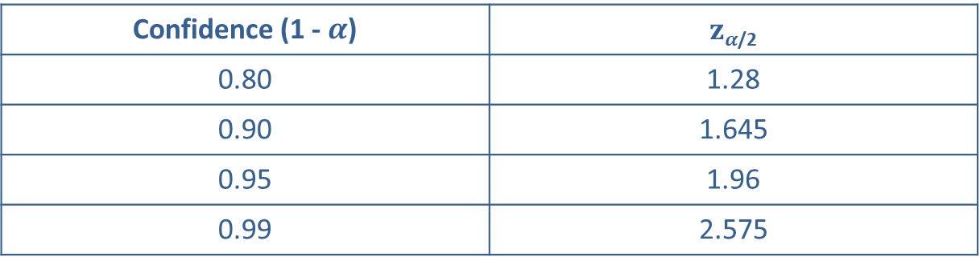
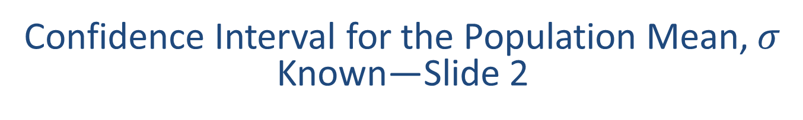
Confidence Interval for the Population Mean, $σ$ Known—Slide 2
Table 2 – Critical Values of z
Confidence (1 - $α$) | $zα$_{/2}
0.80 | 1.28
0.90 | 1.645
0.95 | 1.96
0.99 | 2.575

Slide 29
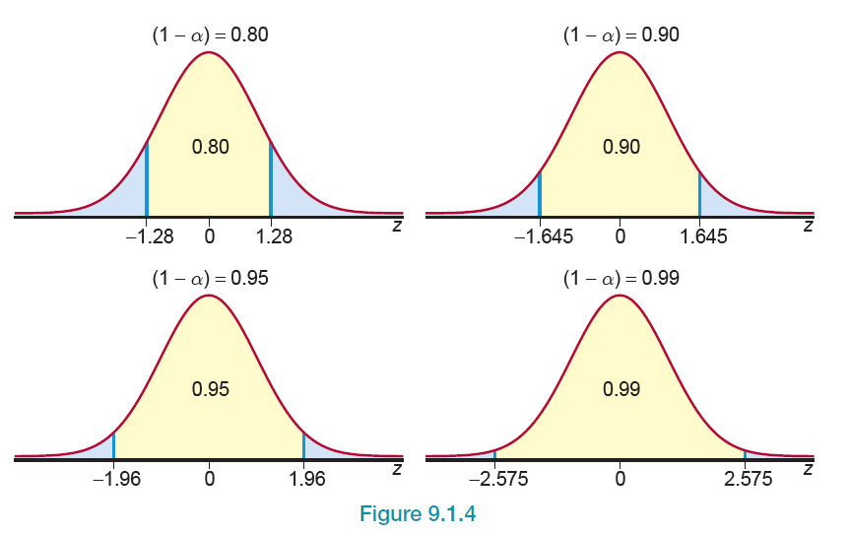
Confidence Interval for the Population Mean, σ Known—Slide 3
Figure 4

Slide 30
Example 1: Constructing a Confidence Interval for the Population Mean with σ Known—Slide 1
Alex was interested in learning the range that he should expect to pay for a lawnmower. He we collected a sample of 100 lawnmower prices from various retailers within a 100-mile radius and found that the average cost was $425. Construct 80%, 90%, 95%, and 99% confidence intervals for the true average cost of a lawnmower if the population standard deviation is 900.

Slide 31


Example 1: Constructing a Confidence Interval for the Population Mean with σ Known—Slide 2
Solution
80% Confidence Interval:
90% Confidence Interval:

Slide 32

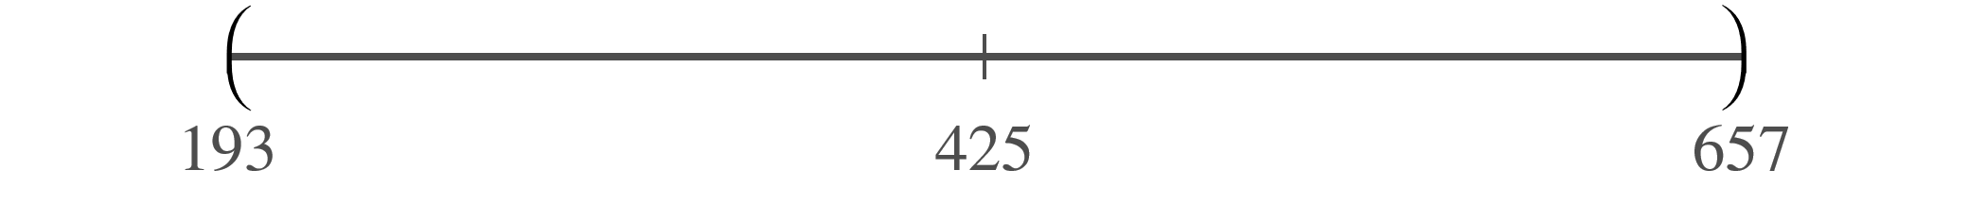
Example 1: Constructing a Confidence Interval for the Population Mean with σ Known—Slide 3
Solution
95% Confidence Interval:
99% Confidence Interval:

Slide 33
Confidence Interval for the Population Mean, σ Known—Slide 4
The intervals in Example 1 illustrate that to achieve more confidence we must pay a price. For a given sample size, the only way to achieve greater confidence is to widen the interval. However, the resulting information provides a less precise location of the population mean.

Slide 34
Example 2: Calculating a Confidence Interval for the Number of New Technology Products—Slide 1
Given the rapid rate of technological innovation, SWN Management Company wants to study the number of new products introduced by top technology firms in the United States. Suppose a random sample of 150 companies is selected and each company is asked to report the number of new products that it has introduced in the last 12 months. It is also known from past experience that the population standard deviation of the new products introduced is 7.85. The sample mean is found to be 8.56 products. Calculate a 98 percent confidence interval for the population mean number of new products introduced in the last 12 months.

Slide 35
Example 2: Calculating a Confidence Interval for the Number of New Technology Products—Slide 2
Solution
From the information given, we know that
Since we want a 98% confidence interval, we need to find the value of
Remember that
represents the z-value required
to obtain an area of (1 − α) centered under the standard normal curve. Therefore, for a 98% confidence interval, α = 0.02.
Similar to finding the values in Table 2 we can use Table A to find the corresponding value of z. That is, if we are to use Table A, we
look up
in the body of the standard normal table.

Slide 36
Example 2: Calculating a Confidence Interval for the Number of New Technology Products—Slide 3
Since the exact value of 0.01 is not in the table, we use the value that is closest. In this case, we can see that 0.0099 corresponds to a z-value of −2.33. Since the standard normal distribution is symmetrical,
capturing an area of
0.01 in the upper tail of the distribution will be 2.33.
For
A 98% confidence interval is then calculated as follows.

Slide 37
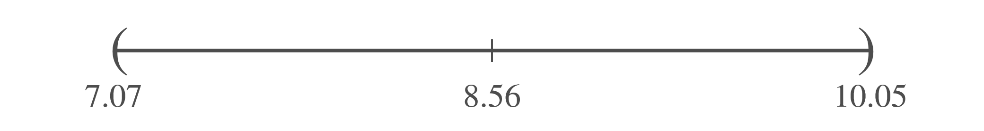

Example 2: Calculating a Confidence Interval for the Number of New Technology Products—Slide 4
Thus, we are $98\%$ confident that the true mean number of new products introduced in the last 12 months will be contained in the above interval.

Slide 38
Definition: Margin of Error
The margin of error, or maximum error of estimation (often denoted as E), is the largest possible distance from the point estimate that a confidence interval will cover.

Slide 39
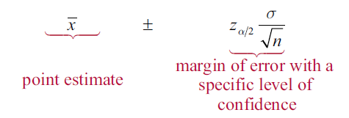
Margin of Error—Slide 1
So far, the confidence interval has been discussed as a way of placing bounds on the location of a parameter with a specific degree of confidence. But we can also think about the confidence interval as a means of describing the quality of a point estimate. Let's look at the expression for the confidence interval for the population mean.
Confidence Interval for μ

Slide 40
Margin of Error—Slide 2
Another interpretation of the confidence interval is given below the expression of the confidence interval for µ. The part of the expression that is added and subtracted to the point estimate,
can be thought of as the margin of
error (also known as the maximum error of estimation) using the point estimate
with a specified level of
confidence. For example, the 95% confidence interval in Example 1 was given as

Slide 41
Margin of Error—Slide 3
We could say that we are 95% confident that the point estimate of μ,
has a margin of error of 176.4 or an
error of estimation no larger than 176.4. Being able to assess the error of an estimate is one of the most useful applications of statistical methods.

