Slide 1
Section 9.2
Estimating the Population Mean, Sigma Unknown

Slide 2
Estimating the Population Mean, Sigma Unknown—Slide 1
In the previous section, we assumed that the population standard deviation was known. In practice this assumption is not very realistic, since the standard deviation describes variability about the mean. If the population standard deviation is known, the mean is usually also known, and there is no need to create an interval estimate for it. Why estimate something we already know?

Slide 3
Estimating the Population Mean, Sigma Unknown—Slide 2
If σ is not known and the distribution of the population is assumed to be normal, then the derivation of the confidence interval must be changed slightly. Provided that the population from which the sample is drawn is normally distributed, the distribution of the quantity
where s is the standard deviation of the sample, has a Student's t-distribution. The t-distribution was discovered by W.S. Gossett in 1908. Gossett published the result under the pen name of Student while working as an employee of the Guinness Brewery in Dublin.

Slide 4
Estimating the Population Mean, Sigma Unknown—Slide 3
The t-distribution is very much like the normal distribution (see Figure 1). It is a symmetrical, bell-shaped distribution with slightly thicker tails than a normal distribution. The t-distribution has one parameter, degrees of freedom. The shape of the t-distribution approaches the normal distribution as the sample size n, and thus the degrees of freedom, become larger.

Slide 5
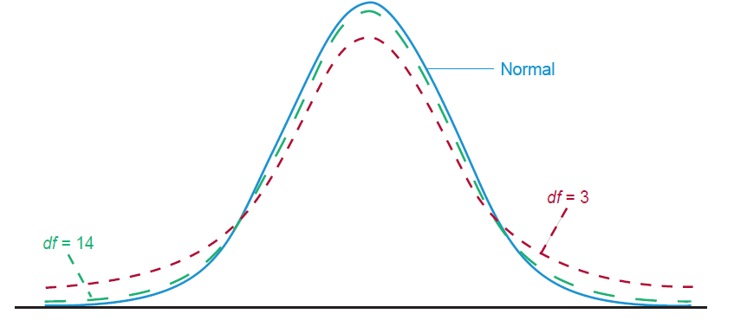
Estimating the Population Mean, Sigma Unknown—Slide 4
Figure 1

Slide 6
Formula: Degrees of Freedom
The degrees of freedom for any t-distribution are computed in the following manner.
Df = number of sample observations − 1 = n − 1

Slide 7
Formula: Confidence Interval for the Population Mean, σ Unknown
If σ is unknown, but the distribution of the population is assumed to be normal, a 100(1 − σ)% confidence interval for the population mean is given by
where
is the critical value for a t-distribution with n − 1
degrees of freedom which captures an area of
in the right tail
of the distribution. Note that this interval is only valid if
is normally distributed.

Slide 8
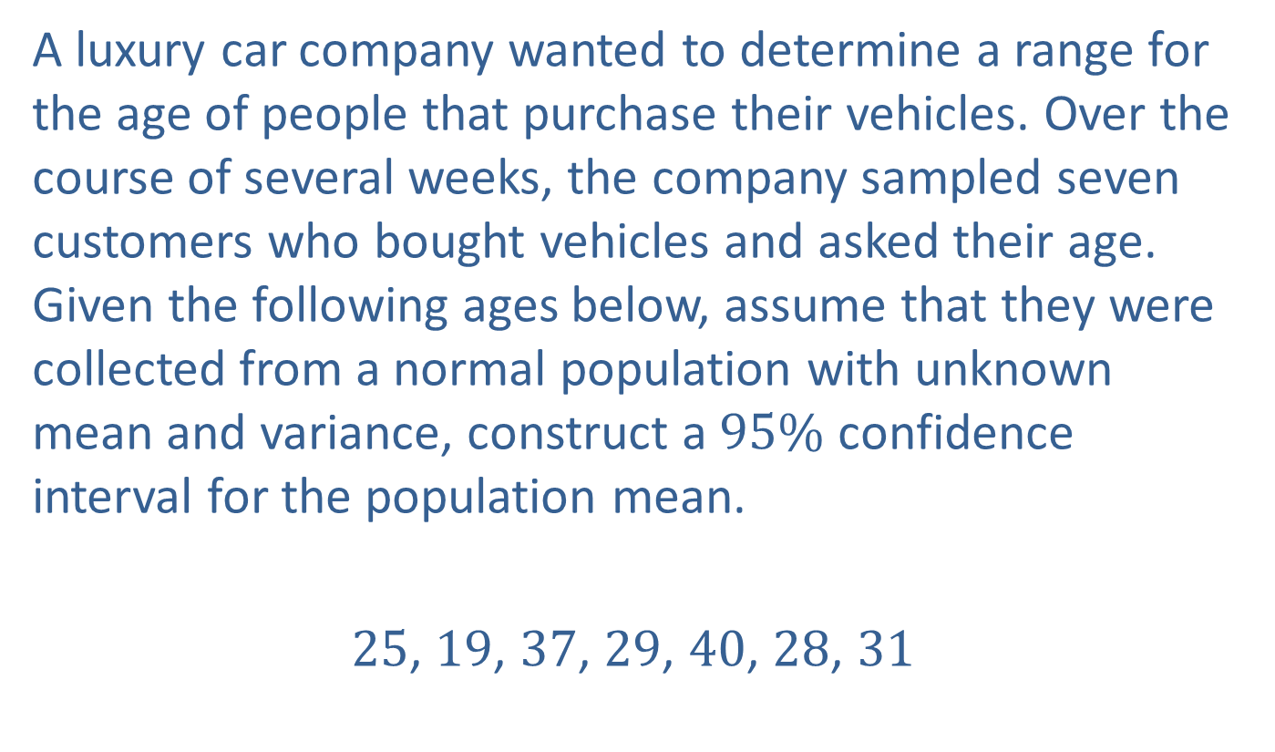
Example 1: Constructing a Confidence Interval for the Mean with σ Unknown—Slide 1
A luxury car company wanted to determine a range for the age of people that purchase their vehicles. Over the course of several weeks, the company sampled seven customers who bought vehicles and asked their age. Given the following ages below, assume that they were collected from a normal population with unknown mean and variance, construct a $95\%$ confidence interval for the population mean.
25, 19, 37, 29, 40, 28, 31

Slide 9
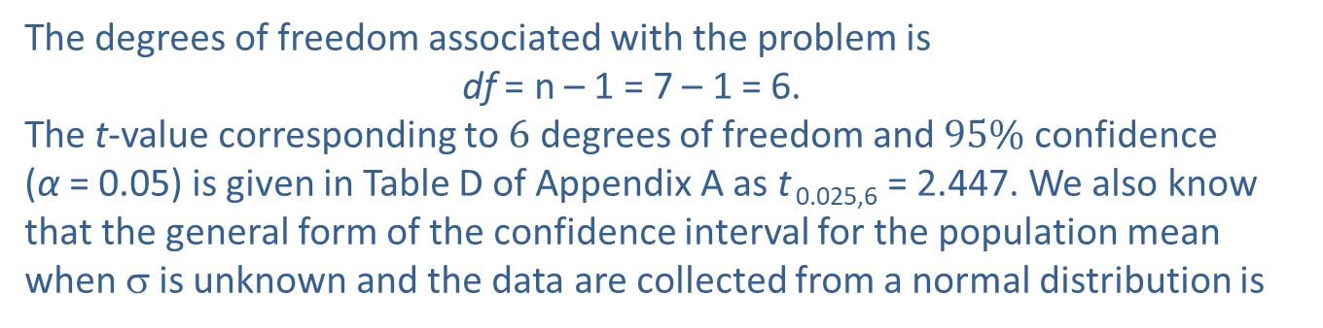
Example 1: Constructing a Confidence Interval for the Mean with σ Unknown—Slide 2
Solution
The sample mean and standard deviation of the customers ages are
The degrees of freedom associated with the problem is
df = n – 1 = 7 – 1 = 6.
The t-value corresponding to 6 degrees of freedom and $95\%$ confidence (α = 0.05) is given in Table D of Appendix A as t _{0.025,6} = 2.447. We also know that the general form of the confidence interval for the population mean when σ is unknown and the data are collected from a normal distribution is

Slide 10
Example 1: Constructing a Confidence Interval for the Mean with σ Unknown—Slide 3
Thus, we are 95% confident that the interval
23.3079 to 36.4063
will contain the population mean.
An alternate interpretation would be that we are 95% confident that the point estimate, 29.8571, has a maximum error of estimation (E) of 6.5492.

Slide 11
Example 2: Constructing a Confidence Interval for Completion Time—Slide 1
A manufacturing company is interested in the amount of time it takes to complete a certain stage of the production process. The project manager randomly samples 10 products as they come from the production line and notes the time of completion. The average completion time is 23.45 minutes with a sample standard deviation of 4.32 minutes. Based on this sample, construct a 95% confidence interval for the average completion time for that stage in the production process. Assume that the population distribution of the completion times is approximately normal.

Slide 12
Example 2: Constructing a Confidence Interval for Completion Time—Slide 2
Solution
Since the company wants to calculate a 95% confidence interval for the average completion time, μ, we know that α = 0.05. We also have a sample size of n = 10 and thus, n – 1 = 10 – 1 = 9 degrees of freedom. Therefore, we use
We also know that the general form of the confidence interval for the population mean when σ is unknown and it is assumed that the population distribution of completion times is approximately normal, is given by:

Slide 13
Example 2: Constructing a Confidence Interval for Completion Time—Slide 3
Thus, we are 95% confident that the true average completion time of that stage of the process is between 20.36 minutes and 26.54 minutes.

Slide 14
Interval Estimation of the Population Mean: A Summary—Slide 1
Two procedures for determining an interval estimate for the population mean:
In Section 9.1 we used the interval
for normally distributed populations in which the population standard deviation, σ, is known.
In Section 9.2 we introduced the t-distribution with n − 1
degrees of freedom and used the interval
to find an interval estimate for the population mean for a normally distributed population where σ is unknown.

Slide 15
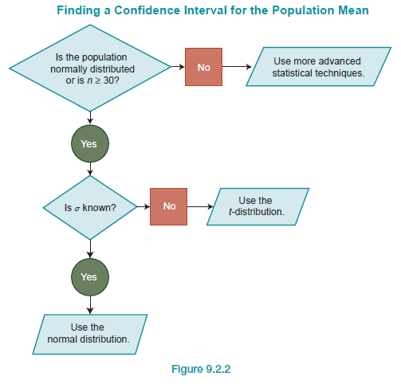
Interval Estimation of the Population Mean: A Summary—Slide 2
Figure 2

Slide 16
Precision and Sample Size: Means
The more accurate an estimate, the greater its potential value in decision making. The only way to accurately determine an unknown population parameter is to perform a census, though this is usually impractical because of cost or time considerations. Realistically, the best interval estimate a decision maker could hope for would be an interval with a small width possessing a large amount of confidence. The width of the confidence interval defines the precision with which the population mean is estimated, the smaller the interval, the greater the precision. If the width of a confidence interval could be controlled, we could achieve estimates with a level of accuracy that is appropriate for the decision at hand.

Slide 17
Determining the Sample Size: σ Known—Slide 1
There are three components that affect the width of the confidence Interval for the population mean:
Represents the distance the confidence interval boundary is from the sample mean
in standard deviation units. The distance is related to the specific level of confidence.
σ Represents the population standard deviation.
n Represents the sample size.

Slide 18
Determining the Sample Size: σ Known—Slide 2
The level of confidence will affect confidence interval width. The higher the level of confidence, the wider the confidence interval.
The population standard deviation, σ, is a constant, and does not change. The sample size, however, is selected by the decision maker. The larger the sample, the smaller the width of the resulting confidence interval for some given level of confidence.
Since the sample size can be increased, which reduces the width of the confidence interval, how large should the sample be? Taking too large a sample wastes money, while taking too small a sample produces an estimator that does not possess sufficient reliability.

Slide 19
Determining the Sample Size: σ Known—Slide 3
The sample size should be selected in relation to the size of the margin of error the decision maker is willing to accept. This can be achieved by setting the error equal to one-half the confidence interval width.
The preceding equation can be solved for the sample size, n.

Slide 20
Determining the Sample Size: σ Known—Slide 4
By selecting a level of confidence and the maximum error, the relationship can be used to determine the sample size necessary to estimate the population mean with the desired accuracy. In order to assure the desired level of confidence, always round the value obtained for the sample size up to the next integer.

Slide 21

Example 3: Calculating the Sample Size Needed for $95\%$ Confidence of the Mean
Consider a population having a standard deviation of 15. We want to estimate the mean of the population. How large of a sample is needed to construct a 95% confidence interval for the mean of this population if the margin of error is equal to 1.5?
Solution
Rounding up, we have to have a sample size of 385 to ensure that we get at least a 95% confidence interval with a margin of error equal to 1.5.

Slide 22
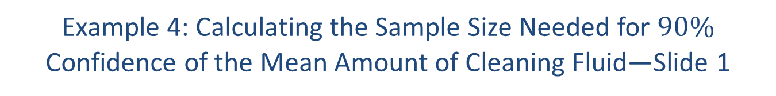
Example 4: Calculating the Sample Size Needed for $90\%$ Confidence of the Mean Amount of Cleaning Fluid—Slide 1
Suppose that a quality control manager at Argon Chemical Company wishes to measure the average amount of cleaning fluid the company is placing in their 12-ounce bottles. The manager is concerned that if the bottles are overfilled, then there could be a chance of an explosion. At the same time, if they are underfilled customers would be unhappy and begin to buy the competitor's product. From previous samples, they believe that the standard deviation is 0.3 ounce. How large a sample must be taken in order to be 90% confident of estimating the mean amount of cleaning fluid in a 12-ounce bottle to within 0.05 ounce?

Slide 23
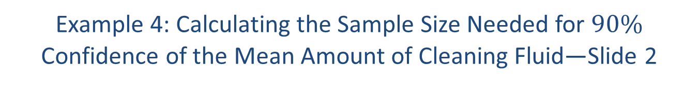
Example 4: Calculating the Sample Size Needed for $90\%$ Confidence of the Mean Amount of Cleaning Fluid—Slide 2
Solution
To be assured of finding the desired level of confidence, always round up. Thus, we are 90% confident that a sample of n = 98 observations would produce an estimate of the mean amount of cleaning fluid in a 12-ounce bottle to within 0.05 ounce. Being able to know the accuracy of your estimate is one of the significant benefits of inferential statistics. In this case, if 98 bottles are measured, we will be 90% confident that the resulting sample mean is within five one-hundredths of an ounce of the true mean. That's close.

Slide 24
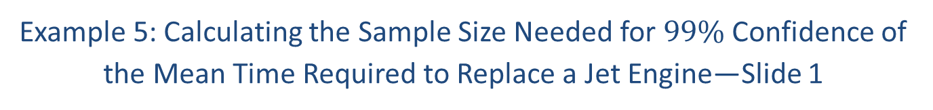
Example 5: Calculating the Sample Size Needed for $99\%$ Confidence of the Mean Time Required to Replace a Jet Engine—Slide 1
An airline's maintenance manager desires to estimate the average time (in hours) required to replace a jet engine in a Boeing 767. How large a sample would be necessary if the manager wishes to be 99% confident of estimating the population mean to within one-quarter of an hour (E = 0.25)? Assume a preliminary sample of size n = 30 has a mean replacement time of 16.7 hours with a standard deviation of 4.3 hours.

Slide 25

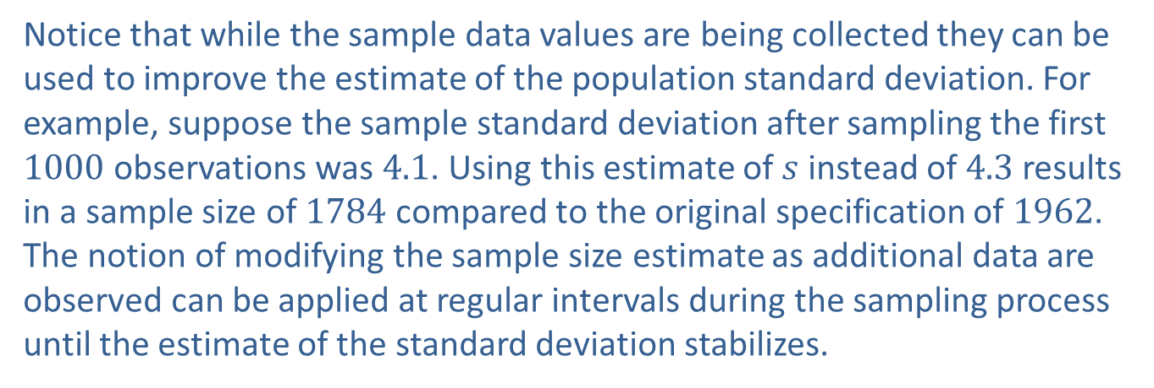
Example 5: Calculating the Sample Size Needed for $99\%$ Confidence of the Mean Time Required to Replace a Jet Engine—Slide 2
Solution
Using the results from the initial sample,
Notice that while the sample data values are being collected they can be used to improve the estimate of the population standard deviation. For example, suppose the sample standard deviation after sampling the first 1000 observations was 4.1. Using this estimate of $s$ instead of 4.3 results in a sample size of 1784 compared to the original specification of 1962. The notion of modifying the sample size estimate as additional data are observed can be applied at regular intervals during the sampling process until the estimate of the standard deviation stabilizes.

