Slide 1
Section 9.4
Estimating the Population Standard Deviation or Variance

Slide 2
Estimating the Population Standard Deviation or Variance
Recall that the sample variance is
and it serves as the point estimate of the population variance, σ². As with the other tests developed for the population mean and the population proportion, we first need to develop a sampling distribution for
that will allow us to calculate a confidence interval for the population variance.

Slide 3
Definition: χ²-Test Statistic
If we have a random sample of size n taken from a normal population, then the sampling distribution of the test statistic is given by
which has a chi-square distribution with n − 1 degrees of freedom.

Slide 4
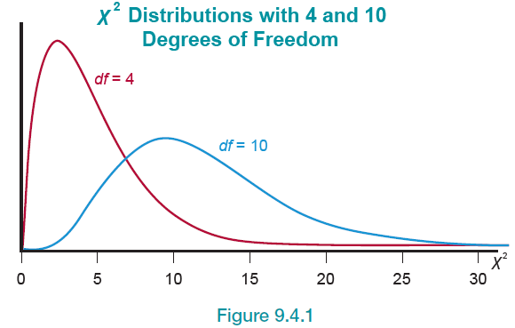
χ² -Test Statistic—Slide 1
The chi-square distribution is a positively skewed (or skewed to the right) distribution. Like the t-distribution, the shape of the distribution is a function of its degrees of freedom.
Figure 1

Slide 5
χ² -Test Statistic—Slide 2
To use the chi-square distribution, we need a chi-square value, denoted by
(the Greek letter chi, pronounced Ki). We'll later call this our critical value for the chi-square distribution. As shown in Figure 2,
is the point on the horizontal
axis under the curve with an area of α to the right of it. The value of
depends on the right-hand tail area, α, and the number of degrees of freedom of the chi-square distribution.

Slide 6
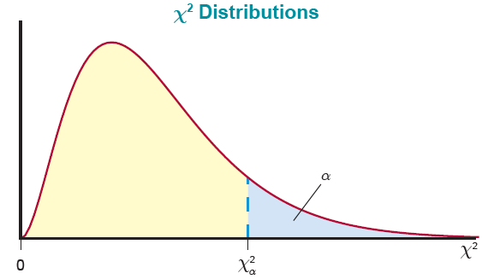
χ² -Test Statistic—Slide 3
Figure 2

Slide 7
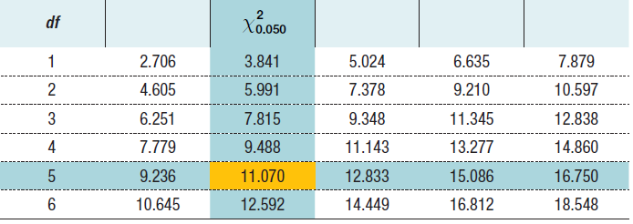
χ² -Test Statistic—Slide 4
Suppose we want to find the chi-square value that gives us a right-hand tail area of 0.05 with 5 degrees of freedom. To do this, we would look down the leftmost column for 5 degrees of freedom and then the column labeled
Doing so, we find that
is 11.070.

Slide 8
Definition: 100(1 − α)% Confidence Interval for σ²
A
confidence interval for σ² is given by
are values under the curve of the
chi-square distribution with n − 1 degrees of freedom.

Slide 9
Example 1: Calculating a Confidence Interval for the Population Standard Deviation—Slide 1
The quality control supervisor of a bottling plant is concerned about the variance of fill per bottle. Regulatory agencies specify that the standard deviation of the amount of fill should be less than 0.1 ounce. To determine whether the process is meeting this specification, the supervisor randomly selects ten bottles, weighs the contents of each, and finds that the sample standard deviation of these measurements is 0.04. Assume that the data are collected from a normal population and compute a 95% confidence interval for the standard deviation of ounces of fill for the bottling plant.

Slide 10
Example 1: Calculating a Confidence Interval for the Population Standard Deviation—Slide 2
Solution
We want to find a 95% confidence interval for the variance. We are given that
n = 10, s = 0.04, and α = 0.05.
To calculate a 95% confidence interval, we use the following formula.
Thus, we need to find the values of
for n − 1 = 10 − 1 = 9 degrees of freedom.

Slide 11
Example 1: Calculating a Confidence Interval for the Population Standard Deviation—Slide 3
Using Table G in Appendix A, at 9 degrees of freedom,
Substituting the values in the formula above, we have

Slide 12
Example 1: Calculating a Confidence Interval for the Population Standard Deviation—Slide 4
So, a 95% confidence interval for the variance of fill of the bottles is between 0.000757 and 0.00533 ounce. However, the problem mentions the tolerance for the standard deviation of fill. So, to ensure that we make our interpretation in terms of the problem, to find a 95% confidence interval for the standard deviation, we take the square root of the confidence interval for the variance, yielding
0.0275 ≤ σ ≤ 0.0730.
The 95% confidence interval for the standard deviation of fill for the bottles is between 0.0275 and 0.0730 ounce, indicating that the process is meeting the specifications of being less than 0.1 ounce.

