Slide 1
Section 11.4
Applications: Distance-Rate-Time, Number Problems, Amounts, and Costs

Slide 2
Objectives
Use systems of linear equations to solve distance-rate-time application problems.
Use systems of linear equations to solve number problems.
Use systems of linear equations to solve amounts and costs problems.

Slide 3
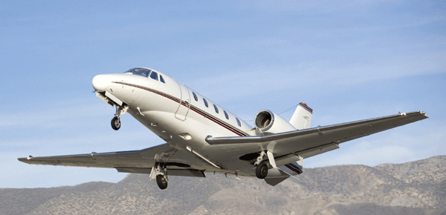
Example 1: Application: Distance-Rate-Time (Rates Unknown)
A small plane flew 300 miles in 2 hours flying with the wind. Then on the return trip, flying against the wind, it traveled only 200 miles in 2 hours. What were the wind speed and the speed of the plane? (Note: The “speed of the plane” means how fast the plane would be flying with no wind.)
Solution
Let s = speed of plane
and w = wind speed.

Slide 4
Example 1: Application: Distance-Rate-Time (Rates Unknown) (cont.)
When flying with the wind, the plane’s actual rate will increase to s + w. When flying against the wind, the plane’s actual rate will decrease to s − w. (Note: If the wind had been strong enough, the plane could actually have been flying backward, away from its destination.)
Rate x Time = Distance
With the wind | s + w | 2 | 2(s + w)
Against the wind | s − w | 2 | 2(s − w)

Slide 5
Example 1: Application: Distance-Rate-Time (Rates Unknown) (cont.)
The system of linear equations is as follows.
With the wind
Against the wind
Apply the distributive property to the left‑hand side of
each equation to find an equivalent system of equations. Then use the addition method to solve the system.
With the wind
Against the wind
Speed of plane

Slide 6
Example 1: Application: Distance-Rate-Time (Rates Unknown) (cont.)
Back substitute s = 125 into one of the original equations.
The speed of the plane was 125 mph, and the wind speed was 25 mph. (Checking will show that these numbers do give distances of 300 mi and 200 mi.)
Wind speed

Slide 7
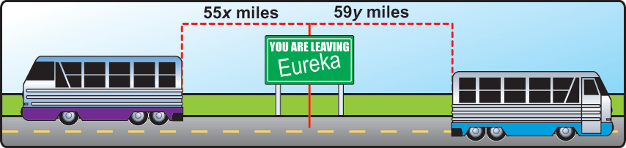
Example 2: Application: Distance-Rate-Time (Times Unknown)
Two buses leave a bus station traveling in opposite directions. One leaves at noon and the second leaves at 1 P.M. The first one travels at an average speed of
55 mph and the second one at an average speed of
59 mph. At what time will the buses be 226 miles apart?

Slide 8
Example 2: Application: Distance-Rate-Time (Times Unknown) (cont.)
Solution
Let x = time of travel for first bus
and y = time of travel for second bus.
Rate x Time = Distance
Bus 1 | 55 | x | 55x
Bus 2 | 59 | y | 59y

Slide 9
Example 2: Application: Distance-Rate-Time (Times Unknown) (cont.)
The system of linear equations is as follows.
The first bus travels 1 hour longer than the second.
The sum of the distances is 226 miles.
Now use the substitution method to solve the system.

Slide 10
Example 2: Application: Distance-Rate-Time (Times Unknown) (cont.)
Back substituting in the first equation ( ) give
x = 1.5 + 1 = 2.5.
Thus, the first bus travels 2.5 hours and the second bus travels 1.5 hours. The buses will be 226 miles apart at 2:30 p.m.

Slide 11
Distance-Rate-Time Problems
Notes
You should consider making tables similar to those illustrated in Examples 1, 2, and 4 when working with applications. These tables can help you organize the information in a more understandable form.

Slide 12
Example 3: Solving a Number Problem
The sum of two numbers is 80 and their difference is 10. What are the two numbers?
Solution
Let x = one number
and y = the other number.
The system of linear equations is as follows.
The sum is 80.
The difference is 10.

Slide 13
Example 3: Solving a Number Problem (cont.)
Now use the addition method to solve the system.
Back substitute 45 for x in the first equation.
The two numbers are 45 and 35.

Slide 14
Example 3: Solving a Number Problem (cont.)
Check
45 + 35 = 80 and 45 − 35 = 10

Slide 15
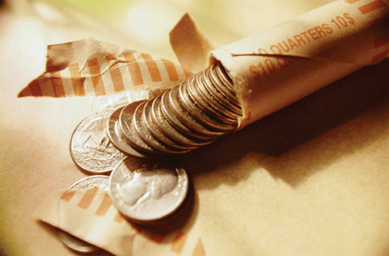
Example 4: Application: Counting Coins
Mike has $1.05 worth of change in nickels and quarters. If he has twice as many nickels as quarters, how many of each type of coin does he have?

Slide 16
Example 4: Application: Counting Coins (cont.)
Solution
We use two equations–one relating the number of coins and the other relating the value of the coins. (The value of each nickel is 5 cents and the value of each quarter is 25 cents.)
Let n = number of nickels
and q = number of quarters.
Coins | # of Coins | Value | Total value
Nickels | n | 0.05 | 0.05n
Quarters | q | 0.25 | 0.25q

Slide 17
Example 4: Application: Counting Coins (cont.)
The system of linear equations is as follows.
Note carefully that in the first equation q is multiplied by 2 because the number of nickels is twice the number of quarters. Therefore, n is bigger.
There are two times as many nickels as quarters.
The total amount of money is $1.05.

Slide 18
Example 4: Application: Counting Coins (cont.)
The first equation is already solved for n, so substituting 2q for n in the second equation gives the following.
Multiply the equation by 100.
So that the coefficients and
constants are integers.
Number of quarters
Number of nickels
Mike has 3 quarters and 6 nickels.

Slide 19
Example 5: Application: Calculating Age
Kathy is 6 years older than her sister, Sue. In 3 years, she will be twice as old as Sue. How old is each girl now?
Solution
We use two equations–one relating their ages now and the other relating their ages in 3 years.
Let K = Kathy’s age now
and S = Sue’s age now.

Slide 20
Example 5: Application: Calculating Age (cont.)
Then the system of linear equations is as follows.
Rewrite the second equation in standard form and solve by addition.
The difference in their ages is 6 years.
In 3 years each age is increased by 3 and Kathy is twice as old as Sue.

Slide 21
Example 5: Application: Calculating Age (cont.)
Second equation in standard form
Sue’s current age
Back substitute S = 3 into one of the original equations.
Kathy’s current age
Kathy is 9 years old and Sue is 3 years old.

Slide 22
Example 6: Application: Finding Amounts and Costs
Three hot dogs and two orders of French fries cost $10.30. Four hot dogs and four orders of fries cost $15.60. What is the cost of a hot dog? What is the cost of an order of fries?
Solution
Let x = cost of one hot dog
and y = cost of one order of fries.

Slide 23
Example 6: Application: Finding Amounts and Costs (cont.)
The system of linear equations is as follow.
Three hot dogs and two orders of French fries cost $10.30.
Four hot dogs and four orders of fries cost $15.60.
Both equations are in standard form. Use the addition method to solve the system.
Cost of one
hot dog

Slide 24
Example 6: Application: Finding Amounts and Costs (cont.)
Back substitute x = 2.50 into one of the original equations.
Back substitute x = 2.50 into one of the original equations.
One hot dog costs $2.50 and one order of fries costs $1.40.
Cost of one order of fries

