Slide 1
Section 11.8
Systems of Linear Inequalities

Slide 2
Objectives
Solve systems of linear inequalities graphically.
Use a graphing calculator to graph systems of linear inequalities.

Slide 3
To Solve a System of Two Linear Inequalities
Procedure
For each inequality, graph the boundary line and shade the appropriate half-plane.
Determine the region of the graph that is common to both half-planes (the region where the shading overlaps).
(This region is called the intersection of the two half-planes and is the solution set of the system.)

Slide 4
To Solve a System of Two Linear Inequalities
Procedure (cont.)
To check, pick one test-point in the intersection and verify that it satisfies both inequalities.
Note: If there is no intersection, then the system has no solution.

Slide 5
Example 1: Solving Systems of Linear Inequalities
Solve the system of linear inequalities graphically.
Solution
Step 1: For x ≤ 2, the points are to the left of and on the line x = 2. For y ≥ −x + 1, the points are above and on the line y = −x + 1.
Step 2: Determine the region that is common to both half-planes.

Slide 6
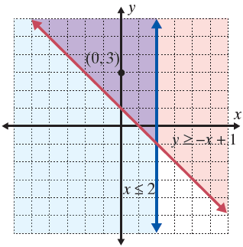
Example 1: Solving Systems of Linear Inequalities (cont.)
Step 3: In this case, we test the point (0, 3). On the graph below, the solution is the purple-shaded region and its boundary lines.
A true statement
A true statement

Slide 7
Example 2: Solving Systems of Linear Inequalities
Solve the system of linear inequalities graphically.
Solution
First, solve each inequality for y.
Step 1: For y ≤ 2x + 6, the points are below and on the line y = −2x + 6. For y < −x + 4, the points are below but not on the line y = −x + 4.

Slide 8
Example 2: Solving Systems of Linear Inequalities (cont.)
Step 2: Determine the region that is common to both half-planes. Note that the line y = −x + 4 is dashed to indicate that the points on the line are not included.
Step 3: In this case, we test the point (0, 0). On the graph below, the solution is the purple-shaded region and its boundary lines.

Slide 9
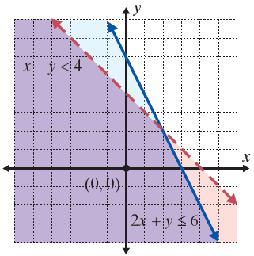
Example 2: Solving Systems of Linear Inequalities (cont.)
A true statement
A true statement

Slide 10
Example 3: Solving Systems of Linear Inequalities
Solve the system of linear inequalities graphically:
Solution
Step 1: For y ≥ x, the points are above and on the line y = x. For y ≤ x + 2, the points are below and on the line y = x + 2.
Step 2: Determine the region that is common to both half-planes.

Slide 11
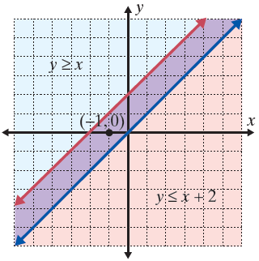
Example 3: Solving Systems of Linear Inequalities (cont.)
Step 3: We test point (−1, 0).
The solution set consists
of the boundary lines
and the region between
them.

Slide 12
Solving Systems of Linear Inequalities
Possible Solutions to Systems of Linear Inequalities
When the boundary lines are parallel there are three possibilities:
The common region will be in the form of a strip between two lines (as in Example 3).
The common region will be a half-plane, as the solution to one inequality will be entirely contained within the solution of the other inequality.
There will be no common region which means there is no solution.

Slide 13
Example 4: Graphing Systems of Linear Inequalities
Use a graphing calculator to graph the system of linear
inequalities:
Solution
Step 1: First solve each inequality for y:
Note: Solving 2x − y ≤ 0 for y can be written as 2x ≤ y and then as y ≥ 2x .

Slide 14
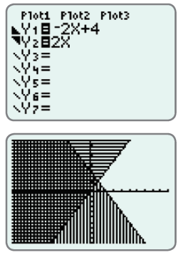
Example 4: Graphing Systems of Linear Inequalities (cont.)
Step 2: Press the Y= key and enter
both functions and the
corresponding symbols
as they appear here.
Remember: To shade your
graphs, position the cursor
over the slash next to Y1
(or Y2) and hit GRAPH
repeatedly until the
appropriate shading is
displayed.

Slide 15

Example 4: Graphing Systems of Linear Inequalities (cont.)
Step 3: Press . The display should appear as follows. The solution is the cross-hatched region and the points on the line 2x − y = 0.

