Slide 1
Section 15.4
Addition, Subtraction, and Multiplication with Radicals

Slide 2
Objectives
Add and subtract radical expressions.
Multiply radical expressions.
Use a graphing calculator to evaluate radical expressions.

Slide 3
Example 1: Adding and Subtracting with Radicals
Perform the indicated operation and simplify, if possible. Assume that all variables represent positive real numbers.
Solution

Slide 4
Example 1: Adding and Subtracting with Radicals (cont.)
Solution

Slide 5
Example 1: Adding and Subtracting with Radicals (cont.)
Solution

Slide 6
Example 1: Adding and Subtracting with Radicals (cont.)
Solution

Slide 7
Completion Example 2: Adding and Subtracting with Radicals
Perform the indicated operations and simplify, if possible. Assume that all variables represent positive real numbers.
Solution
3 + 5 − 1
7

Slide 8
Completion Example 2: Adding and Subtracting with Radicals (cont.)
Solution
1 + 8
4 + 3
9
7

Slide 9
Example 3: Multiplying with Radicals
Multiply and simplify the following expressions. Assume that all variables represent positive real numbers.
Solution

Slide 10
Example 3: Multiplying with Radicals (cont.)
Solution

Slide 11
Example 3: Multiplying with Radicals (cont.)
Solution

Slide 12
Example 3: Multiplying with Radicals (cont.)
Solution

Slide 13
Example 3: Multiplying with Radicals (cont.)
Solution

Slide 14
Completion Example 4: Multiplying with Radicals
Multiply and simplify the following expressions. Assume that all variables represent positive numbers.
Solution
18

Slide 15
Completion Example 4: Multiplying with Radicals (cont.)
Solution
−4
−4
x
32

Slide 16
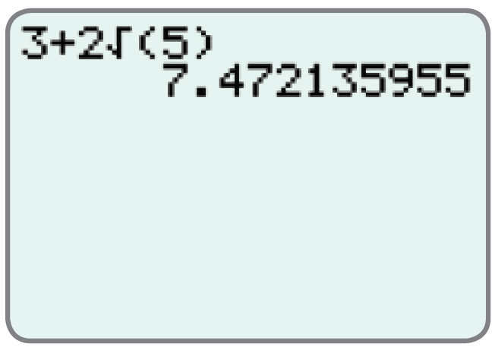
Example 5: Using a Calculator to Evaluate Radical Expressions
Use a TI-84 Plus graphing calculator to evaluate each expression. Round answers to the nearest ten-thousandth.
Solution
The display should appear as follows.
Thus,
Rounded to the nearest ten-thousandth

Slide 17
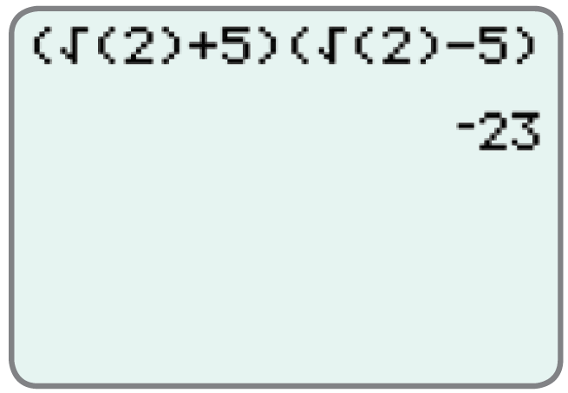
Example 5: Using a Calculator to Evaluate Radical Expressions (cont.)
Solution
The display should appear as follows.
Note: The right parenthesis on 2 must be
included. Otherwise, the calculator will
interpret the expression as
which is not intended.
Thus,

