Slide 1
Section 16.1
Quadratic Equations:
The Square Root Method

Slide 2
Objectives
Solve quadratic equations by factoring.
Solve quadratic equations using the square root method.
Solve problems related to right triangles and the Pythagorean Theorem.

Slide 3
Zero-Factor Property
Properties
If the product of two (or more) factors is 0, then at least one of the factors must be 0. That is, if a and b are real numbers and a · b = 0, then
a = 0 or b = 0 or both.

Slide 4
Quadratic Equations
Definition
Quadratic equations are equations that can be written in the form
ax² + bx + c = 0,
where a, b, and c are real numbers and a ≠ 0.

Slide 5
Solving Quadratic Equations by Factoring
Procedure
Add or subtract terms as necessary so that 0 is on one side of the equation and the equation is in the standard form ax² + bx + c = 0, where a, b, and c are real numbers and a ≠ 0.
Factor completely. (If there are any fractional coefficients, multiply each term by the least common denominator so that all coefficients will be integers.)

Slide 6
Solving Quadratic Equations by Factoring
Procedure (cont.)
Set each nonconstant factor equal to 0 and solve each linear equation for the unknown.
Check each solution, one at a time, in the original equation.

Slide 7
Example 1: Solving Quadratic Equations by Factoring
Solve the quadratic equation by factoring.
Solution
Add 50 to both sides. One side must be 0.
Factor the left-hand side.
Set each factor equal to 0.
Solve each linear equation.

Slide 8
Example 1: Solving Quadratic Equations by Factoring (cont.)
Check

Slide 9
Example 2: Solving Quadratic Equations by Factoring
Solve the quadratic equation by factoring.
Solution
Add 48 to both sides. One side must be 0.
Factor out the GCF, 3.
The trinomial is a perfect square.
Two factors are the same.
The solution is a double root.

Slide 10
Example 2: Solving Quadratic Equations by Factoring (cont.)
Check

Slide 11
Example 3: Quadratic Equations Involving the Sum of Two Squares
Solve the quadratic equation by factoring.
Solution
Note that x² + 4 is the sum of two squares and can be factored into the product of conjugates of complex numbers.

Slide 12
Example 3: Quadratic Equations Involving the Sum of Two Squares (cont.)
Check

Slide 13
Square Root Property
Procedure
If x² = c, then
If then
Note: If c is negative (c < 0), then the solutions will be nonreal.

Slide 14
Example 4: Using the Square Root Property
Solve by using the square root property.
Solution

Slide 15
Example 5: Using the Square Root Property
Solve by using the square root property.
Solution

Slide 16
Completion Example 6: Using the Square Root Property
Solve the following quadratic equation by using the square root method.
Solution

Slide 17
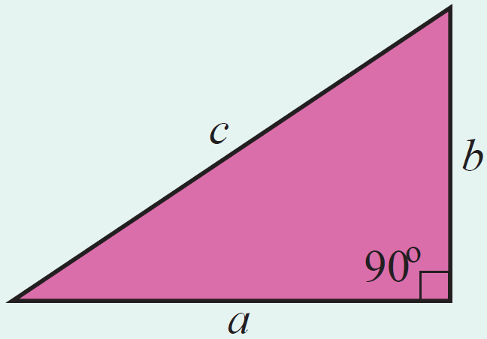
The Pythagorean Theorem
Theorem
In a right triangle, the square of the hypotenuse is equal to the sum of the squares of the two legs.

Slide 18
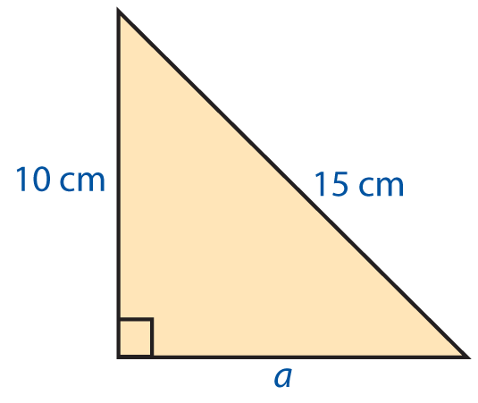
Example 7: The Pythagorean Theorem
If the hypotenuse of a right triangle is 15 cm long and one leg is 10 cm long, what is the length of the other leg?
Solution
Using the Pythagorean Theorem,

Slide 19
Example 7: The Pythagorean Theorem (cont.)
The other leg is cm long (or approximately 11.18 cm long).
(The negative solution to the quadratic equation is not considered because length is not negative.)

Slide 20
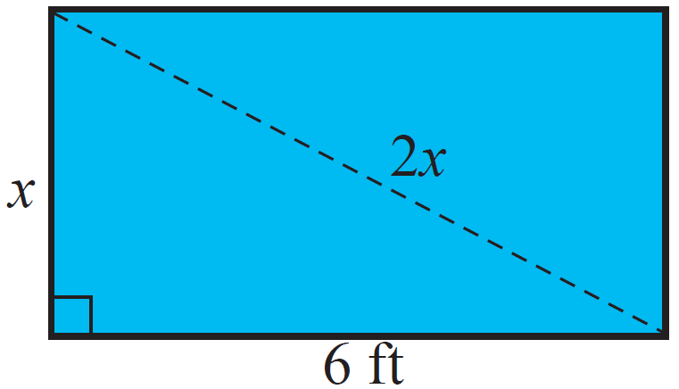
Example 8: The Pythagorean Theorem
The diagonal of a rectangle is twice the width. The length of the rectangle is 6 feet. Find the width of the rectangle.
Solution
Let x = width of the rectangle
and 2x = length of the diagonal.
Then, by using the Pythagorean Theorem, we have

Slide 21
Example 8: The Pythagorean Theorem (cont.)
The width of the rectangle is feet or approximately 3.46 feet.
(The negative solution to the quadratic equation is not considered because length is not negative.)

