Slide 1

Section 16.6
Graphing Quadratic Functions

Slide 2
Objectives
Graph quadratic functions of the form y = ax².
Graph quadratic functions of the form y = ax² + k.
Graph quadratic functions of the form y = a(x – h)².
Graph quadratic functions of the form y = a(x – h)² + k.

Slide 3
Quadratic Functions
Definition
Any function that can be written in the form
where a, b, and c are real numbers and a ≠ 0 is a quadratic function.

Slide 4
Example 1: Graphing Quadratic Functions
Graph each quadratic function, setting up a table of values for x and y as an aid. Choose values of x on each side of the line of symmetry.

Slide 5
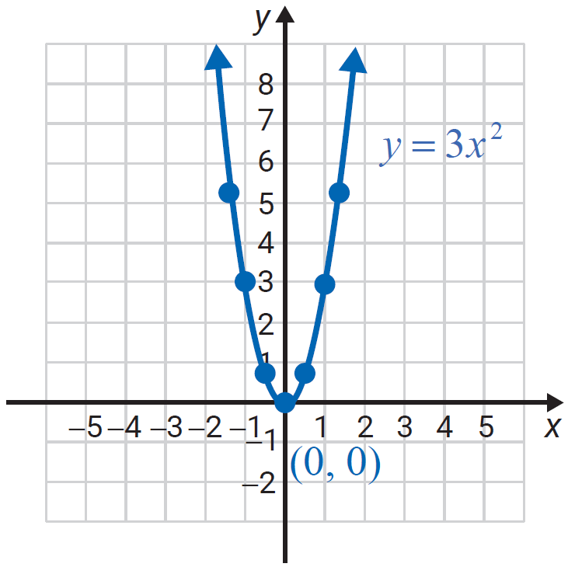
Example 1: Graphing Quadratic Functions (cont.)
Solution
x | y
−1 | 3
0 | 0
1 | 3

Slide 6
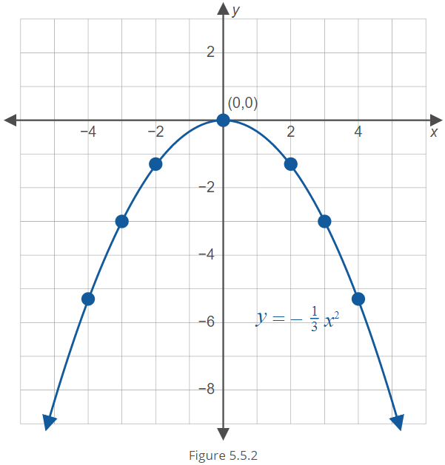
Example 1: Graphing Quadratic Functions (cont.)
Solution
x | Y
−4
−3 | −3
−2
0 | 0
2
3 | −3
4

Slide 7
Example 2: Graphing Quadratic Functions
Find the line of symmetry and vertex for the quadratic function . Then graph the function, setting up a table of values for x and y as an aid. Choose values of x on each side of the line of symmetry.
Solution
The line of symmetry is x = 0. (The parabola opens upward since a is positive.) The vertex is at (0, –3).

Slide 8
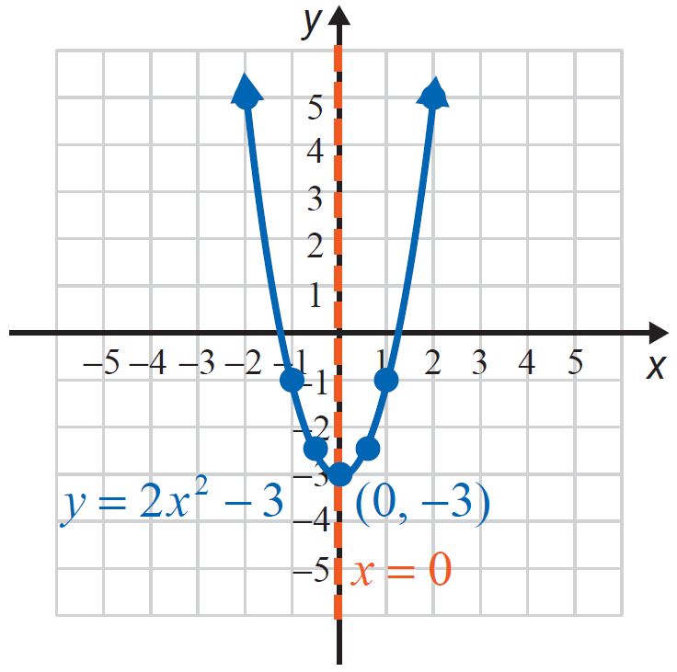
Example 2: Graphing Quadratic Functions (cont.)
x | y
−2 | 5
−1 | −1
0 | −3
1 | −1
2 | 5
−

Slide 9
Example 3: Quadratic Functions
Find the line of symmetry and vertex for the quadratic
function Then graph the function,
setting up a table of values for x and y as an aid. Choose values of x on each side of the line of symmetry.
Solution
The line of symmetry is and the vertex is at
Note that the parabola opens downward since a is negative.

Slide 10
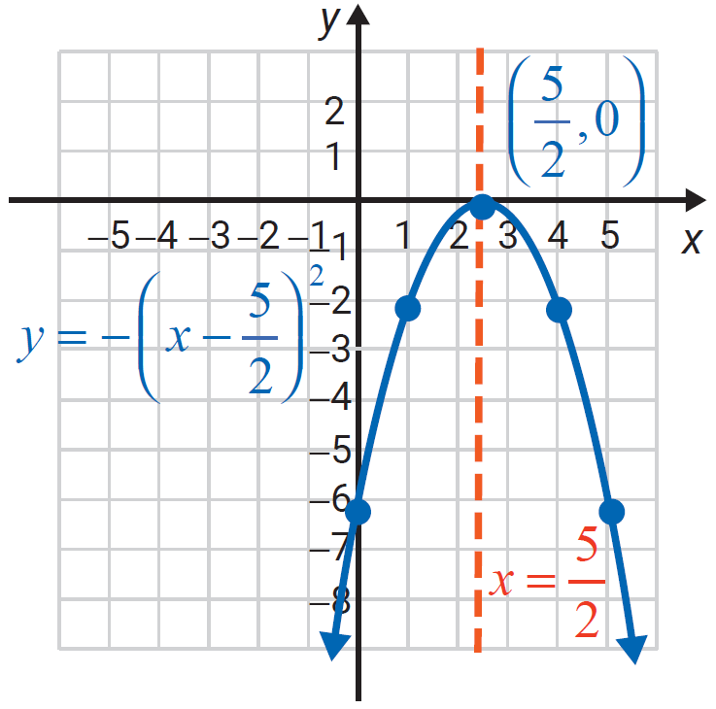
Example 3: Quadratic Functions (cont.)
X | Y
0
1
2
 | 0
3
4
5

Slide 11
Example 4: Graphing Quadratic Functions
Find the line of symmetry and vertex for the quadratic function Then graph the function, setting up a table of values for x and y as an aid. Choose values of x on each side of the line of symmetry.
Solution
The line of symmetry is x = −2. (The parabola opens downward since a is negative.) The vertex is at (−2, 1).

Slide 12
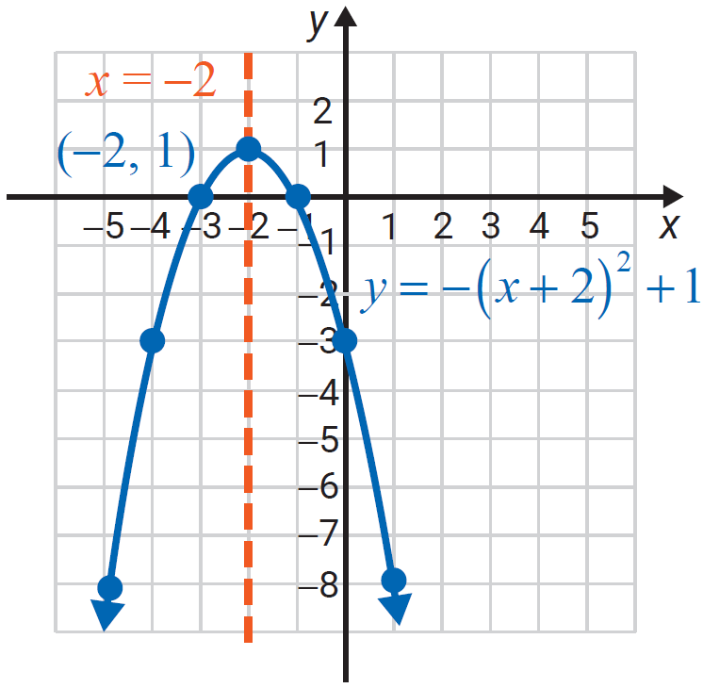
Example 4: Graphing Quadratic Functions (cont.)
X | Y
−5 | −8
−4 | −3
−3 | 0
−2 | 1
−1 | 0
0 | −3
1 | −8

