Slide 1
Section 17.3
Exponential Functions

Slide 2
Objectives
Know the characteristics of an exponential function.
Recognize exponential growth functions.
Recognize exponential decay functions.
Use exponential growth and decay functions to solve applications.
Use exponential functions and the number e to solve compound interest applications.

Slide 3
Exponential Functions
Definition
An exponential function is a function of the form
where b > 0, b ≠ 1, and x is any real number.

Slide 4
Introduction to Exponential Functions
Note
The two conditions b > 0 and b ≠ 1 in the definition are important. We must have b > 0 so that b^{x} is defined for all real x. For example, we do not consider y = (−2)^{x} to
be an exponential function because is not a real number. Also, b ≠ 1. Because the function y = 1^{x} = 1 for all real x, this function is not considered to be an exponential function.

Slide 5
Introduction to Exponential Functions
Note
Because
and so on, for fractions between 0 and 1, we can write
an exponential function with a fractional base between 0 and 1 (these are exponential decay functions) in the form of an exponential function with a base greater than 1 and a negative exponent. Thus, we write

Slide 6
Introduction to Exponential Functions
Note (cont.)
and

Slide 7
General Concepts of Exponential Functions
Definition
For b > 1:
b^{x} > 0
b^{x} increases to the right and is called an exponential growth function.
b⁰ = 1, so (0, 1) is the y‑intercept.
b^{x} approaches the x‑axis for negative values of x. (The x‑axis is a horizontal asymptote. See Figure 1.)

Slide 8
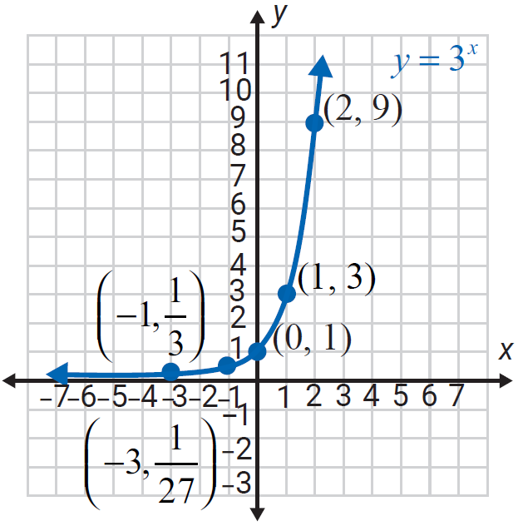
General Concepts of Exponential Functions
Definition (cont.)
Figure 1

Slide 9
General Concepts of Exponential Functions
Definition (cont.)
For 0 < b < 1:
b^{x} > 0
b^{x} decreases to the right and is called an exponential decay function.
b⁰ = 1, so (0, 1) is the y‑intercept.
b^{x} approaches the x‑axis for positive values of x. (The x‑axis is a horizontal asymptote. See Figures 2a and 2b.)

Slide 10
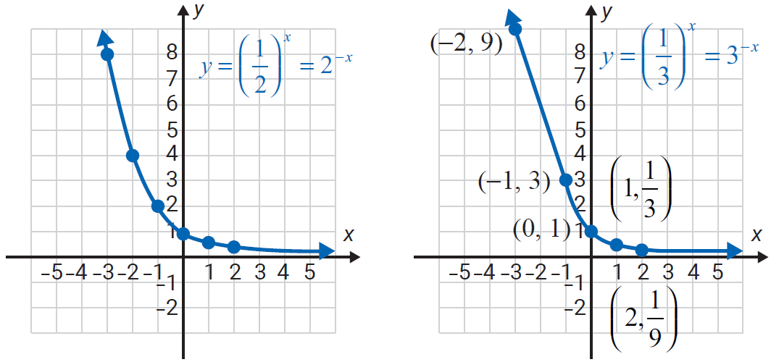
General Concepts of Exponential Functions
Definition (cont.)
Figure 2a
Figure 2b

Slide 11
Example 1 Application: Calculating Bacterial Growth
A scientist has 10,000 bacteria present when t = 0. She knows the bacteria grow according to the function where t is measured in hours. How many bacteria will be present at the end of one day?
Solution
Substitute t = 24 hours and y₀ = 10,000 into the function.
At the end of one day, there will be 40,960,000 bacteria.

Slide 12

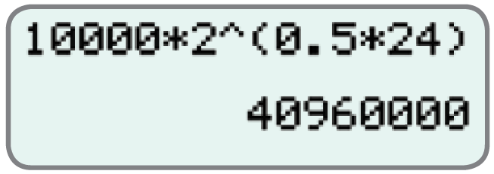
Example 1 Application: Calculating Bacterial Growth (cont.)
Calculators
Calculating Bacterial Growth
You could also use your calculator to calculate the result by entering the numbers as shown in the following display. Press to get the result.

Slide 13
Example 2 Application: Calculating Bacterial Growth
Use the formula for exponential growth, to determine the exponential function that fits the following information: y₀ = 5000 bacteria with 135,000 bacteria present after 3 days.
Solution
Use where t is measured in days. Substitute 135,000 for y, 3 for t, and 5000 for y₀ , then solve for b.

Slide 14
Example 2 Application: Calculating Bacterial Growth (cont.)
The function is

Slide 15
Compound Interest
Formula
Compound interest on a principal P invested at an annual interest rate r (in decimal form) for t years that is compounded n times per year can be calculated using the following formula where A is the amount accumulated.

Slide 16
Example 3 Application: Calculating Compound Interest
If P dollars are invested at a rate of interest r (in decimal form) compounded annually (once a year, n = 1) for t years, the formula for the amount A
becomes Find the value of
$1000 invested at r = 6% = 0.06 for 3 years.
Solution
We have P = 1000, r = 0.06, and t = 3.

Slide 17
Example 3 Application: Calculating Compound Interest (cont.)
The account will have $1191.02 invested in it after 3 years.

Slide 18
Example 4 Application: Calculating Compound Interest
What will be the value of a principal investment of $1000 invested at 6% for 3 years if interest is compounded monthly (12 times per year)?
Solution
Use the formula for compound interest.
We have P = 1000, r = 0.06, n = 12, and t = 3.

Slide 19
Example 4 Application: Calculating Compound Interest (cont.)
Using a calculator
The value of the account after 3 years will be $1196.68.

Slide 20
Example 5 Application: Calculating Compound Interest
Find the value of A if $1000 is invested at 6% for 3 years and interest is compounded daily (365 times per year).
Solution
Use the formula for compound interest
We have P = 1000, r = 0.06, n = 365, and t = 3.

Slide 21
Example 5 Application: Calculating Compound Interest (cont.)
Using a calculator
After three years, there will be $1197.20 in the account.

Slide 22
The Number e
Definition
The number e is defined to be
e = 2.718281828459 …
Note: The number e is on the TI-84 Plus calculator above the divide key.

Slide 23
Continuously Compounded Interest
Formula
Continuously compounded interest on a principal P invested at an annual interest rate r for t years can be calculated using the following formula where A is the amount accumulated.

Slide 24


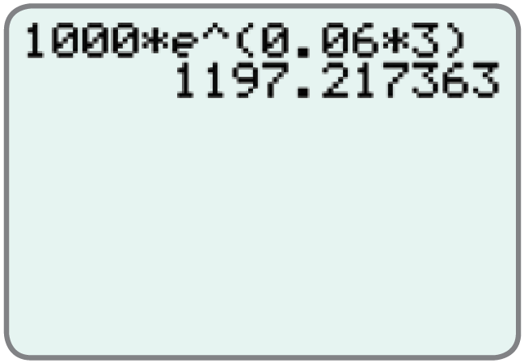

Example 6: Using a Graphing Calculator to Calculate Continuously Compounded Interest
Find the value of $1000 invested at 6% for 3 years if interest is compounded continuously. (In this case, P = $1000, r = 6% = 0.06, and t = 3.)
Solution
Press and and e^(will appear on the display.
To find the value of
enter the numbers as shown and press to get the result.

Slide 25
Example 6: Using a Graphing Calculator to Calculate Continuously Compounded Interest (cont.)
Thus, the value of $1000 compounded continuously at 6% for 3 years will be $1197.22. (Note that from Example 4 there is only a 54 cent gain in A when $1000 is compounded continuously instead of monthly at 6% for 3 years.)

