Slide 1

Section 17.6
Common Logarithms and Natural Logarithms

Slide 2
Objectives
Identify common logarithms (base 10) and use a calculator to find their approximate values.
Use a calculator to find the inverse of a common logarithm.
Identify natural logarithms (base e) and use a calculator to find their approximate values.
Use a calculator to find the inverse of a natural logarithm.

Slide 3
Example 1: Translating between Exponential Form and Common Logarithms
Exponential Logarithmic
Form Form
This is a common logarithm that equals 4.
This is a common logarithm that equals −2.
This is a common logarithm that equals x.

Slide 4
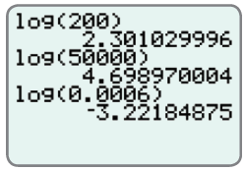
Example 2: Evaluating Common Logarithms Using a Calculator
Use a TI-84 Plus graphing calculator to find the approximate values of the following common logarithms.
a. log 200 b. log 50,000 c. log 0.0006
Solution
log 200 ≈
log 50,000 ≈
log 0.0006 ≈
≈ 2.301029996
≈ 4.698970004
≈ –3.22184875

Slide 5
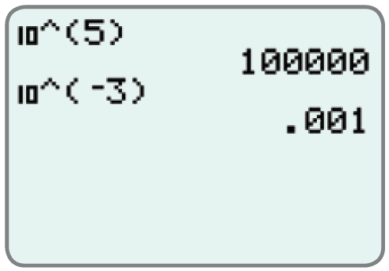
Example 3: Using a Calculator to Find the Inverse Log of N
Use a TI-84 Plus graphing calculator to find the inverse log of N for each expression. (That is, find the value of x.)
a. log x = 5 b. log x = −3
Solution
The calculator gives
x = 10⁵
x = 10⁻³
= 100,000
= 0.001

Slide 6
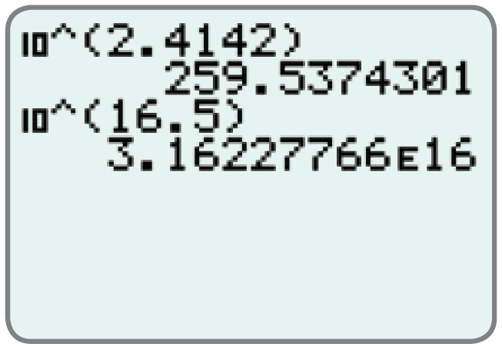
Example 3: Using a Calculator to Find the Inverse Log of N (cont.)
c. log x = 2.4142 d. log x = 16.5
Solution
The calculator gives
x = 10^{2.4142} ≈
x = 10^{16.5} ≈
The letter E in the solution is
the calculator version of
scientific notation.
Thus, 3.16227766E16
≈ 259.5374301
≈ 3.16227766E16
= 3.16227766 × 10¹⁶.

Slide 7
Example 4: Translating between Exponential Form and Natural Logarithms
Exponential Logarithmic
Form Form
This is a natural logarithm that equals t.
This is a natural logarithm that equals 0.
This is a natural logarithm that equals 2.

Slide 8
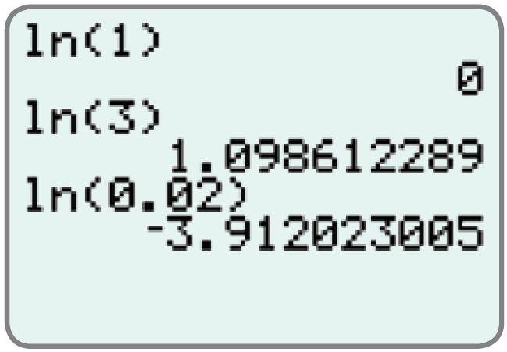
Example 5: Evaluating Natural Logarithms Using a Calculator
Use a TI-84 Plus graphing calculator to find the values of the following natural logarithms.
ln 1 b. ln 3 c. ln 0.02
Solution
From the display we see the results
(accurate to 9 decimal places).
ln 1
ln 3
ln 0.02
= 0
≈ 1.098612289
≈ −3.912023005

Slide 9
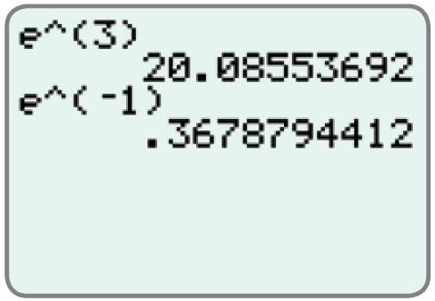
Example 6: Using a Calculator to find the Inverse ln of N
Use a TI-84 Plus graphing calculator to find the inverse ln of N for each expression. (That is, find the value of x.)
a. ln x = 3 b. ln x = −1
Solution
The calculator gives

Slide 10
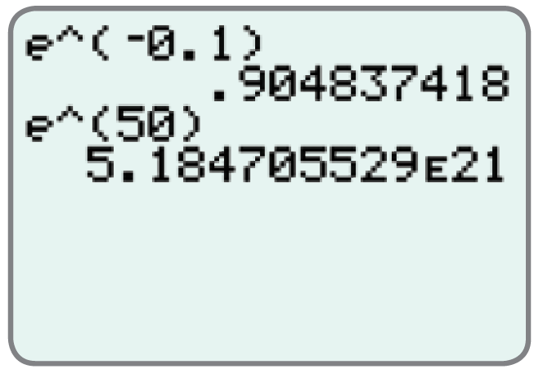
Example 6: Using a Calculator to find the Inverse ln of N (cont.)
c. ln x = −0.1 d. ln x = 50
Solution
The calculator gives

