Slide 1
Section 18.1
Translations and Reflections

Slide 2
Objectives
Evaluate functions at a given expression.
Find the difference quotient for a given function.
Graph horizontal and vertical translations of given graphs of functions.
Graph reflections and translations of given graphs of functions.

Slide 3
Example 1: Using f(x) Notation
For the function find:
f(3)
Solution
f(a)
Solution

Slide 4
Example 1: Using f(x) Notation (cont.)
f(a + 1)
Solution
Replace x with a + 1 and simplify.

Slide 5
Example 2: Finding the Difference Quotient f(x+h)−f(x)/h
Find the difference quotient for the function
Solution
Substituting gives:

Slide 6
Example 3: Finding the Difference Quotient f(x+h)−f(x)/h
Find the difference quotient for the function
Solution
Substituting gives:

Slide 7
Example 3: Finding the Difference Quotient f(x+h) − f(x)/h
Expand (x + h)²
and multiply by 2.
Factor out h.

Slide 8
Horizontal and Vertical Translations
Procedure
Given the graph of y = f(x), the graph of y = f(x−h) + k is
a horizontal translation of h units, and
a vertical translation of k units
of the graph of y = f(x).
Draw the graph of y = f(x) in relation to (h, k) as if (h, k) were the origin, (0, 0). This new graph will be the graph of y = f(x−h) + k.

Slide 9
Example 4: Horizontal and Vertical Translations of y = |x|
Graph the function Use the graph in Figure 5 as a reference.
Solution
Here (h, k) = (3, 2), so there is a horizontal translation of 3 units right and 2 units up. In effect, (3, 2), is now the vertex of the new graph just as (0, 0) is the vertex of the original graph. You should check that the points shown on the graph here do indeed satisfy the function.

Slide 10
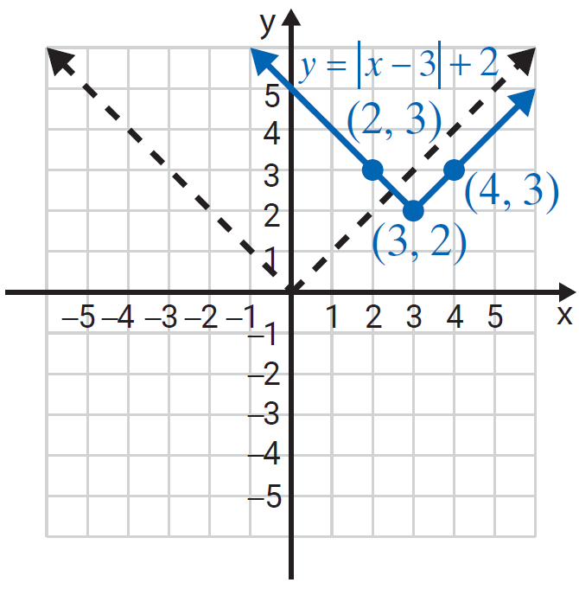
Example 4: Horizontal and Vertical Translations of y = |x| (cont.)

Slide 11
Example 5: Horizontal and Vertical Translations of y = |x|
Graph the function
Solution
Here (h, k) = (−4, −1), so the horizontal translation is −4 (4 units left) and the vertical translation is −1 (1 unit down). The effect is that the vertex is now at the point (−4, −1).

Slide 12
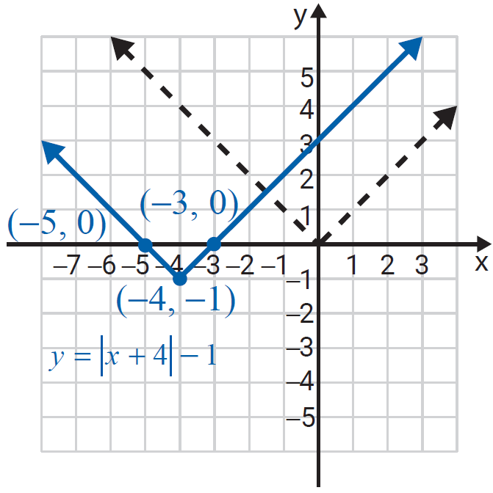
Example 5: Horizontal and Vertical Translations of y = |x| (cont.)

Slide 13
Example 6: Horizontal and Vertical Translations of y = |x|
Graph the function
Solution
Here (h, k) = (−2, 7), so the horizontal translation is −2 (2 units left) and the vertical translation is 7 (7 units up). The effect is that the vertex is now at the point (−2, 7).

Slide 14
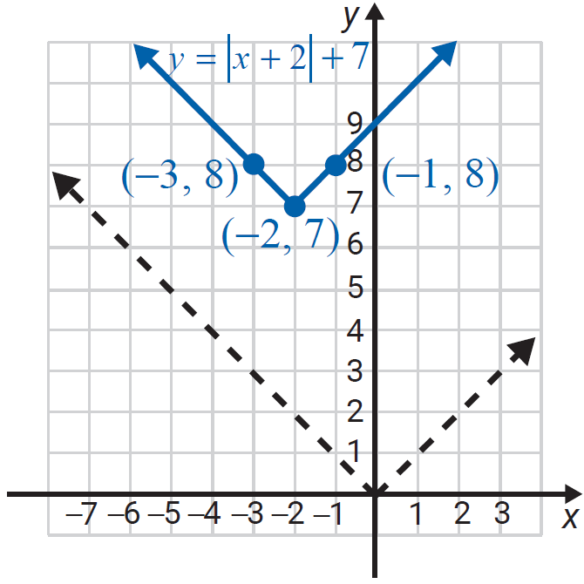
Example 6: Horizontal and Vertical Translations of y = |x|(cont.)

Slide 15
Example 7: Reflections and translations of y = |x|
Graph the function
Solution
The reflection is performed first, followed by the translations.
Here (h, k) = (−2, 5), and the graph is reflected across the x-axis. We show step-by-step how to “arrive” at the graph. (You may do these steps mentally and graph only the last step.)

Slide 16
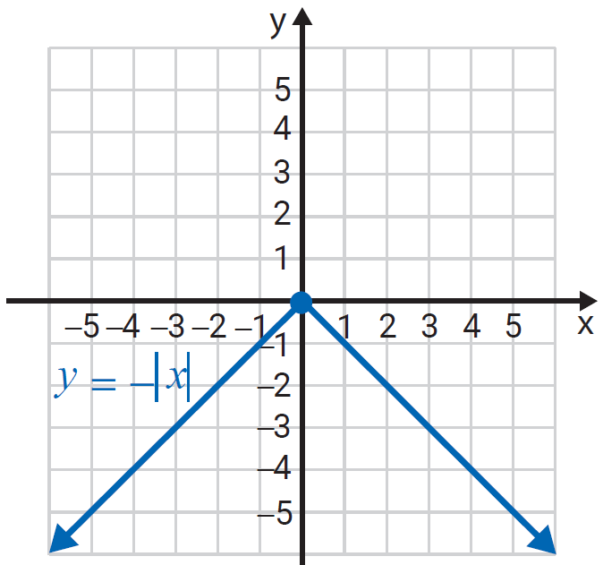
Example 7: Reflections and translations of y = |x| (cont.)
Step 1: Graph the reflection

Slide 17
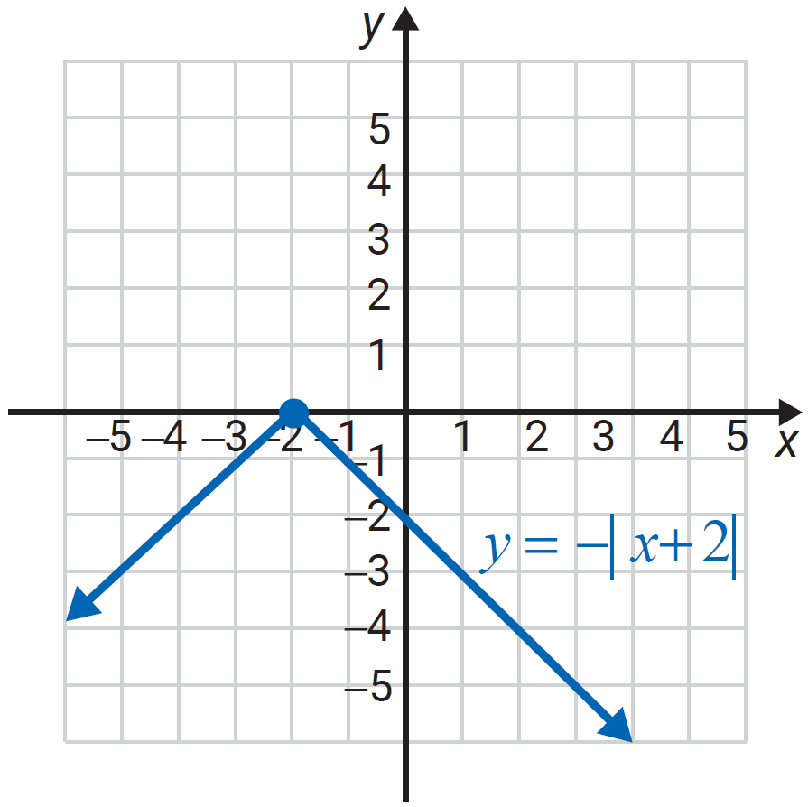
Example 7: Reflections and translations of y = |x| (cont.)
Step 2: Translate the graph 2 units to the left.

Slide 18
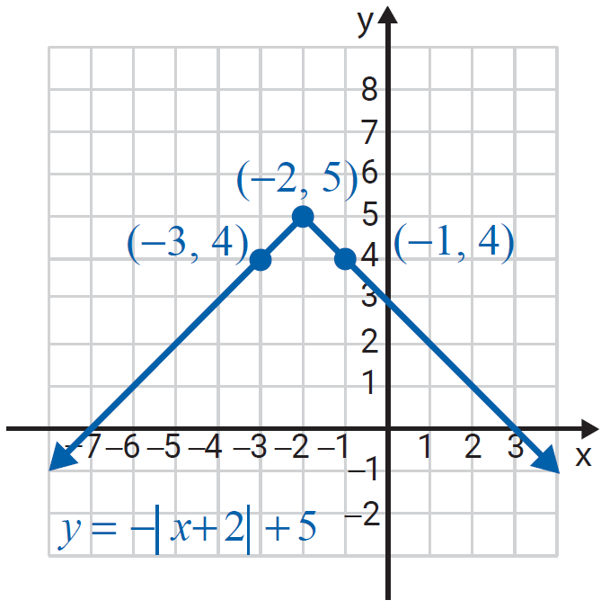
Example 7: Reflections and translations of y = |x| (cont.)
Step 3: Translate the graph 5 units up.

Slide 19
Example 8: Graphing Translations of a Function Given its Graph
The graph of is given. Graph the function
Solution
If is written then is the same as So and there is a horizontal translation of 2 units to the right and a vertical translation of 1 unit up.

Slide 20
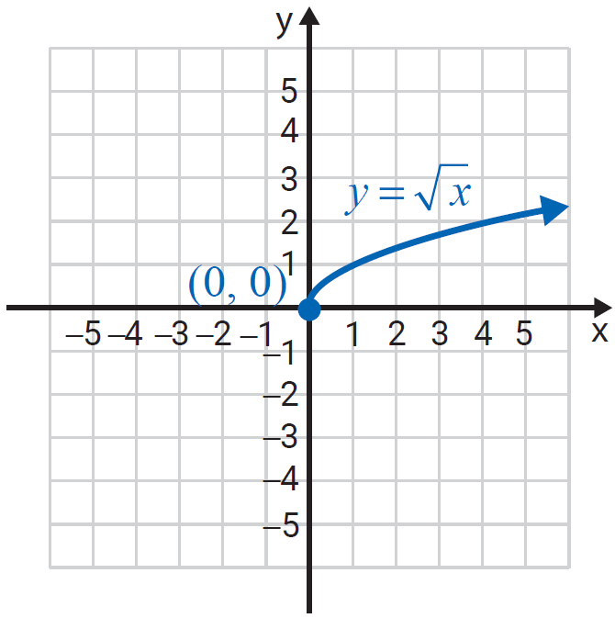
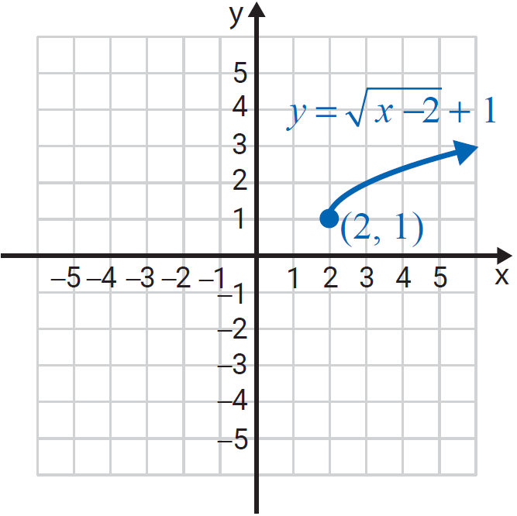
Example 8: Graphing Translations of a Function Given its Graph (cont.)

Slide 21
Example 9: Graphing Translations of a Function Given its Graph
The graph of is given. Graph the function
Solution
Here so translate the graph horizontally 3 units and vertically −2 units. (Add 3 to each x-value and −2 to each y-value.)

Slide 22
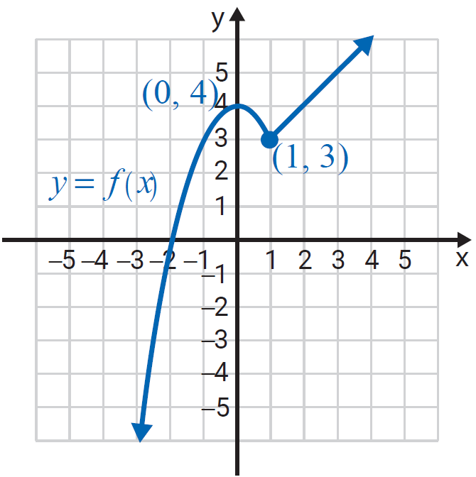
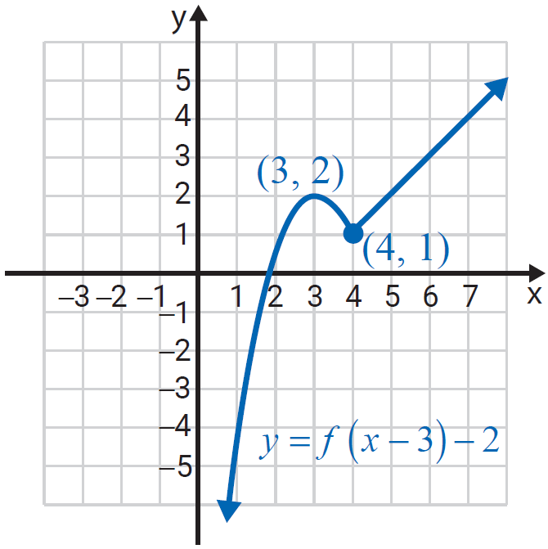
Example 9: Graphing Translations of a Function Given its Graph (cont.)

