Slide 1
Section 18.3
Distance Formula, Midpoint Formula, and Circles

Slide 2
Objectives
Find the distance between any two points on a plane.
Find the midpoint between two points on a plane.
Write the equation of a circle given its center and radius.
Graph circles centered at the point (h, k).
Use a graphing calculator to graph circles.

Slide 3
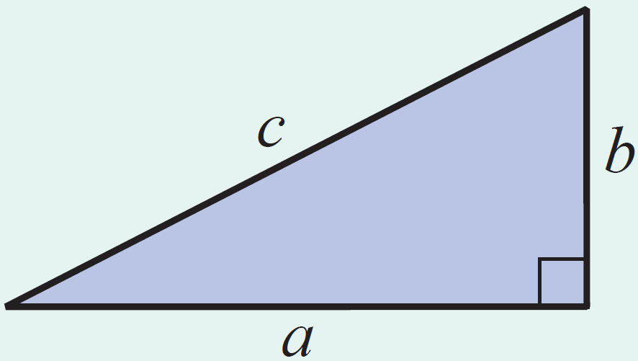
The Pythagorean Theorem
Theorem
In a right triangle, if c is the length of the hypotenuse and a and b are the lengths of the legs, then
c² = a² + b².

Slide 4
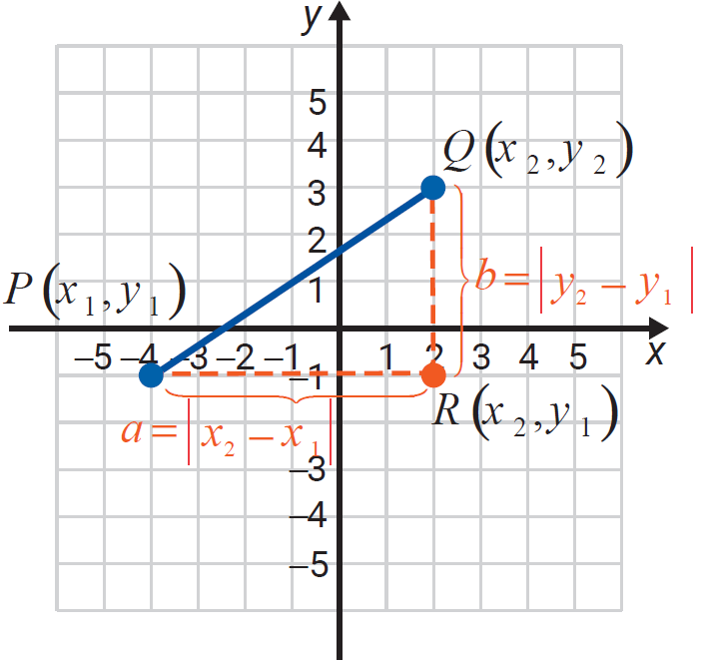
The Distance Formula
Formula
For two points P(x₁, y₁) and Q(x₂, y₂) in a plane, the distance between the points is

Slide 5
Example 1: Using the Distance Formula
Find the distance between the two points (3, 4) and
(−2, 7).
Solution

Slide 6
Example 2: Determining If a Triangle is a
Right Triangle
Use the distance formula (3 times) and the Pythagorean Theorem to determine whether the triangle with vertices at
is a right triangle.
Solution
Find the lengths of the three line segments
and decide whether the Pythagorean Theorem is satisfied.

Slide 7
Example 2: Determining If a Triangle is a
Right Triangle (cont.)

Slide 8
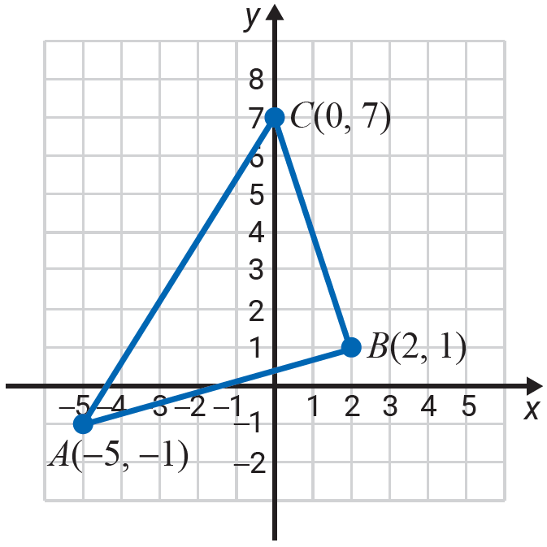
Example 2: Determining If a Triangle is a
Right Triangle (cont.)
The longest side is
The triangle is not a right triangle since
as 89 ≠ 53 + 40.

Slide 9
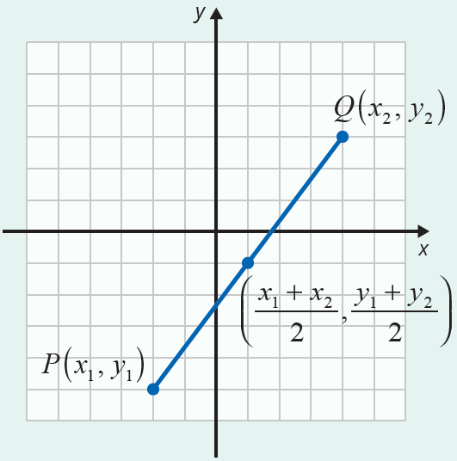
Midpoint Formula
Formula
The formula for the midpoint between two points
P(x₁, y₁) and Q(x₂, y₂) is

Slide 10
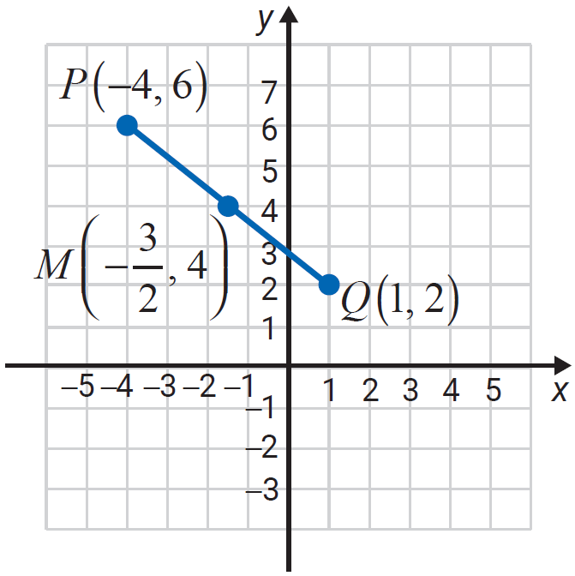
Example 3: Finding the Midpoint
Find the coordinates of the midpoint of the line segment joining the two points P(−4,6) and Q(1,2).
Solution
The midpoint is

Slide 11
Circle, Center, Radius, and Diameter
Definition
A circle is the set of all points in a plane that are a fixed distance from a fixed point.
The fixed point is called the center of the circle.
The distance from the center to any point on the circle is called the radius of the circle.
The distance from one point on the circle to another point on the circle measured through the center is called the diameter of the circle.
Note: The diameter is twice the length of the radius.

Slide 12
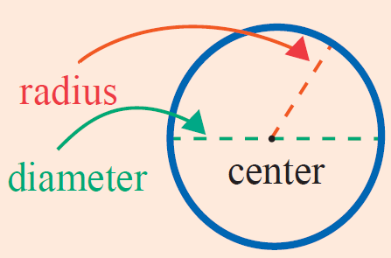
Circle, Center, Radius, and Diameter
Definition (cont.)

Slide 13
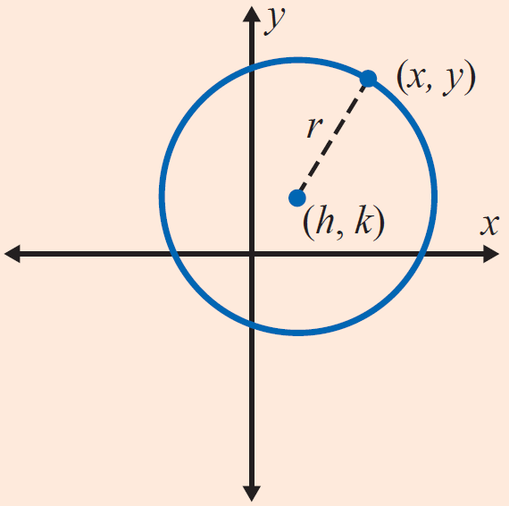
Equation of a Circle
Definition
The equation of a circle with radius r and center at
(h, k) is
If the center is at the origin, (0, 0),
the equation simplifies to

Slide 14
Example 4: Finding the Equation of a Circle
Find the equation of the circle with its center at the origin and radius Are the points and (1,2) on the circle?
Solution
General form for the equation of a circle with center at the origin:
The equation of the circle is
To determine whether or not the points and (1,2) are on the circle, substitute each of these points into the equation.

Slide 15
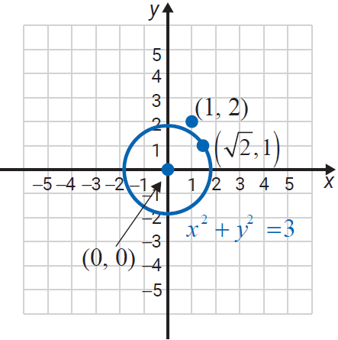
Example 4: Finding the Equation of a Circle (cont.)
Substituting gives
Substituting (1,2) gives
Therefore, is on the
circle, but (1,2) is not on the
circle.

Slide 16
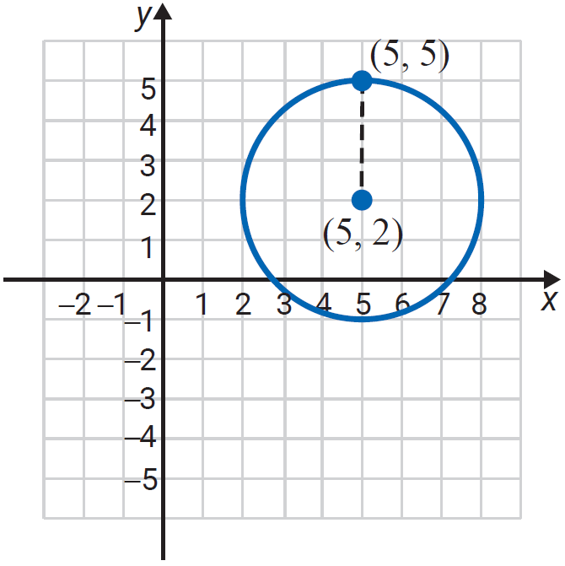
Example 5: Finding the Equation of a Circle
Find the equation of the circle with center at (5, 2) and radius 3. Is the point (5, 5) on the circle?
Solution
General form for the equation of a
circle:
The equation of the circle is
Substituting (5, 5) gives
Therefore, (5, 5) is on the circle.

Slide 17
Example 6: Graphing a Circle
Show that represents a circle. Find its center and radius. Then graph the circle.
Solution
Rearrange the terms and complete the square for
and

Slide 18
Example 6: Graphing a Circle (cont.)
Add 16 and 1 to both sides.
Completes the square
Standard form for the equation of a circle
Center is at and

Slide 19
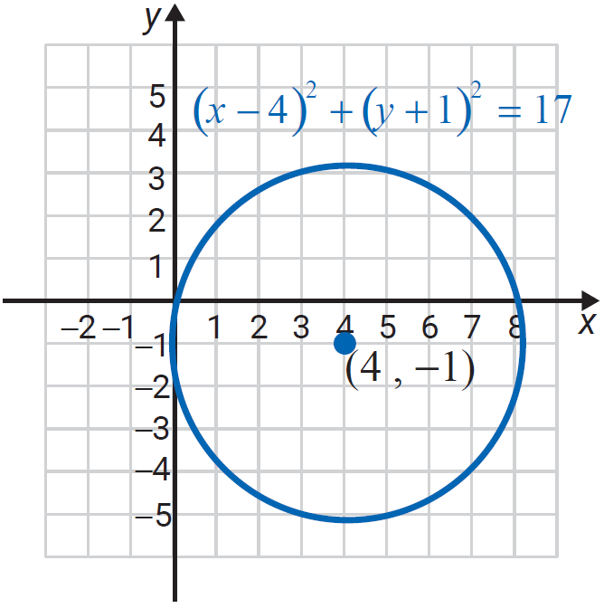
Example 6: Graphing a Circle (cont.)

Slide 20

Example 7: Using a Graphing Calculator to Graph Circles
Use a graphing calculator with a “square window” to graph the circle x² + y² = 9.
Solution
Press the key and set the values to −6 and 6 for Xmin and Xmax and −4 and 4 for Ymin and Ymax, respectively.
Solving for y² gives:
Solving for y₁ and y₂ gives:

Slide 21
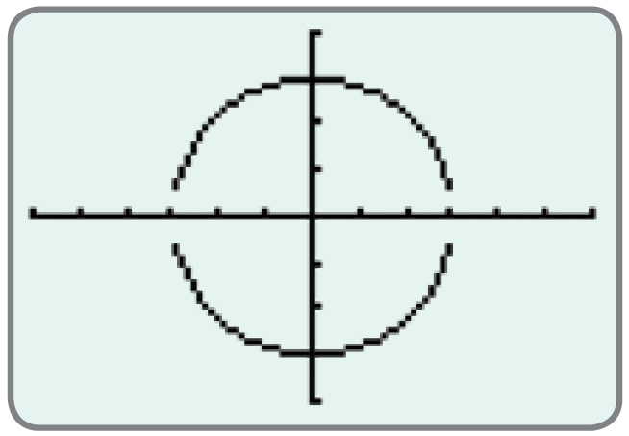
Example 7: Using a Graphing Calculator to Graph Circles (cont.)
Graphing both y₁ and y₂ gives the following graph of the circle.

