Slide 1
Section 6.1
Angles and Triangles

Slide 2
Objectives
Recognize points, lines, planes, rays, and angles.
Classify an angle by its measure.
Recognize complementary and supplementary angles.
Recognize congruent, vertical, and adjacent angles.
Know when lines are parallel and perpendicular.
Classify a triangle by its sides and angles.

Slide 3
Point, Line, Plane
Definition
Term | Representation | Discussion
Point | Point A A | A point is represented by a dot. Points are labeled with capital letters.
·

Slide 4
Point, Line, Plane
Definition (cont.)
Term | Representation | Discussion
Line |  | A line has no beginning or end. Lines are labeled with lowercase letters or by two points on the line.
Line l or line AB
l
A
B

Slide 5
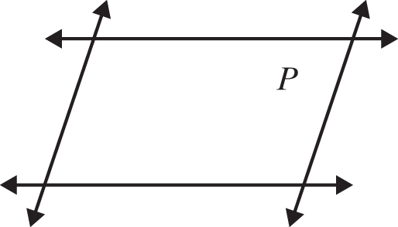
Point, Line, Plane
Definition (cont.)
Term | Representation | Discussion
Plane | Plane P | Flat surfaces, such as a table top or wall, represent portions of planes. Planes are labeled with capital letters.

Slide 6
Ray and Angle
Definition
Term | Definition | Illustrations with Notation
Ray | A ray consists of a point (called the endpoint) and all the points on a line on one side of that point.
Q
P
Ray PQ with endpoint P

Slide 7
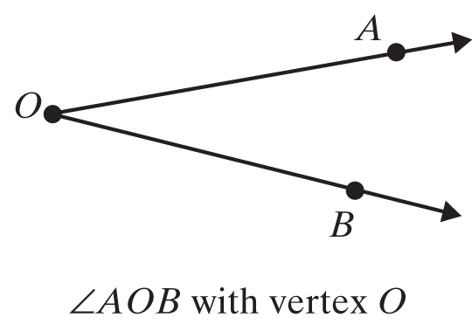
Angles and Measures of Angles
Definition (cont.)
Term | Definition | Illustrations with Notation
Angle | An angle consists of two rays with a common endpoint (called a vertex).

Slide 8
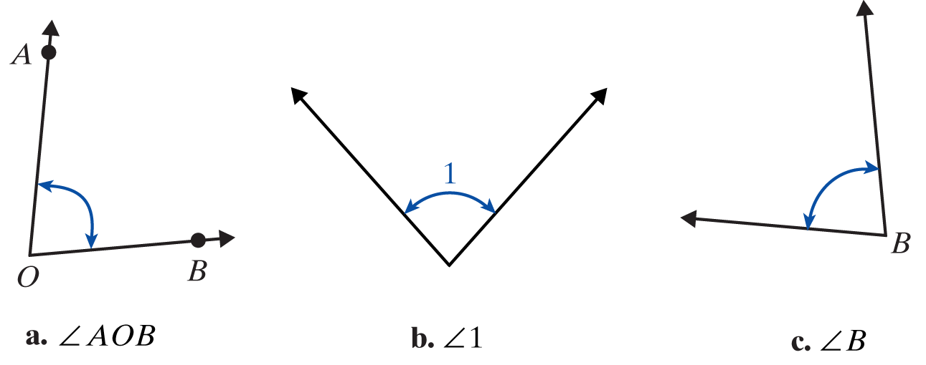
Labeling Angles
Procedure
Three common ways of labeling angles:
Using three capital letters with the vertex as the middle letter.
Using single numbers such as 1, 2, 3.
Using the single capital letter at the vertex when the meaning is clear.

Slide 9
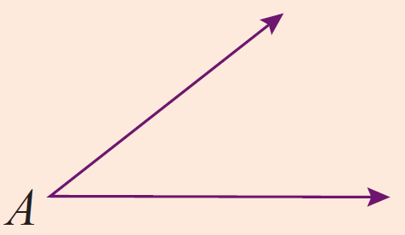
Angles Classified by Measure
Definition
Name | Measure | Illustrations with Notation
Acute |  | is an acute angle.

Slide 10
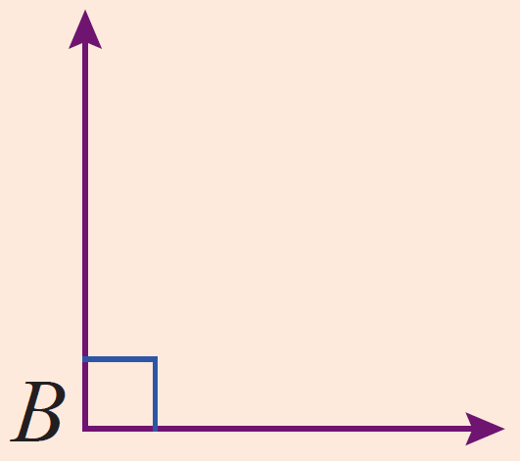
Angles Classified by Measure
Definition (cont.)
Name | Measure | Illustrations with Notation
Right |  | is a right angle.

Slide 11
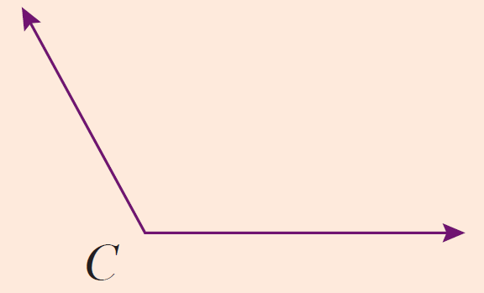
Angles Classified by Measure
Definition (cont.)
Name | Measure | Illustrations with Notation
Obtuse |  | is an obtuse angle.

Slide 12
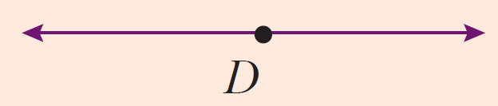
Angles Classified by Measure
Definition (cont.)
Name | Measure | Illustrations with Notation
Straight |  | The rays are in opposite directions. is a straight angle.

Slide 13
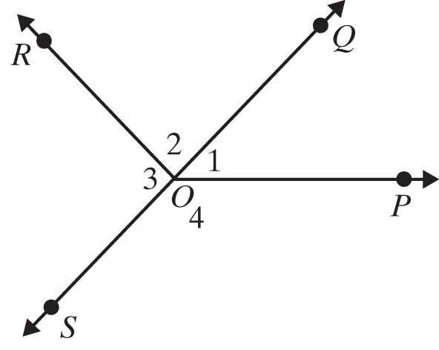
Example 1: Measuring Angles
Use a protractor to check the measures of the given angles.
Solutions

Slide 14
Example 2: Identifying Angles
Classify each angle as acute, right, obtuse, or straight.
a. ∠1
∠2
c. ∠POR
Solutions
∠1
∠2

Slide 15
Example 2: Identifying Angles
Classify each angle as acute, right, obtuse, or straight.
a. ∠1
∠2
c. ∠POR
Solutions
∠POR

Slide 16
Complementary and Supplementary Angles
Definition
Two angles are Complementary if the sum of their measures is 90˚.
Two angles are Supplementary if the sum of their measures is 180˚.

Slide 17
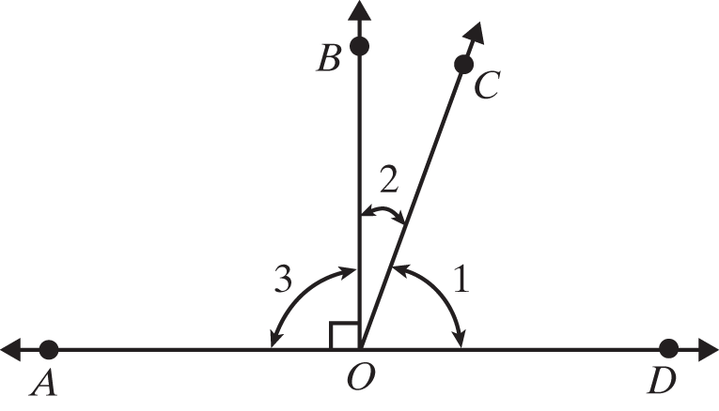
Example 3: Identifying Complementary and Supplementary Angles
In the figure shown, is a straight line. Identify all pairs of complementary, supplementary, and straight angles.

Slide 18
Example 3: Identifying Complementary and Supplementary Angles (cont.)
∠1 and ∠2 are complementary since
∠COD and ∠COA are supplementary since
∠AOD is a straight angle since
∠BOA and ∠BOD are supplementary; and in this case

Slide 19
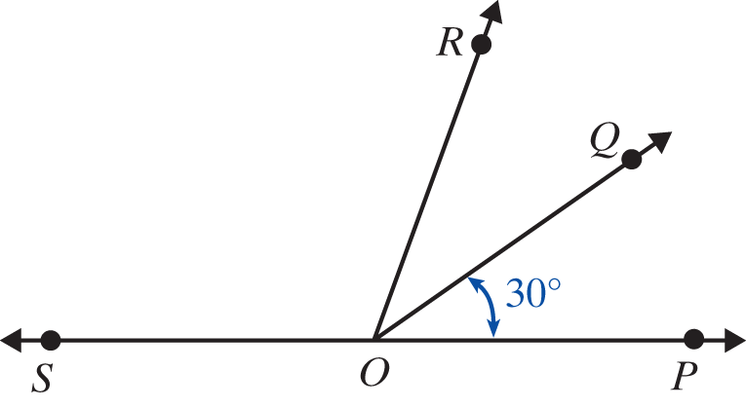
Example 4: Calculating Measures of Angles
In the figure below, is a straight line and
Find the measure of ∠QOS.
Find the measure of ∠SOP.
c. Are any pairs supplementary?

Slide 20
Example 4: Calculating Measures of Angles (cont.)
Solution
Yes, ∠QOP and ∠QOS are supplementary and ∠ROP and ∠ROS are supplementary.

Slide 21
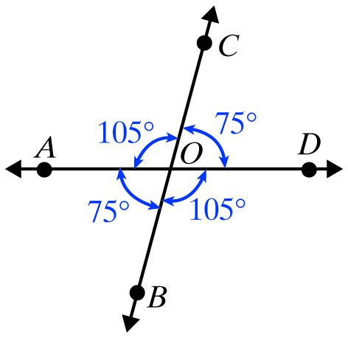
Example 5: Identified Congruent Angles
In the figure shown below, identify the congruent angles.
Solution

Slide 22
Vertical Angles
Definition
Vertical angles are congruent. That is, vertical angles have the same measure.

Slide 23
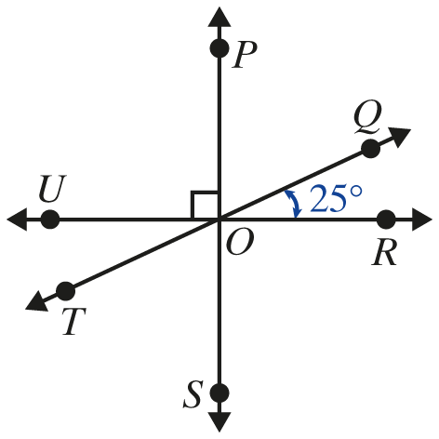
Example 6: Calculating Measures of Angles
In the figure shown, three lines intersect at the point O.
Find the measures of the following angles:
a. ∠TOU b. ∠ROS c. ∠POQ d. ∠SOT

Slide 24
Example 6: Measures of Vertical Angles (cont.)
Solution
are vertical angles and are congruent. They have the same measure,
are vertical angles and are congruent. They have the same measure,

Slide 25
Example 6: Measures of Vertical Angles (cont.)
Because is a straight line, we have
are vertical angles and have the same measure. This means

Slide 26
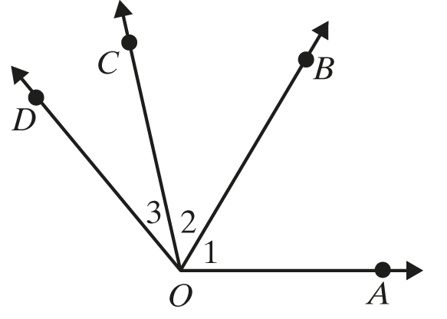
Adjacent Angles
Definition
Two angles are adjacent if they have a common side.
∠1 and ∠2 are adjacent angles.
They have the common side
∠2 and ∠3 are adjacent angles.
They have the common side

Slide 27
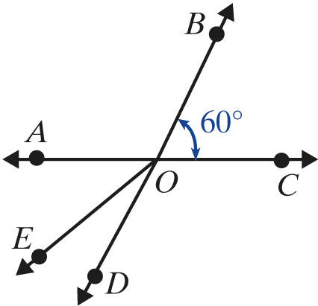
Example 7: Finding Adjacent Angles
In the figure below, are straight lines.
Name an angle adjacent to

Slide 28
Example 7: Finding Adjacent Angles (cont.)
Solution
One angle adjacent to is Two other angles adjacent to are and

Slide 29
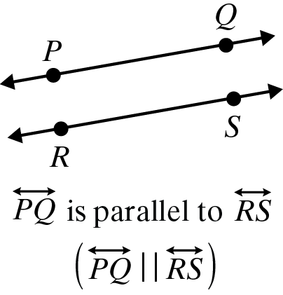
Parallel Lines and Perpendicular Lines
Definition
Term | Definition | Illustrations with Notation
Parallel Lines | Two lines are parallel (symbolized ) if they are in the same plane and do not intersect.

Slide 30
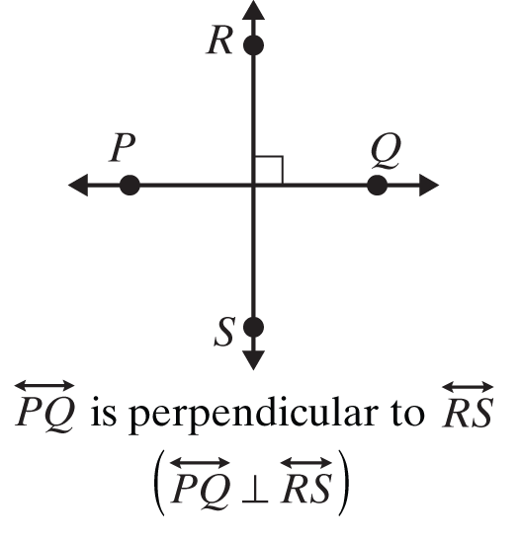
Parallel Lines and Perpendicular Lines
Definition (cont.)
Term | Definition | Illustrations with Notation
Perpendicular Lines | Two lines are perpendicular (symbolized ⊥ ) if they intersect to form right angles.

Slide 31
Parallel Lines and a Transversal
Procedure
If two parallel lines are cut by a transversal, then the following two statements are true.
1. Corresponding angles are congruent.
2. Alternate interior angles are congruent.

Slide 32
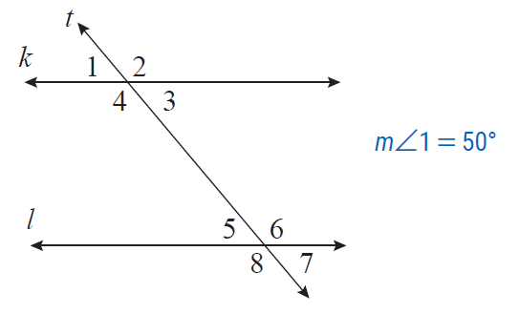
Example 8: Calculating Measures of Angles
In the figure below, lines k and l are parallel, t is a transversal, and Find the measures of the other 7 angles.

Slide 33
Example 8: Calculating Measures of Angles (cont.)
Solution
One way of reasoning is as follows:
∠1 and ∠3 are vertical angles so
∠1 and ∠2 are supplementary angles so
∠2 and ∠4 are vertical angles so

Slide 34
Example 8: Calculating Measures of Angles (cont.)
Now, because ∠1 and ∠5 are corresponding angles, they have the same measures and
Because ∠4 and ∠6 are alternate interior angles, they have the same measures and
Again, with vertical angles and

Slide 35
Classifying Triangles
Note
The line segment with endpoints A and B is indicated by placing a bar over the letters, as in The length of the segment is indicated by writing only the letters, as in AB.

Slide 36
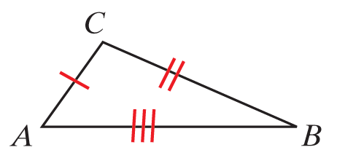
Triangles Classified by Sides
Definition (Note: In the figures, sides with equal length are indicated by the same number of slash marks.)
Name | Property | Example
Scalene | No two sides have equal lengths. | ∆ABC is scalene since no two sides have equal lengths.

Slide 37
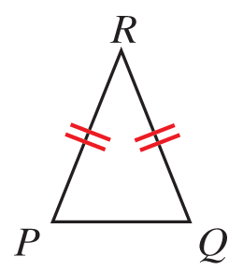
Triangles Classified by Sides
Definition (cont.)
Isosceles | At least two sides have equal lengths. | ∆PQR is isosceles since PR = QR.

Slide 38
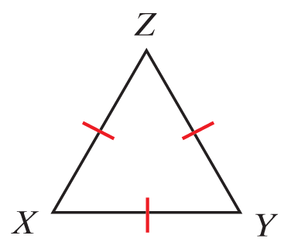
Triangles Classified by Sides
Definition (cont.)
Equilateral | All three sides have equal lengths. | ∆XYZ is equilateral since XY = XZ = YZ

Slide 39
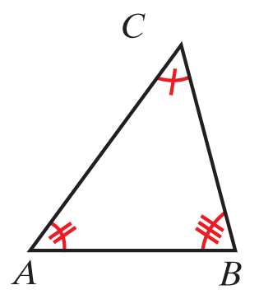
Triangles Classified by Angles
Definition
Name | Property | Example
Acute | All three angles are acute. | are all acute so ∆ABC is acute.

Slide 40
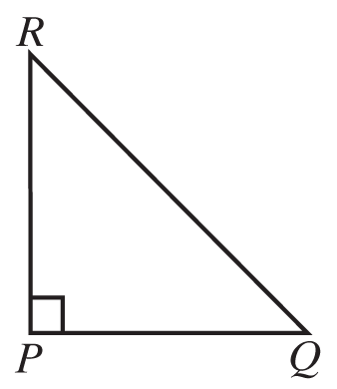
Triangles Classified by Angles
Definition (cont.)
Right | One angle is a right angle. | so ∆PRQ is a right triangle.

Slide 41
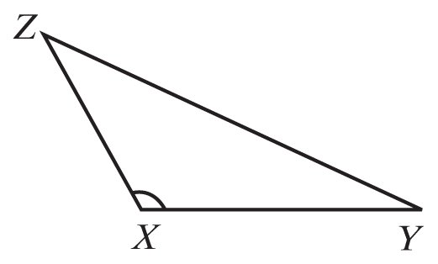
Triangles Classified by Angles
Definition (cont.)
Obtuse | One angle is obtuse. | is obtuse so ∆XYZ is an obtuse triangle.

Slide 42
Three Properties of Triangles
Properties
In a triangle:
The sum of the measures of the angles is 180°.
The sum of the lengths of any two sides must be greater than the length of the third side.
Longer sides are opposite angles with larger measures.

Slide 43
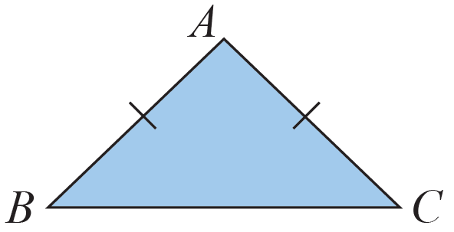
Example 9: Classifying a Triangle by Its Sides
InΔ∆ABC below, AB = AC. What kind of triangle isΔ∆ABC?
Solution
∆ABC is isosceles because two sides have equal lengths.

Slide 44
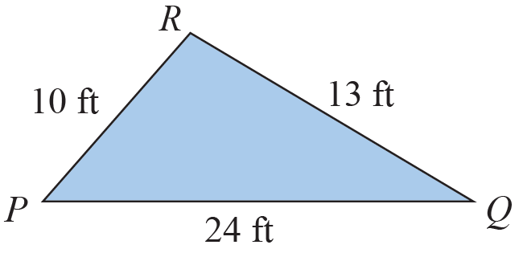
Example 10: Determining Whether a Triangle Exists
∆PQR was drawn and then the lengths of the sides were labeled as shown in the figure. Explain why the labels cannot be correct.

Slide 45
Example 10: Determining Whether a Triangle Exists (cont.)
The labels cannot be correct because PR + QR = 10 ft + 13 ft = 23 ft and PQ = 24 ft, which is greater than the sum of the other two sides. In a triangle, the sum of the lengths of any two sides must be greater than the length of the third side.

Slide 46
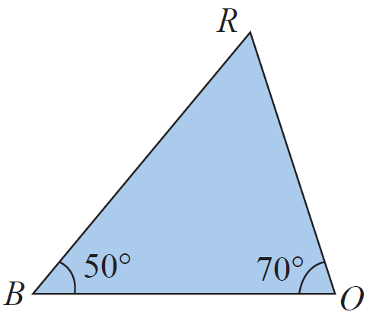
Example 11: Analyzing Triangles
In ∆BOR below, and
What is
Which side is opposite
Which sides include
Is ∆BOR a right triangle? Why or why not?

Slide 47
Example 11: Analyzing Triangles (cont.)
Solutions
The sum of the measures of the angles must be 180°.
Since
is opposite
and include
∆BOR is not a right triangle because none of the angles is a right angle.

