Slide 1
Section 6.4
Circles

Slide 2
Objectives
Know the terms circle, center, radius, and diameter.
Calculate the circumference and area of a circle.
Notes:
2

Slide 3
Circles
Definition
Circle: The set of all points in a plane that are
equidistant from a fixed point called the center of the
circle.
Radius: The distance from the center of a circle to any
point on the circle. (The letter r is used to represent
the radius of a circle.)

Slide 4
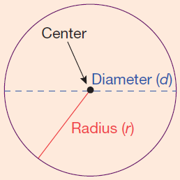
Circles
Definition (cont.)
Diameter: The distance from one point on a circle to another point on the circle measured through the center. (The letter d is used to represent the diameter of a circle and d = 2r.)
Circumference: Perimeter of (or distance around) a circle.

Slide 5
Formulas for Circles
Formula
Circumference: C = 2π r and C = π d
Area:

Slide 6
Formulas for Circumference and Area of a Circle
Notes
The Greek letter π (Pi) is the symbol used for the
constant 3.1415926535… . This number is an infinite
nonrepeating decimal number. For our purposes, we
will use π = 3.14 (accurate to hundredths). However,
You should always be aware that 3.14 is only an
approximation for π and that related answers are only
approximations.

Slide 7
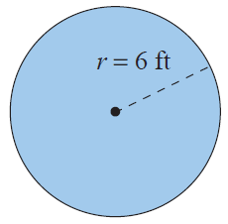
Example 1: Calculating the Circumference and Area of a Circle
Calculate
the circumference
the area of a circle with a radius of 6 ft.
Solution
Using the formula for circumference:
The circumference is 37.68 ft.

Slide 8
Example 1: Calculating the Circumference and Area of a Circle (cont.)
Using the formula for area:
The area is 113.04 ft².

Slide 9
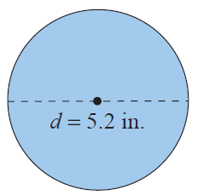
Example 2: Calculating the Circumference and Area of a Circle
Calculate a. the circumference and b. the area of a circle with a diameter of 5.2 in.
Solution
Using the formula for circumference:
The circumference is 16.328 in.

Slide 10
Example 2: Calculating the Circumference and Area of a Circle (cont.)
Using the formula for area:
(In this case )
The area is 21.2264 in².

Slide 11
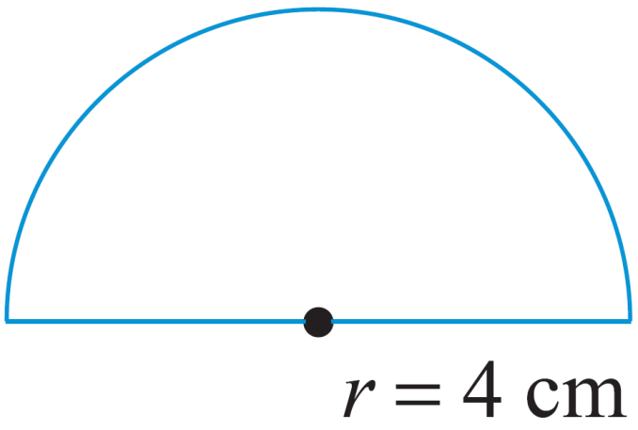
Example 3: Calculating the Perimeter
Calculate the perimeter of the figure shown: a semicircle (half of a circle) and a diameter. The radius is 4 ft long.
Solution
In order to find the perimeter of the figure, find the perimeter of the semicircle and then add the diameter.

Slide 12
Example 3: Calculating the Perimeter (cont.)
Length of semicircle
Diameter
Perimeter = semicircle + diameter
= 12.56 cm + 8 cm = 20.56 cm
The perimeter is 20.56 cm.

Slide 13
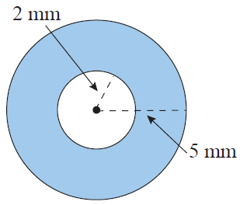
Example 4: Calculating the Area of a Washer
Calculate the area of the washer (shaded portion) with dimensions as shown in the figure.
Solution
Subtract the area of the inside (smaller) circle from the area of the outside (larger) circle.

Slide 14
Example 4: Calculating the Area of a Washer (cont.)
The area of the washer is 65.94 mm².

Slide 15
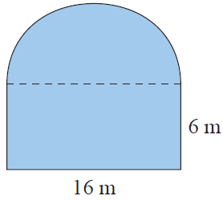
Example 5: Calculating Perimeter and Area
Calculate a. the perimeter and b. the area of the figure shown here with a square base and a semicircle attached to the top. The rectangle has a length of 16 m and a width of 6 m.

Slide 16
Example 5: Finding the Perimeter and Area (cont.)
Solution
The perimeter of the figure is the sum of the lengths of three sides of the rectangle and the length of the semicircle. (Note: The diameter of the semicircle is 16 m.)
Sum of the lengths of three sides of the rectangle
= 6 m + 16 m + 6 m = 28 m
Length of semicircle =
Perimeter of the figure = 28 m + 25.12 m = 53.12 m

Slide 17
Example 5: Finding the Perimeter and Area (cont.)
Calculate the area of the square then subtract the area of the semicircle.
Area of square
Area of semicircle
In this case,

Slide 18
Example 5: Finding the Perimeter and Area (cont.)
Area of the figure = 96 m + 100.48 m
The perimeter of the figure is 53.12 m and the area of the figure is .

Slide 19
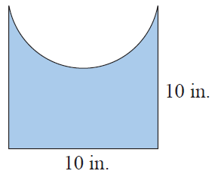
Example 5: Calculating Perimeter and Area
Calculate a. the perimeter and b. the area of the figure shown here with a square base and a semicircle cut out of one side. One side of the square is 10 in. long.

Slide 20
Example 5: Calculating Perimeter and Area (cont.)
Solution
The perimeter of the figure is the sum of the lengths of three sides of the square and the length of the semicircle. (Note: The diameter of the semicircle is 10 in.)
Sum of the lengths of three sides of the square
= 10 in. + 10 in. + 10 in. = 30 in.
Length of semicircle
Perimeter of the figure = 30 in. + 15.7 in. = 45.7 in.

Slide 21
Example 5: Calculating Perimeter and Area (cont.)
Calculate the area of the square then subtract the area of the semicircle.
Area of square
Area of semicircle
In this case,

Slide 22
Example 5: Calculating Perimeter and Area (cont.)
= 60.75 in.²
Area of the figure = 100 in.² – 39.25 in.² The perimeter of the figure is 45.7 in. and the area of the figure is
60.75 in.²

