Slide 1
Section 6.5
Volume and Surface Area

Slide 2
Objectives
Calculate the volumes of solids.
Calculate the surface areas of solids.

Slide 3
Volume
Table 1: From the Metric System From the US Customary System
cubic millimeters (mm³) | cubic inches (in.³)
cubic centimeters (cm³) | cubic feet (ft³)
cubic meters (m³) | cubic yards (yd³)

Slide 4
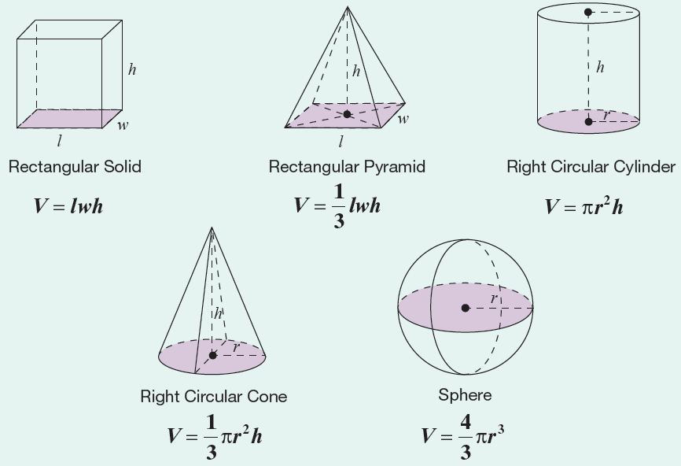
Volume Formulas for Five Geometric Solids
Formula

Slide 5
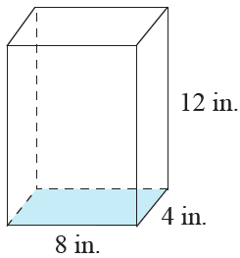
Example 1: Calculating the Volume of a Rectangular Solid
Calculate the volume of the rectangular solid with length 8 in., width 4 in., and height 12 in.
Solution
Using the formula for the volume of a rectangular solid, we have the following.
The volume of the rectangular solid is

Slide 6
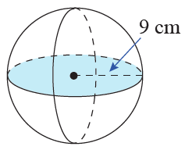
Example 2: Finding the Volume of a Sphere
Calculate the volume of a sphere with radius 9 cm. Use π = 3.14.
Solution
Using the formula for the volume of a sphere:
The volume of the sphere is .

Slide 7
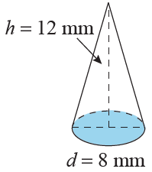
Example 3: Calculating the Volume of a Cone
What is the volume of a cone with a height of 12 mm and a circular base with a diameter of 8 mm?
Solution
We know the diameter of 8 mm, but we need the radius.
The radius is half of the diameter.

Slide 8
Example 3: Finding the Volume of a Cone (cont.)
So applying the formula for the volume of a cone, we have:
The volume of the cone is

Slide 9
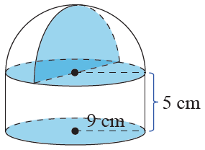
Example 4: Calculating the Volume of a Solid
Calculate the volume of a solid with the indicated dimensions.
Solution
From the figure, we see that the bottom portion of the solid is a cylinder and on top of the cylinder is a hemisphere (one-half of a sphere). Thus, the volume of the solid will be the sum of the volumes of the cylinder and the hemisphere.

Slide 10
Example 4: Calculating the Volume of a Solid (cont.)

Slide 11
Example 4: Calculating the Volume of a Solid (cont.)
The volume of the solid is

Slide 12
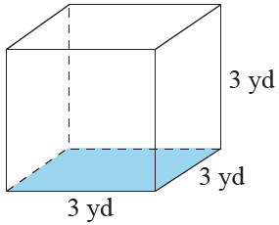
Example 5: Calculating the Volume of a Cube
Calculate the volume of the cube in both cubic yards and cubic feet. (Remember, 1 yd = 3 ft.)

Slide 13
Example 5: Calculating the Volume of a Cube (cont.)
Solution
We apply the formula V = s³ twice; once by using s = 3 yards and once by using s = 9 feet.
The volume of the cube is
Notice that because feet are smaller than yards, there are many more cubic feet than cubic yards in the cube.

Slide 14
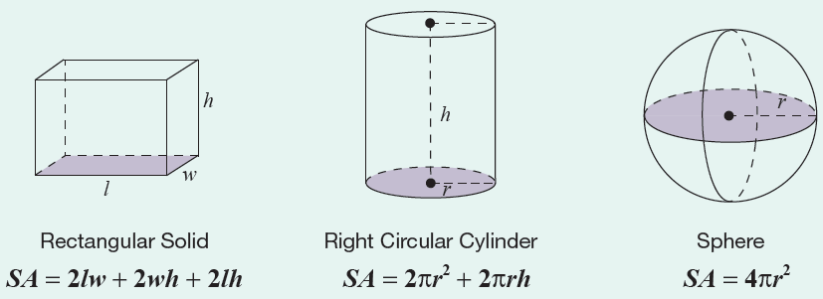
Surface Area Formulas for Three Geometric Solids
Formula

Slide 15
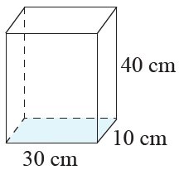
Example 6: Calculating the Surface Area of a Rectangular Solid
Calculate the surface area of a rectangular solid with length 30 cm, width 10 cm, and height 40 cm.
Solution
Using the formula for the surface area of a rectangular solid, we have the following.
The surface area of the rectangular solid is

Slide 16
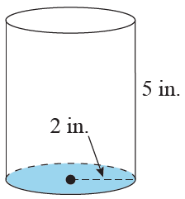
Example 7: Calculating the Surface Area of a Cylinder
Calculate the surface area of a coffee can in the shape of a cylinder with a height of 5 in. and a circular base with a radius of 2 in.

Slide 17
Example 7: Calculating the Surface Area of a Cylinder (cont.)
Solution
Using the formula for the surface area of a cylinder, we have the following.
The surface area of the cylinder is

