Slide 1
Section 7.3
Constructing Graphs from Databases

Slide 2
Objectives
Construct a bar graph from a set of data.
Construct a circle graph from a set of data.

Slide 3
Steps to Follow in Constructing a Vertical Bar Graph
Procedure
Draw a vertical axis and a horizontal axis. Label these axes appropriately.
Mark an appropriate scale on the vertical axis to represent the frequency of each category. (The scale must be uniform. That is, the distance between consecutive marks must represent the same amount.)

Slide 4
Steps to Follow in Constructing a Vertical Bar Graph (cont.)
Procedure (cont.)
Mark the categories of data along the horizontal axis.
Draw the vertical bar for each category so that the height of the bar reaches the frequency of the data in that category. (Note: Make sure the bars have the same width.)
Give the graph a title.

Slide 5
Example 1: Constructing a Bar Graph
Construct a bar graph that represents the following population data.
 | City | Population
1. | New York, NY | 8,175,000
2. | Los Angeles, CA | 3,793,000
3. | Chicago, IL | 2,696,000
4. | Houston, TX | 2,099,000
5. | Philadelphia, PA | 1,526,000
6. | Phoenix, AZ | 1,446,000
7. | San Antonio, TX | 1,327,000
8. | San Diego, CA | 1,307,000
Source: www.census.gov

Slide 6
Example 1: Constructing a Bar Graph (cont.)
Steps 1 and 2: Draw the vertical axis and horizontal axis and mark a scale on the vertical axis that will encompass the numbers from 0 to 8.175 million people. (On this graph, we have chosen to mark the numbers from 0 to 9.0 in a scale of 1 unit.)

Slide 7
Example 1: Constructing a Bar Graph (cont.)
Steps 3 and 4: The horizontal axis marks are labeled with the names of the cities represented in alphabetical order. The height of each vertical bar corresponds to the population (in millions) of each city as given.

Slide 8
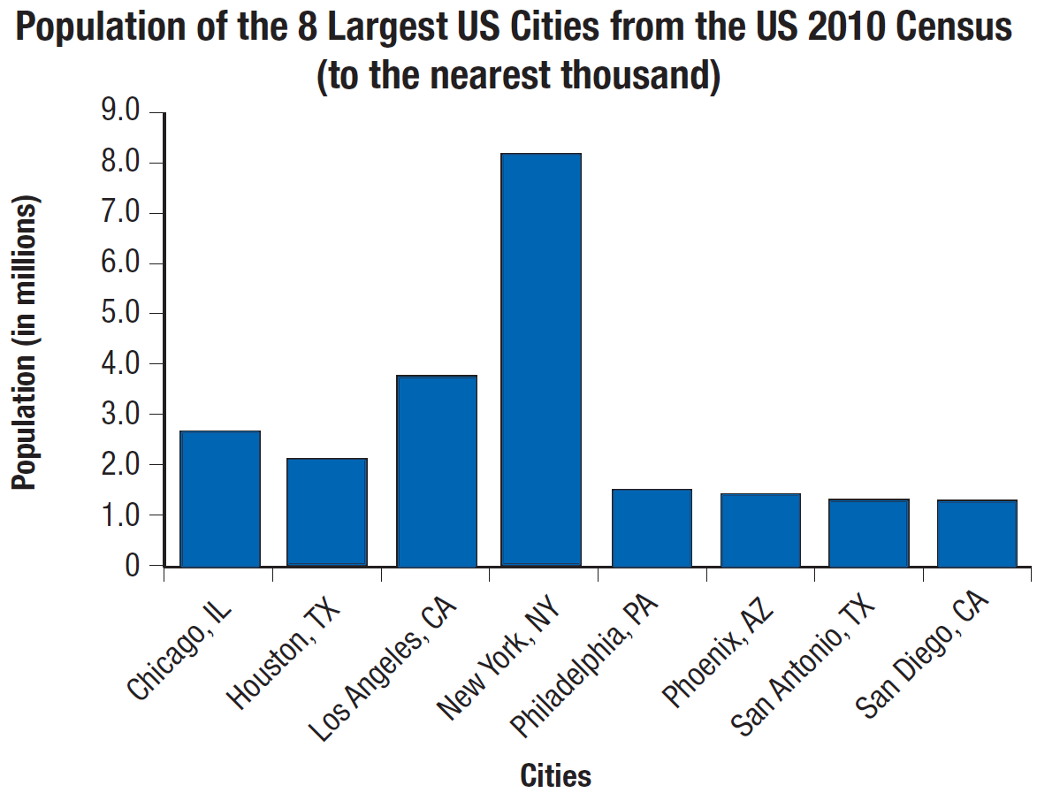
Example 1: Constructing a Bar Graph (cont.)
Step 5: Give the graph a title.

Slide 9
Steps to Follow in Constructing a Circle Graph
Procedure
Find the central angle (angle at the center of the circle) for each category by multiplying the corresponding percent (in decimal form) by 360°.
Draw a circle.
Draw each central angle (use a protractor).
Label each sector with the name and corresponding percent of each category.
Give the graph a title.

Slide 10
Example 2: Constructing a Circle Graph
Construct a circle graph that represents the following data.
Ethnic Breakdown of Students Who Took the SAT (Scholastic Assessment Test), Nationwide, 2010.
Ethnicity | % SAT Taken
African-American | 13%
Asian-American | 11%
Hispanic | 14%
Native American | 1%
White | 54%
Other | 3%
No Response | 4%
Source: CollegeBoard.com

Slide 11
Example 2: Constructing a Circle Graph (cont.)
Step 1: Find the central angle for each category by multiplying the corresponding percent (in decimal form) by 360°.
African-American
Asian-American
Hispanic
Native American
White
Other
No Response

Slide 12
Example 2: Constructing a Circle Graph (cont.)
Steps 2 and 3 and 4: Draw a circle, mark the central angles as close to the actual degrees as is practical, and label each sector. Note that the order of the sectors (pie slices) is not important.
Step 5: Give the graph a title.

Slide 13
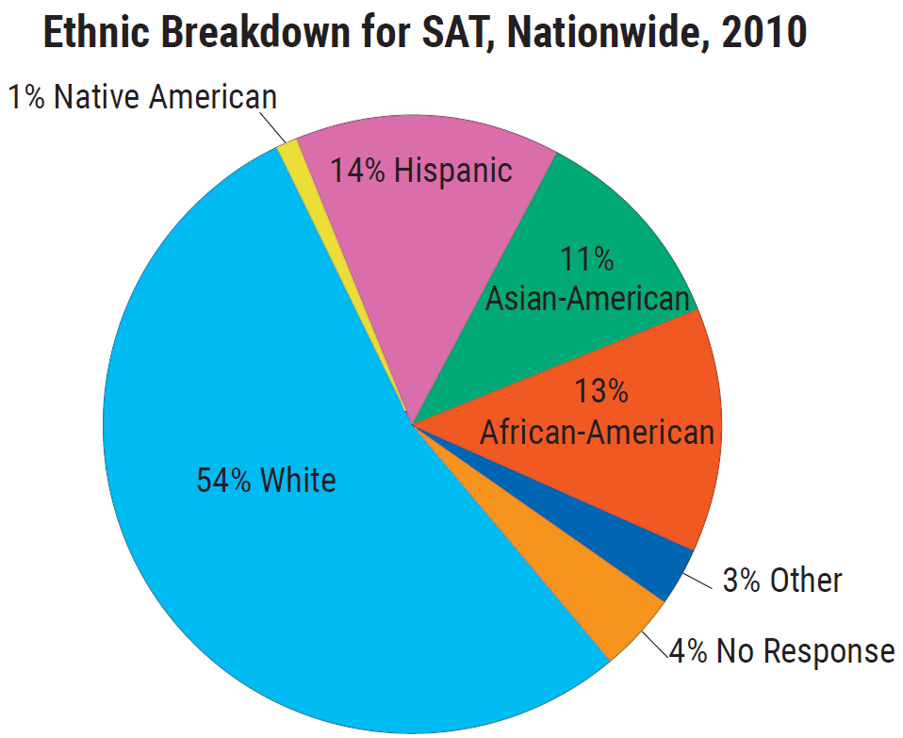
Example 2: Constructing a Circle Graph (cont.)

