Slide 1
Section 9.7
Solving Linear Inequalities in
One Variable

Slide 2
Objectives
Graph intervals of real numbers.
Solve linear inequalities of the form
ax < c and x + b < c.
Solve linear inequalities of the form ax + b < c and ax + b < cx + d.
Use linear inequalities to solve applications.

Slide 3
Intervals of Real Numbers
Notes
The symbol for infinity, (or ) is not a number. It is used to indicate that the interval is to include all real numbers from some point on (either in the positive direction or the negative direction) without end.

Slide 4
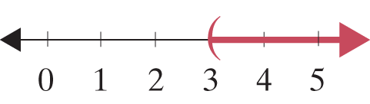
Example 1: Graphing Intervals
Graph the open interval
Solution

Slide 5
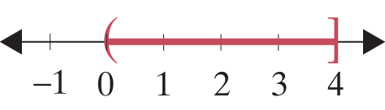
Example 2: Graphing Intervals
Graph the half-open interval 0 < x ≤ 4.
Solution

Slide 6
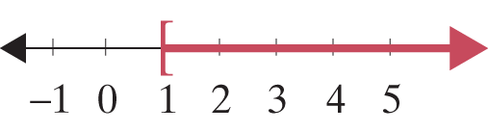
Example 3: Graphing Intervals
Represent the following graph using algebraic notation, and state what kind of interval it is.
Solution
x ≥ 1 is a half-open interval.

Slide 7
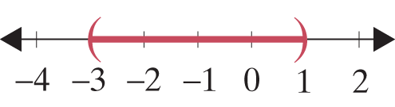
Example 4: Graphing Intervals
Represent the following graph using interval notation, and state what kind of interval it is.
Solution
(−3, 1) is an open interval.

Slide 8
Solving Linear Inequalities: ax < c and x + b < c
Attention!
Any principle or rule stated for inequalities with the < symbol holds true for ≤, >, and ≥ as well.

Slide 9
Addition Principle for Solving Linear Inequalities
Properties
If A and B are algebraic expressions and C is a real number, then the inequalities
A < B
and
A + C < B + C
are equivalent.
(If a real number is added to both sides of an inequality, the new inequality is equivalent to the original.)

Slide 10

Example 5: Solving an Inequality and Graphing the Solution Set
Solve the inequality y − 3.2 ≥ 5.6 and graph the solution set. Write the solution set using interval notation.
Solution
y − 3.2 ≥ 5.6
y − 3.2 + 3.2 ≥ 5.6 + 3.2
y ≥ 8.8
y is in [8.8, ∞).

Slide 11
Example 6: Solving an Inequality and Graphing the Solution Set
Solve the inequality and graph the solution set. Write the solution set using interval notation.
Solution

Slide 12

Example 6: Solving an Inequality and Graphing the Solution Set (cont.)

Slide 13
Multiplication Principle for Solving Linear Inequalities
Properties
If A and B are algebraic expressions and C is a positive real number, then the inequalities
A < B
and
AC < BC
are equivalent.
If A and B are algebraic expressions and C is a negative real number, then the inequalities

Slide 14
Multiplication Principle for Solving Linear Inequalities
Properties (cont.)
A < B
and
AC > BC
are equivalent.
(In other words, if both sides are multiplied by a negative number, then the sense of the inequality is reversed.)

Slide 15

Example 7: Solving an Inequality and Graphing the Solution Set
Solve the inequality 5x > 15 and graph the solution set. Write the solution set using interval notation.
Solution
x is in (3, ∞).

Slide 16

Example 8: Solving an Inequality and Graphing the Solution Set
Solve the inequality −3x ≤ 12.3 and graph the solution set. Write the solution set using interval notation.
Solution
x is in [−4.1, ∞).

Slide 17
Steps for Solving Linear Inequalities
Procedure
Combine like terms on each side of the inequality symbol.
Use the addition principle of inequality to add the opposites of constants or variable expressions to both sides so that constants are on one side and variables on the other.

Slide 18
Steps for Solving Linear Inequalities
Procedure (cont.)
Use the multiplication (or division) principle of inequality to multiply (or divide) both sides by the coefficient of the variable so that the new coefficient is +1. If this coefficient is negative, be sure to reverse the sense of the inequality.

Slide 19
Steps for Solving Linear Inequalities
Procedure (cont.)
A quick (and generally satisfactory) check is to select any one number in your solution set and substitute it into the original inequality. If the statement is false, you need to look for an error in your solution.

Slide 20
Example 9: Solving Linear Inequalities
Solve the inequality and graph the solution set. Write the solution set using interval notation. Solution

Slide 21
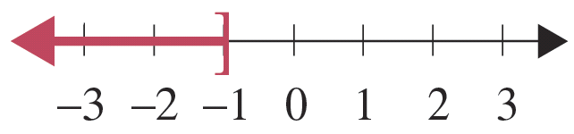
Example 9: Solving Linear Inequalities (cont.)
x is in (−∞, −1].
Check
As a check, pick a number in the solution interval and substitute it into the original inequality. For example, choose −3 and substitute it for x.

Slide 22
Example 9: Solving Linear Inequalities (cont.)
Note that not every number in the interval can be checked, but a true result, as shown here, does give some confidence in the solution interval.

Slide 23
Example 10: Solving Linear Inequalities
Solve the linear inequality and graph the solution set. Write the solution set using interval notation.
Solution

Slide 24
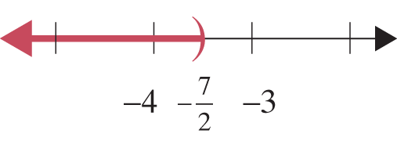
Example 10: Solving Linear Inequalities (cont.)

Slide 25
Example 11: Solving Linear Inequalities
Solve the linear inequality and graph the solution set. Write the solution set using interval notation.
Solution

Slide 26
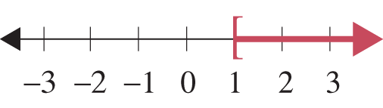
Example 11: Solving Linear Inequalities (cont.)

Slide 27
Completion Example 12: Solving Linear Inequalities
Supply the reasons for each step in solving the linear inequality and graph the solution set. Write the solution set using interval notation.
Solution

Slide 28
Completion Example 12: Solving Linear Inequalities (cont.)
Add −2x to both sides.
Simplify.
Add 7 to both sides.
Simplify.
Divide both sides by 2.
Simplify.

Slide 29
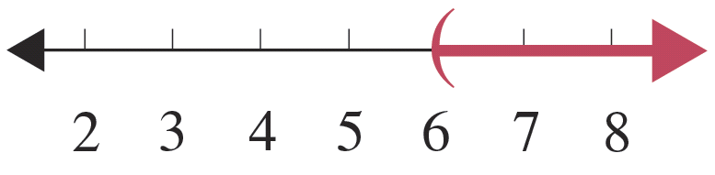
Completion Example 12: Solving Linear Inequalities (cont.)
Graph the interval on a number line.
x is in _______

Slide 30
Example 13: Application: Using Inequalities
A math student has grades of 85, 98, 93, and 90 on four examinations. If he must average 90 or better to receive an A for the course, what scores can he receive on the final exam and earn an A? (Assume that the final exam counts the same as the other exams.)
Solution
Let x = score on final exam.
The average is found by adding the scores and dividing by 5.

Slide 31
Example 13: Application: Using Inequalities (cont.)
If the student scores 84 or more on the final exam, he will average 90 or more and receive an A in math.

Slide 32
Example 14: Application: Using Inequalities
Ellen is going to buy 30 stamps, some 34-cent and some 49-cent. If she has $11.40, what is the maximum number of 49-cent stamps she can buy?
Solution
Let x = number of 49-cent stamps,
then 30 − x = number of 34-cent stamps.
Ellen cannot spend more than $11.40.

Slide 33

Example 14: Application: Using Inequalities (cont.)
Ellen can buy at most eight 49-cent stamps if she buys a total of 30 stamps.

