Slide 1
Section 10.1
The Cartesian Coordinate System

Slide 2
Definition: One-to-One Correspondence
There is a one-to-one correspondence between points in a plane and ordered pairs of real numbers.

Slide 3
Note
Although this discussion is related to ordered pairs of real numbers, most of the examples use ordered pairs of integers. This is because ordered pairs of integers are relatively easy to plot and read on a graph. Ordered pairs with fractions, decimals, or radicals must be plotted by estimating the positions of the points. The precise coordinates intended for such points can be difficult or impossible to read because large dots must be used so the points can be seen.

Slide 4
Note (cont.)
Even with these difficulties, you should understand that we are discussing ordered pairs of real numbers and that points with fractions, decimals, and radicals as coordinates do exist and should be plotted by estimating their positions.

Slide 5
Example 1: Plotting Ordered Pairs
Plot (or graph) the set of ordered pairs.
Note: The listing of ordered pairs within the braces can be in any order.
Solution
To plot each ordered pair, start at the origin (0, 0). For the x‑coordinate, move right if positive and move left if negative. For the y‑coordinate, move up if positive and move down if negative.

Slide 6
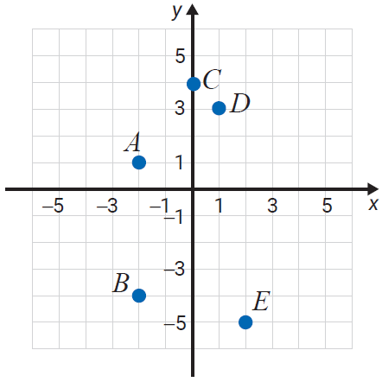
Example 1: Plotting Ordered Pairs (cont.)
For A(−2, 1), move 2 units left and 1 unit up.
For B(−2, −4), move 2 units left
and 4 units down.
For C(0, 4), move no units left or
right and 4 units up.
For D(1, 3), move 1 unit right
and 3 units up.
For E(2, −5), move 2 units right
and 5 units down.

Slide 7
Example 2: Plotting Ordered Pairs
Plot (or graph) the set of ordered pairs.
Solution
To plot each ordered pair, start at the origin, and move as follows.
For A(−1, 3), move 1 unit left and 3 units up.
For B(0, 1), move no units left or right and 1 unit up.

Slide 8
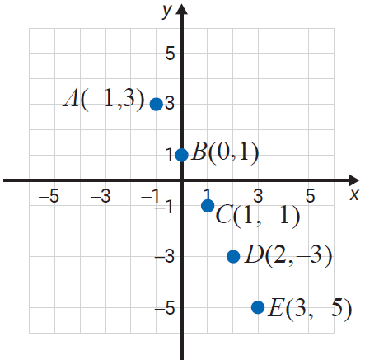
Example 2: Plotting Ordered Pairs (cont.)
For C(1, −1), move
1 unit right and
1 unit down.
For D(2, −3), move
2 units right and
3 units down.
For E(3, −5), move
3 units right and
5 units down.

Slide 9
Example 3: Finding Ordered Pairs
Find the missing coordinates in the ordered pairs so that each point will satisfy the equation 2x + 3y = 12.
(0, ), (3, ), ( , 0), ( , −2)
Solution
The missing values can be found by substituting the given values for x (or for y) into the equation 2x + 3y = 12 and solving for the other variable.

Slide 10
Example 3: Finding Ordered Pairs (cont.)

Slide 11
Example 3: Finding Ordered Pairs (cont.)

Slide 12
Example 4: Finding Ordered Pairs
Complete the table so that each ordered pair will satisfy the equation y = −3x + 1.
x | y | (x, y)
0
 | 4
3
Solution
Substitute each given value for x or y into the equation
y = −3x + 1 to find the ordered pairs and complete the table.

Slide 13
Example 4: Finding Ordered Pairs (cont.)

Slide 14
Example 4: Finding Ordered Pairs (cont.)
The completed table is as follows.
x | y | (x, y)

Slide 15
Example 5: Determining Ordered Pairs
Determine which, if any, of the ordered pairs
, and satisfy the equation .
Solution
To determine whether an ordered pair is a solution to an equation, substitute the x‑coordinate for x and the y‑coordinate for y in the equation to see if the result is a true statement.

Slide 16
Example 5: Determining Ordered Pairs (cont.)
For the ordered pair let and .
For the ordered pair let and .

Slide 17
Example 5: Determining Ordered Pairs (cont.)
For the ordered pair let and .
So the ordered pairs and satisfy the
equation, and the ordered pair does not.

Slide 18
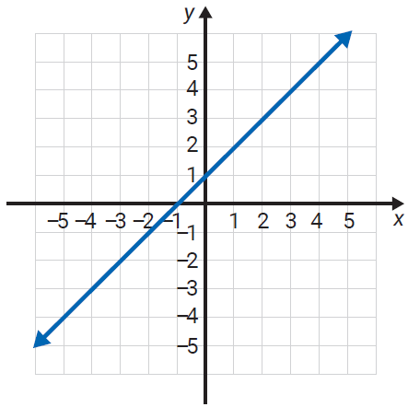
Example 6: Locating Points on the Graph of a Line
The graphs of two lines are given. Each line contains an infinite number of points. Use the grid to help you locate (or estimate) three points on each line.
a.
Solution
Three points on this graph are (−2, −1), (1, 2), and (3, 4). (Of course, there is more than one correct answer to this type of question. Use your own judgment.)

Slide 19
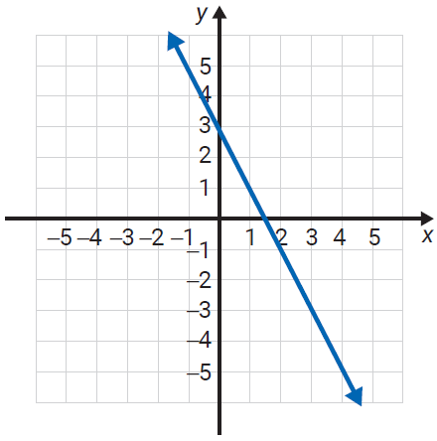
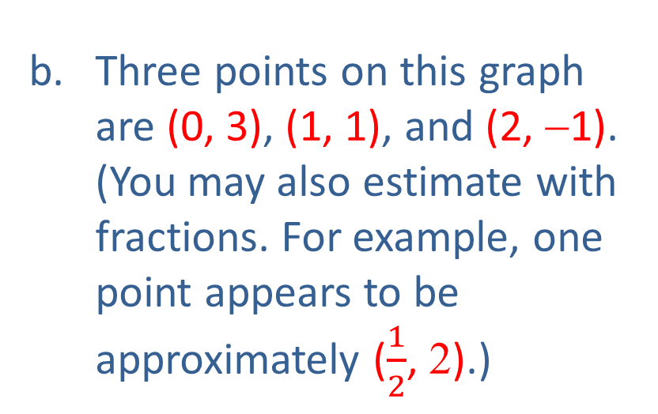
Example 6: Locating Points on the Graph of a Line (cont.)
b.
Solution
Three points on this graph are (0, 3), (1, 1), and (2, −1). (You may also estimate with fractions. For example, one point appears to be approximately ($\frac{1}{2}$, 2).)

