Slide 1
Section 10.6
Graphing Linear Inequalities
in Two Variables

Slide 2
Procedure: Graphing Linear Inequalities
First, graph the boundary line (dashed if the inequality is < or >, solid if the inequality is ≤ or ≥).
Next, determine which side of the line to shade using one of the following methods.

Slide 3
Procedure: Graphing Linear Inequalities (cont.)
Method 1
Test any one point obviously on one side of the line.
If the test-point satisfies the inequality, shade the half-plane on that side of the line. Otherwise, shade the other half-plane.
Note: The point (0, 0), if it is not on the boundary line, is usually the easiest point to test.

Slide 4
Procedure: Graphing Linear Inequalities (cont.)
Method 2
Solve the inequality for y (assuming that the line is not vertical).
If the solution shows y < or y ≤, then shade the half-plane below the line.
If the solution shows y > or y ≥, then shade the half-plane above the line.

Slide 5
Procedure: Graphing Linear Inequalities (cont.)
Note: If the boundary line is vertical, then solve for x. If the solution shows x > or x ≥, then shade the half-plane to the right. If the solution shows x < or x ≤, then shade the half-plane to the left.
The shaded half-plane (and the line if it is solid) is the solution to the inequality.

Slide 6
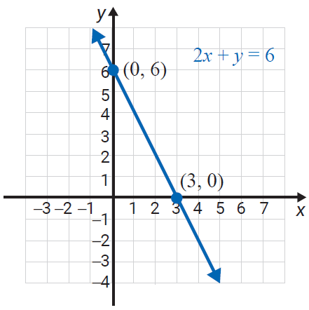
Example 1: Graphing Linear Inequalities
Graph the solution set to the inequality
Solution
Method 1 is used in this example.
Step 1: Graph the boundary line
2x + y = 6 as a solid line
because the inequality is
≤ (less than or equal to).

Slide 7
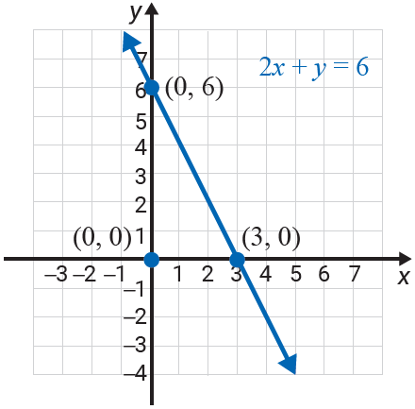
Example 1: Graphing Linear Inequalities (cont.)
Step 2: Test any point on one
side of the line. In this
example, we have
chosen (0, 0).
This is a true statement.

Slide 8
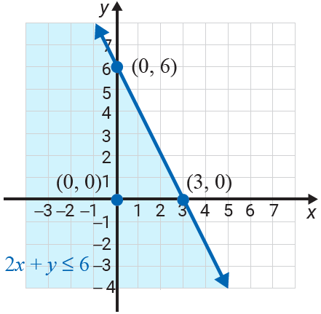
Example 1: Graphing Linear Inequalities (cont.)
Step 3: Shade the half-plane
on the same side of
the line as the point
(0, 0). The shaded
half-plane and the
boundary line is the
solution set to the
inequality.

Slide 9
Example 2: Graphing Linear Inequalities
Graph the solution set to the inequality
Solution
Since the inequality is already solved for y, Method 2 is easy to apply.
Step 1: Graph the boundary line y = 2x as a dashed
line because the inequality is >.

Slide 10
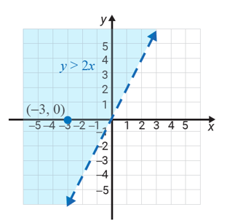
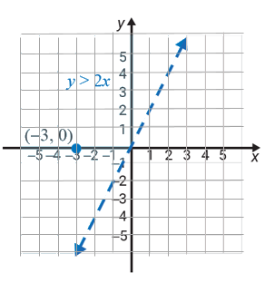
Example 2: Graphing Linear Inequalities (cont.)
Step 2: The solution shows >,
so by Method 2, the
graph consists of those
points above the line.
Shade the half-plane above the line.
Note: As a check, we see that the point
(−3, 0) gives 0 > −6, a true statement.
Thus, we know we have shaded the correct half-plane.

Slide 11
Example 3: Graphing Linear Inequalities
Graph the half-plane that satisfies the inequality y > 1.
Solution
Again, the inequality is already solved for y and
Method 2 is used.
Step 1: Graph the boundary line y = 1 as a dashed line
because the inequality is >. (The boundary line
is a horizontal line.)

Slide 12
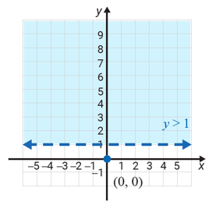
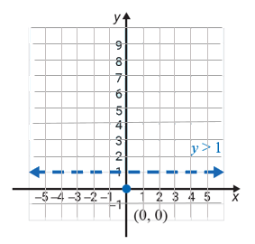
Example 3: Graphing Linear Inequalities (cont.)
Step 2: By Method 2, shade
the half-plane above
the line.

Slide 13
Example 4: Graphing Linear Inequalities
Graph the solution set to the inequality
Solution
The boundary line is a vertical line and Method 1 is used.
Step 1: Graph the boundary line x = 0 as a solid line
because the inequality is ≤ (less than or equal to).
Note that this is the y-axis.

Slide 14
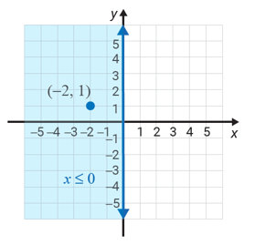
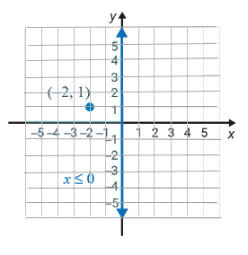
Example 4: Graphing Linear Inequalities (cont.)
Step 2: Test the point (−2, 1).
−2 ≤ 0
This statement is true.
Step 3: Shade the half-plane
on the same side of
the line as (−2, 1).
This half-plane consists
of the points with
x-coordinates 0 or
negative.

Slide 15
Example 5: Graphing Linear Inequalities Using a Calculator
Use a graphing calculator to graph the inequality
Solution
Step 1: Solving the inequality for y gives
Step 2: Press the key and enter the function:
\Y₁ = −2X + 7.

Slide 16
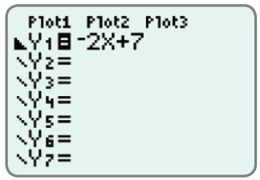
Example 5: Graphing Linear Inequalities Using a Calculator (cont.)
Step 3: Go to the \ and hit three times so that the display appears as follows.

Slide 17
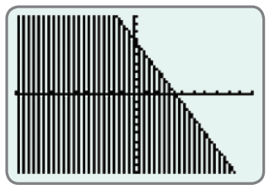
Example 5: Graphing Linear Inequalities Using a Calculator (cont.)
Step 4: Press and (using the standard window settings) the following graph should appear on the display.

Slide 18
Example 6: Graphing Linear Inequalities Using a Calculator
Use a graphing calculator to graph the inequality
−5x + 4y > −8.
Solution
Step 1: Solving the inequality for y gives
Step 2: Press the key and enter the function:

Slide 19
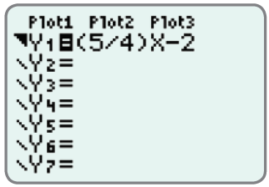
Example 6: Graphing Linear Inequalities Using a Calculator (cont.)
Step 3: Go to the \ and hit two times so that the display appears as follows.

Slide 20
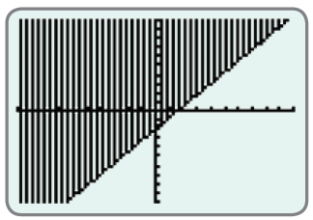
Example 6: Graphing Linear Inequalities Using a Calculator (cont.)
Step 4: Press and (using the standard window settings) the following graph should appear on the display. (Note: The inequality is >, so the boundary line should actually be dashed.)

